Slide 1


January, 2018
2017 Q4 performance review

Slide 2
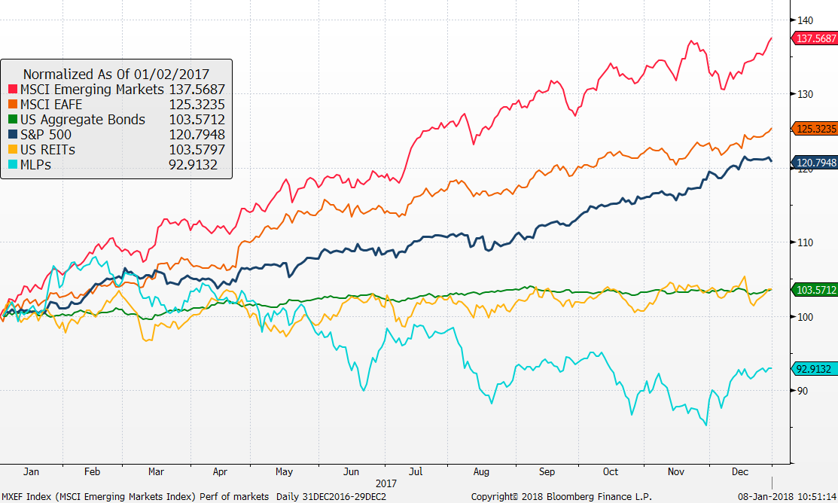
Market Returns
Performance of markets
Source: Bloomberg
MLP’s and REITs have lagged
International Developed stocks have rebounded
EM stocks have performed well

Slide 3
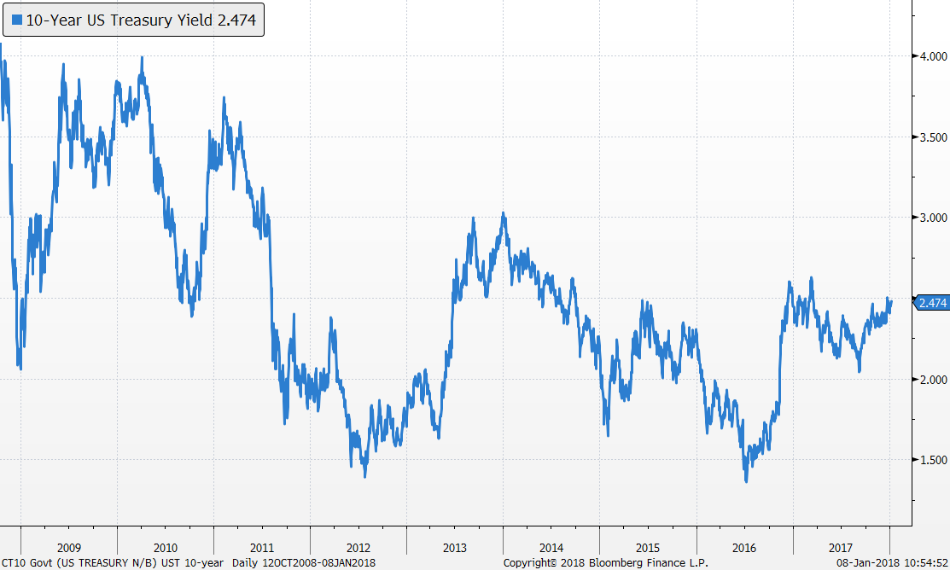

Bond markets
US Treasury 10-Year Yield
Yields rose sharply after US Presidential election
Our bond duration is 4.5 years, shorter than US Aggregate at 6.0 years

Slide 4
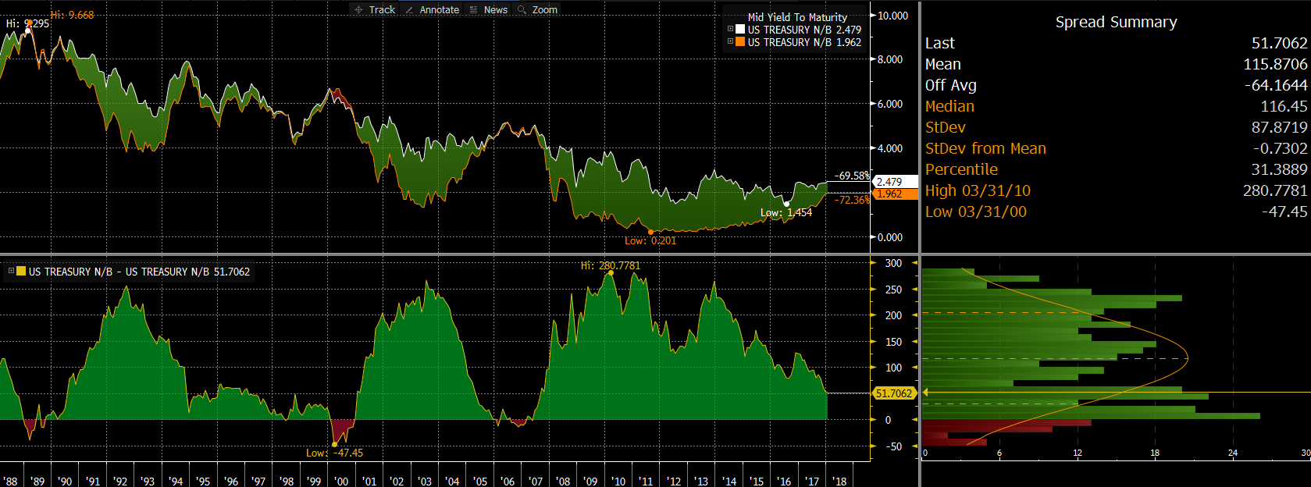
Bond markets – spreads (10y-2y)
Flat yield curve has been a good predictor of recessions.

Slide 5
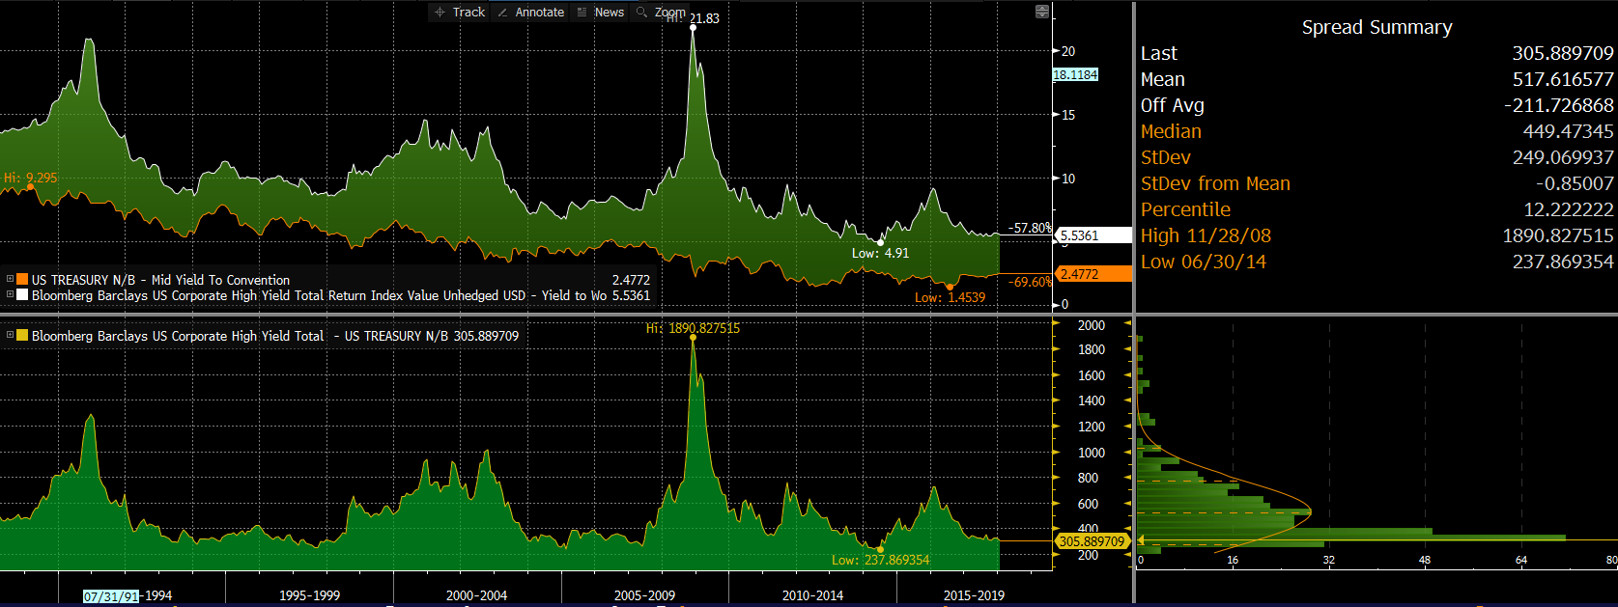
High Yield Spreads
High yield spreads are near record lows reflecting low volatility and investor enthusiasm

Slide 6
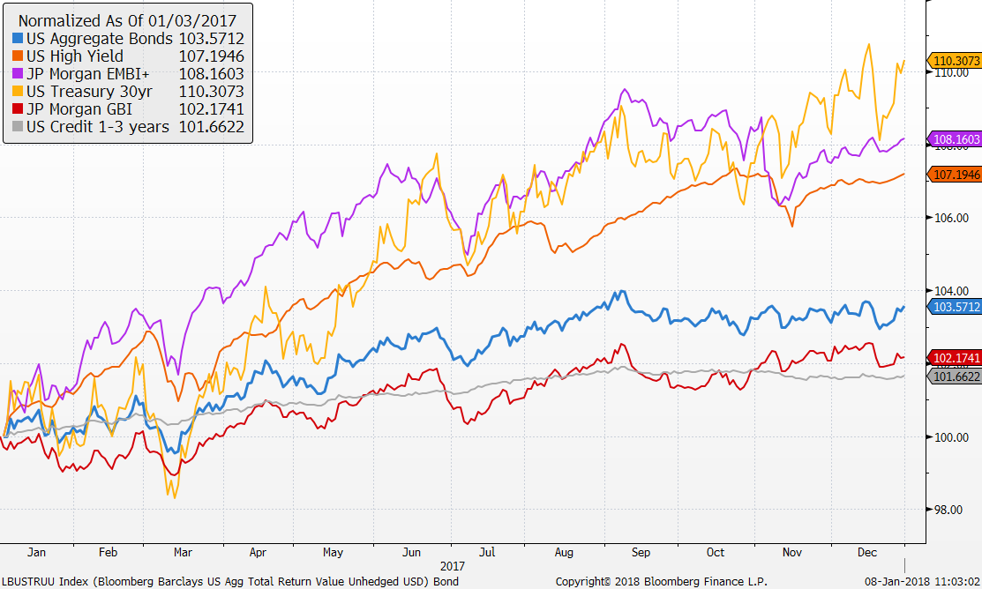
Market Returns
Performance of bond markets
Source: Factset
Credit has performed well
Aggregate bonds continue to post solid returns even with rising short term rates

Slide 7
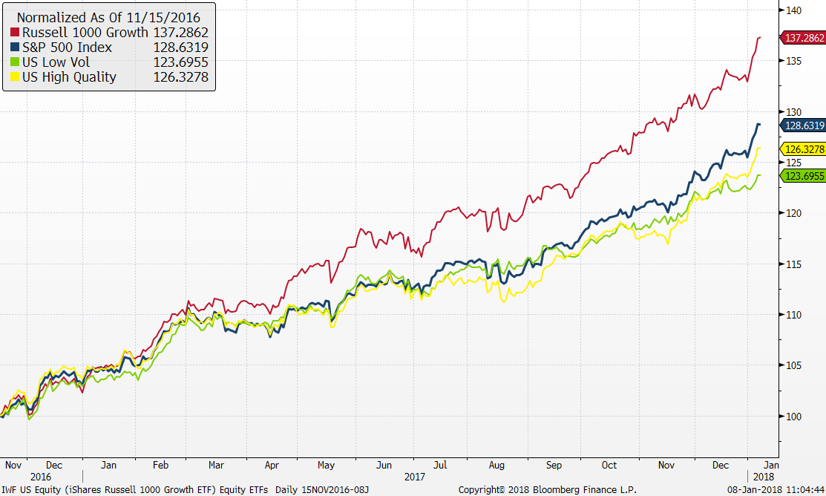
U.S. stock market ETFs
Source: Factset

Slide 8
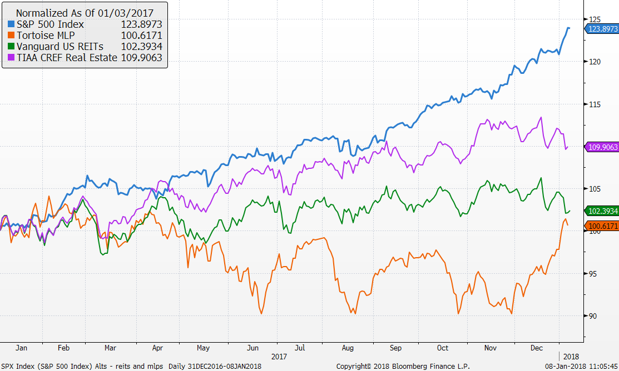
MLPs and REITs have underperformed

Slide 9
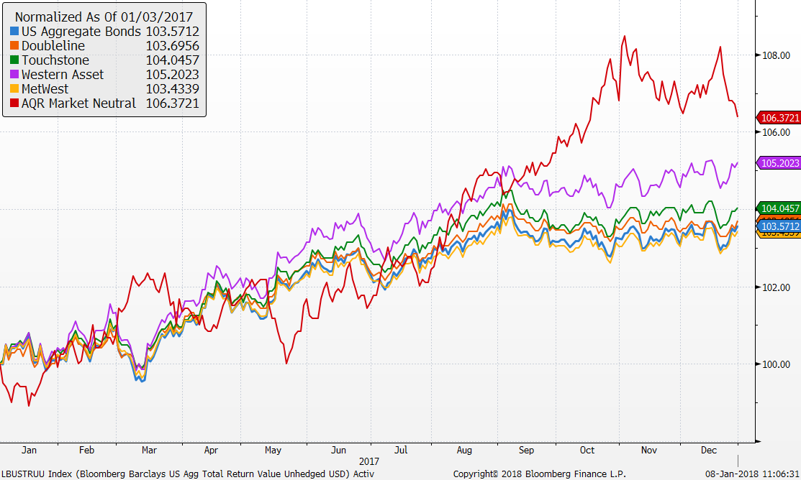
Active bond managers and Market Neutral

Slide 10
Vehicle performance as of 12/31/17

Slide 11
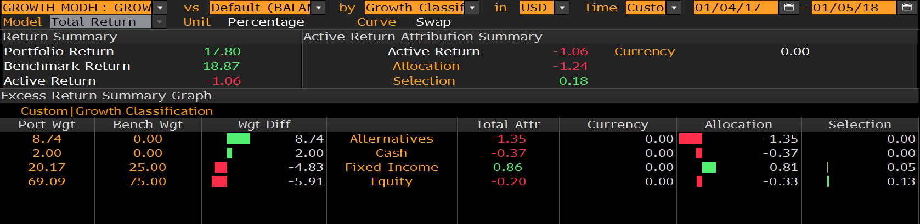
Growth model attribution
1 year
Risk 4.58 versus bench of 4.81
Tracking error 0.70

Slide 12
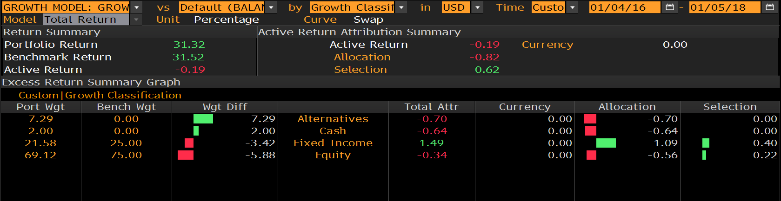
Growth model attribution
2 years
Risk 7.50 versus bench of 8.04
Tracking error 0.98

Slide 13
Growth model changes
Portfolio changes 2017
1/5 reduced short term bonds, increased small cap and added market neutral
2/7 increased MLPs
5/2 eliminated floating rate increased core bond funds and market neutral
7/11 Increased international developed and reduced US large cap
8/8 Switch REIT exposure to active manager, TIAA CREF Real Estate Fund

Slide 14
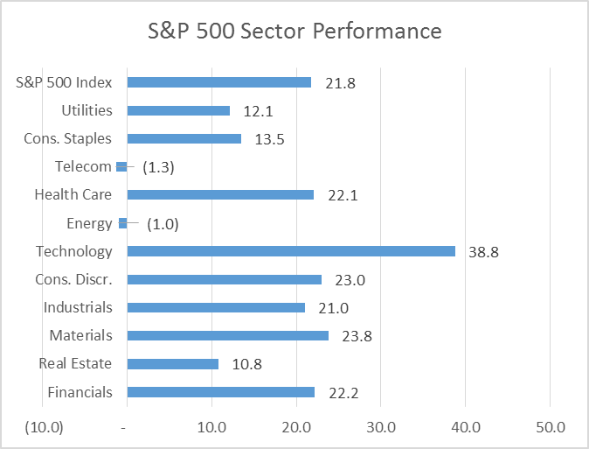
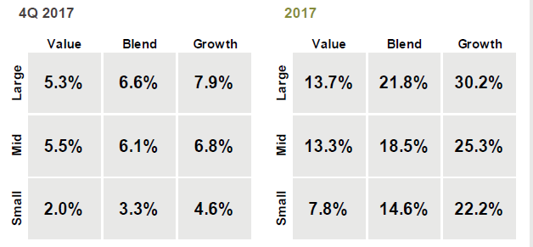
S&P 500 – What happened during Q4
The S&P 500 is up a strong 21.8% for 2017 behind strong fundamentals and continued outperformance by Technology in a growth environment
  S&P 500 returned 6.6% in the fourth quarter
  Five stocks comprising “FAAMG” (FB, AAPL, AMZN, MSFT, and GOOGL) have boosted S&P 500 total returns by over 2% as FAAMG portfolio is up 45.9% for 2017
  On average these companies are growing sales more than 3x the S&P 500
Growth and large firms have performed best.
Measures of volatility in the year’s first half were at or near multiyear lows not only in the U.S., but also in Europe and Asia

Slide 15
Focus equity highlights – YTD
What has driven performance YTD?
Our US equities underperformed the market in 2017 mostly due to security selection in Consumer Discretionary (AAP). However our strong stock selection in Health Care (BCR) and Industrials (LMT) helped mitigate their negative impact.
What’s worked?
Security selection in Health Care and Industrials
Positive performance of CCI (+24bps) partly offset SKT decline (-84bps)
No exposure to Telecom and Utilities was a positive
Top 3 performers in the portfolio:
  FNF +95bps, BCR +77bps, Visa +43bps
What didn’t?
Mostly security selection in Consumer Discretionary
Bottom 3 performers in the portfolio:
  AAP (-188bps), SLB (-96bps) and SKT (-84bps)
Recent Changes in Q4 2017
Brought BKI to full 2% position

Slide 16
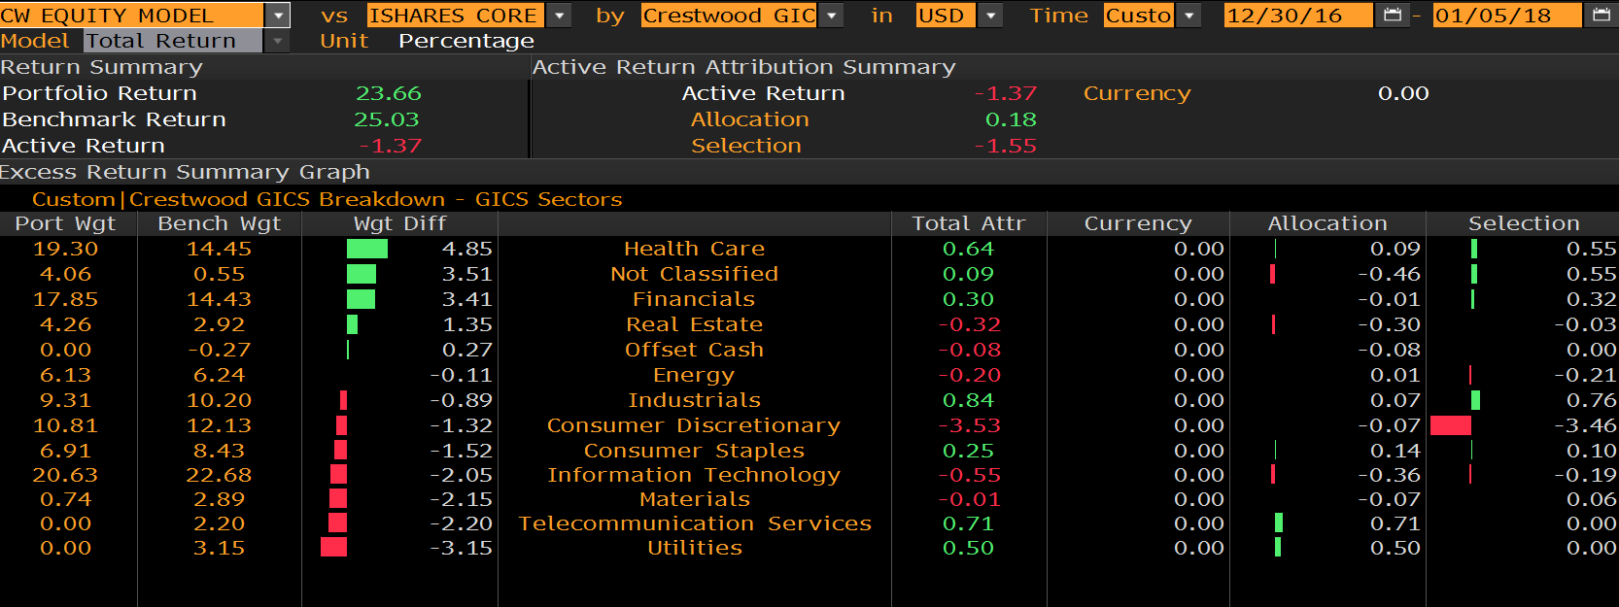
Attribution – 2017

Slide 17
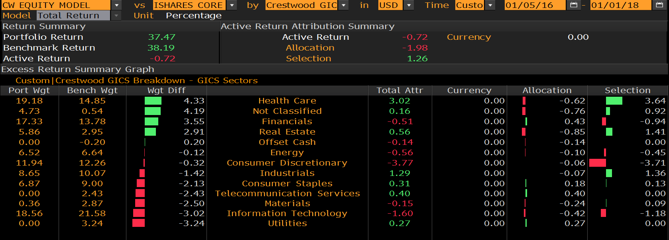
Attribution – Two Years

Slide 18
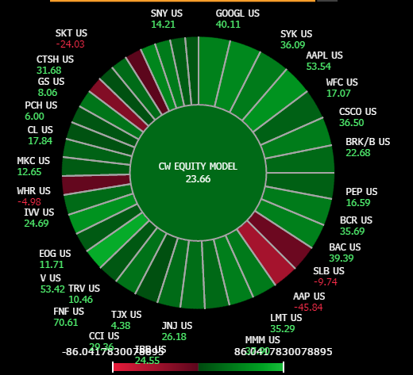
Heat Map– YTD

