Slide 1
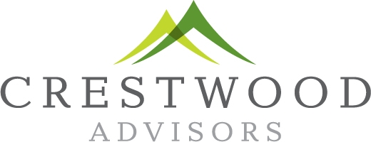
January, 2018
Selling Goldman Sachs

Slide 2
Sales growth
Goldman Sachs relies on trading for revenue and earnings growth. Since 2011 sales have been flat. Trading unit is largest and larger relative than peers. Results have lagged peers.
Trading business fundamentally changed - commoditized
Fixed income transparency in markets
GS prior focus on hedge funds
MiFID Regulations in Europe
Regulation in US
Bank regulation affect capital
Volker Rule – selling private equity
Investment Management and Investment Banking solid businesses

Slide 3
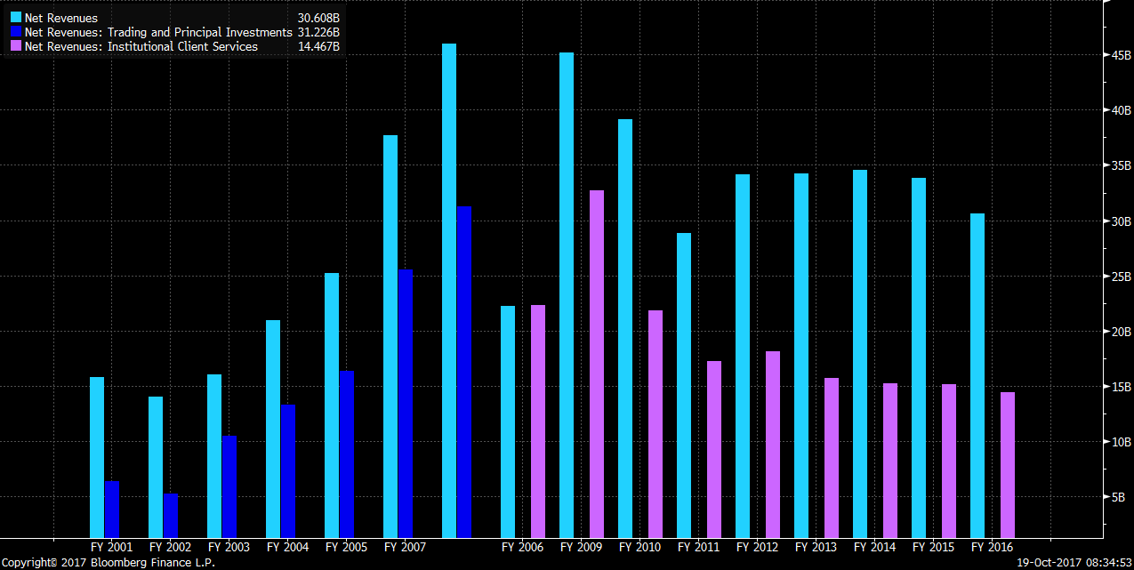
Trading is largest unit
Historically trading revenue has driven GS’ performance
Despite some recent revenue growth outside of Trading, the unit is currently just under 50% of total

Slide 4
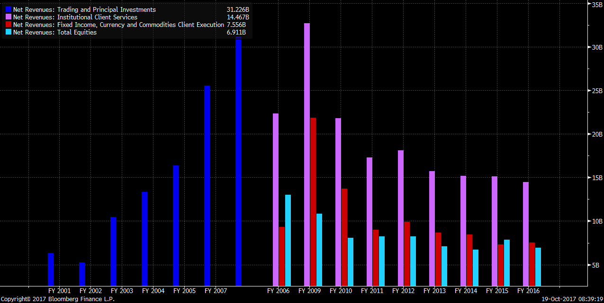
Fixed Income and Currency hit hardest
FICC revenues down over 50%
Less Capital allocated, markets are more transparent and GS has lagged competitors
Demise of hedge funds
Business has been commoditized

Slide 5
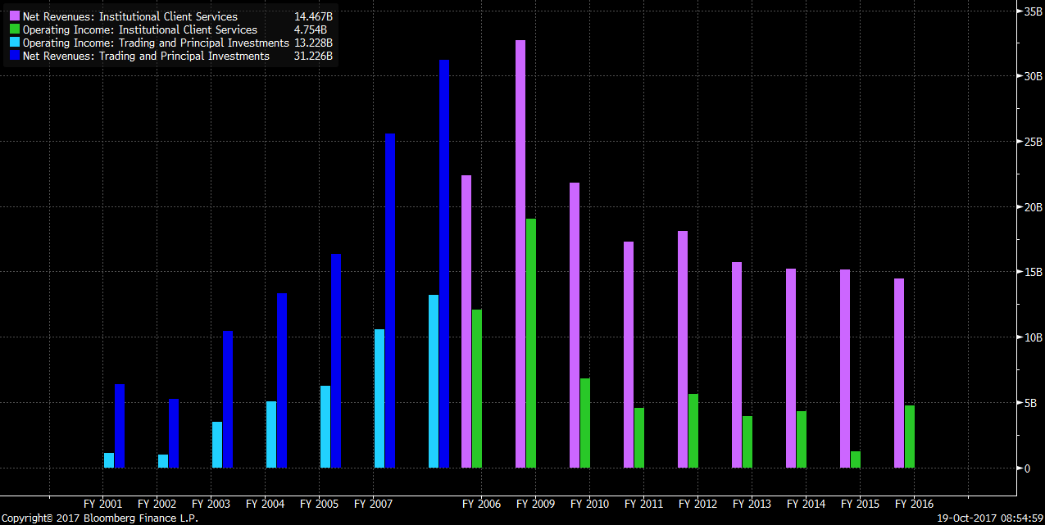
Margins in trading have fallen
Recent improvement due to cost cutting
GS has lagged competitors
Hedge fund weakness has hurt
Market transparency has cut margins

Slide 6
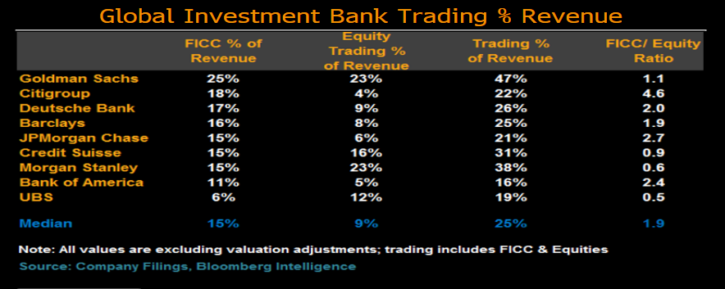
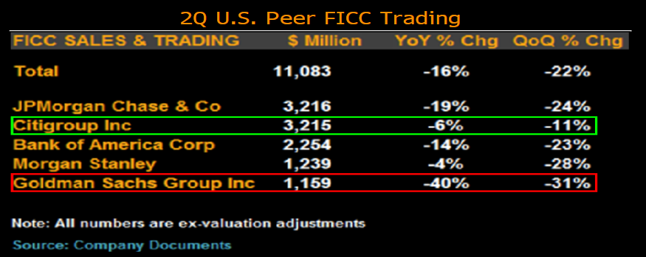
FICC is important to GS and sales have lagged

Slide 7
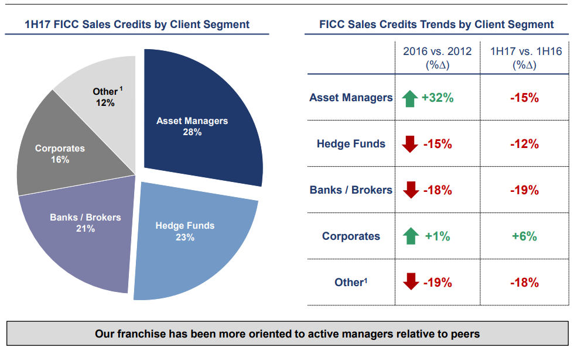
FICC Client Trend

Slide 8
Investing is going away…

Slide 9
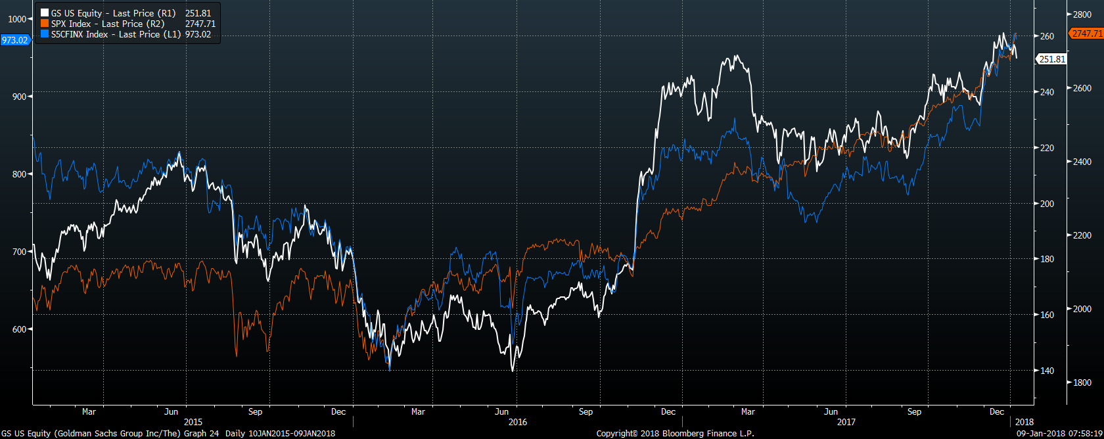
Performance has been solid

Slide 10
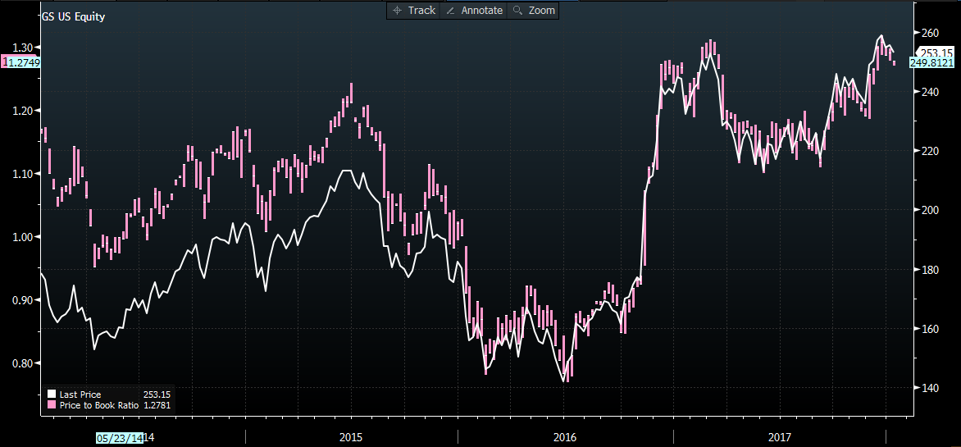
Valuation Near 4-year peak

