Slide 1


April, 2018
2018 Q1 performance review

Slide 2
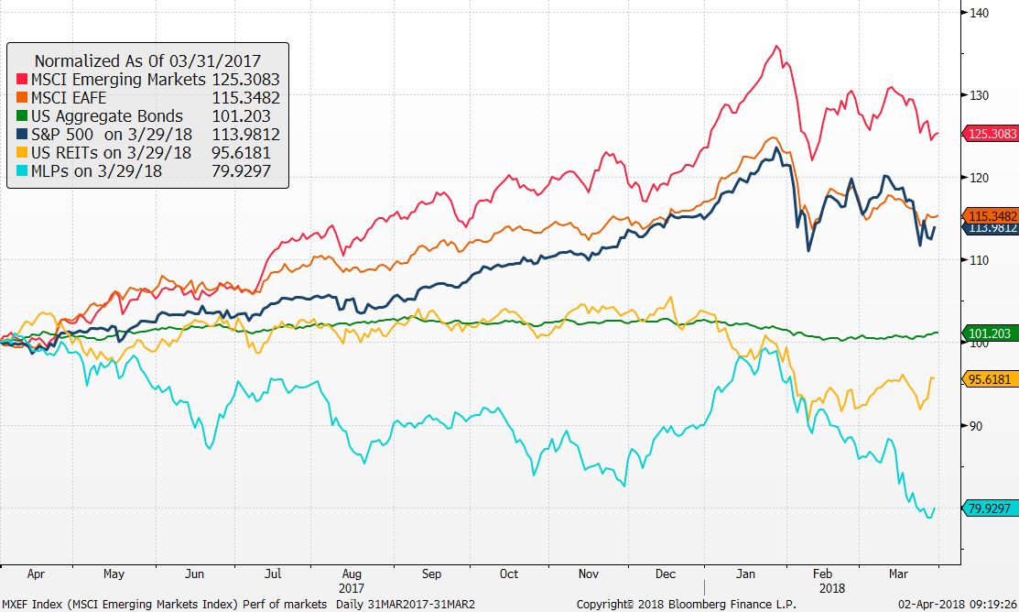
Market Returns
Performance of markets
Source: Bloomberg
MLP’s and REITs have lagged, again.
EM stocks have performed well
Bonds still positive for the past year

Slide 3
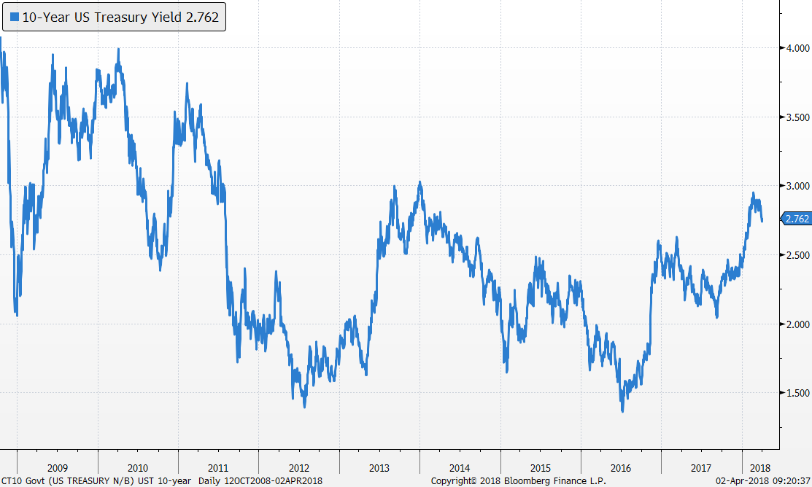

Bond markets
US Treasury 10-Year Yield
Yields rose sharply after US Presidential election and again during the first quarter of 2018
Our bond duration is 4.5 years, shorter than US Aggregate at 6.0 years

Slide 4
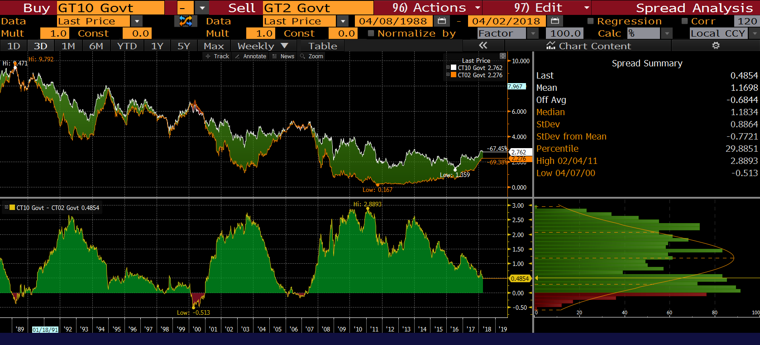
Recession indicator – Not there yet
Bond market spreads (10y-2y)
Flat yield curve has been a good predictor of recessions.

Slide 5
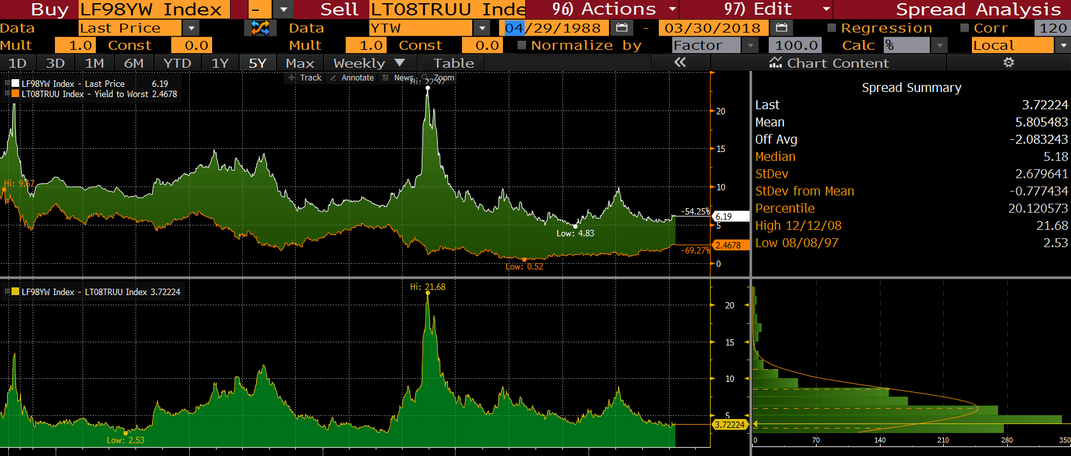
High Yield Spreads
Spreads have stayed low - no sign of panic from bond investors

Slide 6
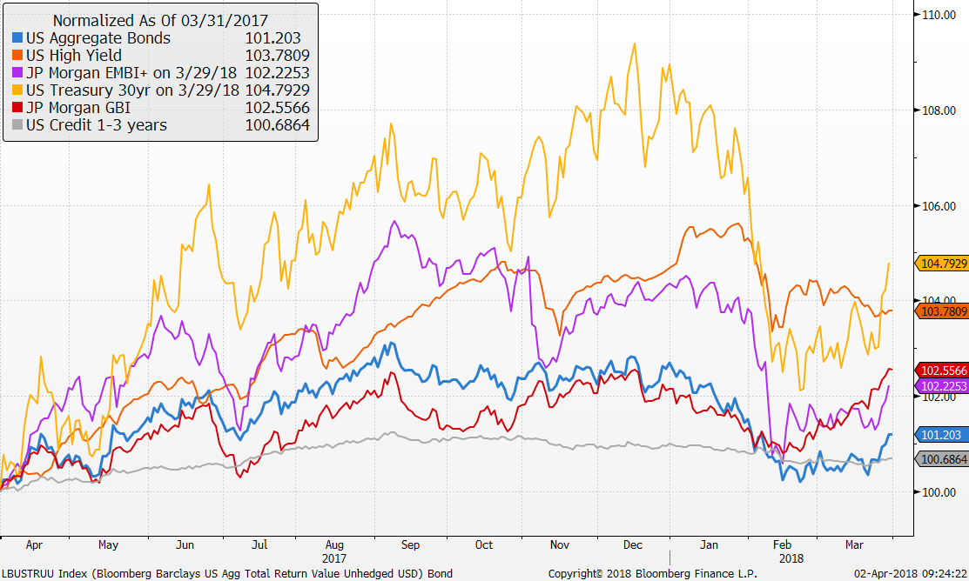
Market Returns
Performance of bond markets
Source: Factset
Long bonds have been hit by rising rates
Credit has held up well
Aggregate bonds continue to post positive returns even with rising short term rates

Slide 7
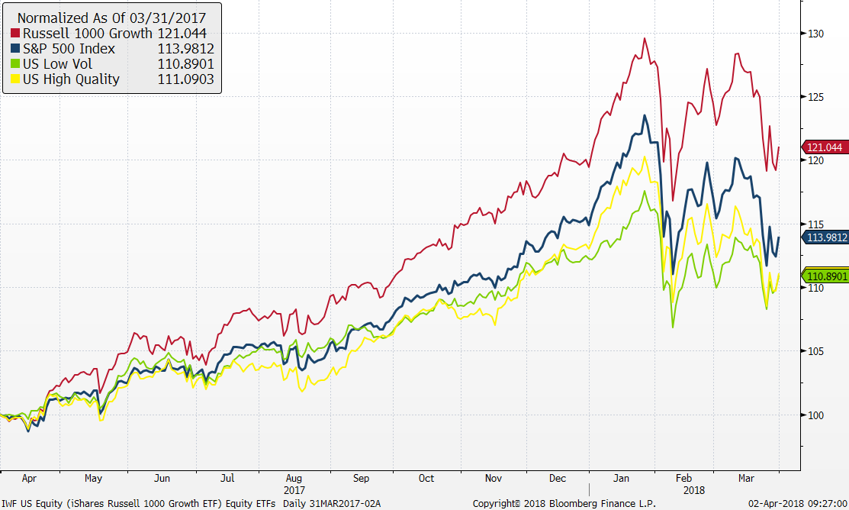
U.S. stock market ETFs
Source: Factset

Slide 8
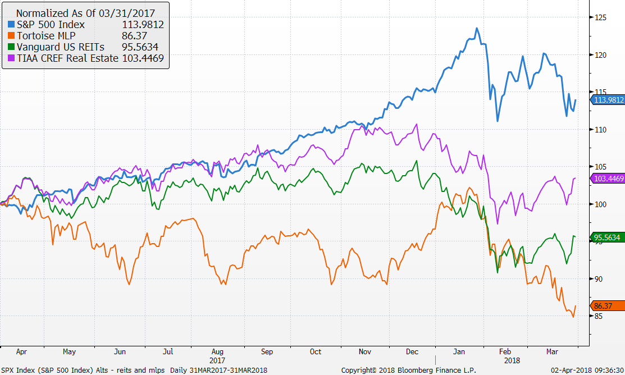
MLPs and REITs have underperformed

Slide 9
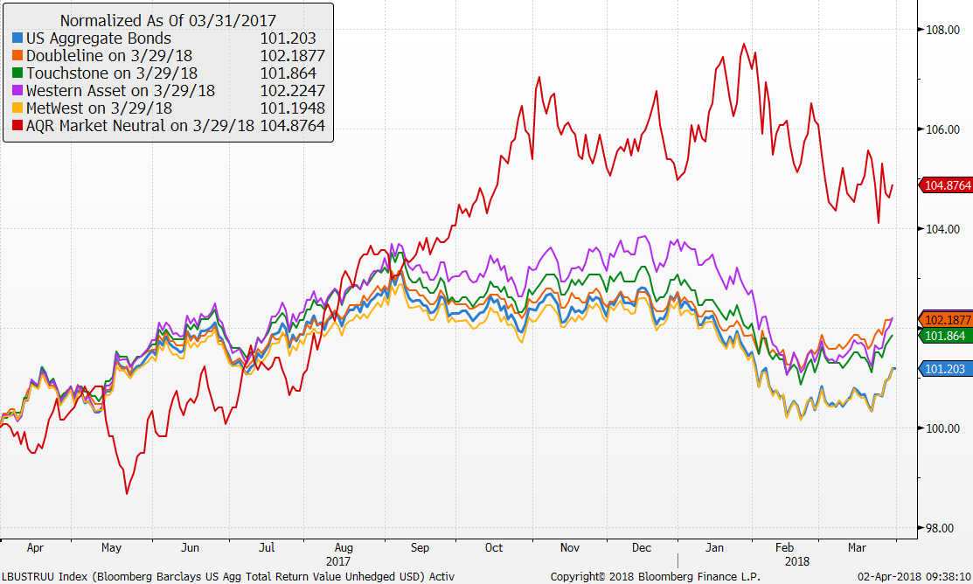
Active bond managers and Market Neutral

Slide 10
Vehicle performance as of 3/31/18

Slide 11
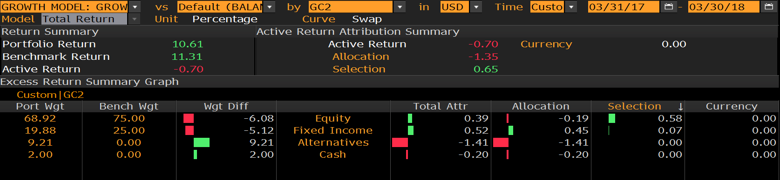
Growth model attribution
1 year
Improvement from yearend which was -1.00%
Lower volatility than the benchmark and solid first quarter

Slide 12
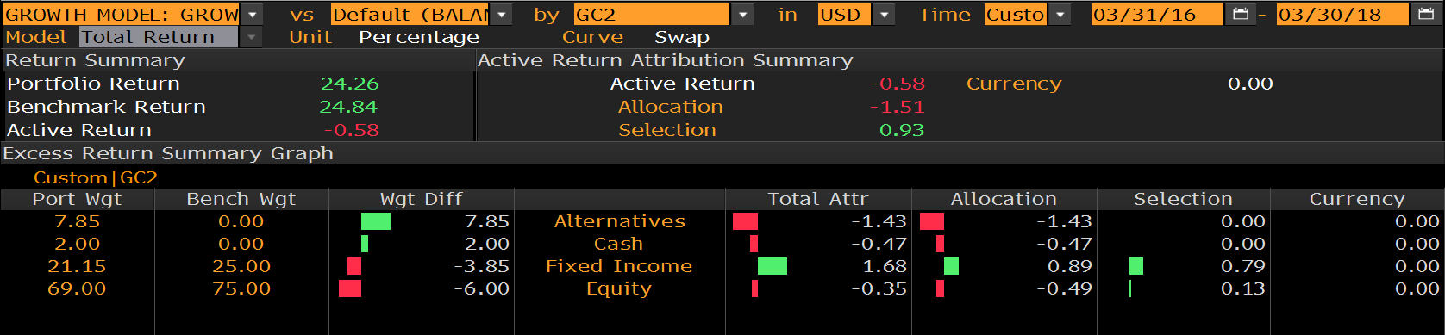
Growth model attribution
2 years
Strong results in fixed income
Risk 7.50 versus bench of 8.04

Slide 13
Growth model changes
Portfolio changes 2018
1/30 reduced bonds, US large cap, increased international stocks, MLPs and Market Neutral
Portfolio changes 2017
1/5 reduced short term bonds, increased small cap and added market neutral
2/7 increased MLPs
5/2 eliminated floating rate increased core bond funds and market neutral
7/11 Increased international developed and reduced US large cap
8/8 Switch REIT exposure to active manager, TIAA CREF Real Estate Fund

Slide 14

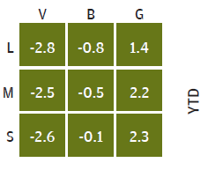
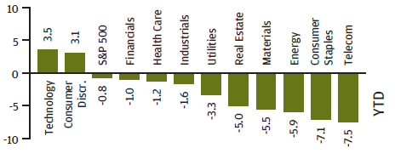
S&P 500 – What happened during 1Q 2018
The S&P 500 is down -1.2% during 1Q 2018 behind strong fundamentals but increased volatility
  Tech and Consumer Discretionary performed best, while Telecom and Staples performed worst
  Investors digested the implications of trade tensions and increasing interest rates during the quarter
  The S&P 500 experienced 6 trading days with moves +/- 2%, compared to 2017 when we saw none
Growth stocks performed best, a continuation of the 2017 trend

Slide 15
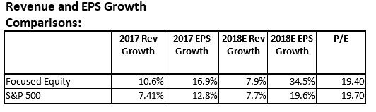
Focus equity highlights – 1Q 2018
What has driven performance in 1Q 2018?
Our US equities outperformed the market by 125bps in the first quarter mostly due to security selection in Tech and Industrials. Stock selection in REITs and Financials had a negative impact on the portfolio. Being underweight the Consumer Discretionary sector offset our positive security selection impact.
What’s worked?
Security selection in Tech and Industrials
No exposure to Telecom and Utilities was once again a slight positive
Top 3 performers in the portfolio: Cisco (+47bps), Booking (+37bps), Resmed (+35bps)
What didn’t?
Being underweight Consumer Discretionary and overweight REITs, and security selection in Financials
Bottom 3 performers in the portfolio: Wells Fargo (-43bps), CVS (-31bps), Tanger (-29bps)
Recent Changes in Q1 2018
Sold Whirlpool and Tanger

Slide 16
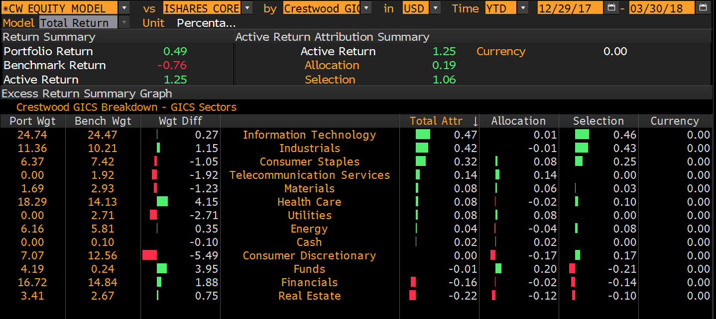
Attribution – 1Q 2018

Slide 17
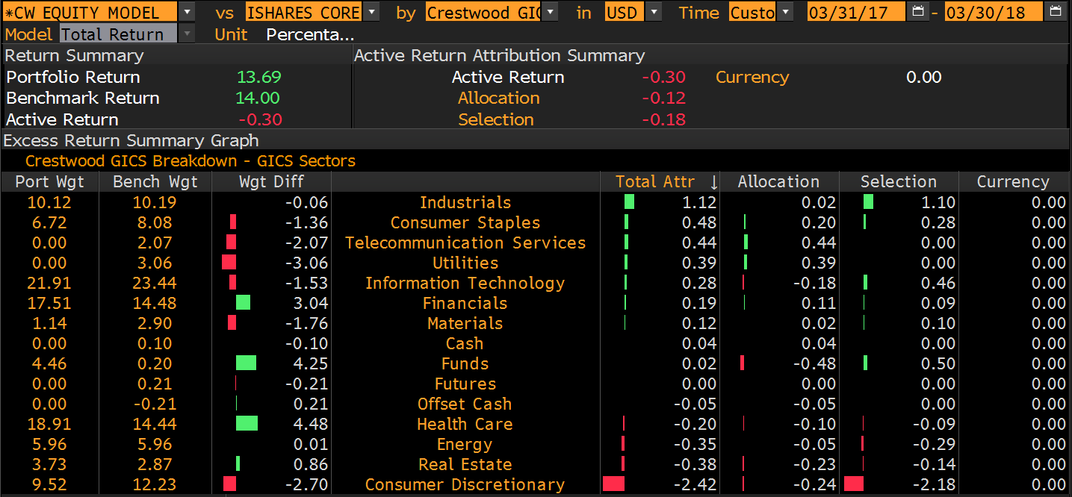
Attribution – One Year

Slide 18
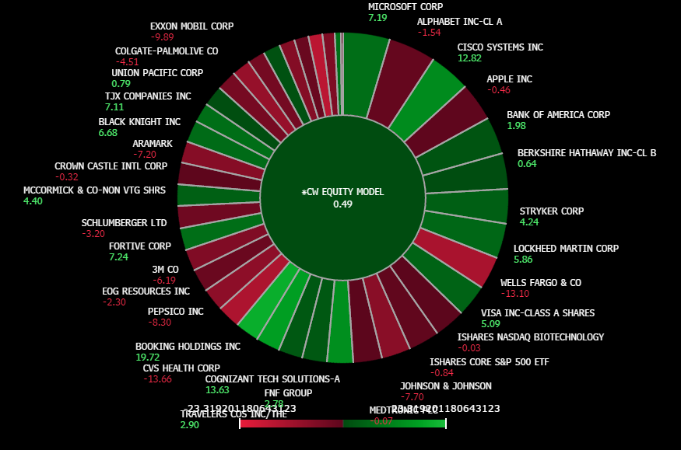
Heat Map– YTD

