Slide 1


Crestwood’s ESG Initiative

Slide 2
Contents
What is SRI?
What is ESG?
ESG benefits
  SRI assets are growing
  Lower portfolio risk
  Potential of higher returns
  Product differentiation
ESG Providers
Rating vary widely
Crestwood’s equity process combining providers – Sustainalytics and RepRisk
Importance of governance
Equity examples
Marketing example
Topic tags

Slide 3
Socially Responsible Investing (Eurosif)
Source JP Morgan

Slide 4
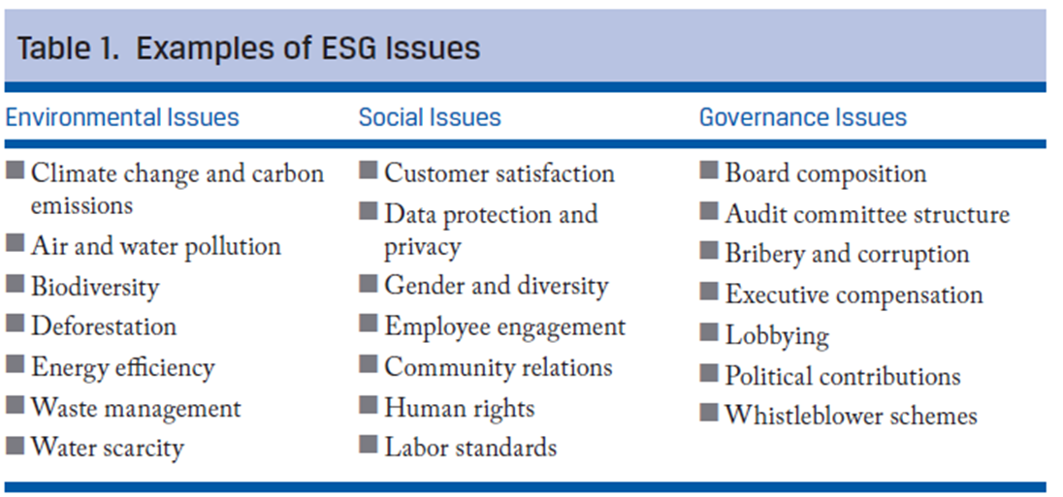
ESG issues

Slide 5
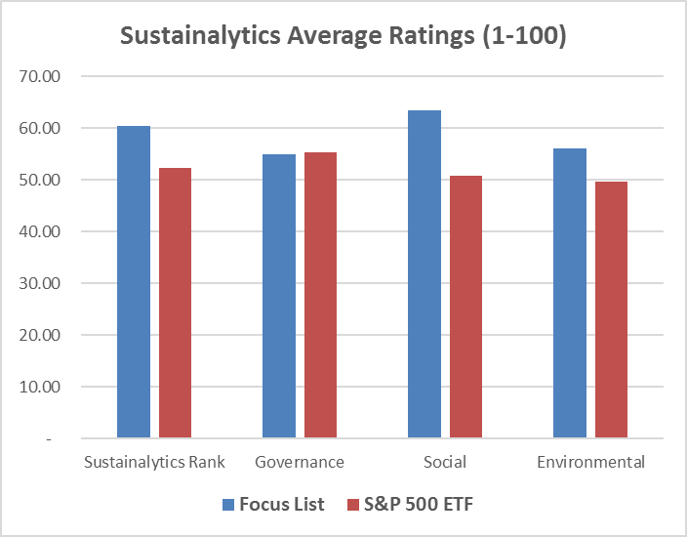
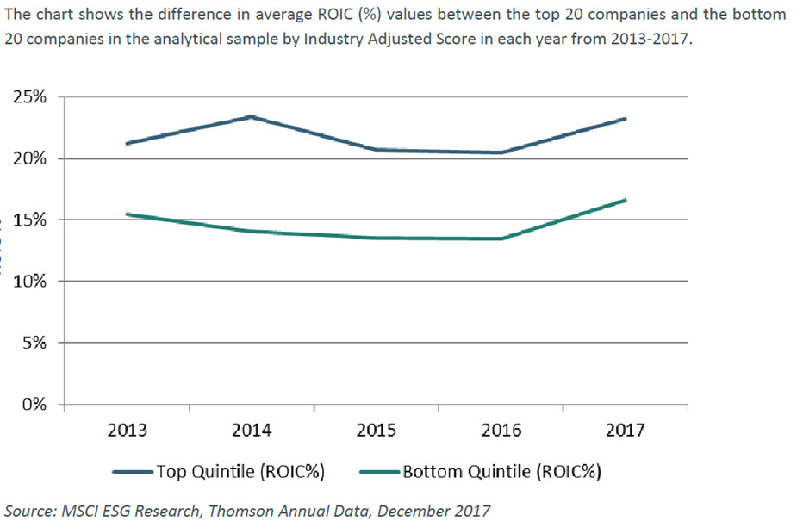
Crestwood’s Focus List
Focus list already has above average ESG scores
Better ESG companies tend to have higher ROICs
Source: Sustainalytics and Bloomberg. The statistics for the Focus List portfolio and S&P 500 Index are aggregated using average.

Slide 6
Surveys show strong support for growth in ESG
Millennials and women care about ESG most
  90% of Millennials are interested in pursuing sustainable investing versus 72% of individuals
  62% of women and 49% of men systemically consider ESG issues in their investment analysis
Advisors underestimate how much responsible investing matters
  65% of clients would be more likely to stay with a financial advisor who could talk about responsible investing. However, only 45% of advisors think that clients would be more likely to stay with them if they can talk about responsible investing
  47% of advisors do not consider ESG issues due to perceived lack of demand from client
  61% of investors say their advisors did not bring up responsible investing in the past 12 months
  47% of advisors indicate that responsible investing does not offer best in class choices
  44% think that responsible investing does not provide the same rate of return as other strategies

Slide 7
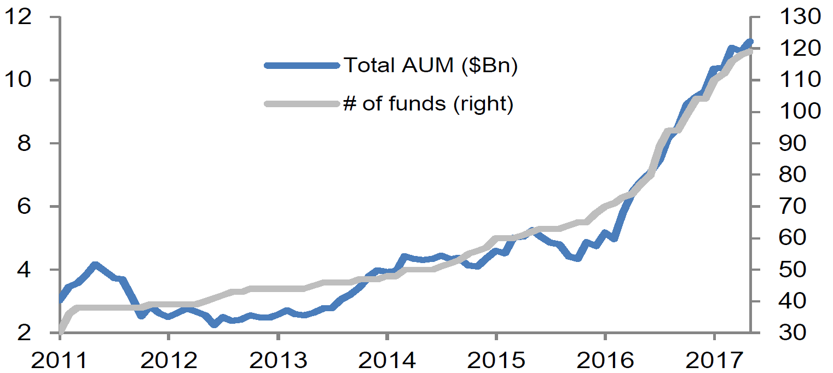
ESG Benefits
Responsible investing assets have shown strong growth
Growth in ESG-Themed ETFs
ESG accounted for $22.89 trillion, or 26 percent, of professionally managed assets in Asia, Australia, New Zealand, Canada, Europe and the U.S. at the start of 2016, according to the report.

Slide 8
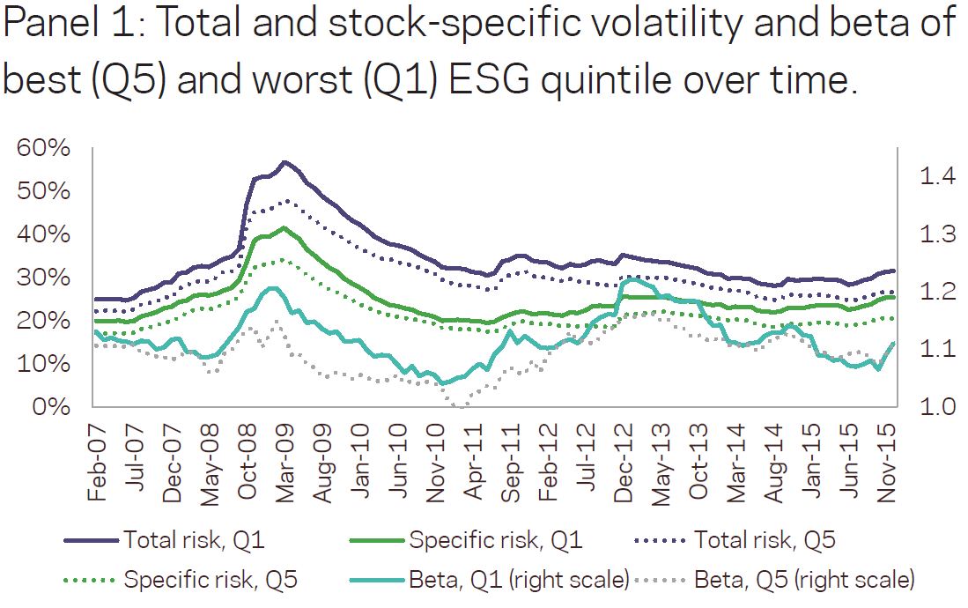
ESG Benefits
Reduced risk
Stocks with the worst ESG exposure have total and stock-specific volatility that is 10-15% higher.

Slide 9
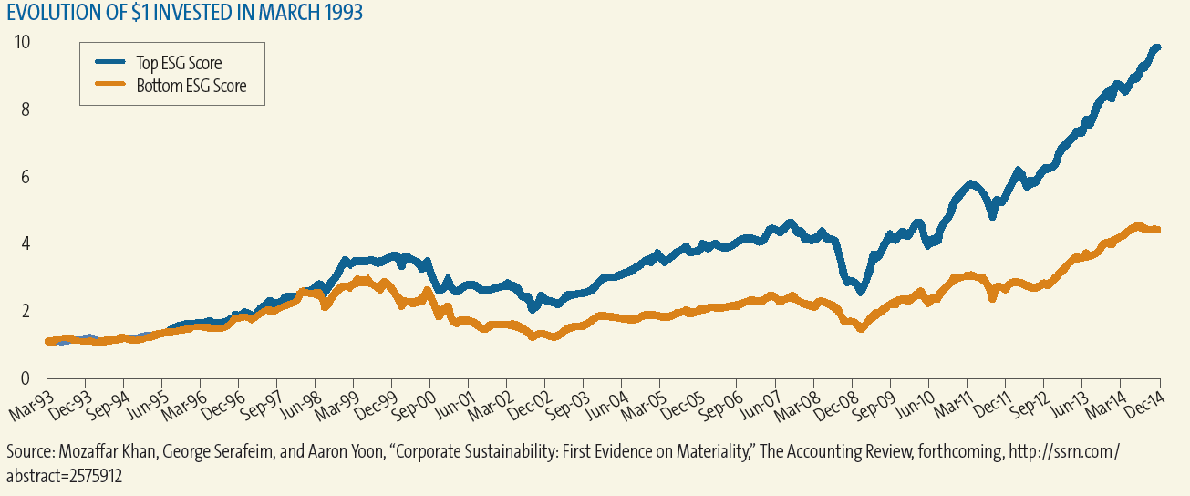
ESG Benefits
Performance - Performance enhancement
Meta study of ESG studies shows:
  Lower cost of capital for firms with strong ESG (14 out of 14 studies )
  Better market-based performance (15 out of 18 studies)
  Better accounting-based performance (10 out of 12 studies)

Slide 10
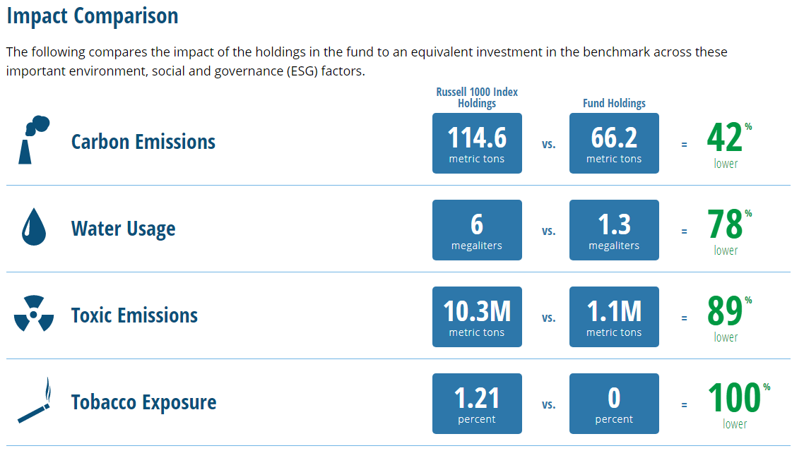
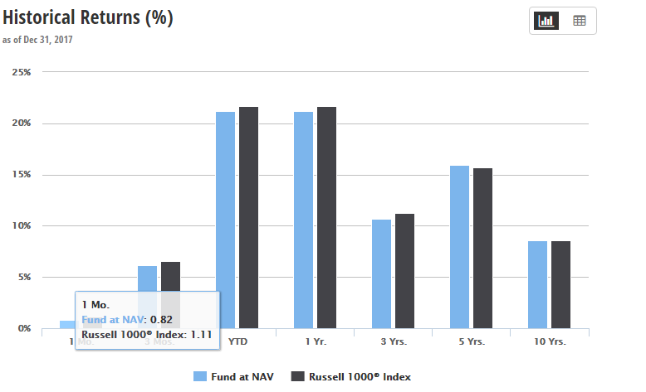
ESG Benefits
Differentiation – performance matters less

Slide 11
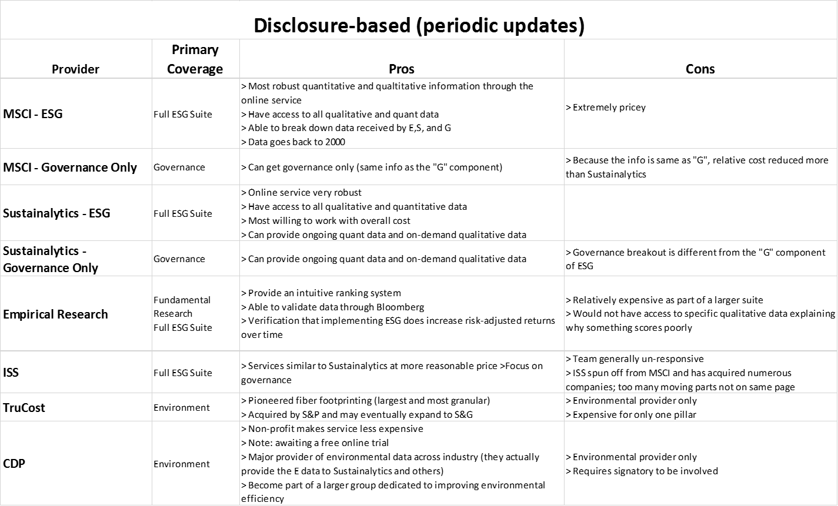
Providers

Slide 12
Providers, continued

Slide 13
ESG rankings and services vary widely
For example, the deviation between Sustainalytics and Robecco is 20 (rankings 1-100)

Slide 14

Crestwood’s equity process
Durable business with high barriers to entry
Market leader in a growing industry
Sustainably high or improving (ROIC), in excess of required rate of return
Strong balance sheet
Attractive long term growth prospects
Capable Management Team
  Investing in growth & making prudent capital allocation decisions
Ownership Structure
  Align interests of management and minority shareholders
Governance and ESG scores, trend in scores and ability to improve
Absolute valuation focus (Price/Earnings, Price/Cash Flow, Price/Sales, Price/Book)
Stock price < Intrinsic value
Price relative to business/growth prospects (conservative discounted cash flow and scenario analysis)
Avoid value traps. Are issues facing a company temporary or permanent?
High Quality
Business
Shareholder
Friendly
Management
Attractive
Valuation

Slide 15
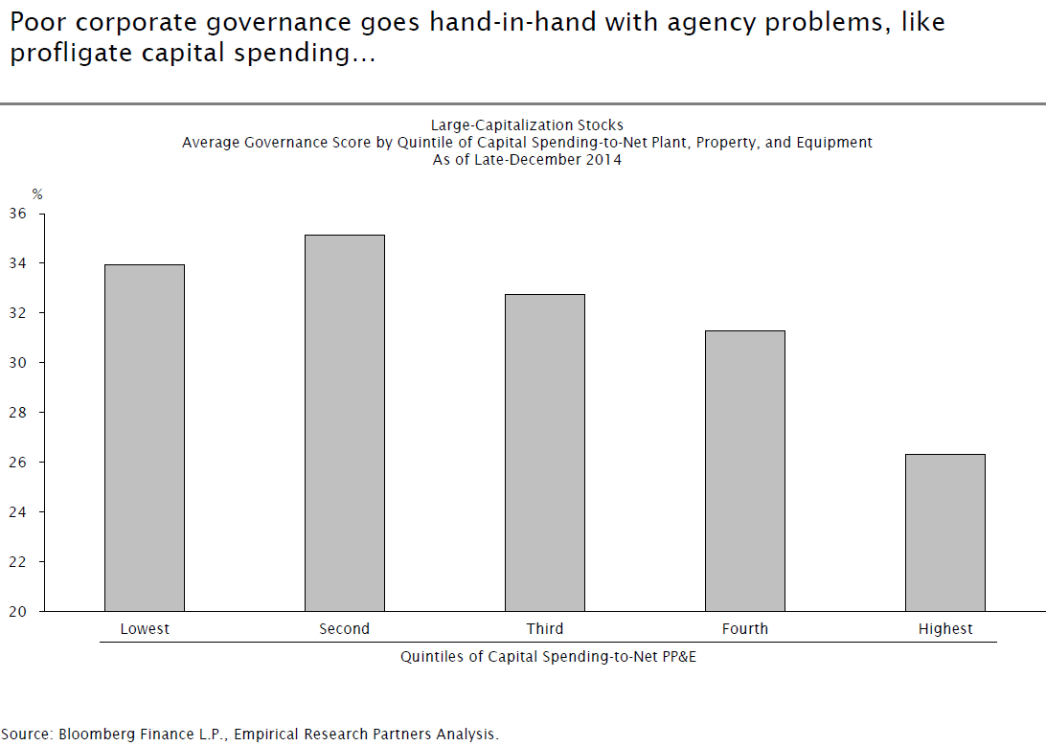
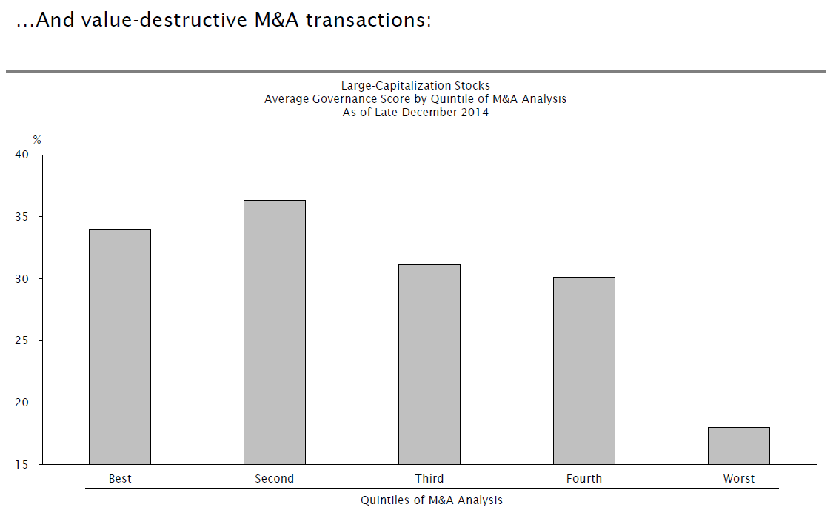
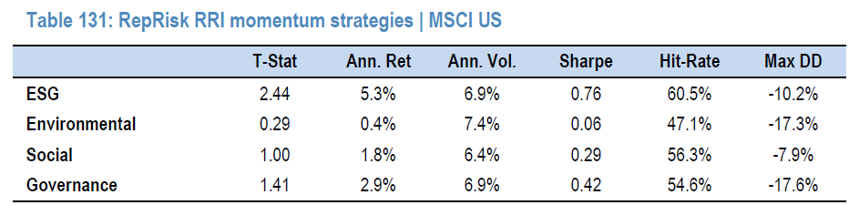
Governance is important

Slide 16
Crestwood’s ESG framework
RepRisk
Sustainalytics
Combining news-based and disclosure-based shown to improve returns and lower risk
ESGQ (JP Morgan) Returns enhanced 3.5% annually
Current rank
Current ranks with focus on governance
Mitigating factors?
Trends
What is the trend in the rank?
Why is the rank trending?
Firm’s ability and willingness to improve
As part of due diligence talk to company to review key issues
Glass Lewis vote Crestwood’s proxies with a focus on shareholder rights
Impact

Slide 17
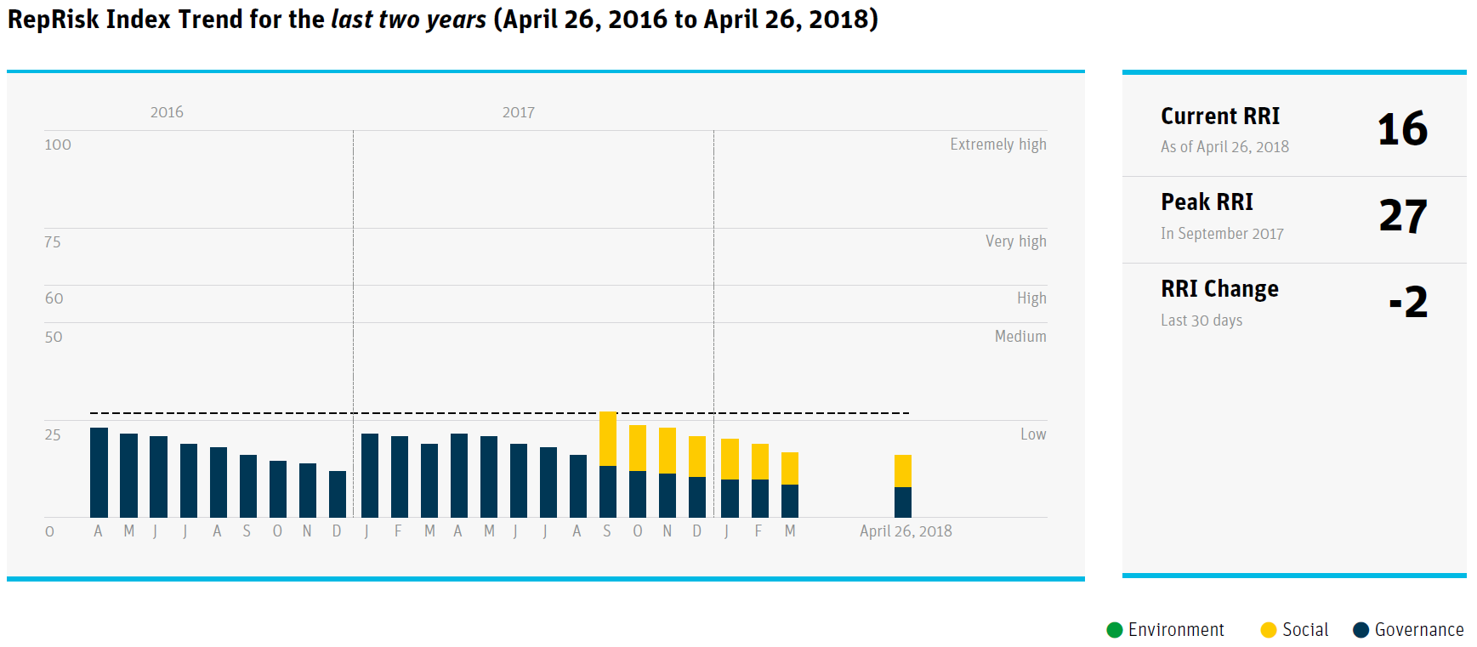
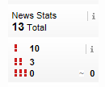
McCormick

Slide 18
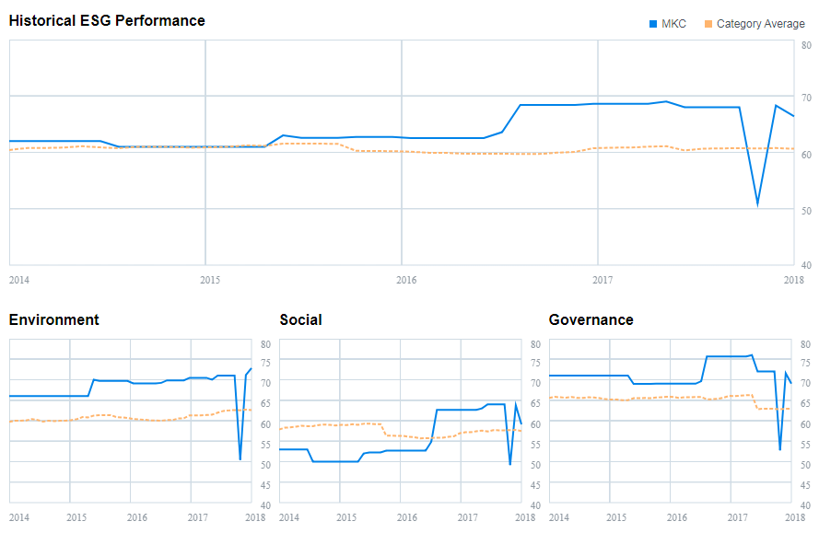
McCormick Sustainalytics

Slide 19
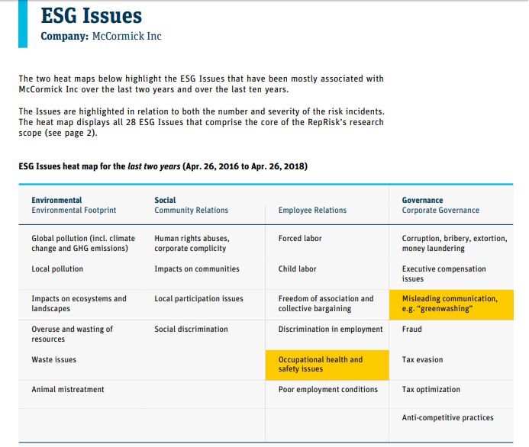
McCormick RepRisk

Slide 20
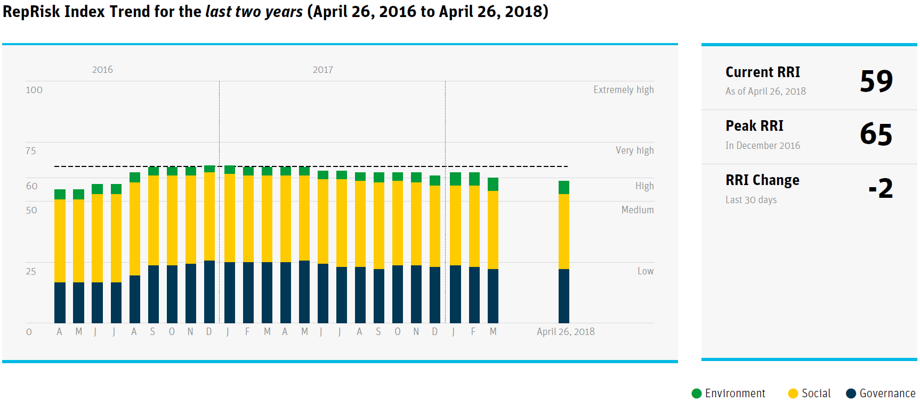
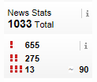
Apple RepRisk

Slide 21
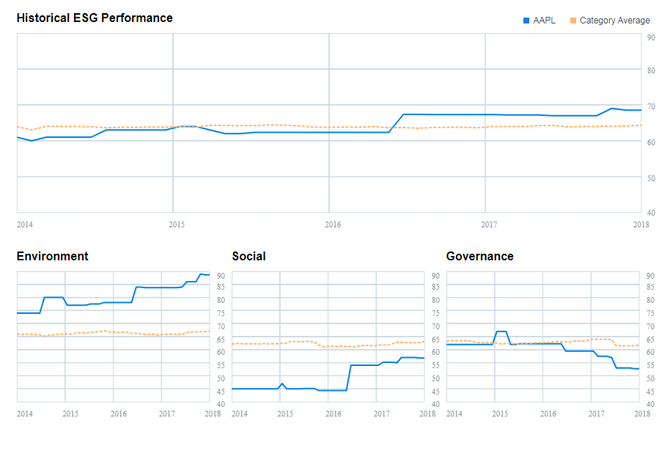
Apple Sustainalytics

Slide 22
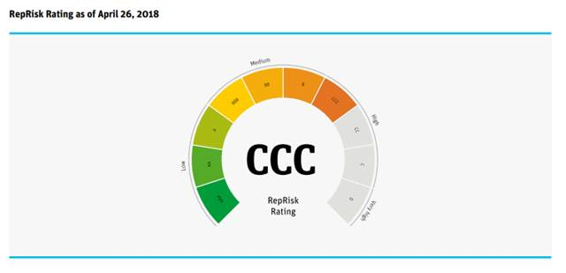
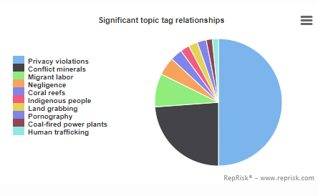
Apple RepRisk

Slide 23

Apple Flagged for Supply Chain Issues

Slide 24
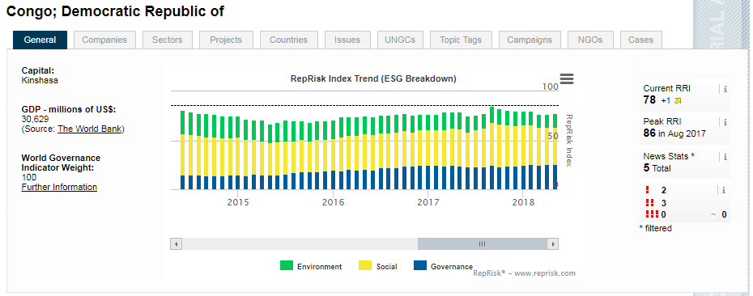
Cobalt Issues Not Just About Apple
Cobalt is an element critical for powering the clean energy revolution.
The world is increasingly powered by lithium-ion batteries, from smartphones to laptop computers to electric vehicles.
More than 50% of the world’s cobalt supply originates in the Democratic Republic of Congo (DRC).
Labor abuse issues are widespread in the DRC.
‘Clean Energy Evolution’ may not be as “clean” as it is claimed to be.

Slide 25
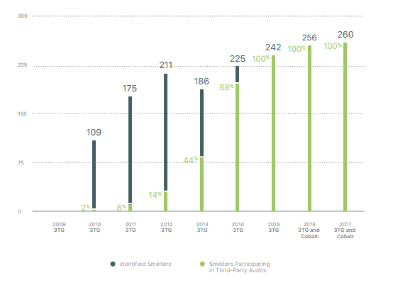
Third Party Assessment Participation 3TG and Cobalt

Slide 26
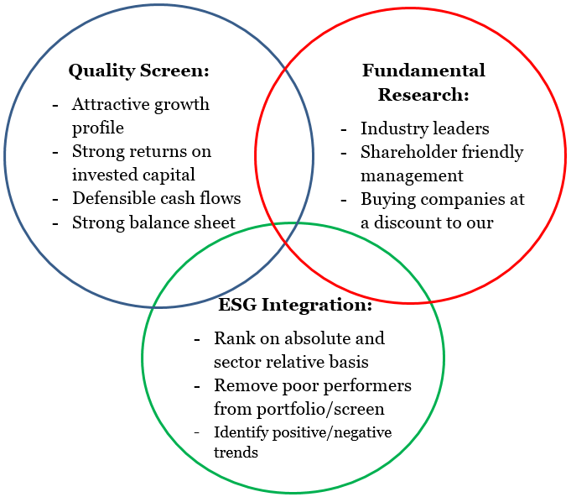
How will we implement ESG into our process?
Improving process by reducing risk
  What are we looking to accomplish? The ultimate goal of implementing ESG is to improve our investment process by attempting to reduce risk within our portfolio
  The process:
  Combine fundamental analysis with SRI/ESG overviews
  Monitor existing names and enhance screening process
  Evaluate positive or negative trends
Enhancing a Successful Process
  Screening new names:
  Does a company pass our fundamental screen?
  Does ESG rank or trend enhance the company’s quality?
  Based fundamental analysis and ESG integration, should we add position to the portfolio?

Slide 27
RepRisk Topic Tags
Exclusion

Slide 28
RepRisk Topic Tags
Exclusion

