Slide 1


July, 2018
2018 Q2 performance review

Slide 2
Outlook 2018
Fundamentals are sound but risks remain
U.S. maintaining economic momentum in 2018
The U.S. economic expansion continues in 2018 with an improving labor market, positive consumer confidence, low interest rates, favorable regulatory environment and new pro-growth tax changes
Expect benefits of tax cuts and regulation rollbacks to outweigh potential drag from higher tariffs and reduced immigration.
Expected 2018 consensus S&P 500 revenue (~9%) and earnings (~21%) growth adds support to long-lived bull market
International markets still attractive
Global economic growth is showing synchronized strength. The International Monetary Fund is forecasting 2018 global growth at 3.9% (faster than U.S. growth)
Compared to U.S. market valuations, developed international and emerging markets remain relatively attractive
Risks remain but have shifted
Forward looking market valuations have come down to more normalized levels with strong earnings driven by top line growth and tax cuts
There are risks of an escalating trade war which would likely impact the S&P 500 to an even greater degree than GDP
Inflation risks have increased as tight labor markets lead to increased wage growth. Tax cuts, commodity prices, and protectionism could be accelerants
China’s high debt levels remain a concern given authorities efforts to constrain credit growth
Market volatility remains above the low levels seen throughout 2017, but are consistent with its long-term history
Information is current and believed to be accurate as of 3/31/2018

Slide 3
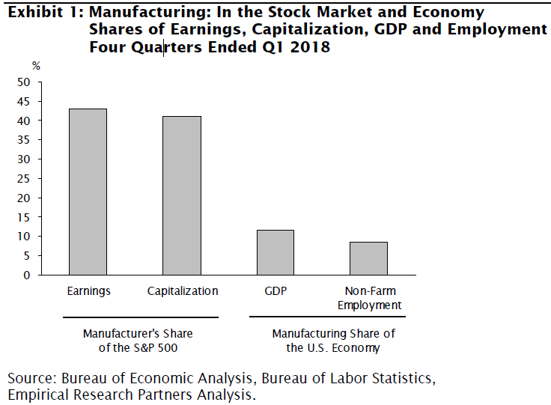
Tariffs
Given their current scope and size, tariffs should not outweigh recent stimulus and derail the US economy.
Tariffs will affect manufacturing and potentially earnings more so than GDP. Supply chains in China have driven up margins and lowered US capital intensity, increasing free cash flow margins and multiples.
In time, tariffs could increase inflation and elicit higher interest rates.
Potential for protectionism to escalate – automobiles?

Slide 4
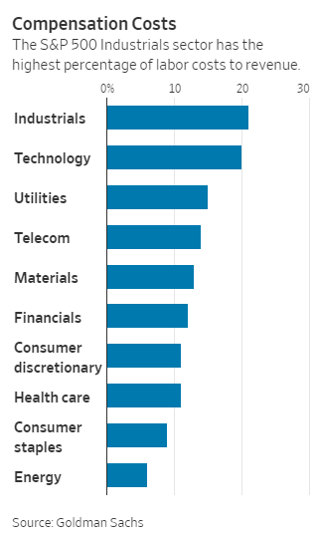
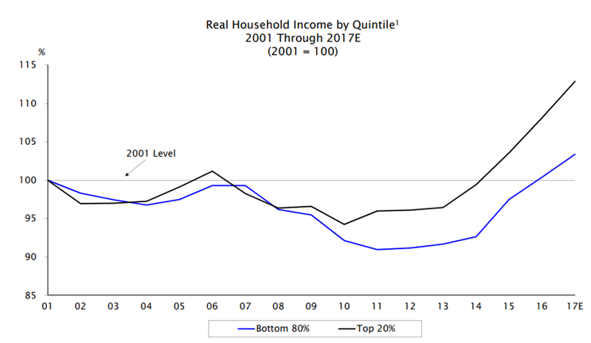
Wage Growth
Wages are increasing, but not expected to materially affect S&P 500 earnings.
Labor is 13% of revenue for companies in the S&P 500
Currently, only a portion of wage increases are being passed on to consumer as higher prices
Wage growth should help consumption and GDP growth

Slide 5
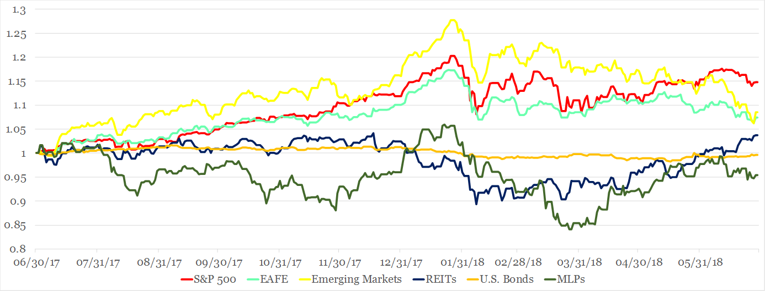
Return of Market Indices
The upward trend that prevailed in 2017 has reversed as market volatility and correlations have increased. While economic fundamentals remain strong, uncertainty over U.S. trade policies and potential retaliatory actions has rattled investors.
Bond prices are also under pressure as the Federal Reserve continues to increase short term rates in conjunction with improving growth and inflation expectations.
Maintaining a diversified portfolio of assets should help to mitigate overall volatility with the intention of providing strong risk-adjusted returns over time.
Source: Bloomberg. EAFE is MSCI EAFE Index, Emerging Markets is MSCI Emerging Markets and U.S. Bonds is Barclays U.S. Aggregate. REITs is the DJ US Select Real Estate Securities Index. MLPs is Alerian MLP Index. The above information is through 6/30/2018. See last page for important information.

Slide 6
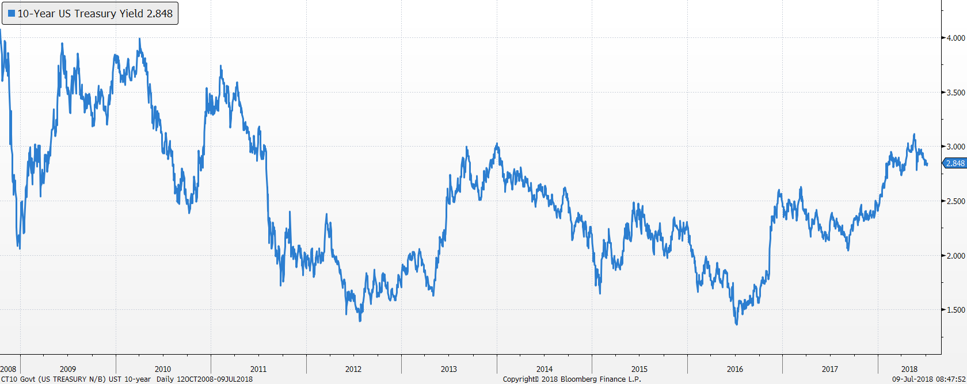
Bond markets
US Treasury 10-Year Yield
Yields rose sharply after US Presidential election and again during the first quarter of 2018
Our bond duration is 4.5 years, shorter than US Aggregate at 6.0 years

Slide 7
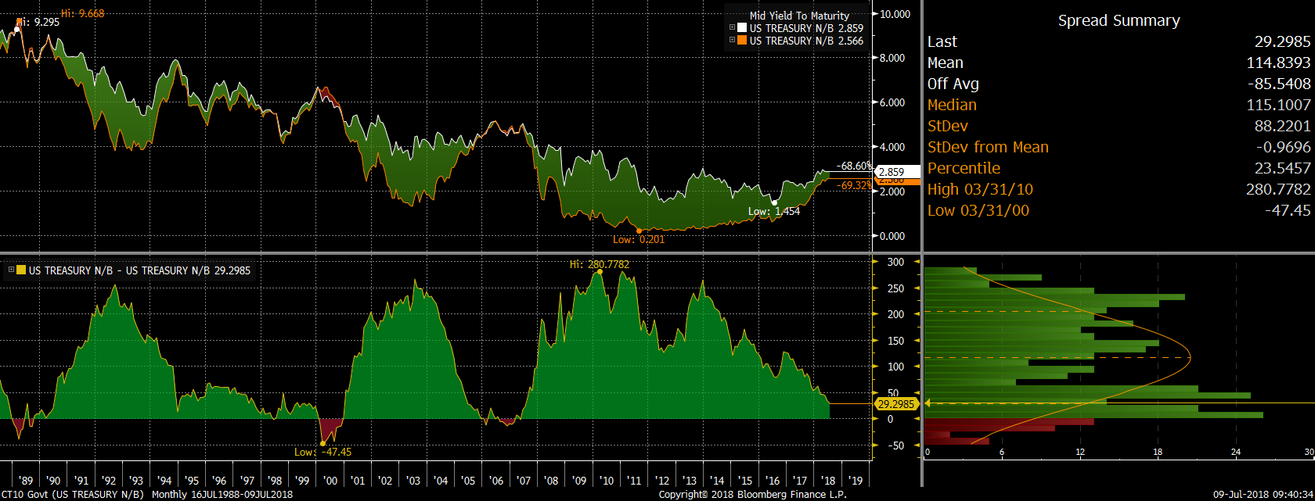
Recession indicator – Not there yet
Bond market spreads (10y-2y)
Flat yield curve has been a good predictor of recessions. Percentile has dropped from 29th to 23rd

Slide 8
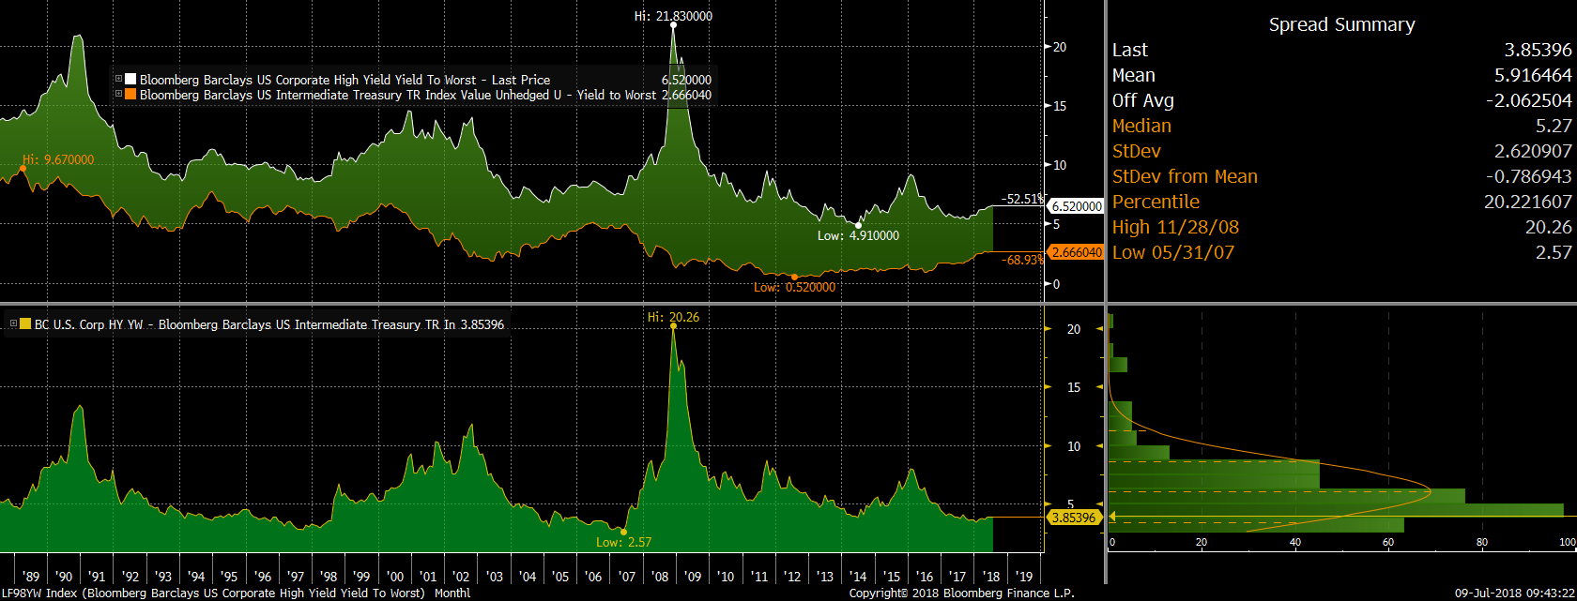

High Yield Spreads
Spreads have stayed low - no sign of panic from bond investors

Slide 9
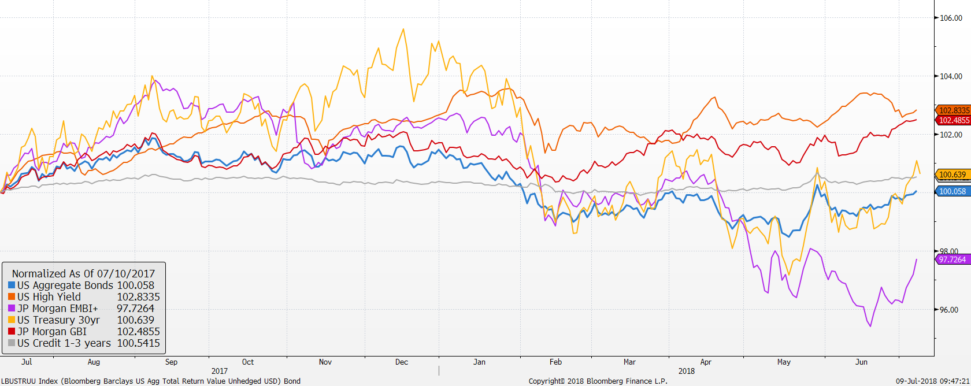
Market Returns
Performance of bond markets
Source: Factset
EM bonds hit by strong dollar and higher US rates
Credit has held up well
Aggregate bonds continue to post positive returns even with rising short term rates

Slide 10
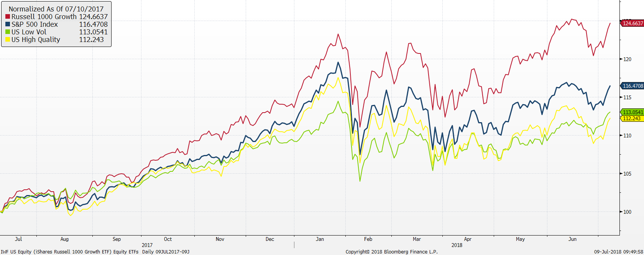
U.S. stock market ETFs
Source: Factset

Slide 11
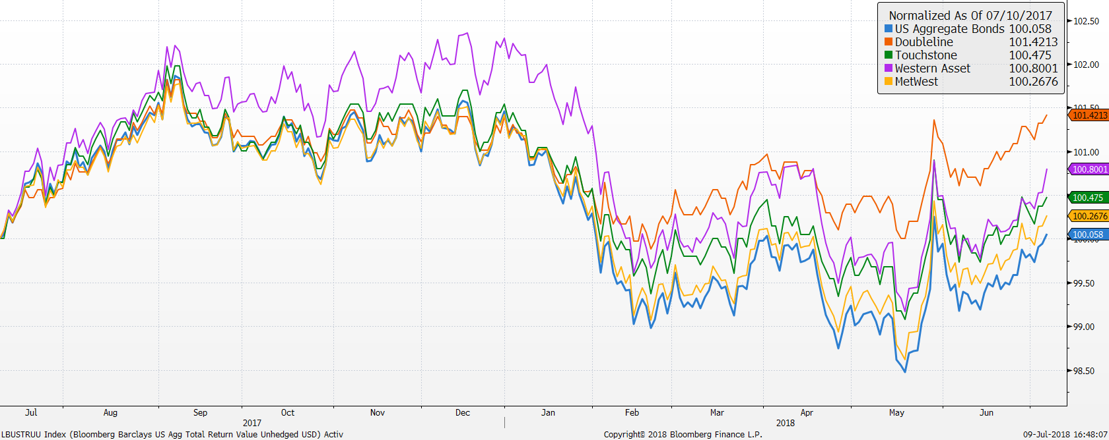
Active bond managers

Slide 12
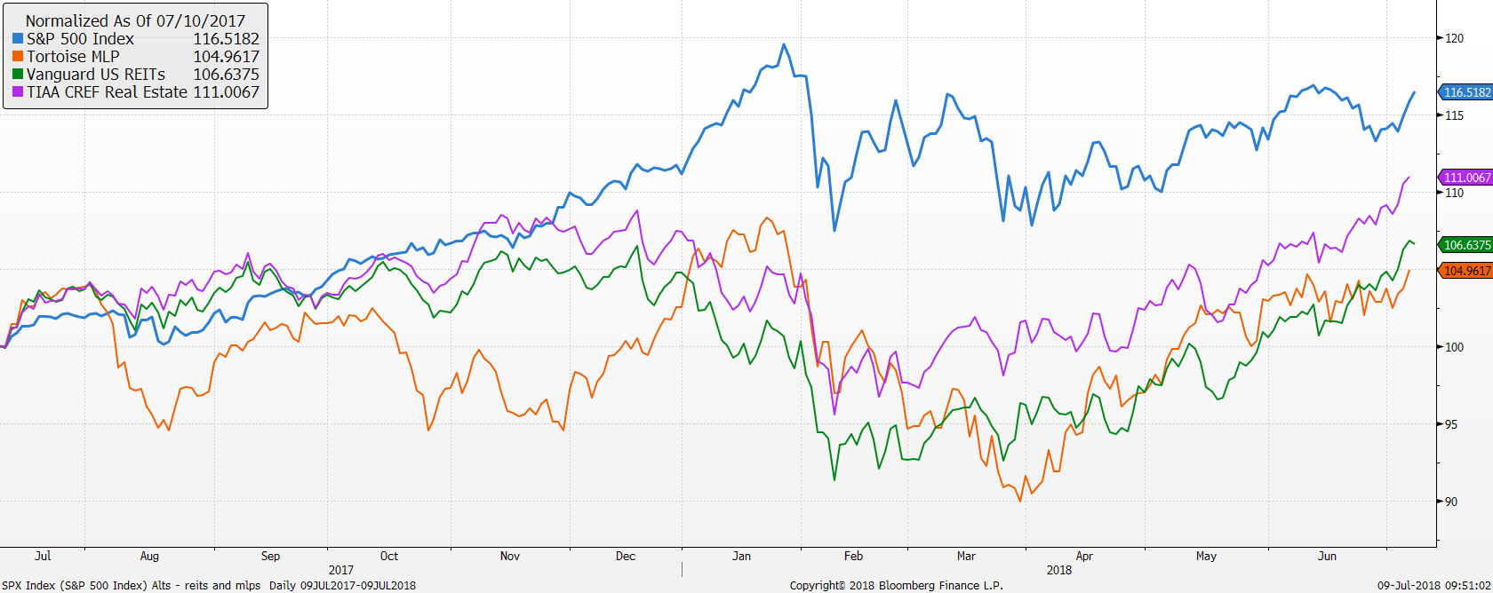
MLPs and REITs have recovered some ground

Slide 13
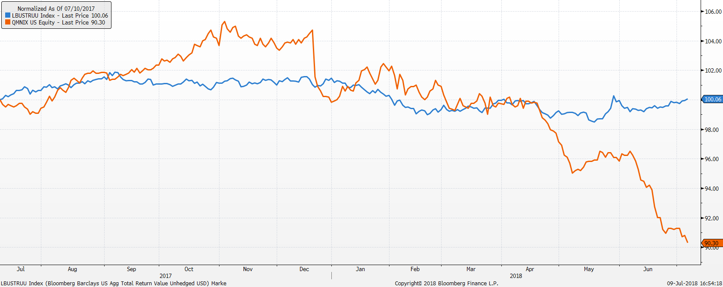
AQR Market Neutral has struggled
Underperformance in stock selection has been a value vs. growth story across the board at AQR
Companies deemed more expensive have been outperforming those less expensive
Strategy does not change its factor weights so performance should turn around when the signals turn
While performance is atypical in magnitude and direction, returns are within broad distribution for the strategy, just at the outer bounds

Slide 14
Vehicle performance as of 6/30/18

Slide 15
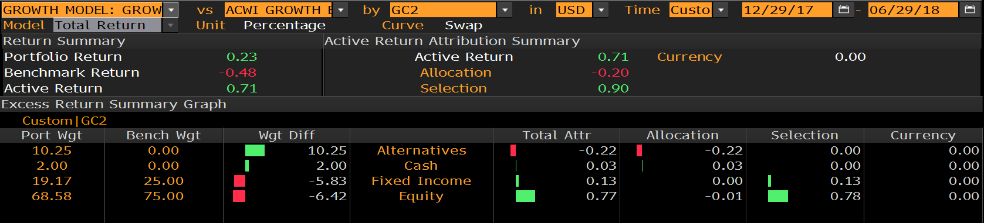
Growth Model attribution
Year-to-Date relative to 75% ACWI & 25% US Aggregate
US stock outperformance and overweight added value
Lower duration helped bonds
Alternatives lagged

Slide 16
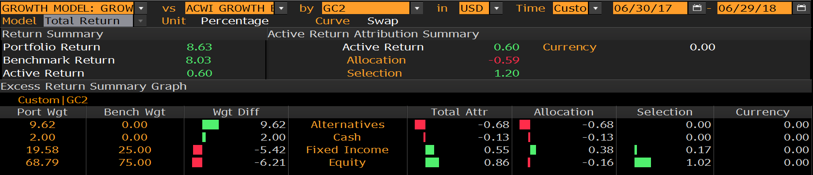
Growth Model attribution
One year relative to 75% ACWI & 25% US Aggregate
US stock outperformance and overweight added value
Lower duration helped bonds
Alternatives lagged

Slide 17
Growth model changes
Portfolio changes 2018
1/30 reduced bonds, US large cap, increased international stocks, MLPs and Market Neutral
Portfolio changes 2017
1/5 reduced short term bonds, increased small cap and added market neutral
2/7 increased MLPs
5/2 eliminated floating rate increased core bond funds and market neutral
7/11 Increased international developed and reduced US large cap
8/8 Switch REIT exposure to active manager, TIAA CREF Real Estate Fund

Slide 18
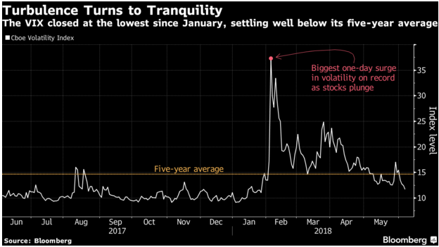
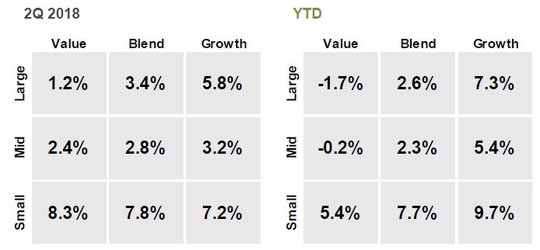

S&P 500 – What happened during 2Q 2018
The S&P 500 is up 3.4% during 2Q 2018 (+3.8% YTD) behind strong fundamentals
  Tech and Consumer Discretionary performed best, while Staples, Financials and Industrials performed worst
  Volatility decreased during the quarter:
YTD growth stocks performed best, a continuation of the 2017 trend, but in 2Q18, we saw small cap value category outperform the small cap growth category

Slide 19
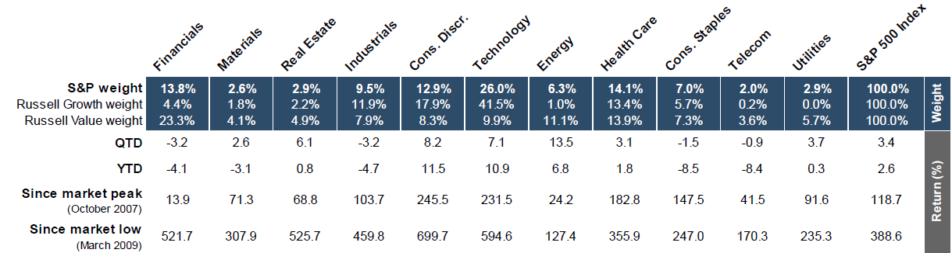
Sector Returns YTD and since market peak/low

Slide 20
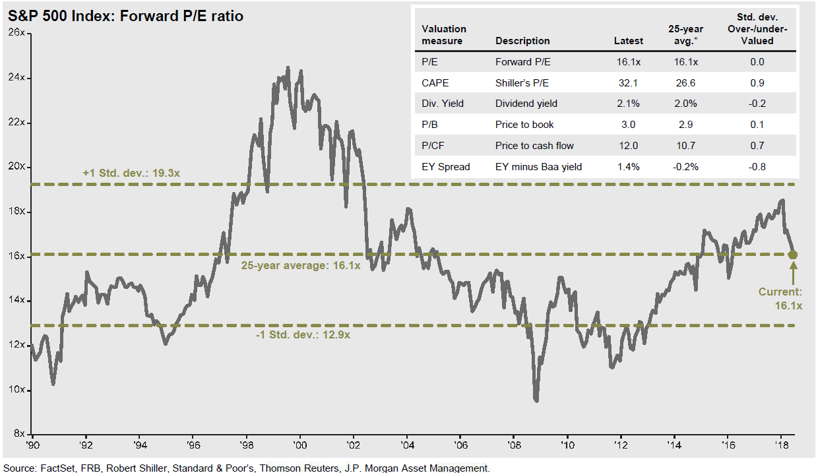
S&P 500 Forward P/E

Slide 21
Focus Equity Highlights – YTD
What has driven performance YTD?
Our US equities outperformed the market by 53bps year to date mostly due to security selection in Consumer Staples, Tech, Industrials and Healthcare. Stock selection in REITs, Financials and Consumer Discretionary had a negative impact on the portfolio. Being underweight the Telecom and Staples had a positive impact, while being underweight Discretionary was a negative.
What’s worked?
Security selection in Staples, Tech, Industrials, Healthcare
No exposure to Telecom was once again a slight positive
Top 3 relative performers in the portfolio: Resmed, TJX, Black Knight
What didn’t?
Being underweight Consumer Discretionary and overweight Financials
Stock selection in REITS
Bottom 3 relative performers in the portfolio: Tanger, 3M, Aramark
Recent Changes in Q2 2018
Added 50bps to MMM from cash at the end of April

Slide 22
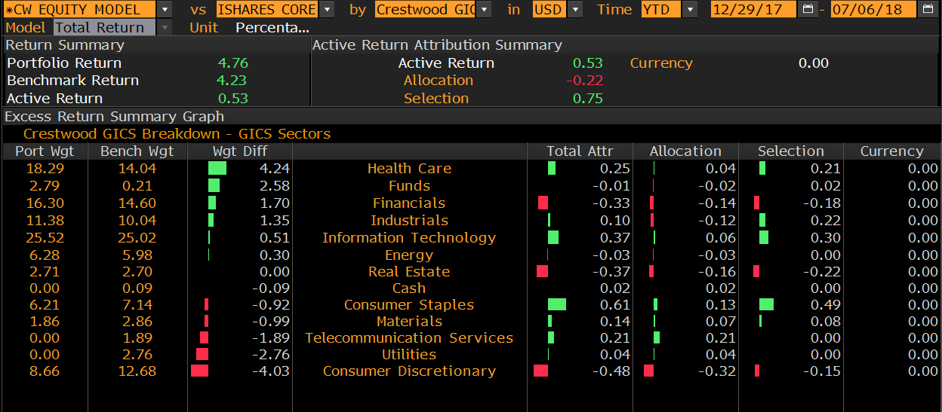
Attribution – Year to Date

Slide 23
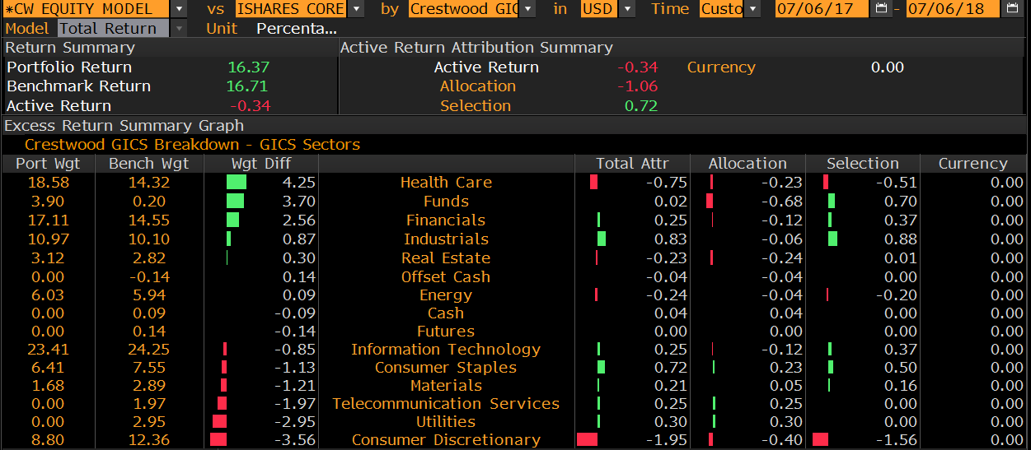
Attribution – One Year

Slide 24
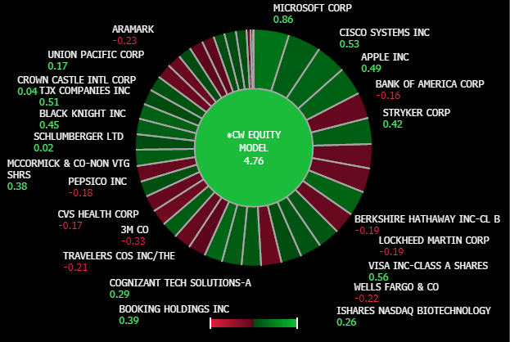
Heat Map– YTD

