Slide 1
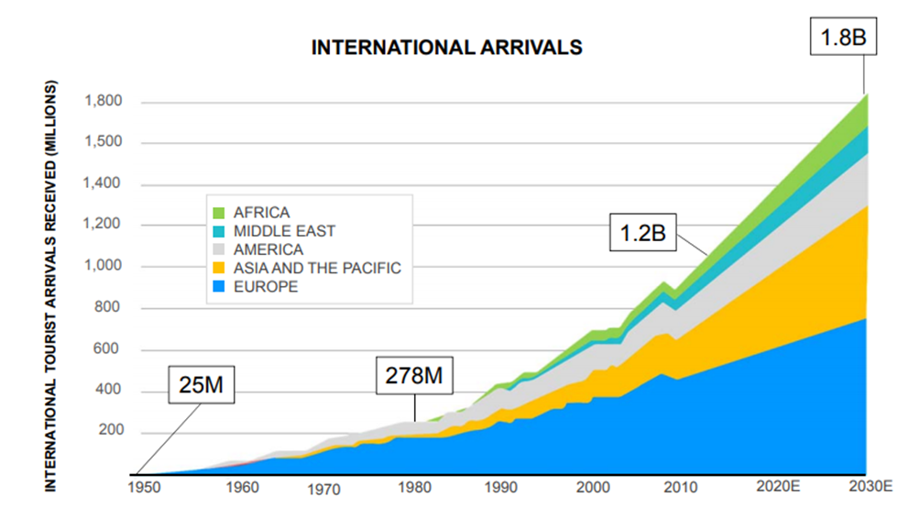
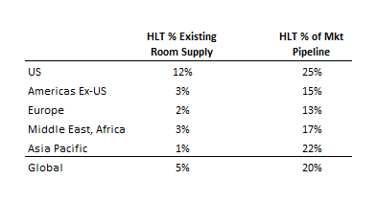
Hilton (HLT) One of the World’s Largest, Fastest-Growing Hospitality Companies
The Company:
About – Hotel operator and franchiser with geographic and chain scale diversity of 14 brands, 5,400 hotels and 880k rooms across 106 countries (Hilton, Hampton Inn & Hilton Garden Inn ≈ 2/3 of portfolio).
Shift from hotel ownership to franchising results in resilient, asset-light, fee-based model.
Network effect moat of leading hotel brand and global scale lead to room revenue premiums and lower distribution costs.
Increasing global market share– value proposition of Hilton brand network generating 20% share of global room pipeline, well ahead of current 5% global room share.
Secular Growth in International Travel
Source: UN World Travel Organization
The Opportunity:
Secular shift to brand affiliation – better economics of branding driving record pipeline in fragmented and underpenetrated global hotel market.
Substantial returns on minimal capital – we expect capital efficient growth and high incremental margins will lead to increasing returns (ROIC) and a higher multiple.
Unit growth and fee based model reduce cyclicality – Lower operating leverage vs ownership reduces earnings volatility and unit growth offsets potential room rate weakness.
Growing Market Share of Future Development
Source: STR Global (March 2018)

