Slide 1
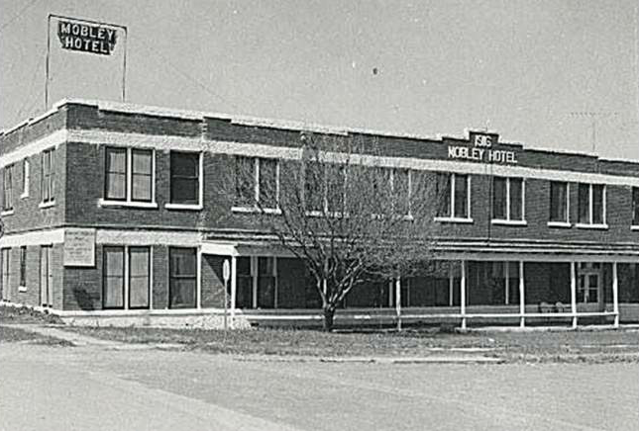
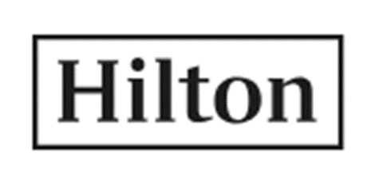

Slide 2
14 brands across
106 countries
5,400 Properties
880,000 Rooms

Slide 3
Why Invest?
Network effect of leading hotel brand and global scale provide a moat which they can monetize through a resilient, asset-light, fee-based model.
Record pipeline generating substantial returns on minimal capital should drive valuation multiple.
Generating significant cash which is returned to shareholders through dividends and buybacks.
Favorable ESG Rating.

Slide 5
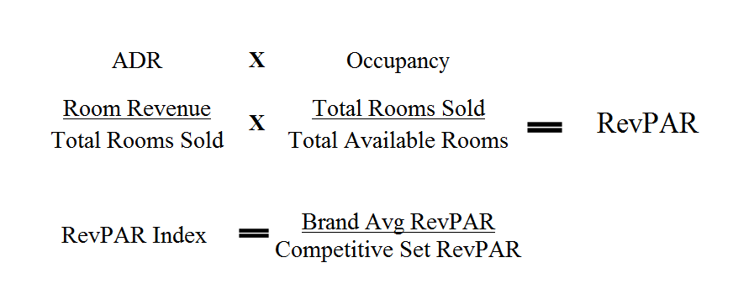
RevPAR – Revenue per Available Room
RevPAR: combines unit revenue measure and capacity utilization into one metric.
RevPAR Index: tells you the brand’s competitive set premium/discount.

Slide 6
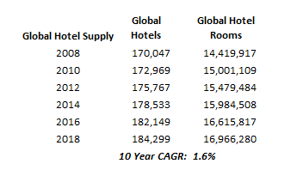
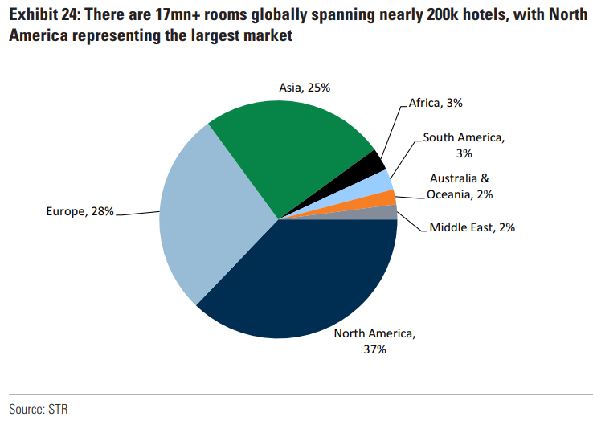
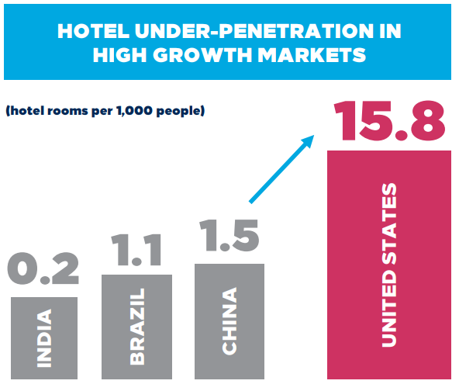
Global Room Supply

Slide 7
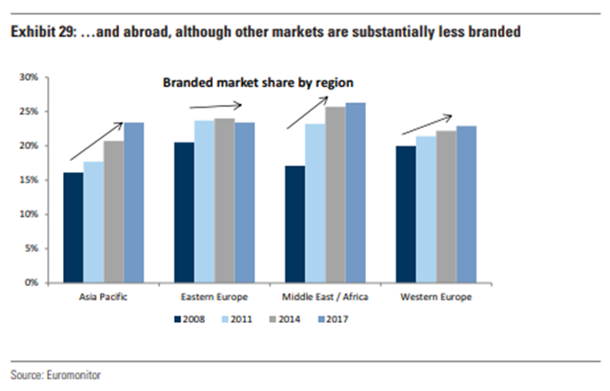
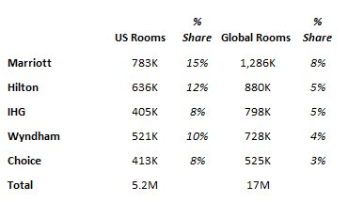
Fragmented Global Market
The global market is fragmented, but a changing competitive environment is driving a secular shift to brand affiliation.

Slide 8
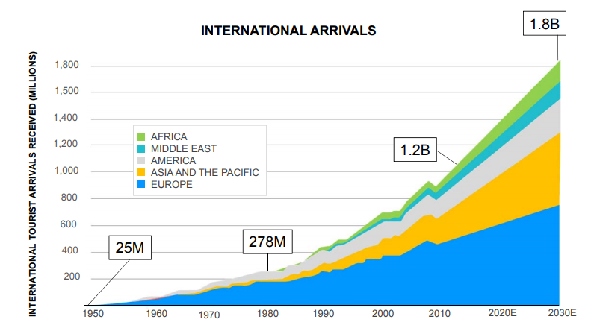
Growing Travel Spend
World Tourism Council Estimates
UN World Travel Estimates

Slide 9
Hotel Business Models

Slide 10
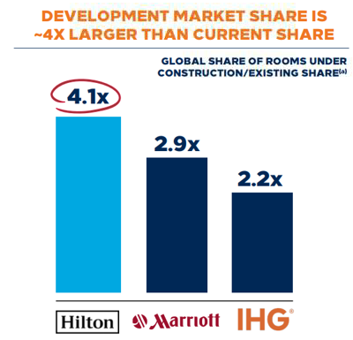
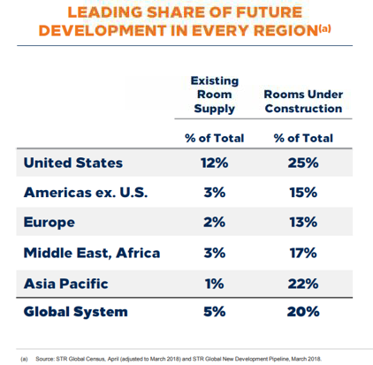
Branding = Better Owner Economics
Better economics leads to unit growth with 3rd party capital.
Higher RevPAR Index.
Lower OTA fees.
Higher % direct book.
Lower overhead costs.
Virtuous cycle of increasingly powerful brand and loyalty network drives scale and better economics.
Value proposition leads to disproportionate pipeline share.

Slide 11
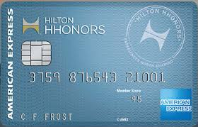
Loyalty Program
Key part of their virtuous cycle: drives fee growth while delivering a better product to customers and better economics to franchisees.
78m members
59% of system-wide occupancy
The cost of reward points are passed through to the franchisees.
Co-branded cards drive loyalty membership.

Slide 12
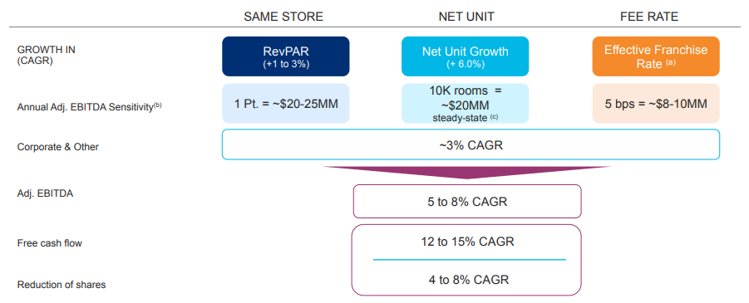
Model Drivers

Slide 13
Pipeline Conversion Value Creation

Slide 14
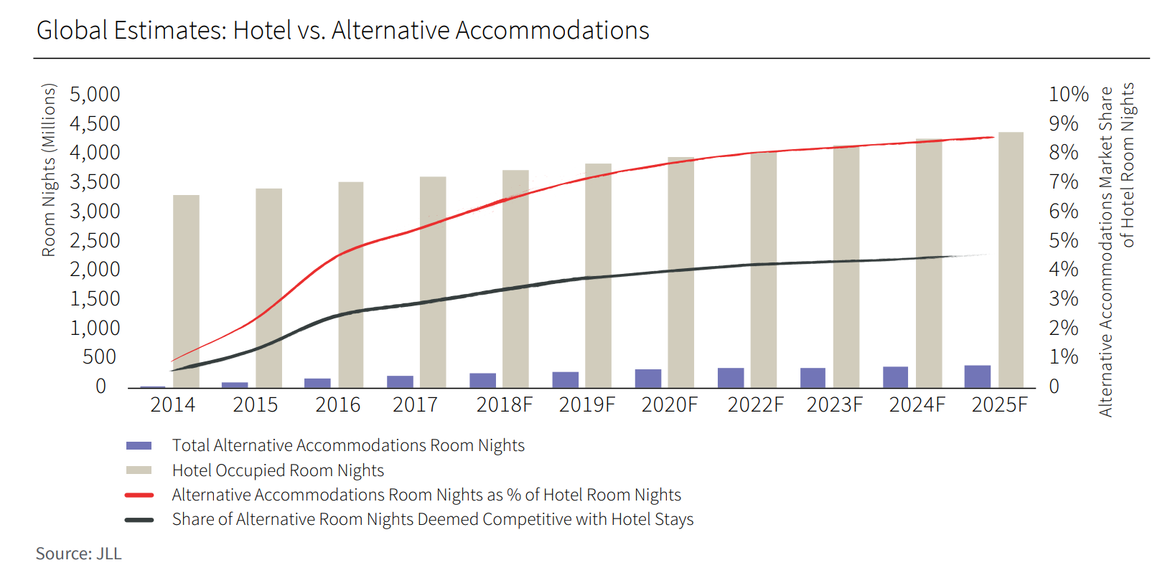
Key Risks
Brand inconsistency as a result of franchise model.
Lower than expected pipeline growth.
Competition from alternative accommodations (e.g. Airbnb).
Negative RevPAR trends.

Slide 15
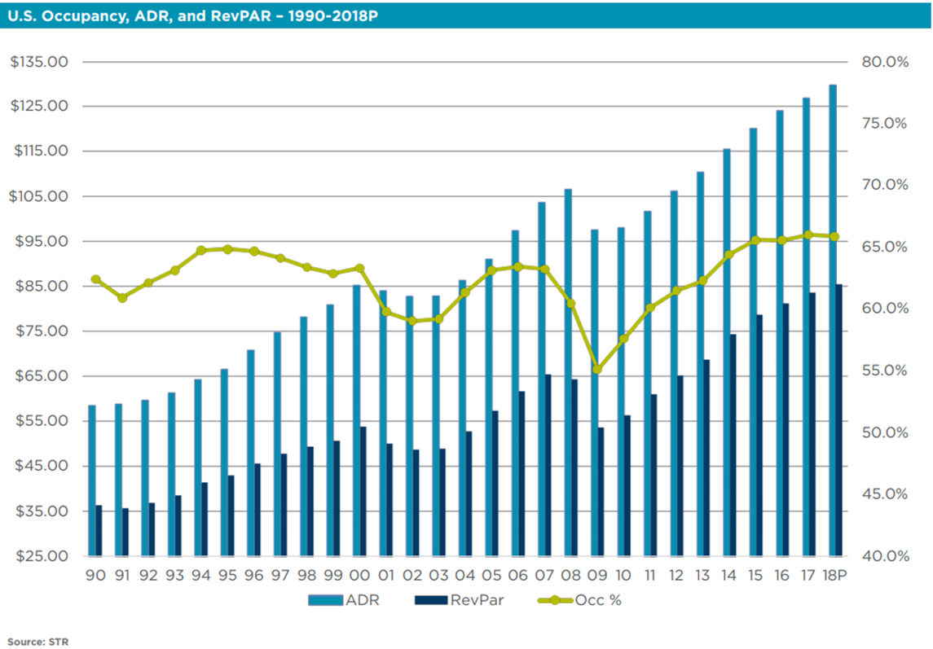
Historical RevPAR Trends

Slide 16
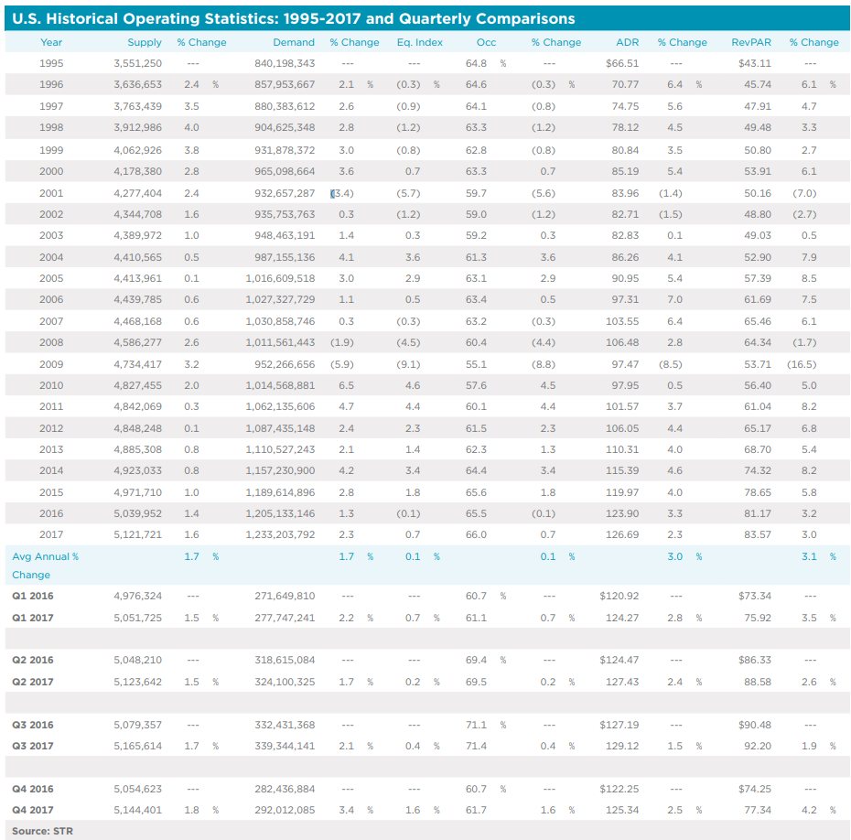

Slide 17
Valuation
Assumes:
MSD unit growth - they have close to 3 yrs. worth of unit growth already under construction
LSD RevPAR
Stable FCF Margins

