Slide 1
September 2018
Market Neutral Strategy Review
Internal Use Only

Slide 2
Why did we buy a market neutral strategy?
Strategy to limit risk with return potential above the Agg
Mix of offsetting long a short equity positions
Goal is to have a beta of zero over time
Limiting exposure to movements in the equity markets
Provides diversification benefit as part of a balanced portfolio
Generally low correlation to traditional asset classes
Correlation Since Inception
Rolling Beta Since Inception

Slide 3
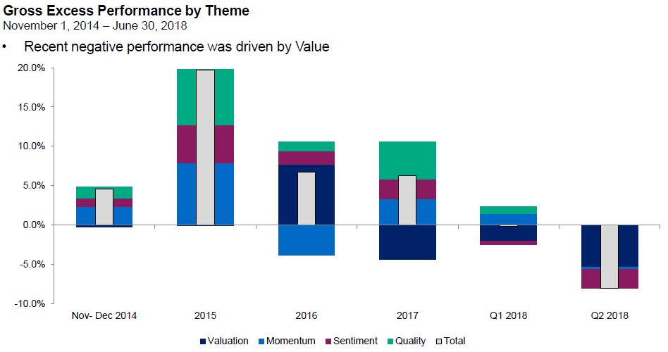
Why has QMNIX underperformed?
Value vs. growth
Themes focused on cheap versus expensive securities based on comparisons within industry
Underperformance across most regions and across many different flavors of valuation
Investor Sentiment
Themes focused on investor activity in the market, including short activity
Losses have been driven by both long and short positions and spread out across different names
Attribution by Theme Since Inception

Slide 4
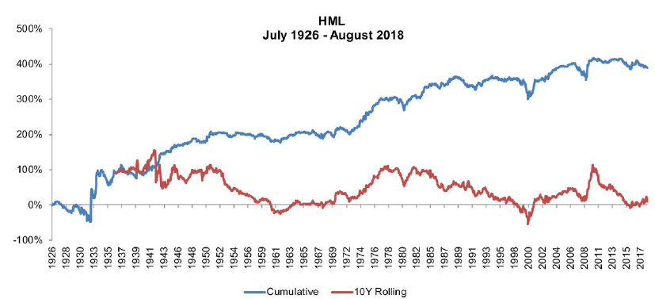
Why are we remaining invested in QMNIX?
The investment theory behind this strategy is not broken
Value investing has outperformed for nearly a century and non-normal distributions have occurred in the past
We do not believe the value factor has been arbitraged away, meaning there is still opportunity to generate alpha
Despite recent underperformance, we remain focused on long term results
The losses this year have already been endured; since the fund’s inception (10/2014) QMNIX has still outperformed the Agg by 17%
We still believe in the efficacy of holding a zero beta strategy as part of a broad portfolio
From a portfolio perspective, we still believe in the benefits provided by non-correlated assets
Value Investing – High Minus Low

