Slide 1


Emerging Market review

Slide 2
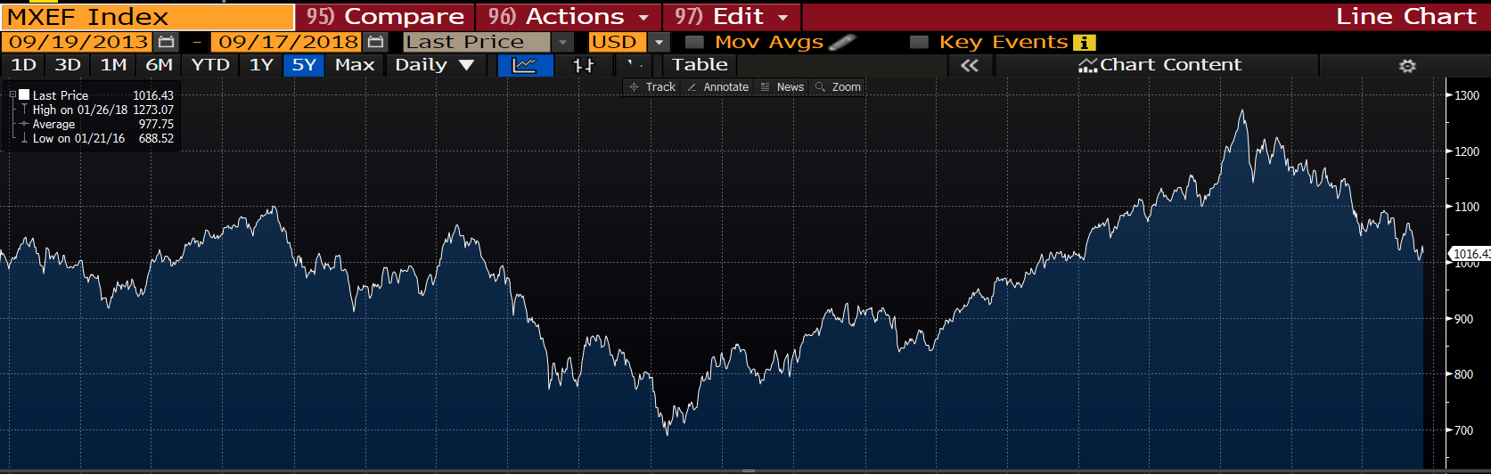
Returns over 5 Years

Slide 3
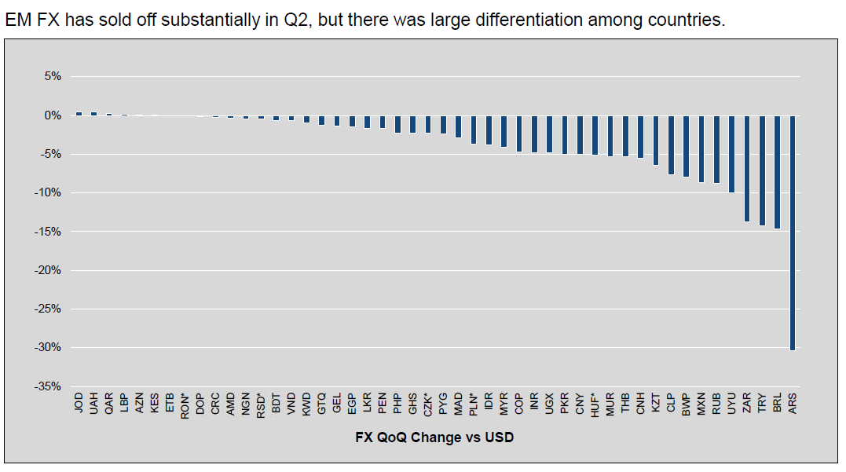
Recent crisis
Rising US rates are a headwind
For smaller economies, falling currencies hurts

Slide 4
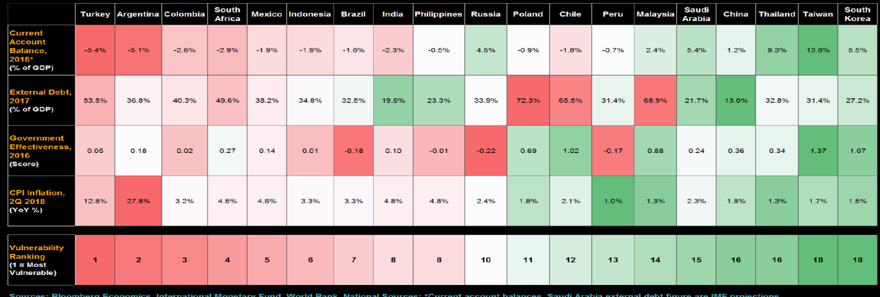
Contagion?

Slide 5
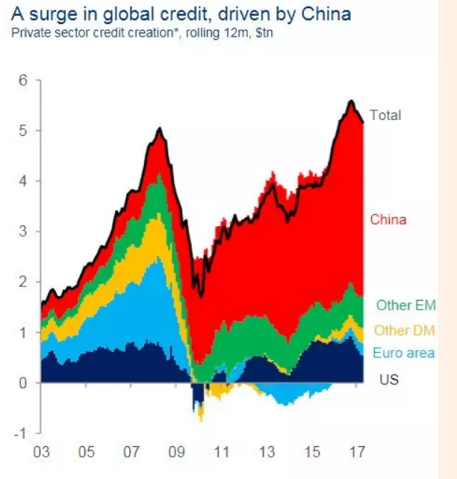
Surge in Debt

Slide 6
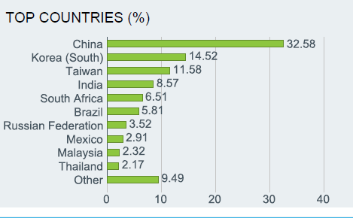
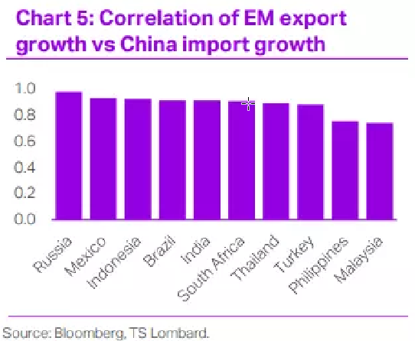
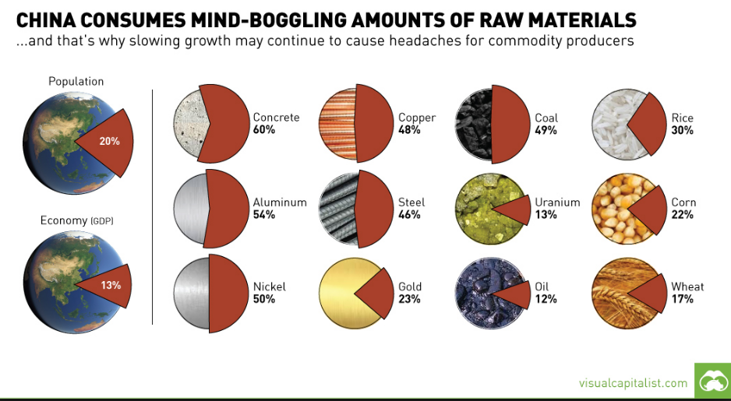
China a large part of EM and important driver of growth

Slide 7
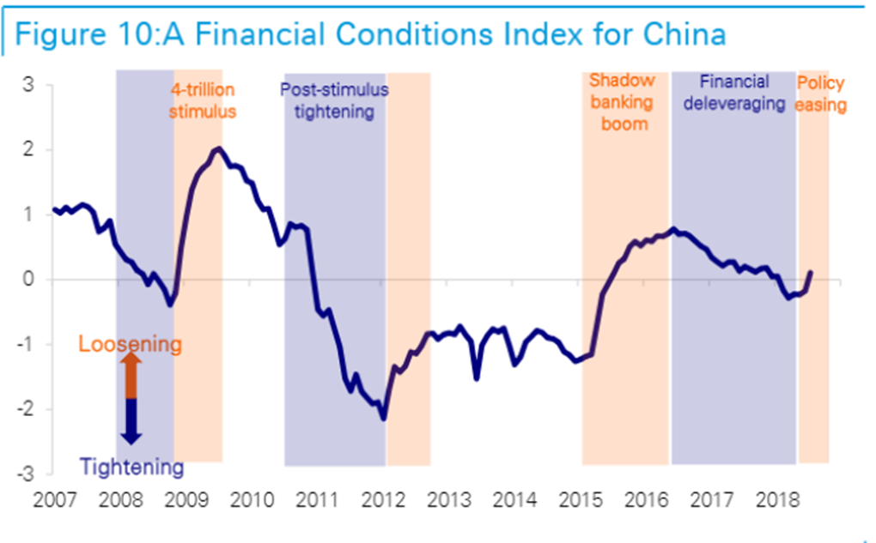
On/off Stimulus for China
China can create stimulus and grow the economy but financing options are becoming more limited

Slide 8
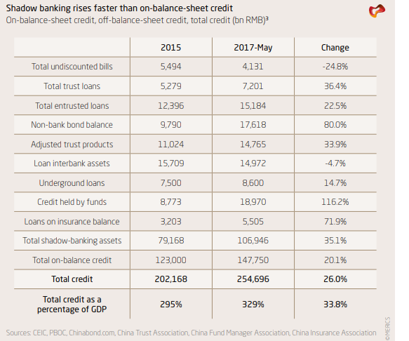
Shadow Banking

Slide 9
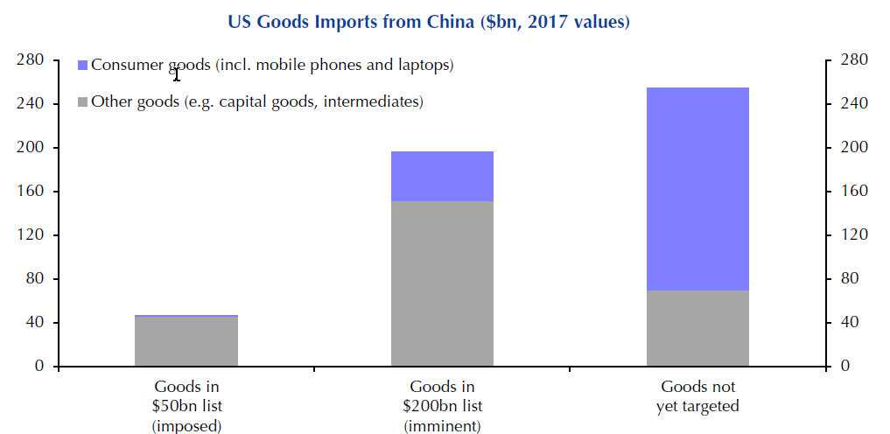
Growing trade war

Slide 10
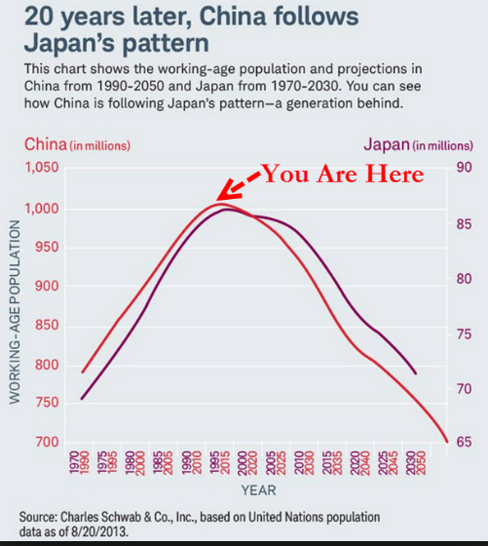
Demographics
GDP growth = workforce growth + productivity
Poor outlook for long term growth

Slide 11
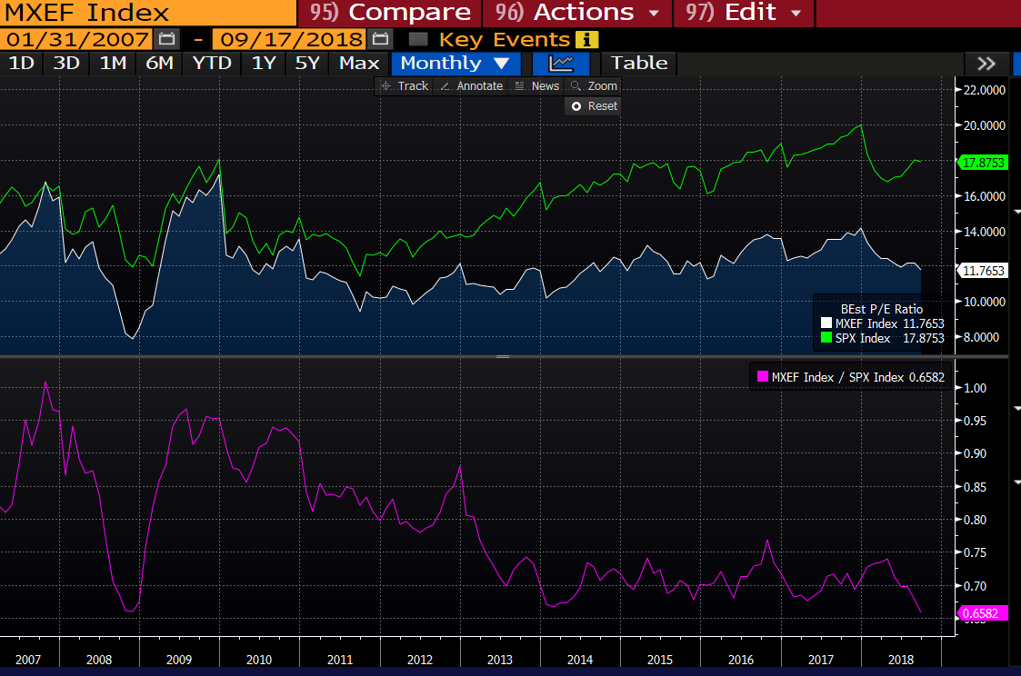
Valuations are cheap

Slide 12
Conclusion
Rising US interest rates and strong US dollar are a headwind for EM economies
Contagion is possible, but not base case
China slowdown a concern as China is a major driver of EM growth
Escalation of tariffs and trade war a concern
Valuations are cheap, but concerns remain

