Slide 1


October, 2018
2018 Q3 performance review

Slide 2
Outlook 2018
Fundamentals are sound but risks remain
U.S. maintaining economic momentum in 2018
The U.S. economic expansion continues in 2018 with an improving labor market, positive consumer confidence, low interest rates, favorable regulatory environment and new pro-growth tax changes
Expect benefits of tax cuts and regulation rollbacks to outweigh potential drag from higher tariffs and reduced immigration.
Expected 2018 consensus S&P 500 revenue (~9%) and earnings (~21%) growth adds support to long-lived bull market
International markets still attractive
Global economic growth is showing synchronized strength. The International Monetary Fund is forecasting 2018 global growth at 3.7%
Compared to U.S. market valuations, developed international and emerging markets remain relatively attractive
Risks remain but have shifted
Forward looking market valuations have come down to more normalized levels with strong earnings driven by top line growth and tax cuts
There are risks of an escalating trade war which would likely impact the S&P 500 to an even greater degree than GDP
Inflation risks have increased as tight labor markets lead to increased wage growth. Tax cuts, commodity prices, and protectionism could be accelerants
China’s high debt levels remain a concern given authorities efforts to constrain credit growth
Market volatility remains above the low levels seen throughout 2017, but are consistent with its long-term history
Information is current and believed to be accurate as of 6/30/2018

Slide 3
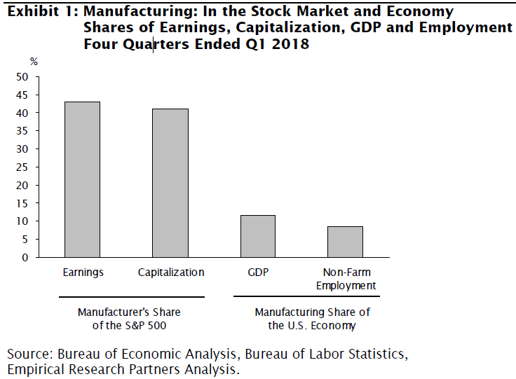
Outlook 2018
Tariff Concerns
Still believe that tariffs should not derail the U.S. economy
Tariffs will affect manufacturing earnings more so than GDP. Supply chains in China have driven up margins and lowered U.S. capital intensity, increasing free cash flow margins and multiples.
In time, tariffs could increase inflation and elicit higher interest rates.
Potential for protectionism to escalate – automobiles?
Information is current and believed to be accurate as of 6/30/2018

Slide 4
Return of Market Indices
Despite an increase in volatility, U.S. equity markets have rebounded, driven mostly by positive earnings growth. While economic fundamentals remain strong, uncertainty over U.S. trade policies has rattled investors and driven up the U.S. Dollar, leading to a sell off in international equity markets.
Bond prices are also under pressure as the Federal Reserve continues to increase short term rates in conjunction with improving growth and inflation expectations.
Maintaining a diversified portfolio of assets should help to mitigate overall volatility with the intention of providing strong risk-adjusted returns over time.
Source: Bloomberg. EAFE is MSCI EAFE Index, Emerging Markets is MSCI Emerging Markets and U.S. Bonds is Barclays U.S. Aggregate. REITs is the DJ US Select Real Estate Securities Index. MLPs is Alerian MLP Index. The above information is through 9/30/2018. See last page for important information.

Slide 5
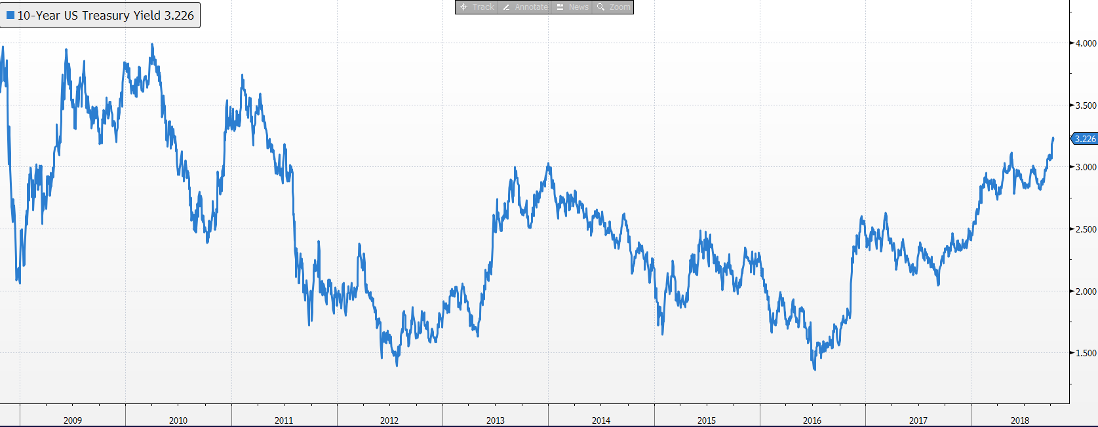
Bond markets
US Treasury 10-Year Yield
Yields rose sharply after US Presidential election and again during the first quarter of 2018
Our bond duration is 4.5 years, shorter than US Aggregate at 6.0 years

Slide 6
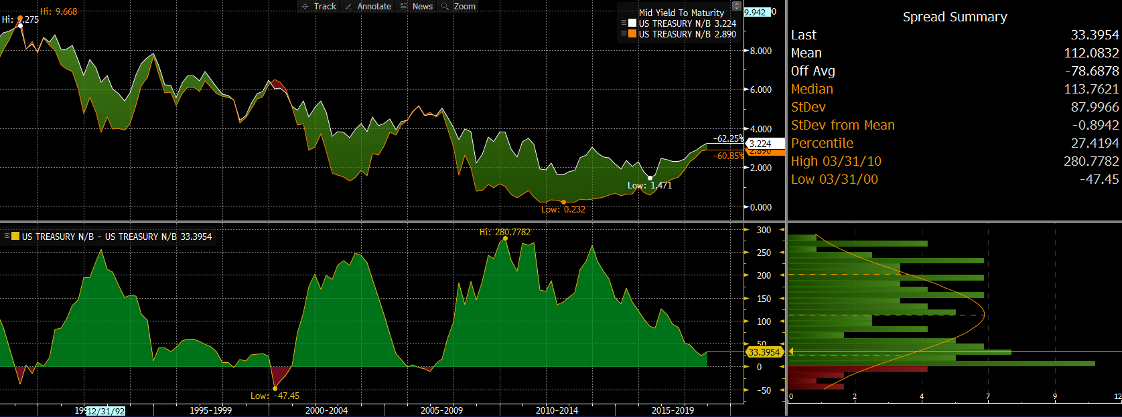
Recession indicator – Not there yet
Bond market spreads (10y-2y)
Flat yield curve has been a good predictor of recessions. Percentile has dropped from 29th to 23rd

Slide 7
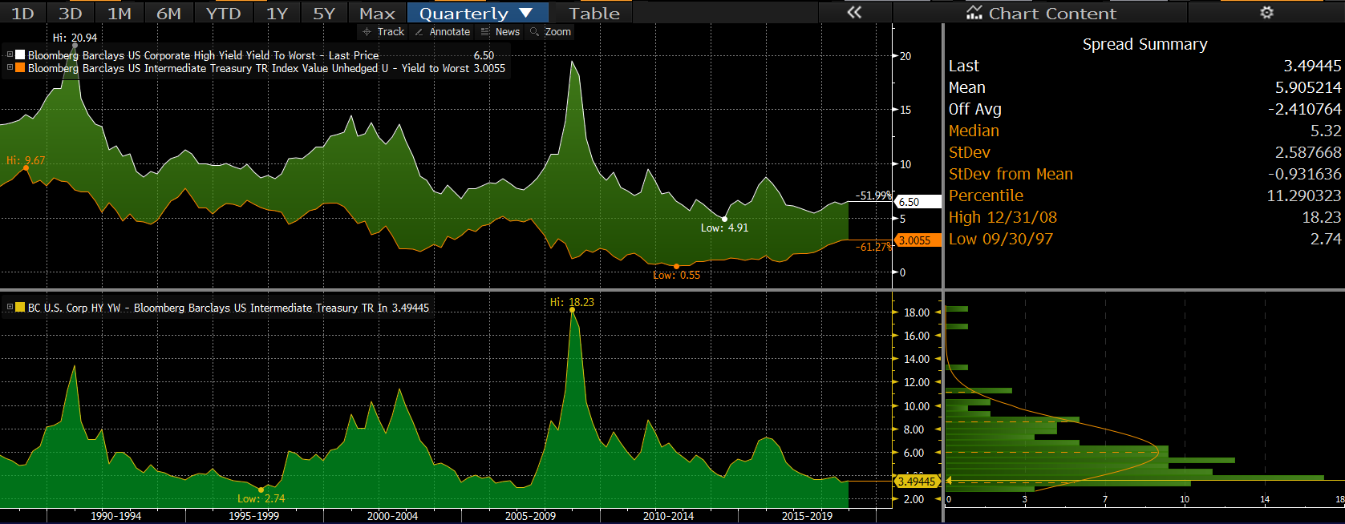

High Yield Spreads
Spreads have stayed low - no sign of panic from bond investors
Last QTR’s spread was 20th percentile

Slide 8
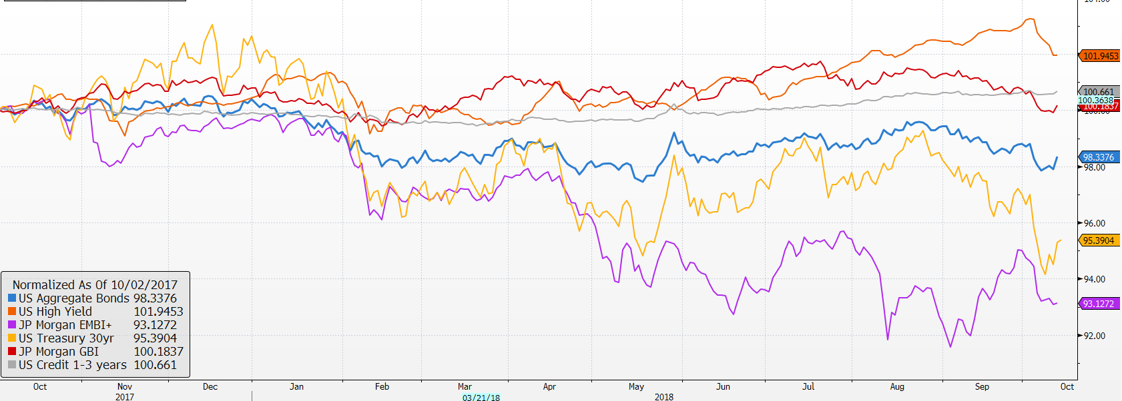
Market Returns
Performance of bond markets
Source: Factset
EM bonds hit by strong dollar and higher US rates
Credit has held up well, until recently
Aggregate bonds continue to post positive returns even with rising short term rates

Slide 9
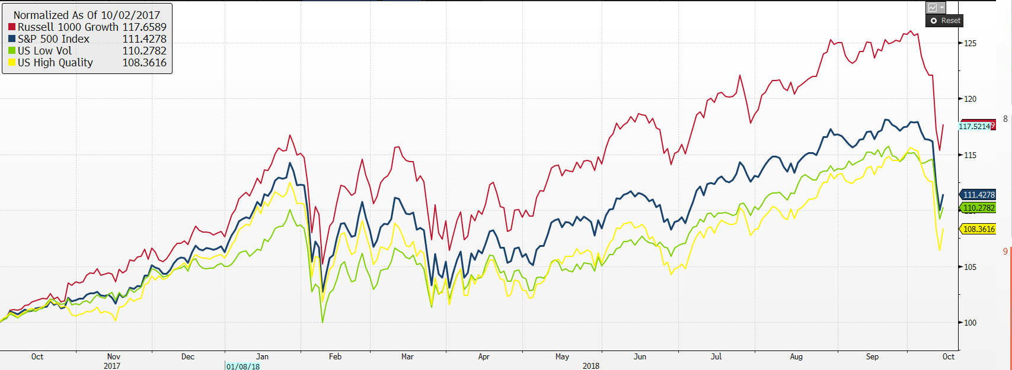
U.S. stock market ETFs
Source: Factset

Slide 10
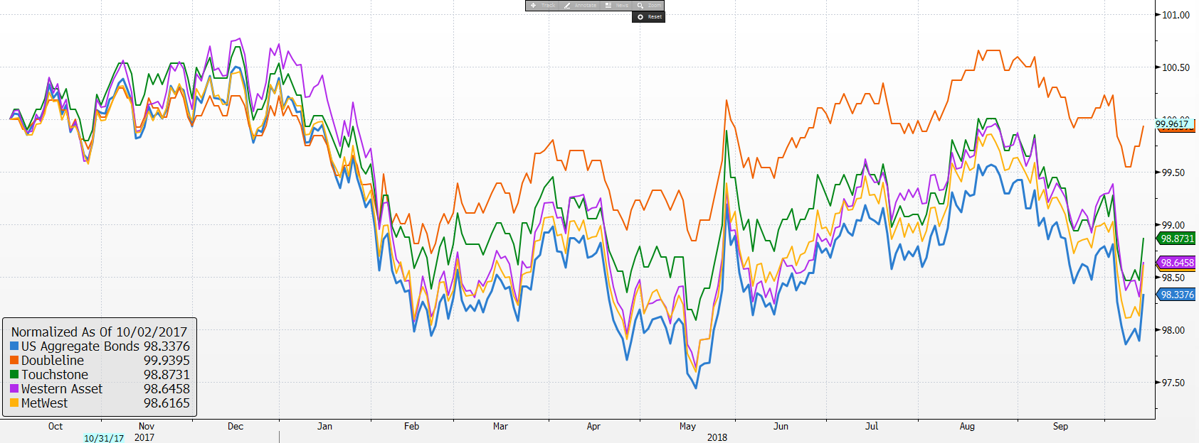
Active bond managers

Slide 11
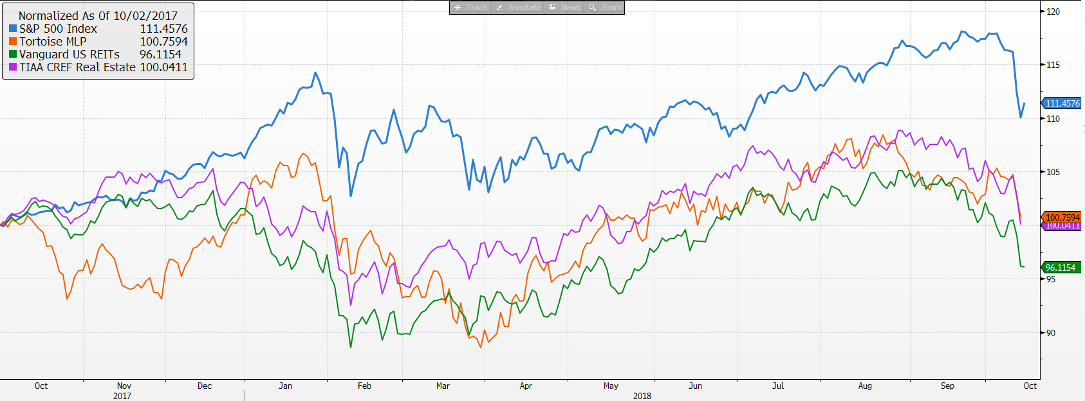
MLPs and REITs have recovered some ground

Slide 12
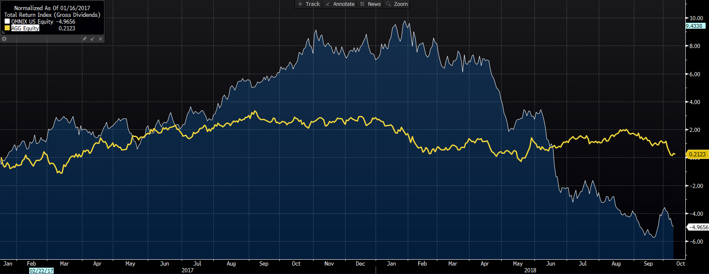
AQR Market Neutral has struggled
Underperformance in stock selection has been a value vs. growth story across the board at AQR
Companies deemed more expensive have been outperforming those less expensive
Strategy does not change its factor weights so performance should turn around when the signals turn
While performance is atypical in magnitude and direction, returns are within broad distribution for the strategy, just at the outer bounds

Slide 13
Vehicle performance as of 10/10/18

Slide 14
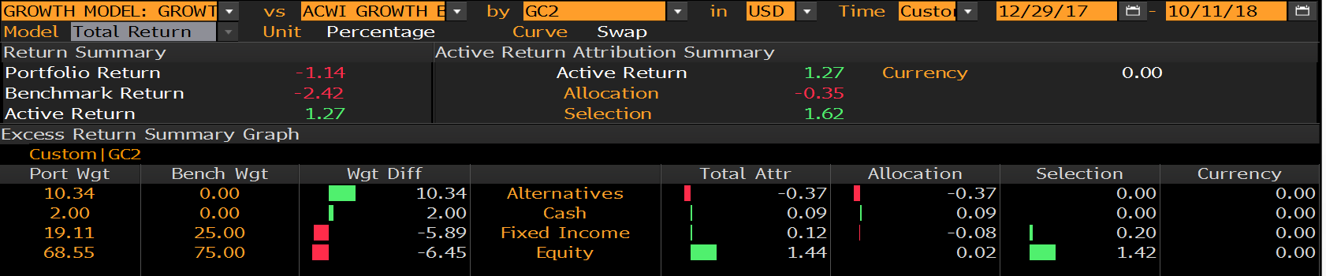
Growth Model attribution
Year-to-Date relative to 75% ACWI & 25% US Aggregate
US stock outperformance and overweight added value
Lower duration helped bonds
Alternatives lagged

Slide 15
Growth model changes
Portfolio changes 2018
9/28 Changed US large cap vehicles
  70% IVV 40% TOSZX
  10% SPHQ 40% USMV
  10% USMV 20% MTUM
  10% IWF
9/28 Replace IEFA with JPIN
1/30 reduced bonds, US large cap, increased international stocks, MLPs and Market Neutral
Portfolio changes 2017
1/5 reduced short term bonds, increased small cap and added market neutral
2/7 increased MLPs
5/2 eliminated floating rate increased core bond funds and market neutral
7/11 Increased international developed and reduced US large cap
8/8 Switch REIT exposure to active manager, TIAA CREF Real Estate Fund

Slide 16
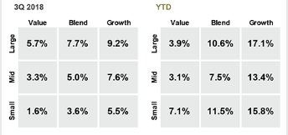
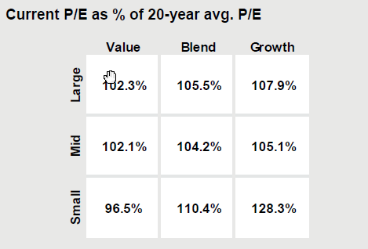
S&P 500 – What happened during 3Q 2018
The S&P 500 was up over 10% year-to-date
  YTD growth stocks performed best, a continuation of the 2017 trend. Small cap value outperformance from last quarter reversed trend.
  Large cap valuations at a small premium to long-term average. Small cap growth valuations are the most stretched.

Slide 17
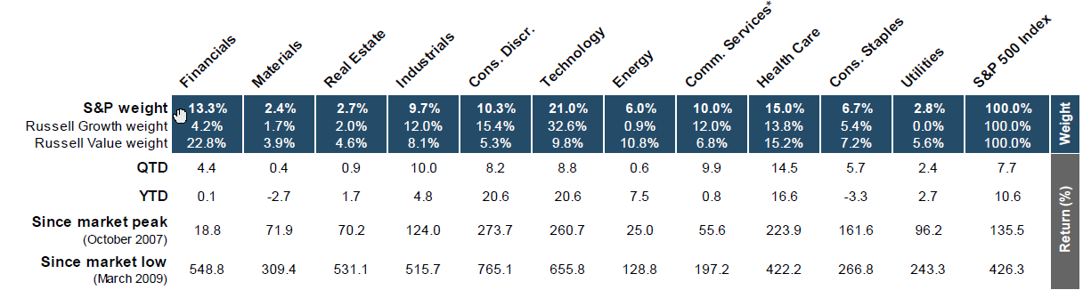
Sector Returns YTD and since market peak/low
Best performing sectors: Tech, Discretionary and Health Care
Worst performing sectors: Staples, Materials and Financials

Slide 18
Focus Equity Highlights – YTD
What has driven performance YTD?
Our US equities outperformed the market by 194bps year to date.
We gained 144bps in Q3 driven by outperformance in Industrials, Materials and Communication Services.
The biggest outperformers in the quarter were Lockheed, Cisco and CVS with each adding more than 40bps.
The biggest detractor in the quarter was SLB (-14bps).
What’s worked?
Biggest contributors to outperformance: Tech, Staples, Industrials
Owning Biotech ETF => +43bps
Top 3 relative performers in the portfolio: CSCO, TJX, RMD
What didn’t?
Not owning Amazon => -148bps
Stock selection in REITS: owning Tanger => -31bps
Worst 3 relative underperformers in the portfolio: SKT, CL, MMM
Recent Changes in Q3 2018
Started 200bps position in HLT

Slide 19
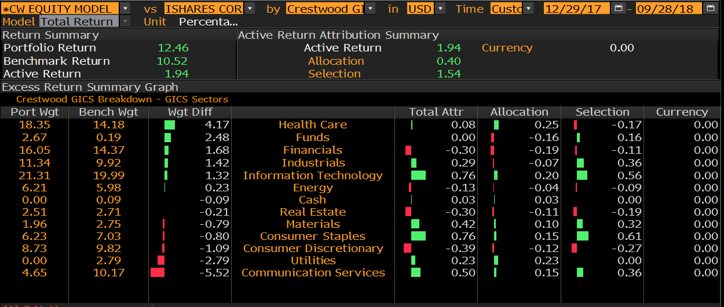
Attribution – Year to Date

Slide 20
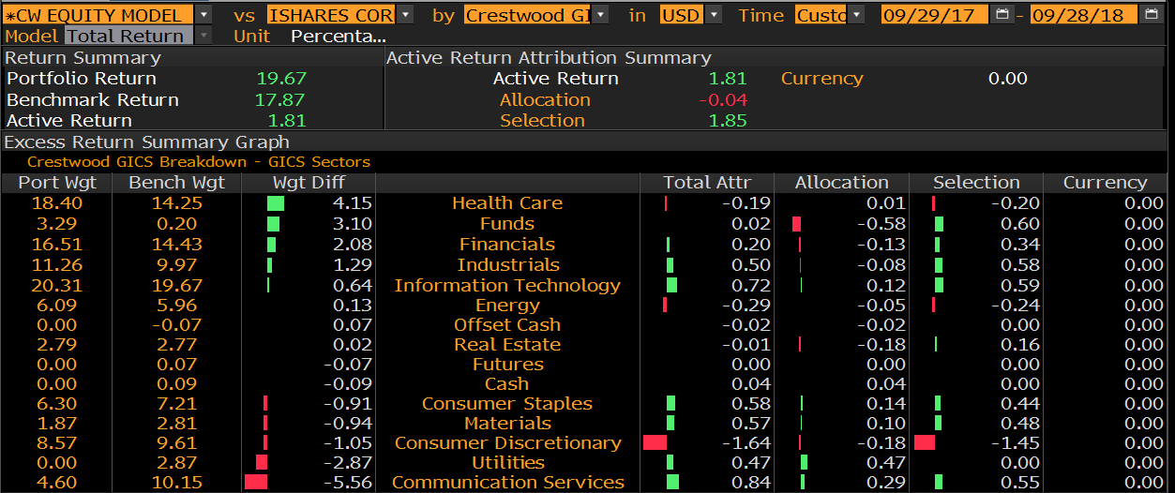
Attribution – One Year

Slide 21
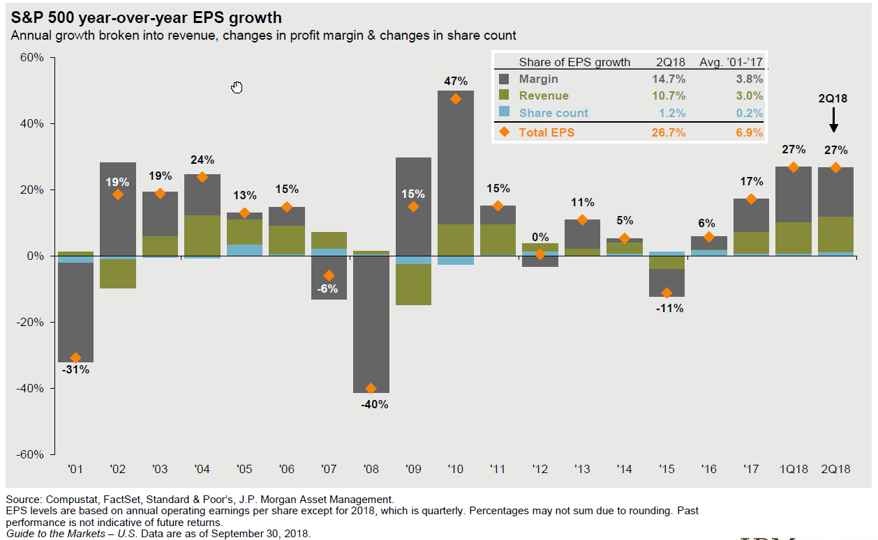
Sources of EPS Growth

Slide 22
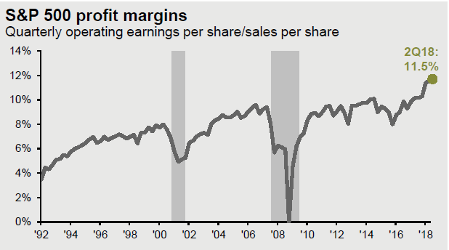
Corporate Profits

Slide 23
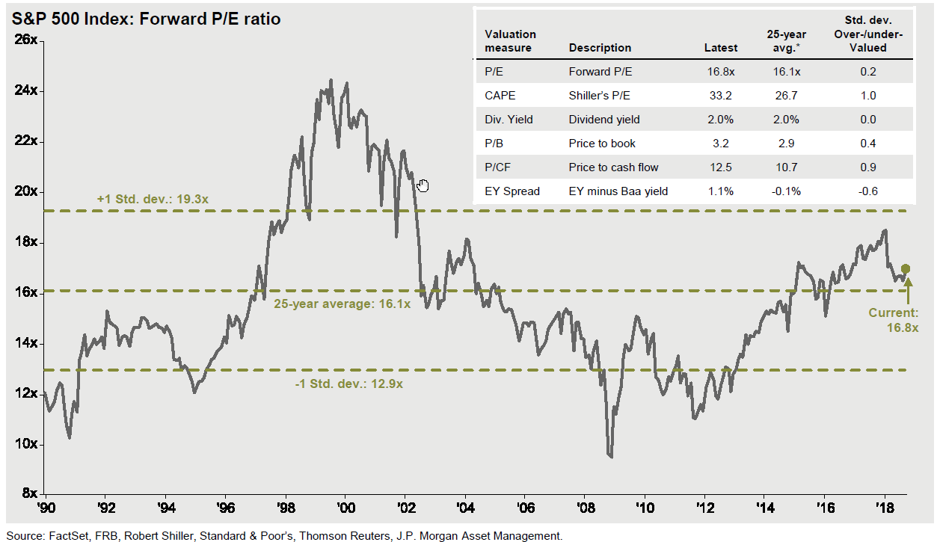
S&P 500 Forward P/E Ratio

