Slide 1


October, 2018
Beyond Expectations

Slide 2
Equity Investments
Philosophy and Process
We believe a concentrated portfolio of high quality companies purchased at attractive valuations will outperform over a market cycle with lower risk. We assume a 3-5 year investment horizon which allows us to focus on long term results.
Idea Generation
Screens, Conferences,
Watch List, Industry Experience
Does this Business Satisfy our Criteria?
High Quality
Business
Shareholder
Friendly
Management
Attractive
Valuation
Yes Add to Portfolio
No Continue to Monitor

Slide 3

A Closer Look at Equity Idea Generation
Screening
Proprietary screen to narrow potential investment opportunities from 1,000 names to < 100
Below is an example of the first few names from a recent screen
Filtering factors
Long term return on capital
Long term free cash flow
Margin stability and growth
Shareholder yield
Change in ROE components over the past year
Removes companies at risk of default, financial distress and earnings manipulation

Slide 4
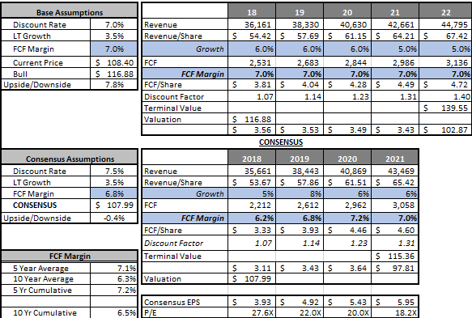
Security valuation and modeling
Seek investments that trade at a discount to our estimates of intrinsic value and have an attractive risk/reward profile
When evaluating a potential investment opportunity:
  Build proprietary financial models to estimate intrinsic value based on relevant valuation metrics:
    DCF, FCF yield
    Sum of parts
    Price to book
    Price to earnings
    Enterprise value to EBITDA
  Perform scenario analysis to understand a range of potential outcomes
  Integrate a conservative bias to our analysis to account for the “art and science” nature of valuing a business and investing
For illustration purposes: An example of a discounted cash flow analysis

Slide 5
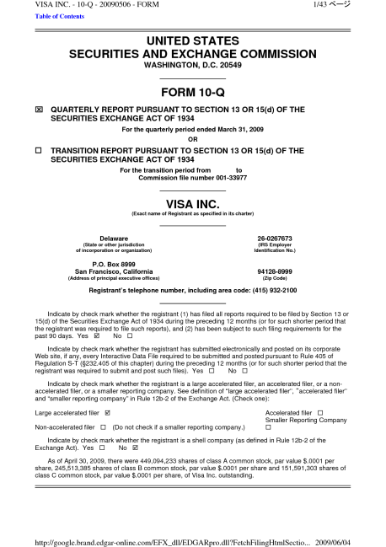
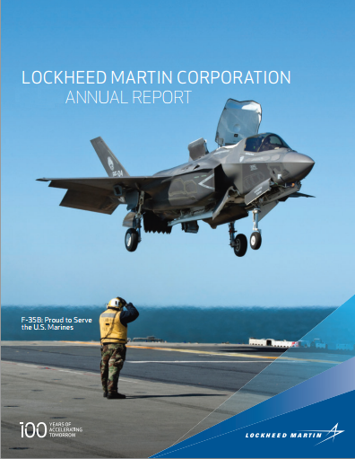
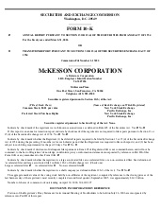
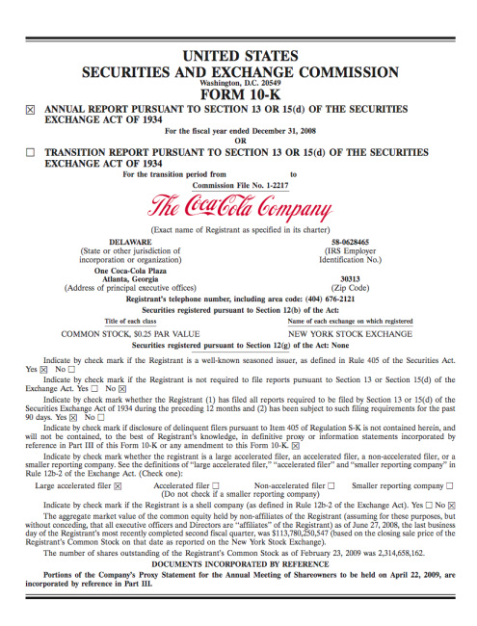
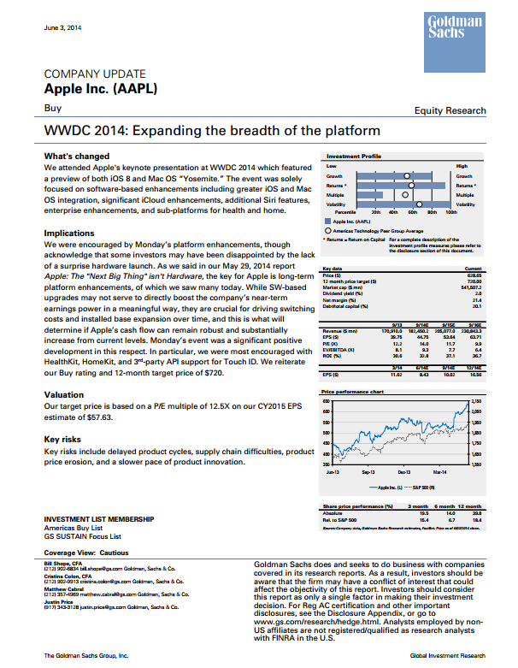
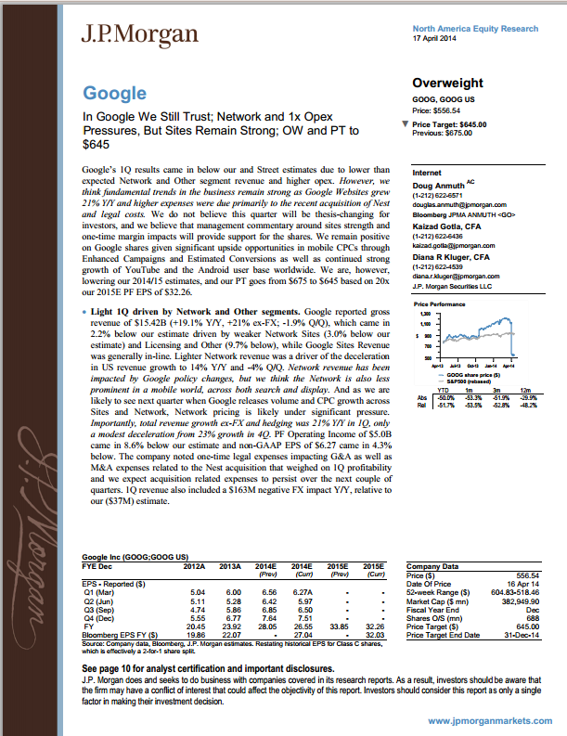
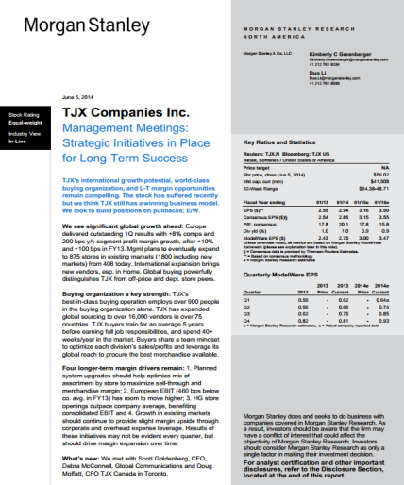
A Focus on understanding the business
Crestwood research involves:
A rigorous review of available public information:
  Financial statements
  SEC filings (10Q, 10K)
  Press releases
  Conference calls with company management and investor relations
  Industry reports and trade journals
Compare our views to Wall Street research
  Contextualize our opinion of an investment opportunity
  How does our opinion differ from consensus?
Crestwood’s independent research provides an objective and often times contrarian view of current opportunities

Slide 6
Equity Investment Criteria
High Quality
Business
Shareholder
Friendly
Management
Attractive
Valuation
Durable business with high barriers to entry
Market leader
Industry Analysis
Sustainably high or improving returns
Strong balance sheet
High returns of capital
Understandable business
Skilled management team
Prudent capital allocation decisions
Ownership structure that aligns interest of management with shareholders
Supportive compensation policies
Evaluation of ESG policies
Valuation focus – price/earnings, price/cash flow, price/sales and price/book
Stock price < intrinsic value
Price relative to business prospects using discounted cash flow analysis
Avoid value traps
Add to Focus list
+
+
=

Slide 7
Equity Portfolio Construction
Portfolio Construction
Concentrated high quality portfolio (35-40 stocks)
Average position size 3%
  Cognizant of sector weights but not bound by a benchmark
  Flexibility to invest in companies across the market capitalization spectrum (>$1 billion)
Invest opportunistically where we have identified a catalyst(s) for value creation due to specific circumstances (cyclical inflection, restructuring, acquisition/divestiture, etc.)
Our investment time horizon of 3 - 5 years is a competitive advantage
Sell Discipline
Sell stocks when risk/reward no longer justifies holding a position based on intrinsic value
Thesis fails to play out
Actively trim outsized positions to manage risk and pursue other opportunities
Top 10 Equity Positions*
Microsoft Alphabet Apple Cisco Visa Stryker Berkshire Hathaway Lockheed Martin Medtronic iShares NASDAQ Biotech
* CW Focus Equity as of 9/30/18

