Slide 1


Crestwood’s US large cap funds

Slide 2
Changes to US Large Cap funds
Increases opportunity for outperformance
Increase active share and exposure to value
Core Satellite (old)
Balanced Allocation (new)
Low- Vol
10%
USMV
Quality & Value
40%
TOSZX
Quality
10%
SPHQ
Growth
10%
IWF
Core
70%
IVV
Momentum
20%
MTUM
Low Vol
40%
USMV
New active manager Toreador Select owns 50 quality companies selling at attractive valuations
Adding momentum (MTUM) for growth (IWF)
Adding more low volatility

Slide 3
Goals in picking funds
Keep fees and turnover low
Combine value and momentum
Maintain exposure to quality and low volatility to have similar return profile as Focus Equity portfolio
Increase value exposure
Increase active share and avoid big sector bets which tend to have big performance swings
Keep quality high - high ROIC funds will score better in ESG

Slide 4
Research findings about selecting active managers
Keep fees and turnover low
  Mark Carhart’s research was the first to use survivorship bias free database of funds. Only persistence he found was in underperforming funds. Expenses and transaction costs explain most persistence. “On persistence in Mutual Funds” 1997
Own funds that are different than the market - avoid closet indexers.
  Cremers and Petajisto showed that active share is important for relative performance. “How Active is Your Fund Manager? A New Measure That Predicts Performance” 2007
  Cremers and Pareek show that high active share and patient funds with high holdings duration (low turnover) outperform;
Value and Momentum effects can add value together
  Asness “Value and Momentum Everywhere” 2013

Slide 5
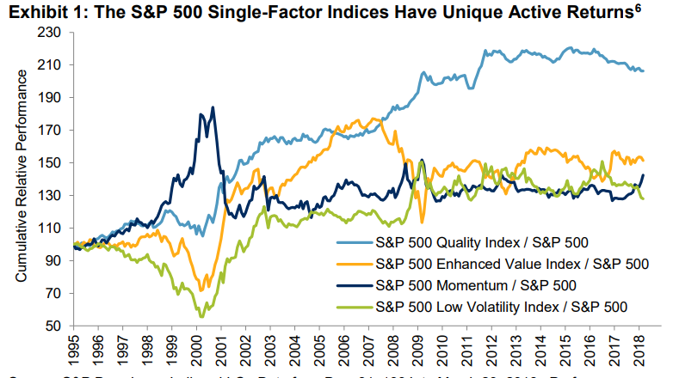
S&P Factor returns
Factors are stock characteristics that can explain differences in stocks returns
Value, Momentum and Size have been shown to exist for a long time

Slide 6
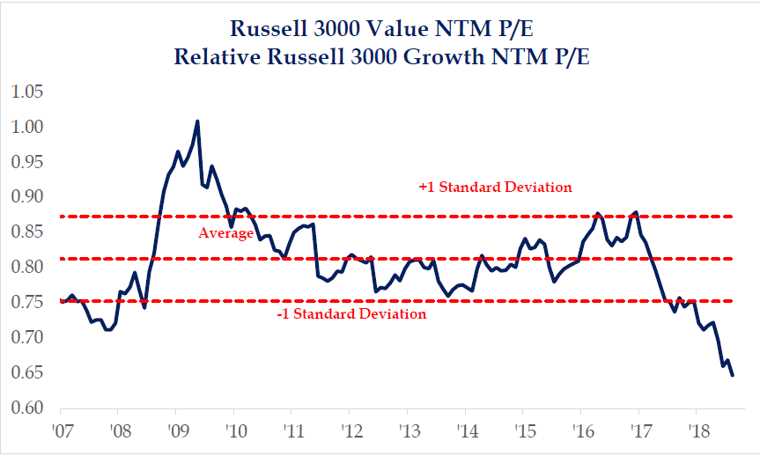
Probably a good time to add value

Slide 7
How Value factor works
Value companies are companies that are selling at a discount to their true valuation
Value strategies buy cheap stocks, wait for the p/e multiple to return to normal (increase) and then sell. When a value strategy rebalance the p/e tends to fall.
Value needs to rebalance as value stocks return to normal returns once the valuation gap closes
Why are value stocks mispriced?
  Behavioral finance – Investor overreacting to bad news
Why has value underperformed since 2010
  Relative to FAANG
  Arbitrage, though O’Shaughnessy sees no evidence of this
  Prevalence of value traps
  Poor performance of finance

Slide 8
iShare factor ETFs correlations
5-years

Slide 9
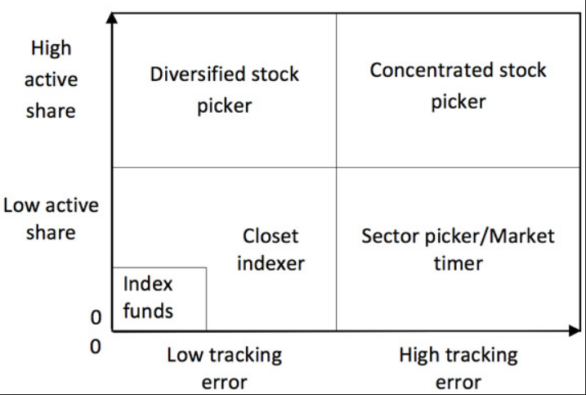
High active share without big sector bets

Slide 10
Keep ROIC high
Good for ESG scores and quality
ESG Rank is 50% RepRisk rank and 50% Sustainalytics rank

Slide 11
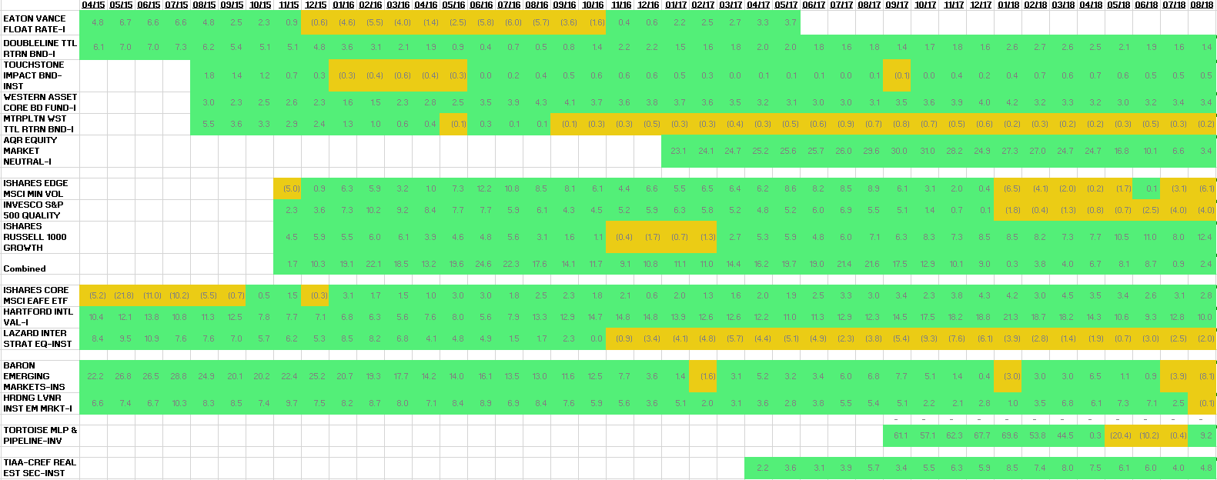
Why Active?
Crestwood has a strong track record (82%)
Trailing 3-year returns minus benchmark

Slide 12
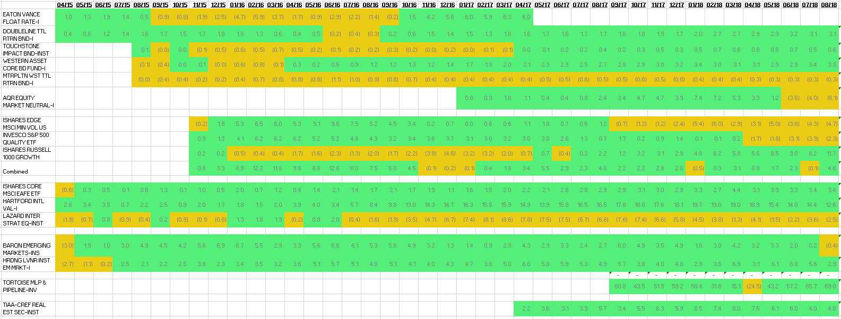
Crestwood has a strong track record (71%)
Returns since purchase minus benchmark
Performance at purchase may not be indicative of fund’s skill
Factor approach in US large cap has worked
Still short time period

Slide 13
Growth model fees – up 13 bips

Slide 14
Toreador Select Fund (AFG 50)
High active share - 50 holdings
Low turnover 20% - patient process
Screens well for both quality and value
Fees 75bips (100bips for NTF)
Sector neutral (same as S&P 500 weights) with equal weighted holdings within sectors
Focused on stock selection
Comfortable with process – Economic Margin valuation. Stock names are vetted by analyst.
Strong track record
Idiosyncratic risk
Fund started 2/1/17. Fund assets $55m, soon to add $175mm. Runs SMAs worth $800m

Slide 15
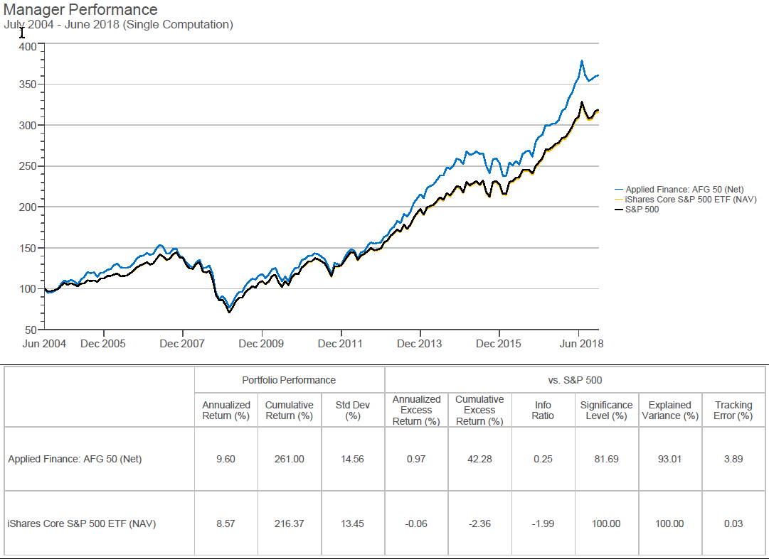

Slide 16
