Slide 1


Crestwood’s ESG Strategy

Slide 2
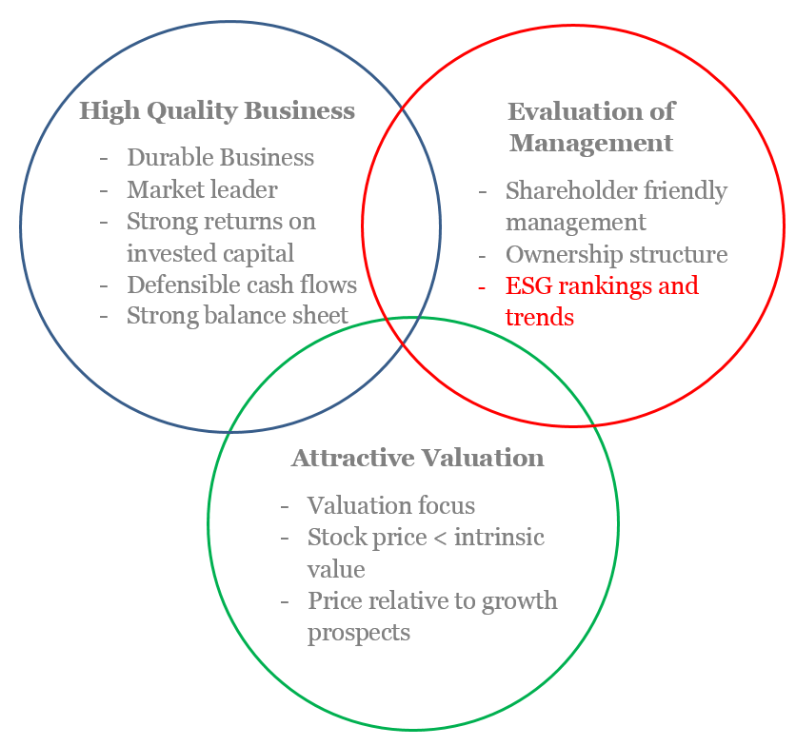
Socially Responsible Investing
Integrating ESG into our equity process
  Philosophy: We believe integrating ESG factors into our investment process will enhance our evaluation of companies management and improve our risk adjusted performance.
  The Process
  Enhance fundamental analysis with ESG overviews
  Combine news-based ESG rankings with company disclosure-based ESG rankings
  Monitor trends and evaluate rankings
Enhancing a Successful Process
  Importance of Governance
  We believe that better run companies are better investments
  Poorly run companies are prone to wasteful capital spending and value-destructive M&A transactions
  Studies have shown the Governance factor to improve returns and lower risks

Slide 3
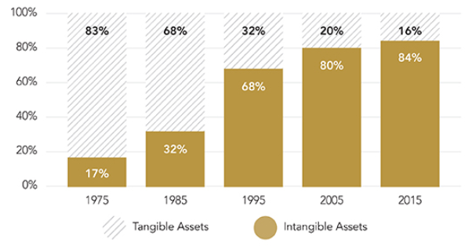
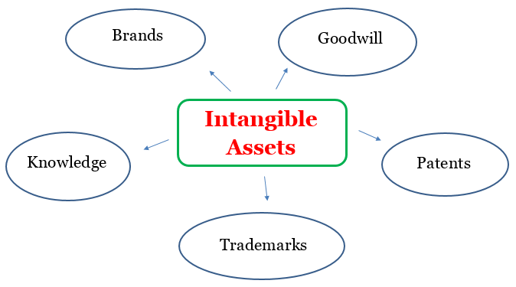
Growth in Intangibles
The way companies are valued is evolving
  What is an intangible asset?
  Non-physical attribute that costs a company time and money, delivering value over time; not considered capital expenditure
What should we know about intangibles?
  Growing in Value & Importance: intangibles make up over 80% of the market value of the S&P 500
  Major Effect on Valuation: profitable companies with high intangibles tend to have higher ROIC and higher valuation
  Scalability: unique intangible assets can drive competitive advantages
  Difficult to Quantify: valuations of intangibles are frequently not listed on balance sheets as they generally do not have secondary markets.
Components of S&P 500 Market Value
Source: Intangible Asset Market Value Study 2017, Ocean Tomo
  How can ESG help mitigate risk?
  As intangibles increase as a percentage of market value, the need for companies to protect their moat becomes more vital
    Brand & Trademark: avoiding circumstances that tarnish a company’s image
    Knowledge: treating employees fairly to limit turnover in order to keep top workers in-house
  ESG scoring provides us an additional resource to monitor company behavior and potentially avoid risks that could diminish the intangible value of our investments
Intangible Asset Examples
Source: Crestwood Advisors
Information is current and believed to be accurate as of 06/30/2018

Slide 4
Socially Responsible Investing
Importance of Governance
  Process: We combine news-based ratings with company disclosure-based ratings. The two approaches provide analysis of news, events and company structure which when combined allow for a thorough analysis of company risk due to governance issues.
  Philosophy: We believe that combining these two approaches will improve our ability to screen companies with management problems
  Topics for news-based service
  Corruption, bribery, extortion an money laundering
  Executive compensation issues
  Misleading communications
  Fraud
  Tax evasion and optimization
  Anti-competitive practices
  Topics for disclosure-based service
  Board/management quality and integrity
  Board Structure
  Shareholder rights
  Remuneration
  Audit and financial reporting
  Stakeholder governance
  Governance is important as we believe that better run companies are better investments. When considering these ranking we observe the trend of the rankings (worse or better?). As part of our due diligence we discuss any governance issues with companies to assess their ability and willingness to improve.

Slide 5
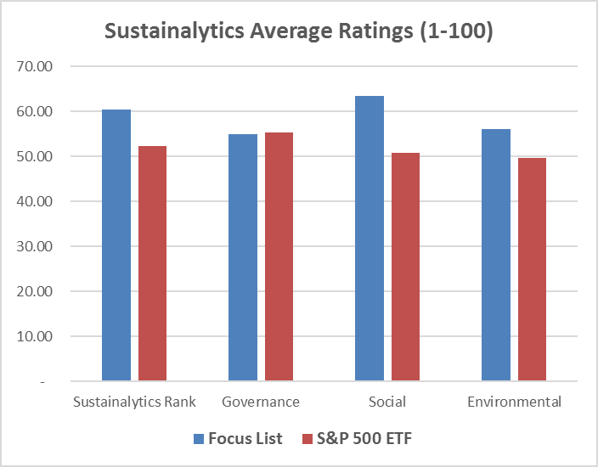
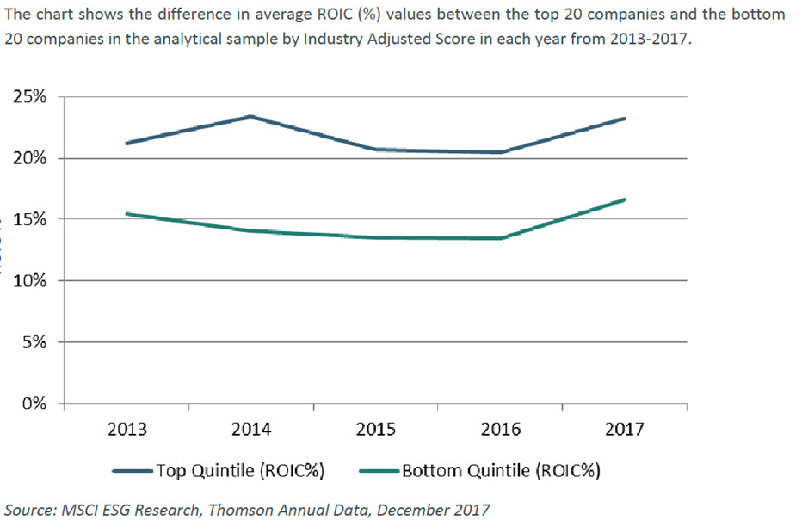
Socially Responsible Investing
Crestwood’s Focus List
  Crestwood’s Focus list of companies ranks well against the average rank of S&P 500 index companies. A key screening criteria for the Focus list is return on invested capital. These quality companies tend to have high ESG scores.
Focus list already has above average ESG scores
Better ESG companies tend to have higher ROICs
Source: Sustainalytics and Bloomberg. The statistics for the Focus List portfolio and S&P 500 Index are aggregated using average.

Slide 6
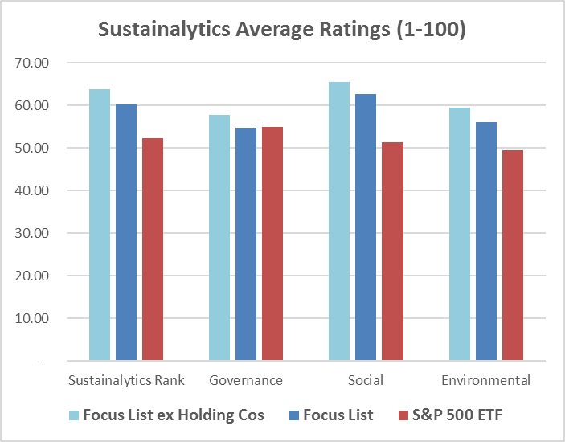
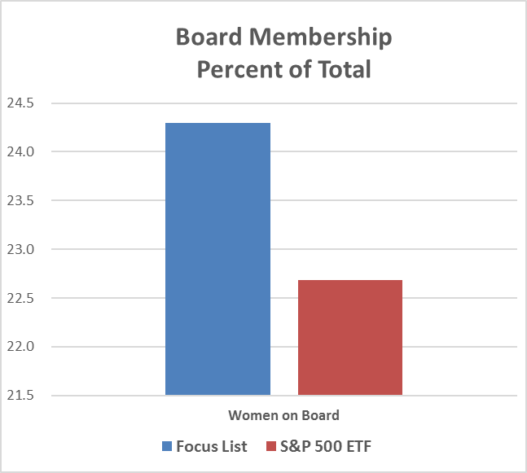
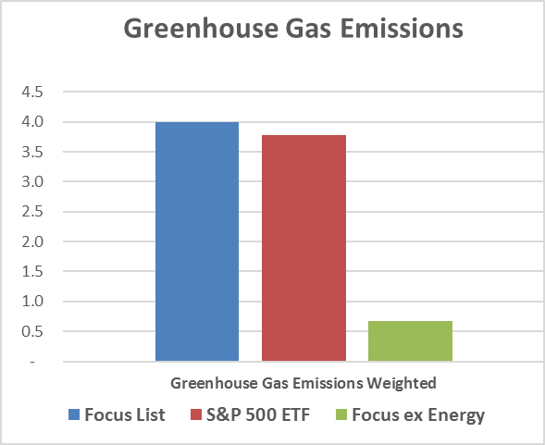
Current ratings of Crestwood’s Focus List
Source: Sustainalytics, CDP and Bloomberg. Greenhouse gas emissions are From CDP, Carbon Disclosure Project and are Scope 1 emissions which are measured in millions of tons of carbon dioxide equivalent. The Scope 1 measure is divided by company revenues. The statistics for the Focus List portfolio and S&P 500 Index are aggregated using average.

Slide 7
Bottom five and top five holdings

Slide 8
Sample of topics that are monitored

Slide 9
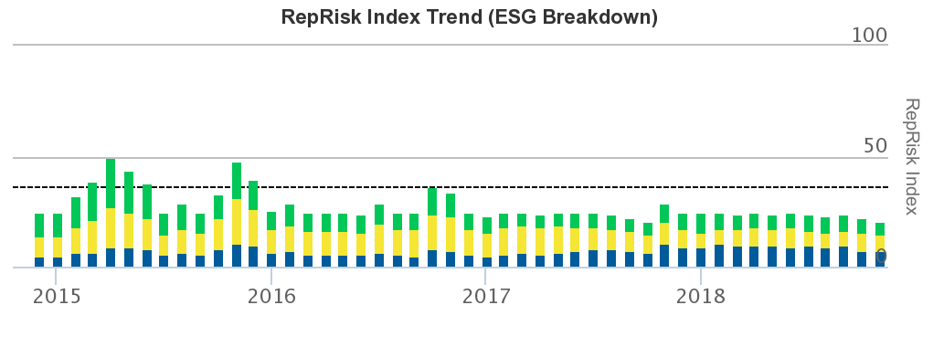


Berkshire Hathaway
ESG Report
What is impacting Berkshire’s ESG score
As a holding company, Berkshire lacks a statement regarding ESG policies
Berkshire Energy produces electricity using coal
Why we still own Berkshire
Berkshire does not believe in dictating policies to companies
RepRisk sees few issues for Berkshire Hathaway
Geico and other insurance subsidiaries rank well
Leader in renewable energy with 39% of production sourced from wind, water, solar and geothermal
Berkshire Energy has an impeccable safety record

Slide 10
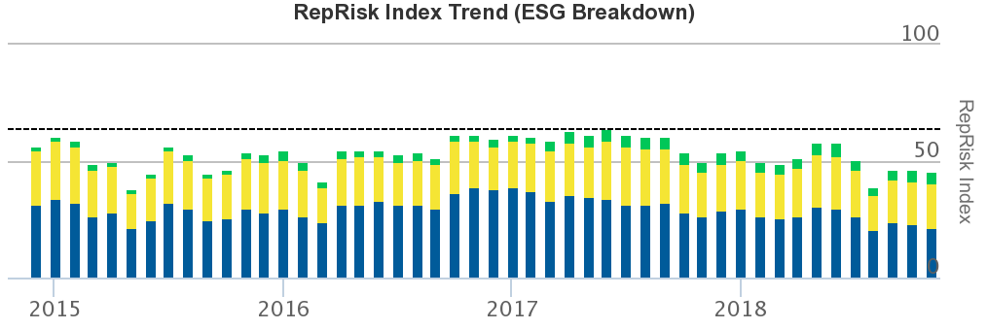
Wells Fargo
ESG Report
What is impacting Wells Fargo’s ESG score
Well publicized management issues, including improper lending practices, poor employee relations and mishandling of client accounts.
Illegal account openings without knowledge or consent of customers
Why we still own Wells Fargo
Working hard to rebuild their brand and reputation. ESG scores have improved.
Materially changed management, replacing their CEO, CFO and 6 board directors.
Improved relations with employees, increasing wages, retirement benefits and stock incentives
Improved relations with clients through overdraft protection, zero-balance alerts and credit card enhancements

Slide 11
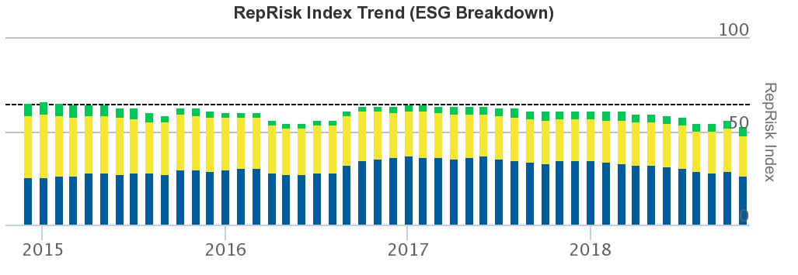
Apple
ESG Report
What is impacting Apple’s ESG score
Conflict minerals, child labor, privacy concerns, tax evasion/optimization, country risk.
Why we still own Apple
Key lithium ion battery component (cobalt) is sourced in the Democratic Republic of Congo causing Apple to be flagged for conflict minerals, country risk and child labor. This is a multi-industry issue (electric vehicles) and Apple is actively addressing this via a consortium with other companies. This includes increasing audits of their supply chain.
US tax reform is resulting in reduced tax optimization strategies.
Apple is addressing privacy concerns and does not profit from user data.
Apple’s operations use 100% renewable energy. Every data center, retail store, corporate office, and colocation facility in 43 countries around the world now run on clean power.

Slide 12
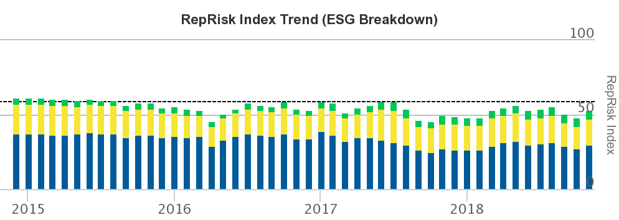
Bank of America
ESG Report
What is impacting Bank of America ESG score
Controversial products and services in mortgage backed securities, and concerns of price fixing in Libor and foreign exchange markets
Why we still own Bank of America
Many of the mortgage concerns and issues date back to before the financial crisis. Current news centers around settlement of prior issues.
Making an effort in environmental sustainability – purchased 100% of power from renewable sources, reduced energy use by 39%, reduced water use by 39%, reduced landfill waste by 14% and reduced paper usage by 31%.
$2 billion in philanthropic investments globally

Slide 13
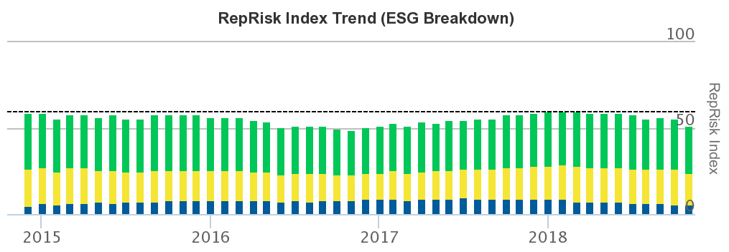
Exxon Mobil
ESG Report
What is impacting Exxon’s ESG score
Role in climate change and global pollution such as oil spills (example: Exxon Valdez in 1989)
Earthquakes possibly caused by fracking
Why we still own Exxon
Exxon now has a spill prevention program in place: 55% spills reduction since 2011
Fracking is controversial – some advantages
  Less noisy than conventional drilling
  Faster to develop so less disruptive for local communities (truck traffic during exploration phase): exploration lasts a few days for fracking vs. 4-6 weeks for drilling).
  Preventions are taken to avoid ground water contamination bu installing pipes along the way and avoid dirty water to contaminate drinking water
  Horizontal drilling limits the number of surface drilling sites (better for communities)

Slide 14
ESG With Our Active Equity Managers
Implementation at different levels
  Review of our active equity managers: goal was to determine to what degree these managers and their parent companies think about and utilize ESG
  Different tiers of values: we discussed ESG based on corporate initiatives, broad firm resources, and portfolio integration
  Varying degrees of implementation: certain firms have an ESG policy at all levels while others are in the process of making this change
  Governance as a common theme: despite some differing policies, all believe that governance is a major driver of strong investments
  Below are some examples of how is ESG is being utilized at each level. These do not apply to all active mangers.
  Are ESG values being recognized and practiced at the corporate level?
  Participation in collaborative initiatives – shaping future of responsible investment
  Build out of a sustainability task force
  Participation in UNPRI (UN Supported Principles for Responsible Investing)
Corporate Initiatives
  Does the firm implement ESG into its investing or have internal resources to do so?
  Proxy Voting – investment professionals responsible for providing vote recommendations
  Third-party resources used to help evaluate ESG risks
  Broad emphasis on governance as an input to mitigate risk and evaluate quality
Firm’s Resources
  How does the portfolio manager utilize ESG when making stock selections?
  Informal incorporation of ESG principles into research process
  ESG factors utilized as part of the overall assessment of company quality and value
  Fund level analysts responsible for providing proxy voting recommendations
Portfolio Integration
Information is current and believed to be accurate as of 09/30/2018

Slide 15
What is being done by our active managers?
Breaking down specifics at each level
  Below is a breakdown of what each active equity manager is doing at each level

