Slide 1
December 2018
Real Estate Investment Allocation
Increasing REITs

Slide 2
Thesis and Proposed Changes
We believe this is a good time to increase our exposure to real estate assets. We are nearing the end of a credit cycle and economic growth is slowing. The Fed has indicated that the pace of rate increases may actually slow down, and REITs tend to underperform at the beginning of rate cycles. We believe we have gotten past the initial period of underperformance.
Real estate should benefit on a relative basis from the recent uptick in inflation, and companies have the ability to raise rents to mirror rising yields. Income producing equities should perform relatively favorably if the stock market continues to perform poorly.
The selloff in retail REITs has actually presented buying opportunities for our active manager, and we continue to benefit from the team’s ability to appropriately allocate across the REIT landscape.
REITs are attractively priced relative to broad U.S. equity markets and historical averages, and they are backed by strong fundamentals across most sub-sectors
Proposed Allocation:
We are distributing the proceeds from the sale of QMNIX between REITs (TIREX) and Core Bonds
Allocation Increases

Slide 3
Presentation Overview
Valuation and Income:
P/FFO below longer term average and REITs trading below property NAV
REITs currently yielding over 4% in a low interest rate environment
Strong Fundamentals
Net operating income is stable and growing by mid-single digits year over year
Private investments have historic amounts of dry powder that could increase demand and prices
U.S. Centric Diversification
REITs are U.S.-centric investments with little exposure to trade issues
Despite recent underperformance, real estate has historically been one of the greatest performing asset classes

Slide 4
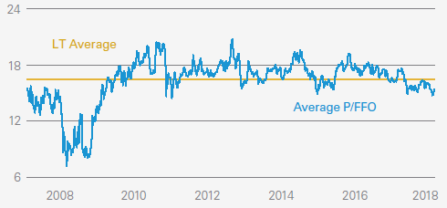
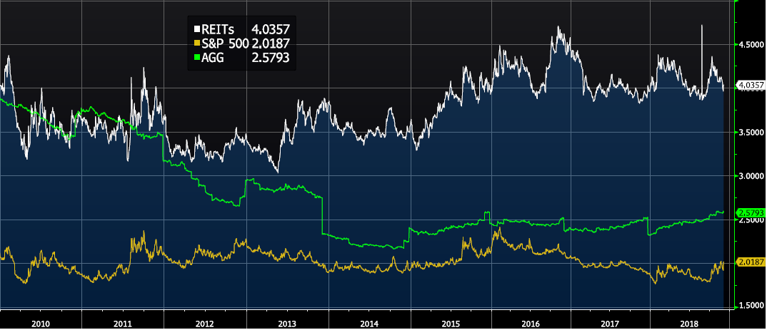
Valuation and Income Areas of value & income production
Broad valuations fair with pockets of opportunity
REIT P/FFO multiples are now 1.0 multiple below the longer term average of 16.5x
Relative to S&P 500 P/E multiples, ratio is at 28th percentile (1 being cheapest) over past ten years
REITs are currently trading nearly 10% below underlying net asset value, substantially lower than the sector’s long term historical 2-3% average premium
Price to Funds From Operation
Dividend Yield – REITs Yielding Over 4%
REITs are Income Producing
Despite rising rates, we continue to experience a low interest rate environment
From a pure yield perspective, real estate provides appealing risk-adjusted income when compared to the S&P 500 and the Barclays Agg
REITs provide income production with the ability to increase rents across certain real estate sub-sectors

Slide 5
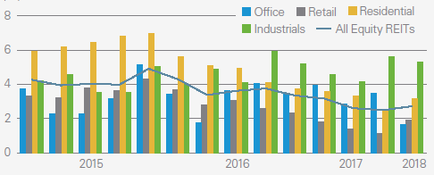
Fundamentals remain strong Strong earnings growth and backing of private investment
NOI Growth
REIT earnings are very stable and are growing at mid-single digits annually
Earnings growth should translate into comparable dividend growth, and through September, 78 U.S. real estate companies have announced dividend increases
Steadily growing economy, lower construction rates, and solid demand for U.S. real estate should support asset prices
Value opportunity in certain sectors including retail which sold off substantially over the past two years
Property Net Operating Income Growth
Private investing dry powder
Real estate M&A activity in the U.S. is at levels not seen in more than a decade
Buyers increasingly include private equity investors who see REITs as attractively priced compared to private markets
Private equity managers currently hold $294 billion in un-invested capital earmarked for real estate investments, looking to buy what REITs own
Un-invested Private Capital

Slide 6
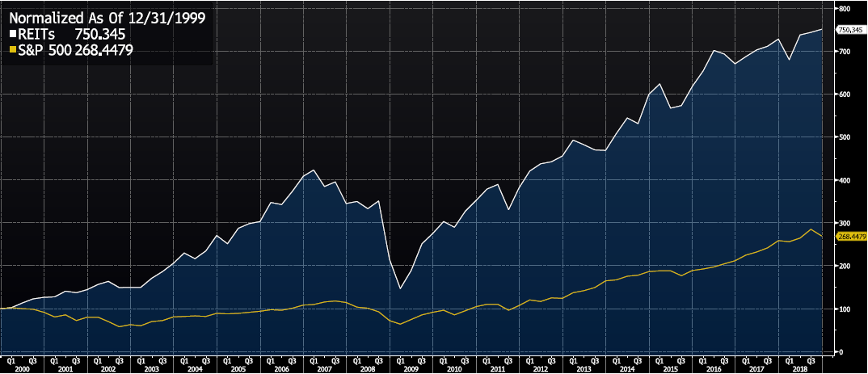
Defensive position with upside U.S. centric play with growth opportunity
REITs minimally affected by trade rhetoric
REIT earnings are more “local economy dependent” rather than globally focused
TIREX investment universe is purely focused in North America
Correlation to Equity Markets – lowest in ten years
Long Term Returns – REITs vs. S&P 500
Possibility for strong relative performance
While REITs have experienced a period of underperformance of late, historically, real estate is one of the strongest performing asset classes
Diversification benefits enhanced by decreasing correlation of returns

