Slide 1
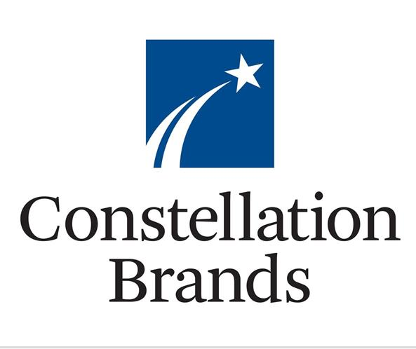
INTERNAL USE ONLY
Notes:
1

Slide 2
How Did We Find the Idea?
Desire to add to consumer staples:
Valuation more attractive following drop in oil price (thus positive impact on margins)
Becoming more defensive at this stage of the economic cycle
Screened well

Slide 3
Investment Thesis Overview
STZ helps position our portfolio to be more defensive at this stage of the economic cycle
valuation is attractive: STZ is down ~20% YTD, DCF and historical multiples analysis confirm this is an attractive entry point
STZ comes out of a heavy capex investment cycle to support its growth: FCF margins are set to inflect thanks to lower capex and growing operating cash flows

Slide 4
Investment Thesis: Company Details BUY 2% position
STZ owns the fastest growing beer portfolio in the US and is #1 multi-category alcoholic beverages supplier in the US
#1 high-end beer in US, #1 imported beer in US, #3 brewer overall but gaining share vs top 2
#2 US wine sales, #1 imported vodka in US
STZ continues to have HSD top line growth and high margins that should incrementally improve going forward
Quality business:
High barriers to entry in the beer market
Pricing power of STZ brands reflected in margins: 50% GM, 30% operating margin
Divesting lower end brands
Shareholder friendly:
share buyback opportunistically – focus on growing its business is the priority
dividend yield of 1.5% (initiated in 2016), largely covered by FCF

Slide 5
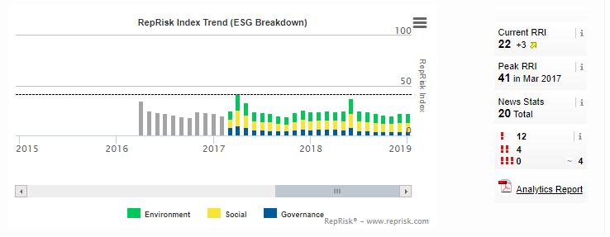
ESG Scores
STZ’s ESG scores: Sustainalytics score momentum is positive… although from a low level
So where do they need to improve?
Governance:
12 Board members vs. peers median of 11 gives them a bad Sustainalytics mark
On the positive side, their number of women on the board is 25% vs 19.6% for peers median
Environment:
Water usage/shortage is the bigger risk in Mexico (creating tensions with local population).
However the Mexican government approved of the plant construction
An independent study showed that the operations account for less than 1% of the total water extracted from the Allende-Piedras Negras Aquifer. This study also indicated other industries using water from this basin include livestock (84%), urban supply (13%), industrial (2%) and energy generation (1%).
Their facility in Nava has one of the best water efficiency rates in the industry
Their wastewater treatment system reuses about 26% of incoming water
Reprisk rating is good:

Slide 6
Alcoholic Beverages Industry Overview
Consolidation of alcoholic market continues
Low private label penetration in alcohol sector – not a threat
Consumers see value in alcoholic beverages brands
Global alcoholic beverage segment is expected to remain resilient ~5% CAGR next 5 years
Alcoholic beverage stocks are resilient to underlying economic cycles in the US, and show almost no correlation to US GDP growth

Slide 7
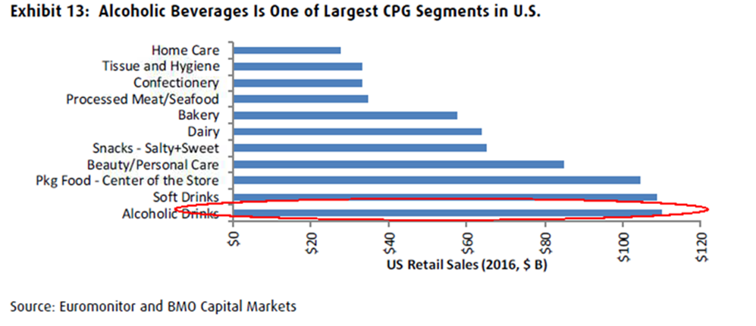

Slide 8
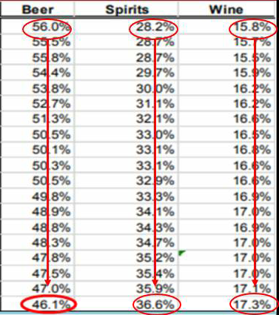
Total Beer category is losing to spirits & wine
Craft beer & import beer keep gaining market share → STZ has better exposure to those growing categories than peers
Share of US retail sales evolution in the US:

Slide 9
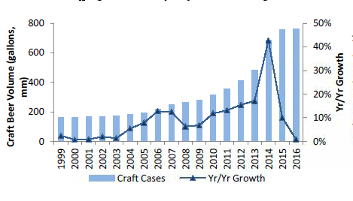
Industry Overview: Beer
Concentrated beer market: 70% of the US market is owned by ABI & Molson Coors, although they have been losing share for 10 years
Top 5 players globally own 53% market share (vs 38% in 2007)
Tiered distribution system (coming from prohibition times) makes it harder for small players to get national distribution without large player’s help
US beer sales to grow ~4% CAGR over the next 5 years, with premium/super-premium accounting for 89% of the growth
HSD growth for imports (Mexican beer)
Recently seeing a rebound in craft beer: 6-8% growth expected

Slide 10
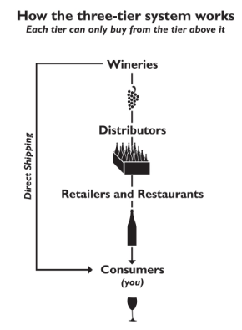

Slide 11
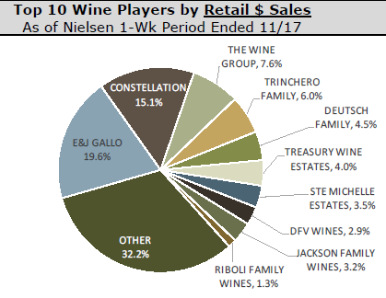
Industry Overview: Wine & Spirits
Low barriers to entry: it’s easier to access shelf space with retailers
WINE:
Wine industry is more fragmented than beer: having distribution scale matters
Wine has grown in retail volume share in North America by 230bps since 2006 (now ~12%), and represents 24% of the $ value sold
US wine sales to grow 4% CAGR over next 5 years
SPIRITS:
Spirits market represents 6.5% of NA volumes sold but 28% of $ value
US Spirits to grow ~5% CAGR over next 5 years, driven by whiskies

Slide 12
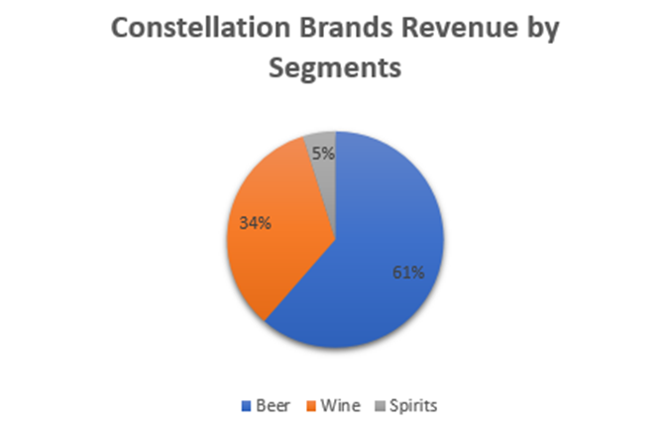
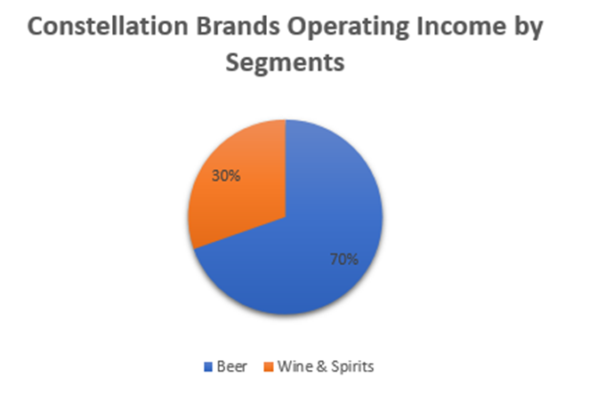
Business Description
$35B market cap company
Constellation Brands produces beer, wine, and spirits and is one of the largest multi-category alcoholic beverage suppliers in the U.S.
The firm generates over 97% of its revenue in the U.S.
100 brands including:
Imported beer: Corona, Modelo, Pacifico: owns the rights to distribute in the US
Craft beer: Ballast Point
Wine: Robert Mondavi, Black Box, Clos du Bois
Spirits: Svedka

Slide 13
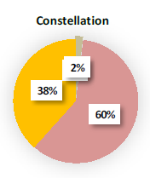
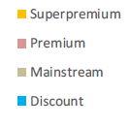
STZ’s Beer Category

Slide 14
Investment Characteristics
Offense:
Premiumization of its wine & spirit portfolio
Wine >$11/bottle growth rate is above 10%, vs ~2% for bottles <$11
Modelo & Corona to appeal to Hispanics that are a rising share of the US legal drinking age group (1/2 of the increase over the next 10 years).
Hispanics prefer drinking beer, specifically imported beer
Cannabis equity investment: 37% equity stake in Canopy Growth, a Canadian cannabis firm
Defense:
Little correlated to GDP growth
The firm owns six of the top-selling 15 imported beer brands in the U.S.
Deeply entrenched relationships with distributors, retailers, and on-premises channels that depend on its leading brands to drive volume
Greater distribution network than local craft breweries

Slide 15
Revenue Growth Drivers
Drivers to organic growth:
Volume growth from increased distribution
Demographics: around 40% of the firm’s sales are to Hispanic consumers and the population of Hispanic legal drinking age adults is expected to grow at a 3% compound rate through 2025
Pricing: 1-2% in beer, minimal in wine, driven more by premiumization of portfolio: focus on high end, premium and super-premium brands.
Divestment of lower end brands (still 30% of portfolio) could add another 3-4% to top line growth
Product innovation: extension of existing brands - had little cannibalization so far
M&A: STZ has added craft breweries and premium wines & spirits to its portfolio
Ballast Point (Dec 2015)
Funky Buddha Brewery, a leading craft brewery in Florida (Aug 2017)
Obregon Brewery (2016)
Four Corners (Texas, acquired July 2018)

Slide 16
Margin Growth Drivers
Operating margins improved from 27% in FY14 to 39.5% in FY18, thanks to a good pricing strategy and COGS improvements
Divestment of lower-priced brands: should drive high-single digit EBIT growth, improving margins
Higher-priced wine (Meomi & Kim Crawford have 60-70% gross margins)
Strategy to build brands in wine the same way they did in beer
Operating leverage from volume growth to continue:
Next catalyst in leverage:
incremental production capacity coming on line in Mexicali and Obregon
Those plants are located on the West Coast of Mexico, giving STZ significant freight advantage for shipments into California (~25% of total volume)
Improved sourcing: Glass/aluminum & cardboard represent 70% of Constellation Brands supply costs
Obregon Brewery & Nava expansion (completion end FY19
Nava glass plant (completion end of 2019): should supply over 60% of the firm's needs for glass
Aluminum cans: big margin opportunity. Continued ongoing shift toward aluminum cans (away from bottles), which is generally margin accretive

Slide 17
Cannabis Investment: Canopy Growth
Canopy Growth Profile:
Market leader in Canadian cannabis industry: owns 36% of supply contracts (1-3 years), 30% of SKUs national distribution
Largest legal cannabis production footprint in the world
Revenue growth acceleration expected: consensus estimates $565M USD sales in 2020 -> $1.4B in 2022
Margin expansion from scaled production and increased distribution
Targeting net income positive in 2022
Medical products backed by clinical supported claims
Patented key processing innovations
Why Cannabis?
Strategic long-term investment that should pay dividends as the Canadian adult use market sorts itself out and sales continue to ramp, in addition to the international medical opportunity
Seen as “once in a century” disruptive market transition - market evolving quickly: could become $200B in global retail value in next 15 years
Cannabis-based beverages are already in development in Canada (with STZ partnership) and will launch in Q4 2019
Deal Profile:
Constellation invested $4B – ~37% ownership: adding $60M in interest expenses ($0.25-30/share impact on $9.47 estimated EPS for FY19)
Option to own 55% in 3 years
STZ will nominate 4 board members out of 7
Should be accretive to STZ by FY21

Slide 18
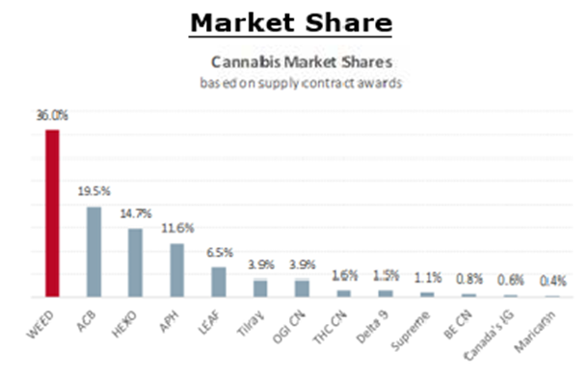

Slide 19
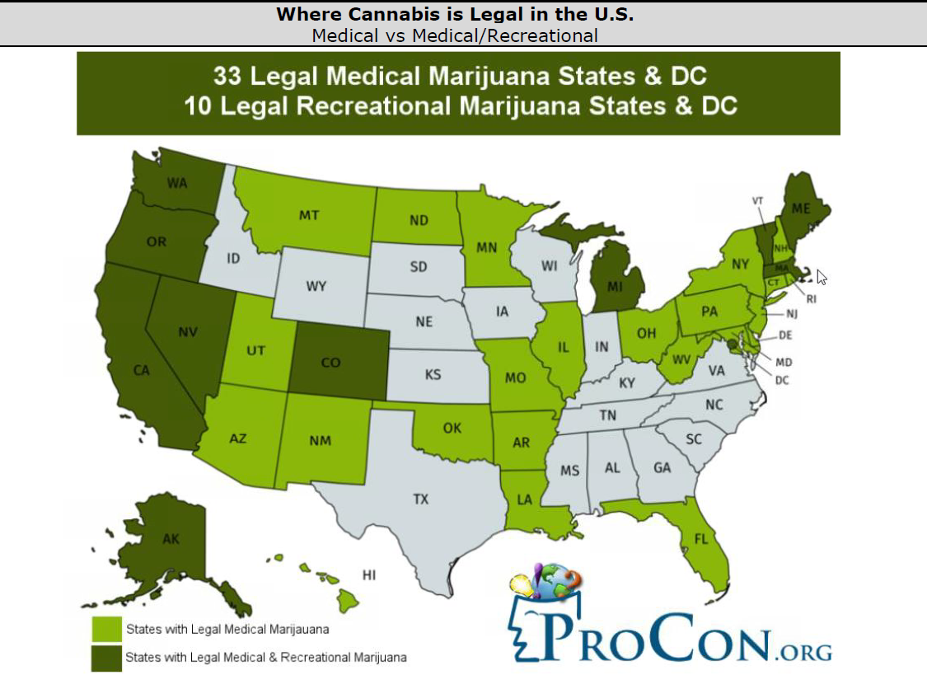

Slide 20
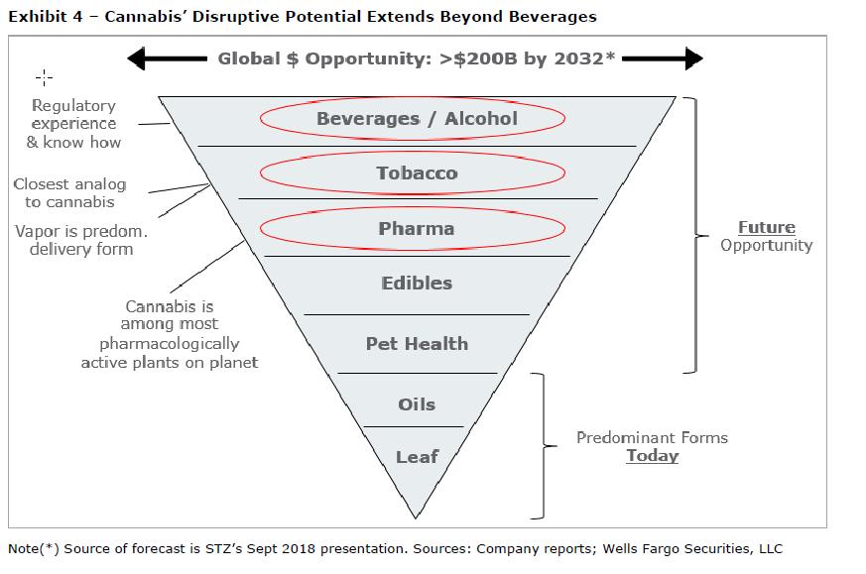
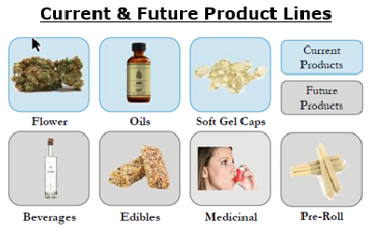

Slide 21
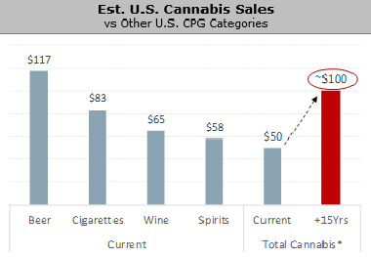
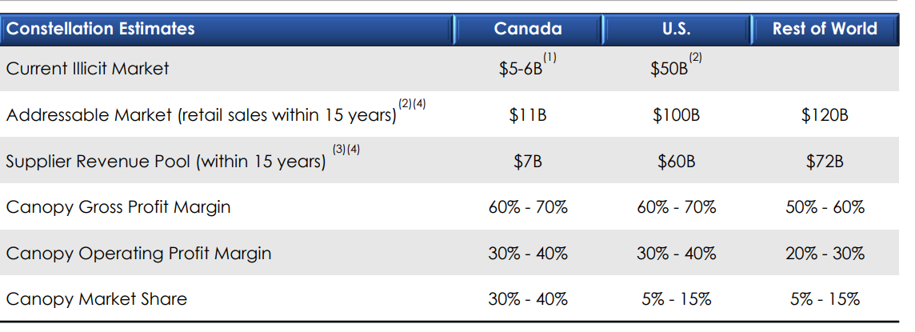

Slide 22
Capital Allocation Overview
The company prioritizes investing in:
Growth in the business
Deleveraging the balance sheet: 3.6x net debt/EBITDA as of Q2 FY19, going back to mid 4x once Canopy deal is done
Increasing the dividend: Dividend yield of 1.5%. Payout ratio target of 30% (current mid-teens)
Buybacks: priority on strategic investments rather than share repurchases
Capex
Between FY14-17, STZ spent over $2.3 billion (17.4% of last 3 years beer sales) to support growth and development of the US beer business:
Increased capacity in breweries: new capacity coming in stages until FY21 (Mexicali scheduled for Dec 2019)
Build glass furnace
Inflection in capital spending (lower) is coming: these recent capacity investments should support higher volumes through FY24 without incurring the need for incremental investments

Slide 23
Free Cash Flow: 2019 growth driven by OCF growth & Capex moderation

Slide 24
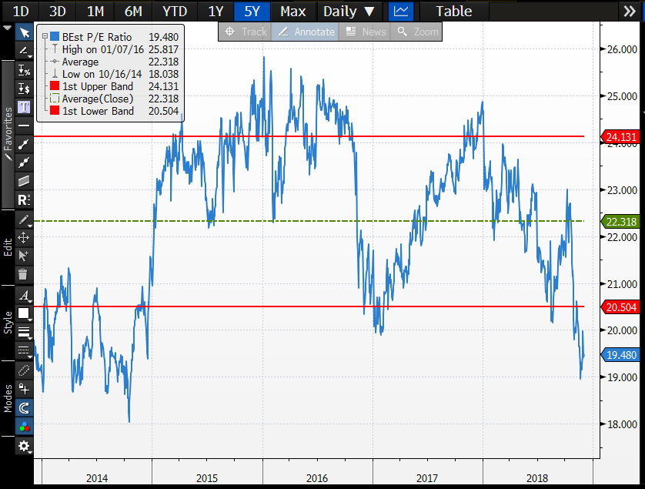
Valuation: P/E Multiples Analysis

Slide 25
Investment Risks
Regulation risks with cannabis in US
The Sands family holds the majority of the company’s Class B convertible stock, which grants its owners 10 times the voting rights of Class A shareholders. As such, the Sands family has the majority of voting power, which creates potential for the company to act counter to the interests of minority shareholders. Still, the firm has historically acted in the best interests of shareholders, as evidenced by its excess returns on invested capital
Major slow down in Mexican beer consumption

Slide 26
Conclusion
STZ helps position our portfolio to be more defensive at this stage of the economic cycle
valuation is attractive: STZ is down ~20% YTD, DCF and historical multiples analysis confirm this is an attractive entry point
STZ comes out of a heavy capex investment cycle to support its growth: FCF margins are set to inflect thanks to lower capex and growing operating cash flows

