Slide 1


January, 2019
2018 Q4 performance review

Slide 2
Forward P/E valuation

Slide 3
Shiller P/E
Valuations have improved, but expected returns are below average

Slide 4
Valuation for EAFE
Valuations remain attractive in EAFE

Slide 5
Outlook 2019
Fundamentals are sound but risks remain
Expect U.S. economy to slow in 2019
While the 2018 tax cuts remain in place, their contribution to ongoing year-over-year growth will begin to fade. We expect economic growth to slow but remain positive.
Expect current tariffs to have small negative effect on U.S. growth, but their effect on companies’ supply chains and earnings will be larger. Further protectionism on consumer goods, specifically technology and autos, would have a greater effect on growth
Consensus revenue growth estimates for the S&P 500 are ~5% for 2019. Earnings growth will slow in the second half as further margin expansion will be difficult given rising interest costs, tariffs and higher wages
U.S. equity valuations have improved given strong earnings growth and falling prices
International markets still attractive
Global economic growth is driven by consumer strength in the U.S. The International Monetary Fund is forecasting 2019 global growth at 3.7%
Compared to U.S. market valuations, developed international and emerging markets remain relatively attractive
Risks remain but have shifted
While inflation has remained under control and below 3.0%, inflation risks have increased as tight labor markets and tariffs put upward pressure on prices
China’s slowing economy and high debt levels remain a concern given authorities efforts to constrain credit growth
There are risks of an escalating trade war which would likely impact the S&P 500 earnings to an greater degree than GDP
Higher U.S. interest rates and stronger U.S. Dollar have been headwinds for emerging market economies, especially those that have substantial debt in U.S. Dollars
Information is current and believed to be accurate as of 12/31/2018

Slide 6
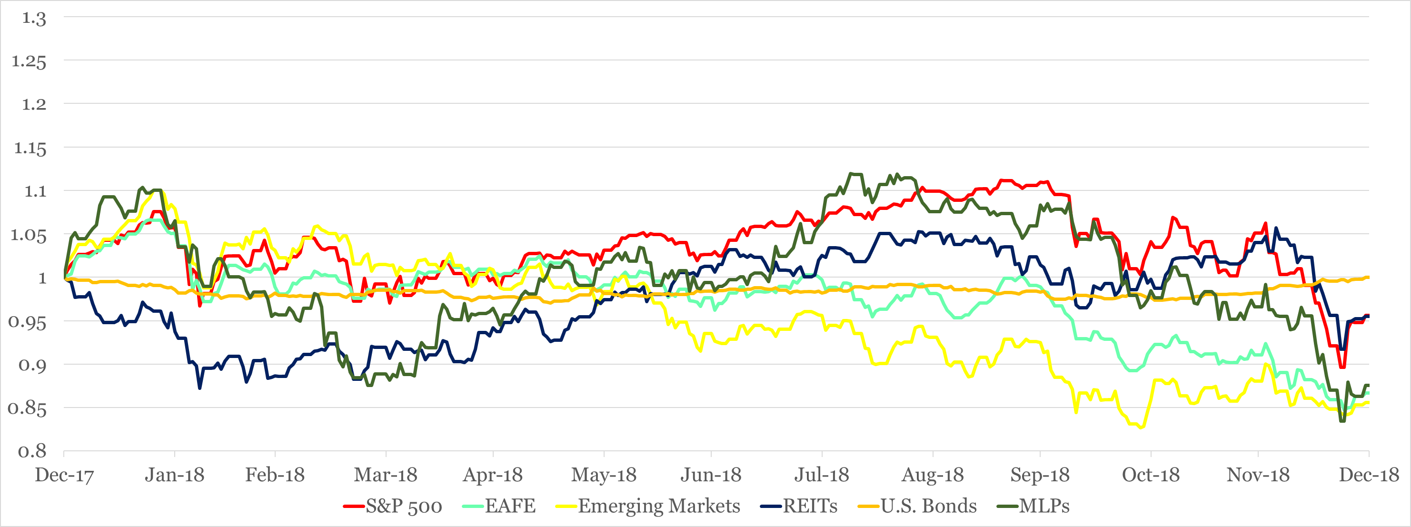
Return of Market Indices
Volatility in U.S. equity markets picked up over the fourth quarter, and we experienced the first down year for the S&P 500 since 2008. While economic fundamentals remain healthy, uncertainty over slowing global growth and trade has driven broad market concerns.
As the Fed appears to begin slowing rate increases, bond prices have held strong amidst the volatility in equity markets as investors have sought less risky investments.
Maintaining a diversified portfolio of assets has helped to mitigate overall volatility with the intention of providing strong risk-adjusted returns over time.
Source: Bloomberg. EAFE is MSCI EAFE Index, Emerging Markets is MSCI Emerging Markets and U.S. Bonds is Barclays U.S. Aggregate. REITs is the DJ US Select Real Estate Securities Index. MLPs is Alerian MLP Index. The above information is through 12/31/2018. See last page for important information.

Slide 7
Asset Class Returns
Tough year!

Slide 8
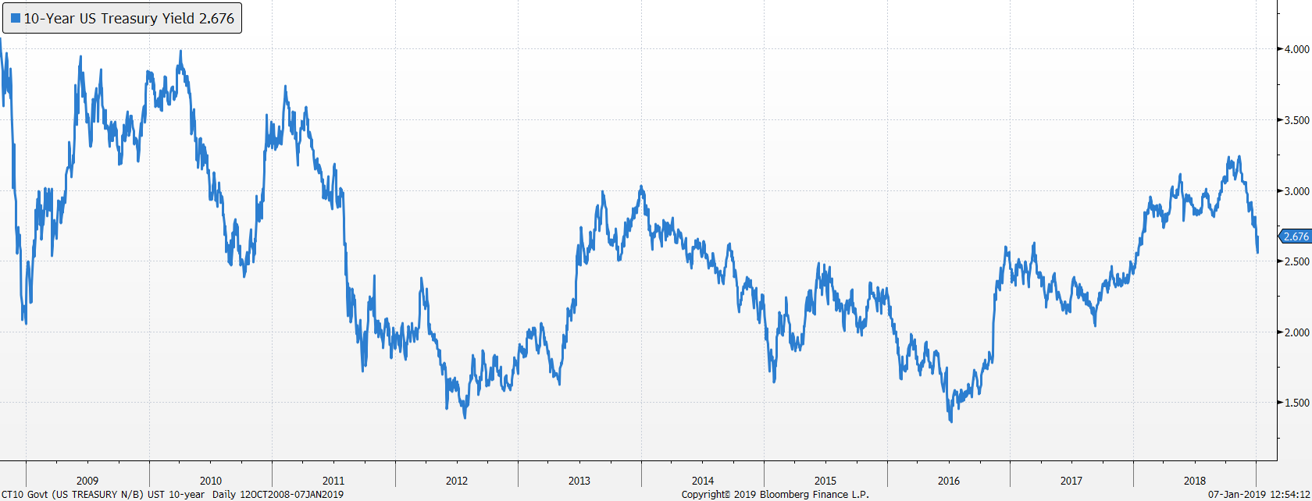
Bond markets
US Treasury 10-Year Yield
Yields fell at the end of 2018 as market volatility increased
Our bond duration is 4.5 years, shorter than US Aggregate at 6.0 years

Slide 9
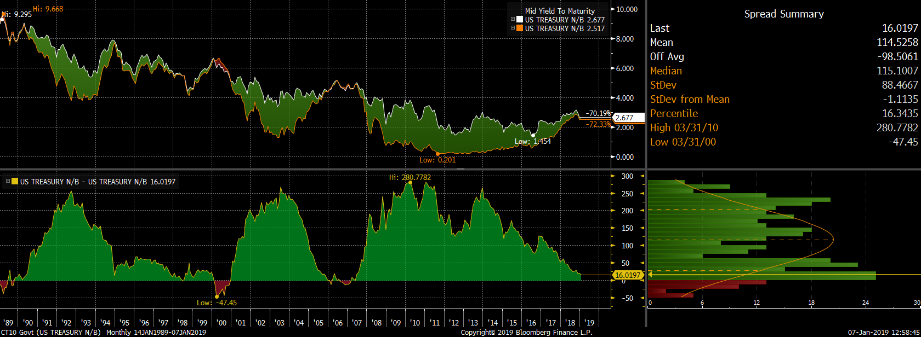
Bond market spreads (10y-2y)
Late cycle
Flat yield curve has been a good predictor of recessions. Percentile has dropped from 23rd to 16th

Slide 10
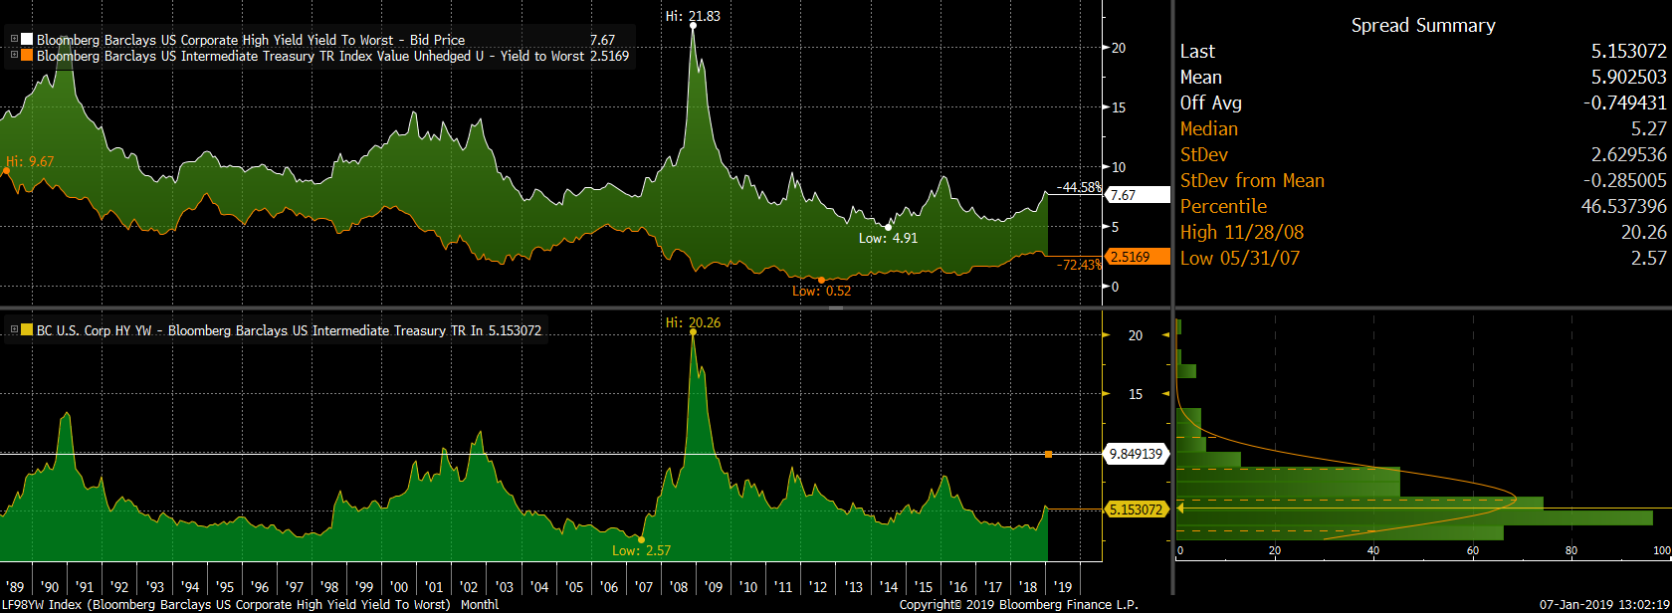

High Yield Spreads
Spreads have increased as the market has fallen
Spread percentile has increased from 20th to 46th

Slide 11
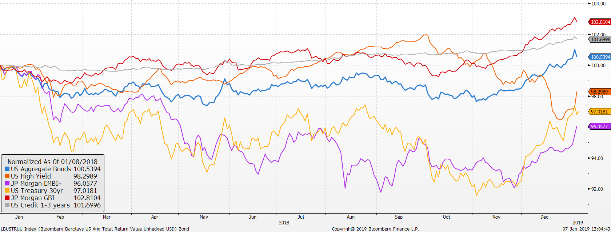
Market Returns
Performance of bond markets
Source: Factset
EM bonds has recovered some after being hit by strong dollar and higher US rates
Credit has fallen though not to recession levels
Aggregate bonds continue to post positive returns even with rising short term rates

Slide 12
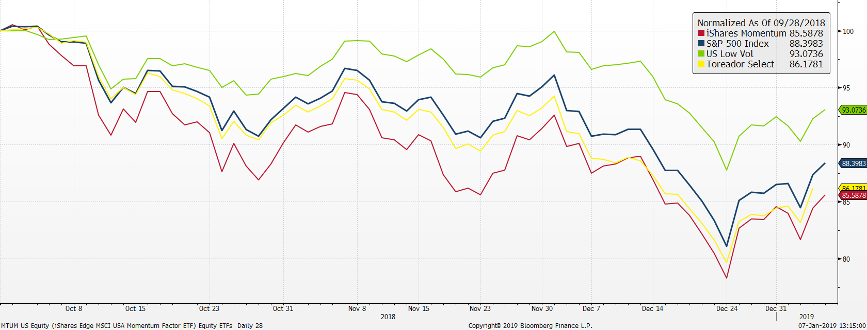
U.S. stock market ETFs
Low Volatility holding up well
Source: Factset

Slide 13
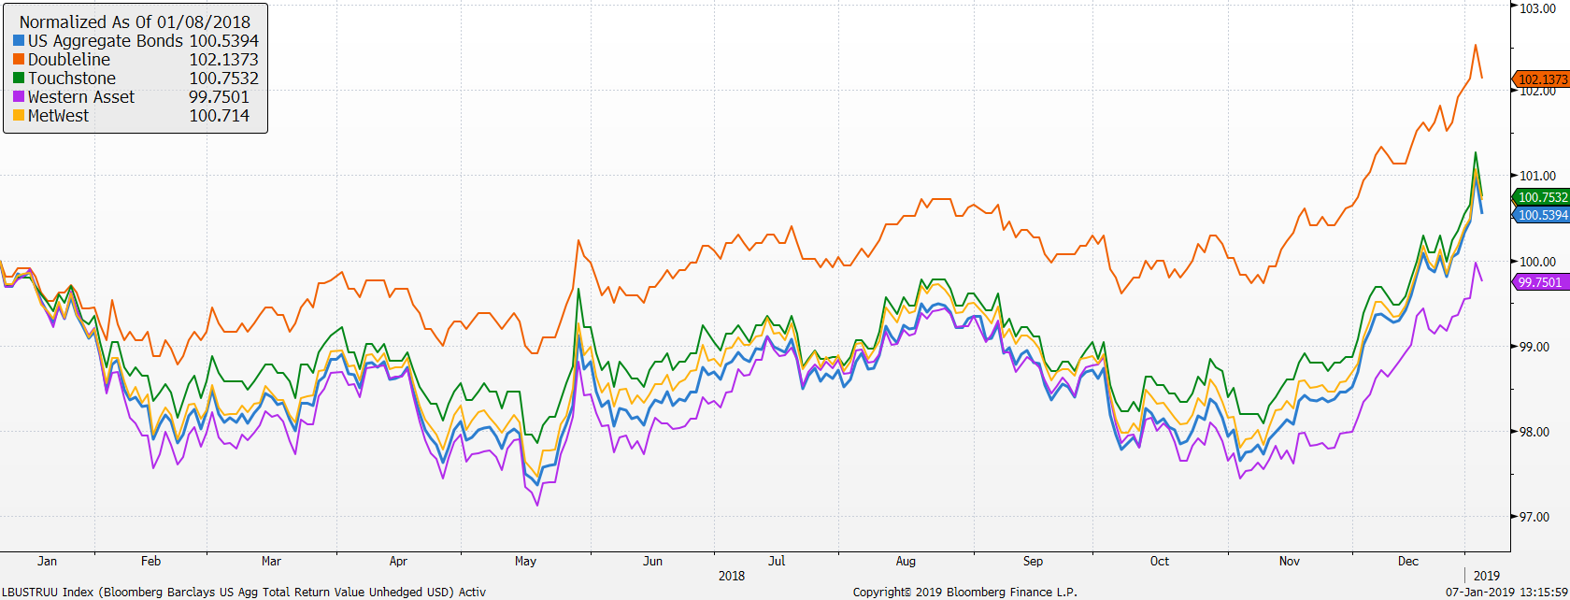
Active bond managers
Doubleline has done well
Credit exposure has hurt Metwest

Slide 14
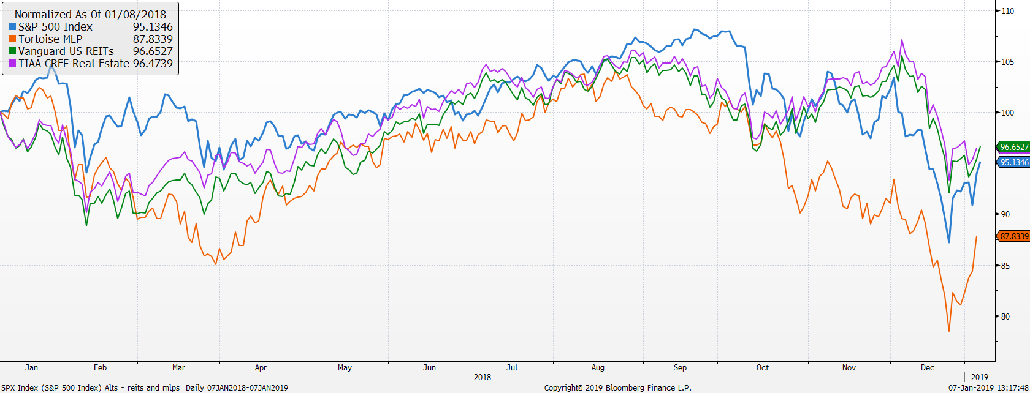
REITs have improved

Slide 15
Vehicle performance as of 12/31/18

Slide 16
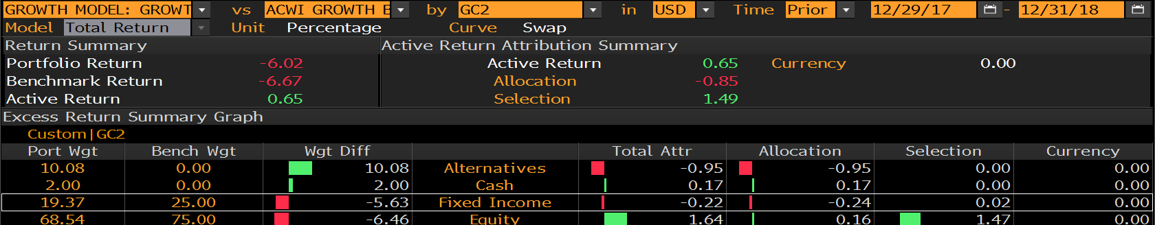
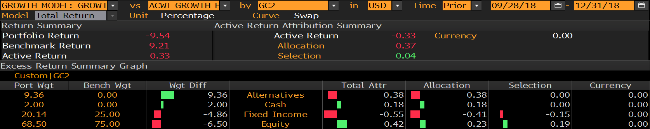
Growth Model attribution
Year-to-Date relative to 75% ACWI & 25% US Aggregate
Lower duration hurt as rates fell versus Aggregate Bonds
Alts dragged down returns

Slide 17
Growth model changes
Portfolio changes 2018
1/30 reduced bonds, US large cap, increased international stocks, MLPs and Market Neutral
9/28 Changed US large cap vehicles
  70% IVV 40% TOSZX
  10% SPHQ 40% USMV
  10% USMV 20% MTUM
  10% IWF
9/28 Replace IEFA with JPIN
11/28 Sold QMNIX to IGSB
12/11 Added 2% to Real Estate
Portfolio changes 2017
1/5 reduced short term bonds, increased small cap and added market neutral
2/7 increased MLPs
5/2 eliminated floating rate increased core bond funds and market neutral
7/11 Increased international developed and reduced US large cap
8/8 Switch REIT exposure to active manager, TIAA CREF Real Estate Fund

Slide 18
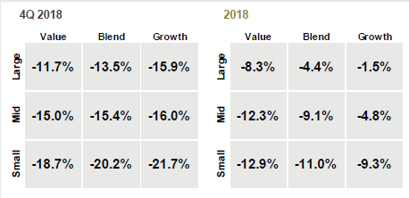
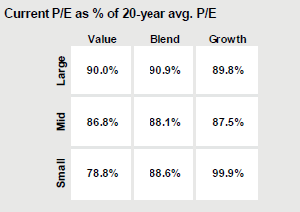
S&P 500 – What happened during 4Q 2018
The S&P 500 was down over 4% in 2018
  YTD growth stocks performed best, but the trend reversed in Q4 with Value outperforming growth.
  Current P/E multiples across all styles are at a discount to long-term average.

Slide 19
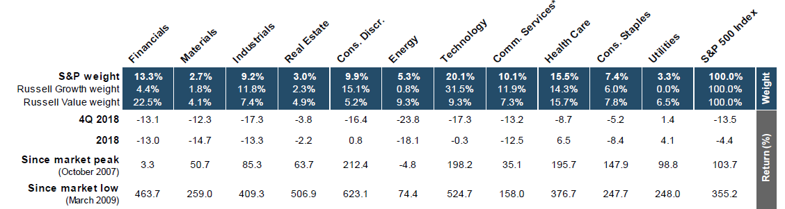
Sector Returns
Q4 best performing sectors: Utilities and REITs
2018 best performing sectors: Healthcare and Utilities
Q4 worst performing sectors: Energy, Tech and Consumer Discretionary
2018 worst performing sectors: Energy and Materials

Slide 20
Focus Equity Highlights – 2018
What has driven performance YTD?
Our US equities outperformed the market by 131bps for 2018.
We lost 21 bps in Q4 driven by underperformance in Energy and Industrials.
The biggest underperformers in the quarter were LMT, EOG, ARMK and SLB.
Not owning AMZN added 83bps in Q4.
What’s worked?
Biggest contributors to outperformance: Tech, Staples & Communication Services
Top contributors to outperformance: RMD (+74bps), MCK (+72bps), CSCO (+43bps), TJX (+37bps),
What didn’t?
Stock selection in Energy and in Consumer Discretionary: Owning SLB and not owning AMZN.
Top detractors to full year performance: SLB (-71bps), ARMK (-67bps), LMT (-54bps), CL (-34bps)
What changed?
Sold CTSH, ARMK
Bought STZ
Added to LMT, ST, AAPL, TJX, HLT

Slide 21
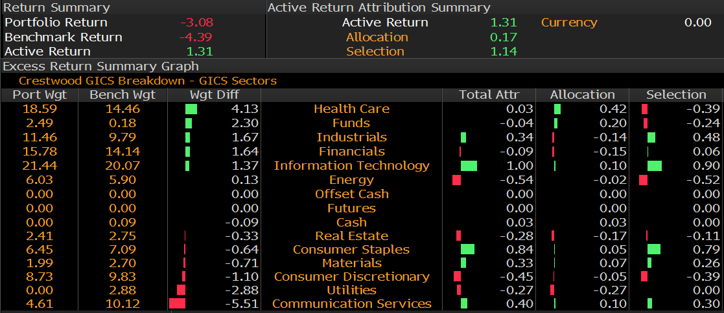
Attribution 2018

Slide 22
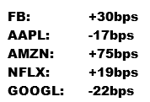
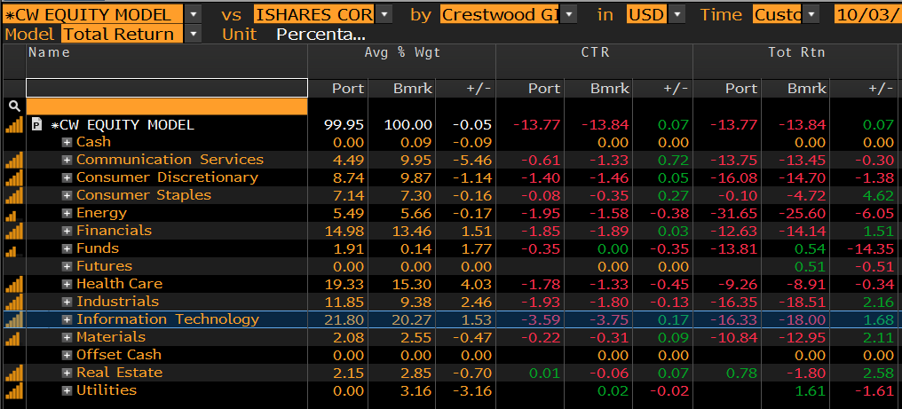
FAANGS
Since the selloff started on October 3rd the S&P was down almost 14% through 12/31 and we gained 7 bps.
Our position w/ the FAANG stocks added 85bps during that period

Slide 23
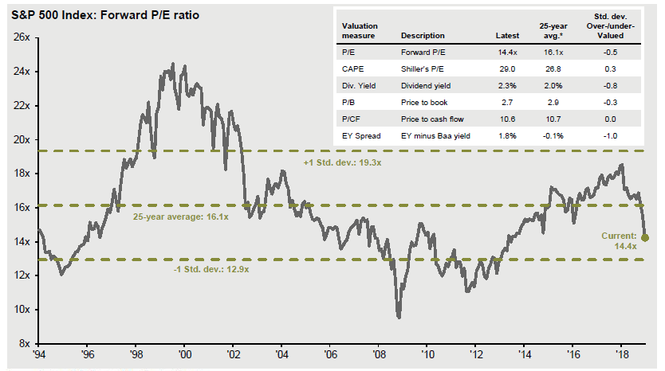
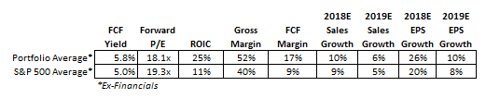
S&P 500 Forward P/E Ratio

Slide 24
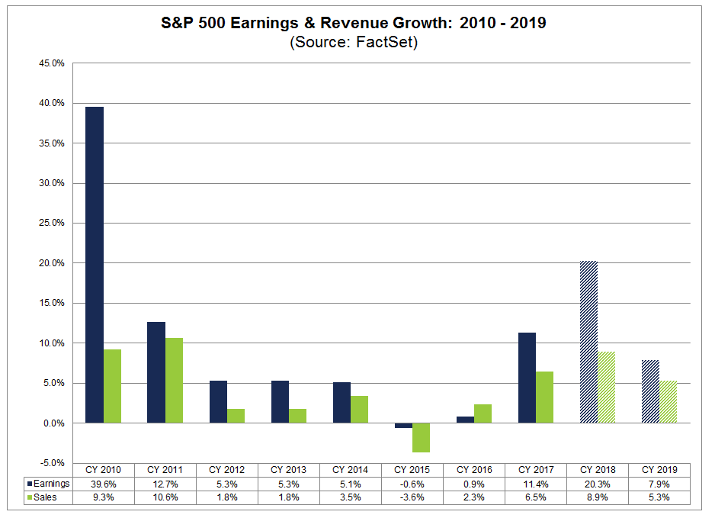
Historical and Forecast S&P Growth

Slide 25
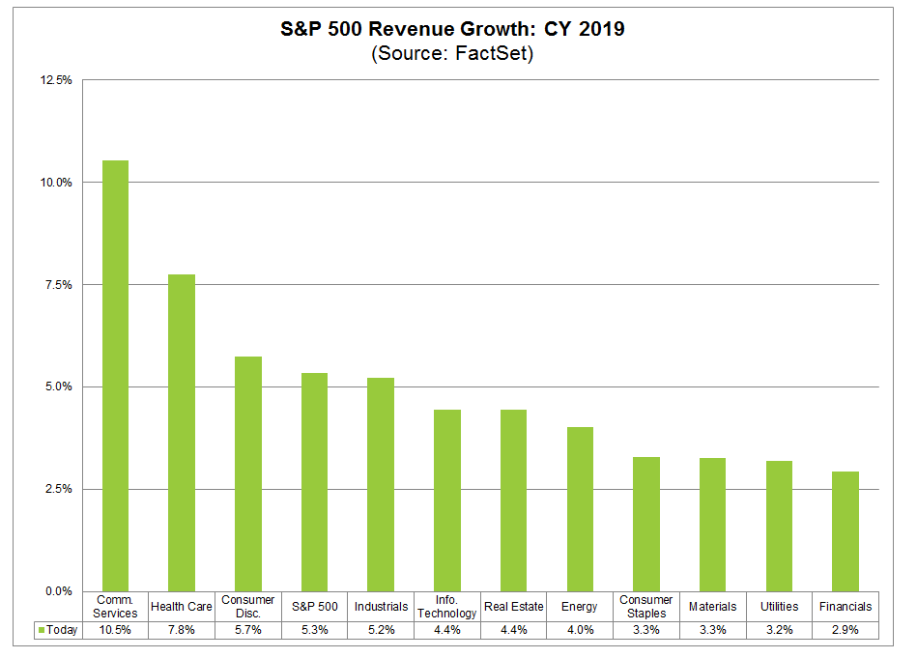
2019 Expected Revenue Growth by Sector

Slide 26
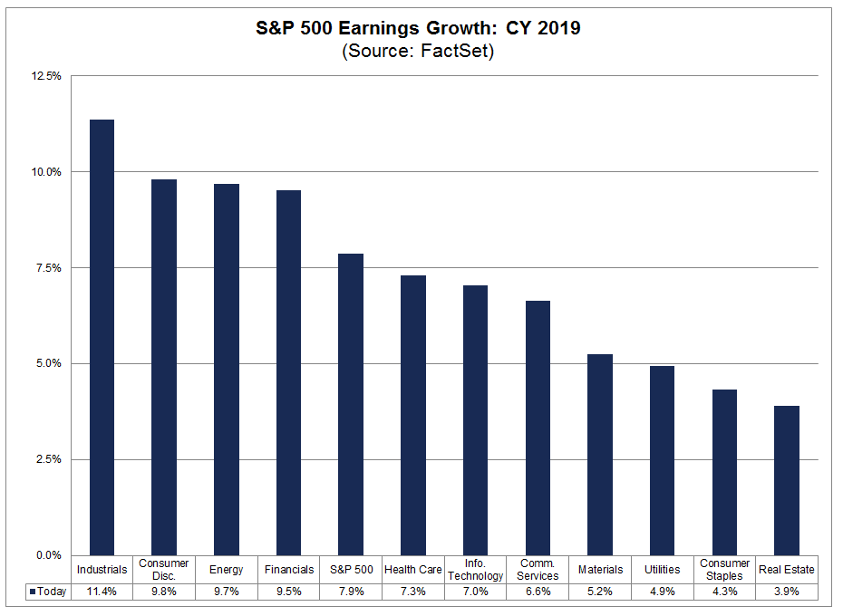
2019 Expected Earnings Growth by Sector
Estimated earnings growth rate for CY 2019 is 8%.
All 11 sectors are projected to report YoY growth in earnings, led by the Industrials, Consumer Discretionary, Energy, and Financials.

Slide 27
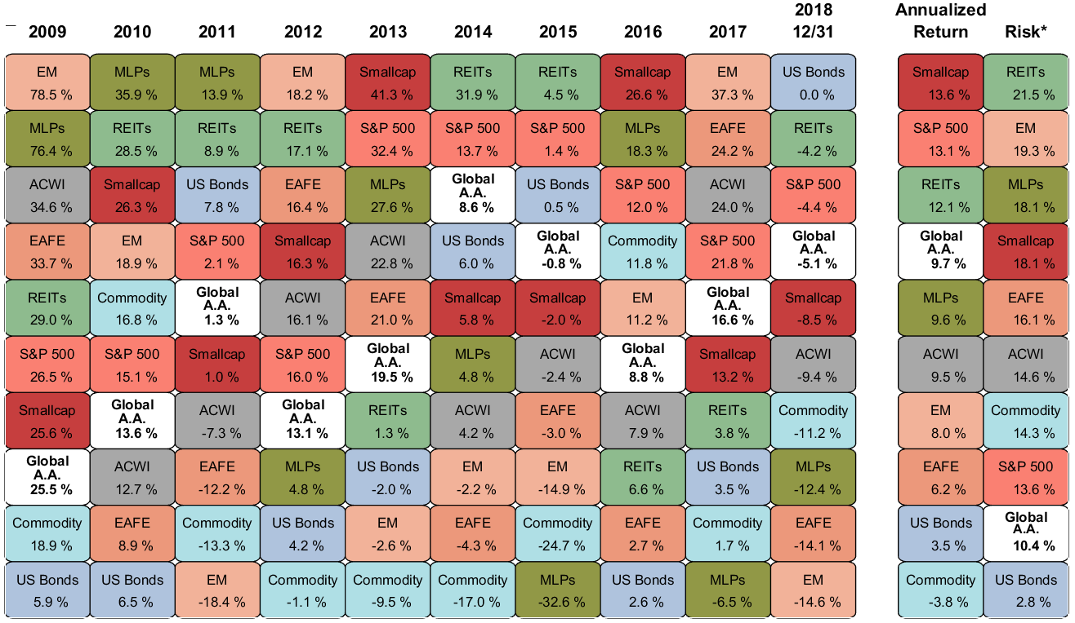
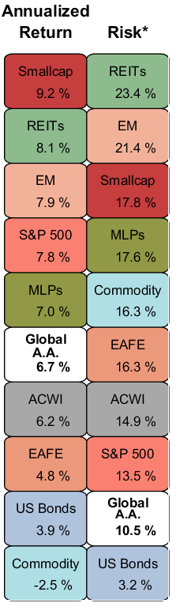
Why it Makes Sense to Diversify
How to position for high valuations and looming volatility
Over past 15 years a diversified portfolio offers stock market returns at lower risk level.
Past 10 Years
Past 15 Years
Source: Bloomberg, MatLab
*Risk is calculated using standard deviation. “Global A.A.” represents a global asset allocation portfolio and is calculated using monthly returns and 51.0% S&P 500 Index, 25.0% Barclay’s Aggregate, 13.5% MSCI EAFE and Canada Index, 4% MSCI Emerging Markets, 2% DJ US Real Estate Index, 2% S&P Smallcap index and 2.5% Alerian MLP index. Indexes used: REITs is the DJ US Real Estate Index, EM is MSCI Emerging Markets, EAFE is MSCI EAFE and Canada Index, Smallcap is S&P 600 Smallcap index, US Bonds is Barclay’s US Aggregate Bond Index and Commodity is Bloomberg Commodity Index
Information is current and believed to be accurate as of 12/31/2017

Slide 28
Global Asset Allocation
Prudence and patience
Prudence and patience reward long-term investors
Best and worst calendar-year returns
Past 15 years
*Asset Class Returns as of 12/31/2018 . “Global A.A.” represents a global asset allocation portfolio and is calculated using monthly returns and 51% S&P 500 Index, 25% Barclay’s Aggregate, 13.5% MSCI EAFE and Canada Index, 4% MSCI Emerging Markets, 2% DJ US Real Estate Index, 2% S&P Smallcap index and 2.5% Alerian MLP index. Indexes used: REITs is the DJ US Real Estate Index, EM is MSCI Emerging Markets, EAFE is MSCI EAFE and Canada Index, Smallcap is S&P 600 Smallcap index, US Bonds is Barclay’s US Aggregate Bond Index and Market Neutral is AQR Market Neutral fund, and MLPs is the Alerian MLP Index. All data represents total return for stated period. Figures in enclosed box are annualized return for past 15 years.
Information is current and believed to be accurate as of 12/31/2017

Slide 29
Global Asset Allocation
How time horizon affects asset allocation
Best and worst returns for 1,3 and 5 year rolling investment horizons
Monthly returns since 1/31/2003
*Asset Class Returns as of 12/31/2018 Indexes used: US Bonds is Barclay’s US Aggregate Bond Index, ACWI is the MSCI All Country World index, 40%/60% is 40% ACWI and 60% US Bonds; 60%/40% is 60% ACWI and 40% US Bonds, 75%/25% is 75% ACWI and 25% US Bonds, 90%/10% is 90% ACWI and 10% US Bonds. All data represents total return for stated period.
Information is current and believed to be accurate as of 12/31/2018

