Slide 1
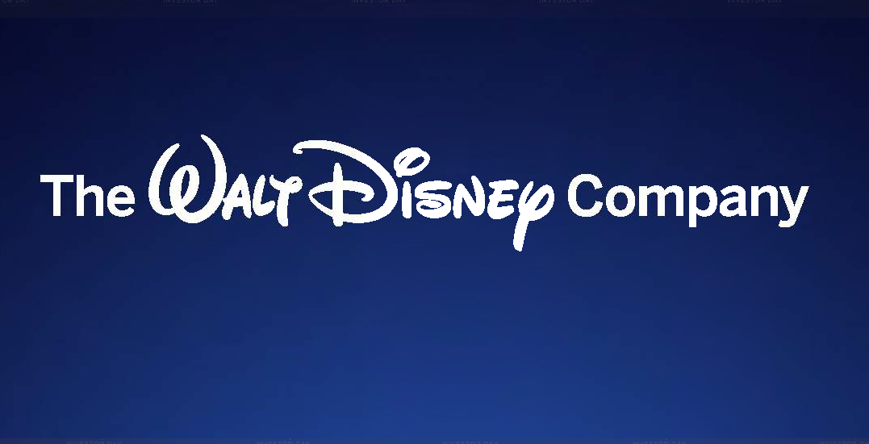

Slide 2
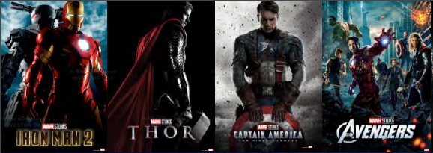
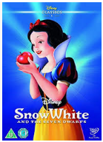
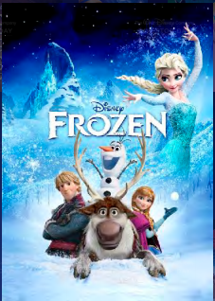
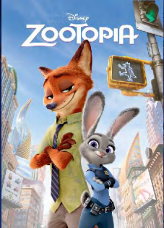
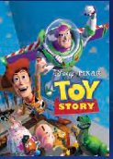
Built on world class brands

Slide 3
Investment Thesis
Evergreen brands and synergistic business model results in better yield on content spend and ability to create higher budget, quality content.
New direct-to-consumer (DTC) initiative will strengthen synergies between businesses and lead to structurally higher margins and higher multiple on recurring revenue business.
Recent Fox acquisition improves their content positioning and global growth opportunities.
High quality company with solid balance sheet, strong FCF generation and ROIC.

Slide 4
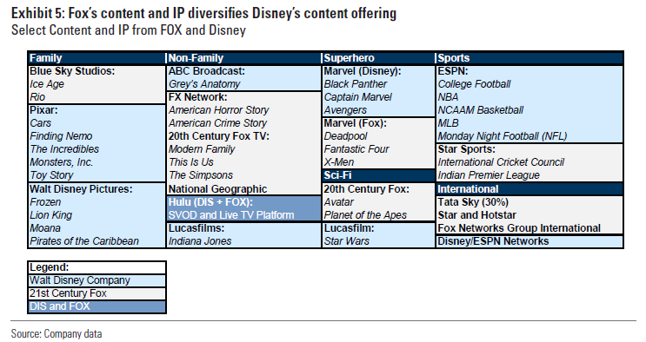
Fox Acquisition closed in March Scale advantages, content diversity and geographic growth opportunities
Acquired part of Fox for ~$70B
21st Century Fox, Fox Searchlight, National Geographic, Star India, Hulu
Selling Sky & RSNs
50% stock, 50% cash
Leverage ratio increasing to 2.4x
Will be accretive after 2 years assuming $2B in synergies.

Slide 5
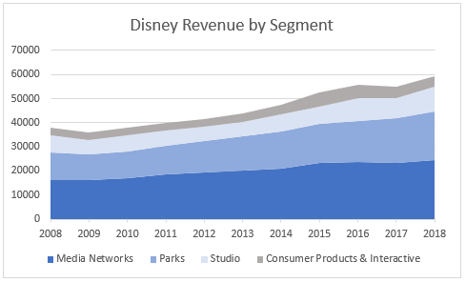
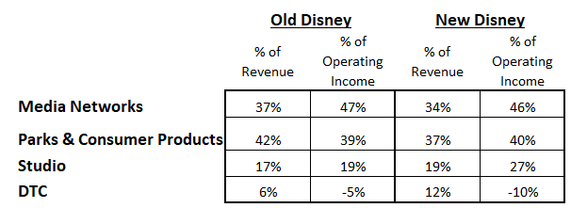
Disney’s revenue composition… Dominated by TV and Parks, but DTC will be a growing piece over time

Slide 6
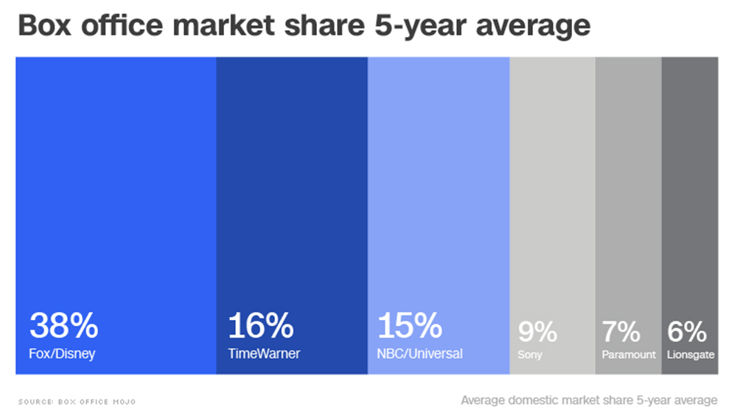
Studio Entertainment Disney’s R&D engine
Comprised of: Walt Disney Pictures, Pixar, Marvel, Lucasfilm, 21st Century Fox, Fox Searchlight
R&D Factory: the studios create content that drives revenue for ancillary products across the company.
Revenue: theatrical distribution, home entertainment, licensing fees
Market share leader: 35-40% of the US box office
Blockbuster strategy – fewer films, better take rates, high ROI sequels, ripple effect across the company

Slide 7
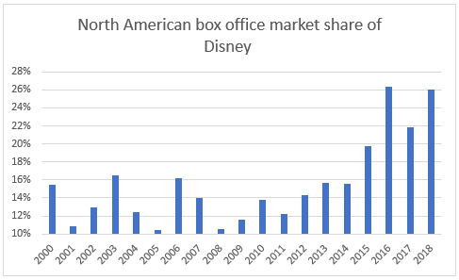
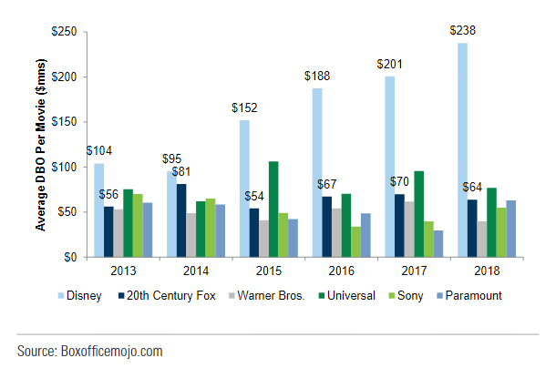
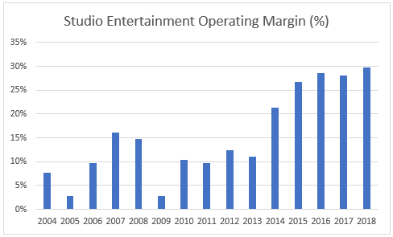
Studio Entertainment Blockbuster strategy = fewer films, higher share and margin expansion…
Average domestic box office (DBO) per film for major studios

Slide 8
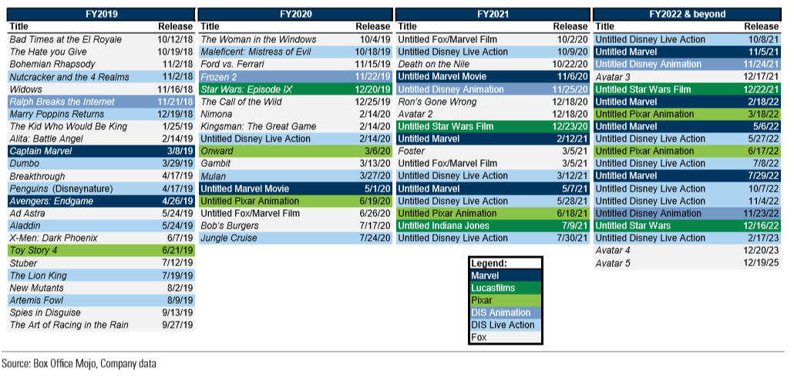
Studio Entertainment FY19-FY22 & beyond announced film slate and release dates by genre

Slide 9
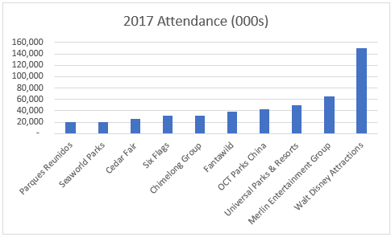
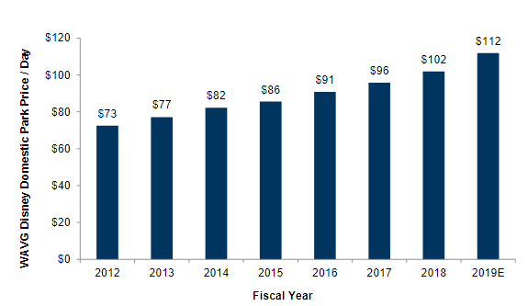
Parks, Experiences & Consumer Products
Parks: revenues from admissions, merchandise, food and beverages
Revenue: 65% domestic parks; 17% int’l parks; 18% consumer products
Highly capital intensive, high fixed cost, high incremental margins
Consumer products: revenues from royalties and IP licensing, 342 retail stores globally
Disney theme park prices have steadily increased....

Slide 10
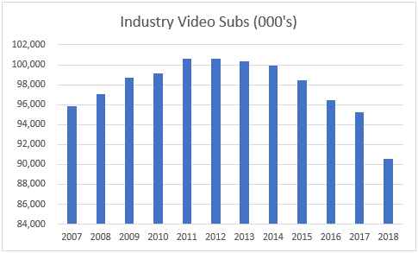
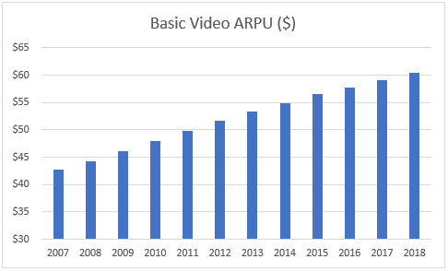
Media Networks Disney’s biggest segment and facing disruption
Cable: Disney, ESPN and Freeform
Broadcasting: ABC
Revenues: affiliate fees, advertising & licensing
Trends: Declining viewership and rising content costs (especially sports rights)
Outlook: their DTC initiative counteracts some of this risk
ESPN – profit driver and linchpin of cable bundle

Slide 11
Disney’s DTC Future
Disney + $6.99/month SVOD Global Disney, Pixar, Marvel, Star Wars, National Geographic Not taking any programming off the Disney Channel. Massive content library: >500 films, >7,000 TV episodes New original content: movies and TV shows 2024 Target: 60-90 million subs | ESPN+ $4.99/month, >2 million subs SVOD + advertising US & expanding Augments cable TV channel, does not overlap/replace. Will launch in Latin America 2024 Target: 8-12m subs Profitable in 2023 | Hulu Disney owns 60% SVOD, ad-supported and vMVPD 4 subscriber levels >25 million subs Not yet profitable Evaluating international rollout strategy 2024 Target: 40-60m subs Profitable in 2023 | Hotstar >300 million MAU’s in India SVOD & ad-supported Asia focused Technology excels at delivering high quality video in low bandwidth environments

Slide 12
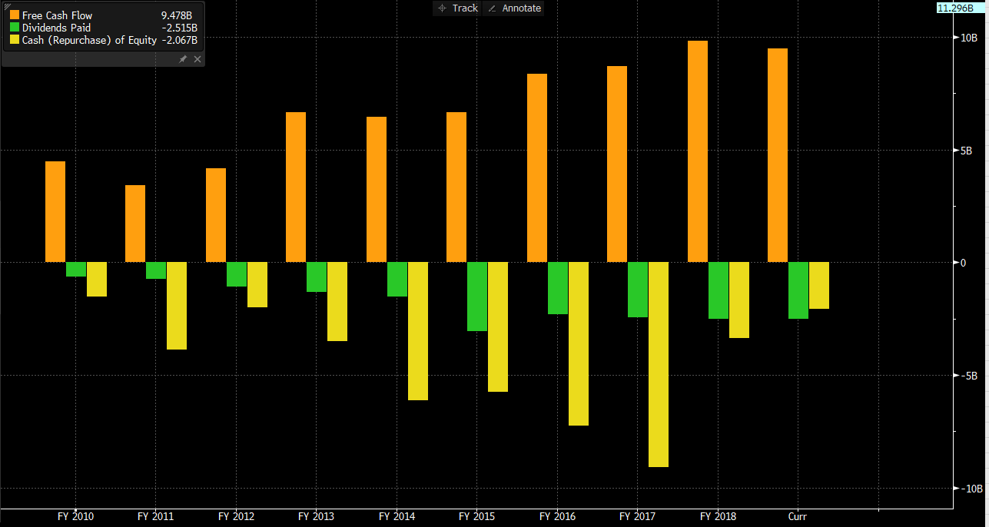
Capital Allocation Since 2013 they’ve bought back 23% of their share count

Slide 13
DCF Valuation

Slide 15
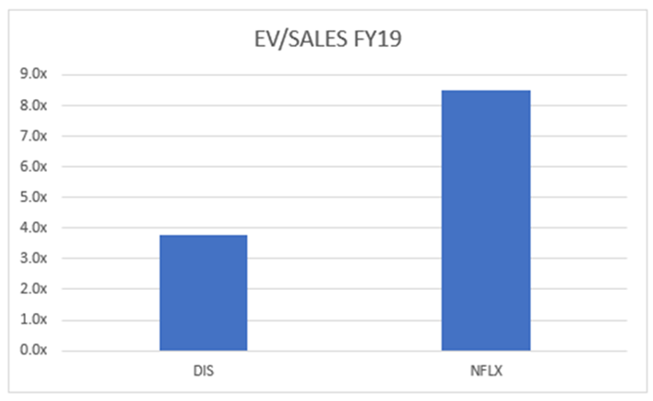
Analysis of street sum-of-the-parts valuation

Slide 16
Risks:
ESPN subscriber losses
Inability to attract DTC subscribers
Content no longer resonates
Decline in global travel

Slide 17
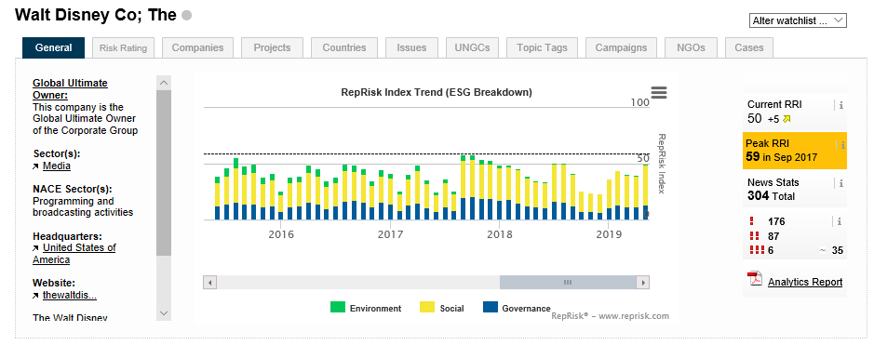
ESG Rating:

