Slide 1


Decreasing MLP Exposure

Slide 2
MLP Sale Rationale
  What are we proposing?
  We are proposing to eliminate our allocation to the MLP sector and increase our exposure to U.S. equities for the time being.
  Why are we making this change?
  We consider MLPs to be a tactical asset class rather than a long term, strategic holding (like REITs) within our diversified asset allocation. Elements of our broad investment thesis have not held up and we believe this is a proper time to exit the investment.
  Valuation and Income Component: Using dividend yield as an indicator of valuation and forward looking performance, MLPs are not currently cheap. As some of the largest MLP companies have cut distributions, the absolute level of dividend payouts for the index has fallen.
  Risk/Return Profile: MLPs are a more risky asset class than broad U.S. equities and total returns have not adequately compensated us for the amount of risk taken. As a tactical asset class, entry point becomes very important due to the volatile return profile.
  Exposure to Energy: The correlation of MLPs to the energy sector has moved upward and we anticipate this relationship to continue. The correlation to energy prices on the downside is more than double that on the upside since our original investment.

Slide 3
Relative Forward Returns vs. MLP Yield
  Comparison of MLP dividend yield and relative return versus S&P 500
  Current Dividend Yield is approximately 7.8%; outperformance generally seen following yield of 8.5% or greater
  We are in a territory of uncertainty using yield as our valuation metric
  Relative Returns
  Yield

Slide 4
MLP Dividends Per Share
  Absolute dividend per share since 2013
  Total dividend payouts have gradually decreased over time (driven recently by cuts in some larger constituents)
  Since an uptick in overall distribution in mid-2018 MLP companies have decided to focus more on capital investment than dividend payout
  Absolute Div Payout
  Date
Source: FactSet; Crestwood Advisors

Slide 5
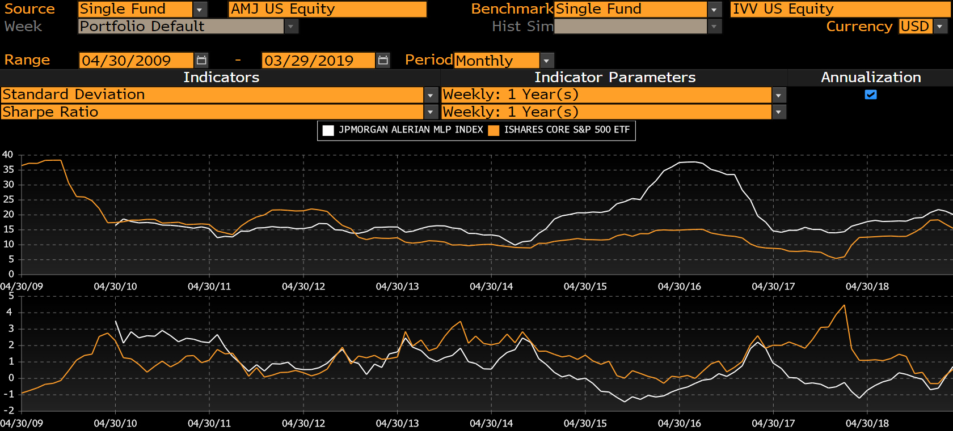
Risk/Return Profile Compared to S&P 500
  Risk and return compensation relative to the S&P 500
  Since 2013 – 2014 MLPs have been consistently more risky than the S&P 500 with some major spikes
  While there were periods of outperformance, investors have not been properly compensated for the risk
  AMJ vs. S&P 500: Standard Deviation & Sharpe Ratio

Slide 6
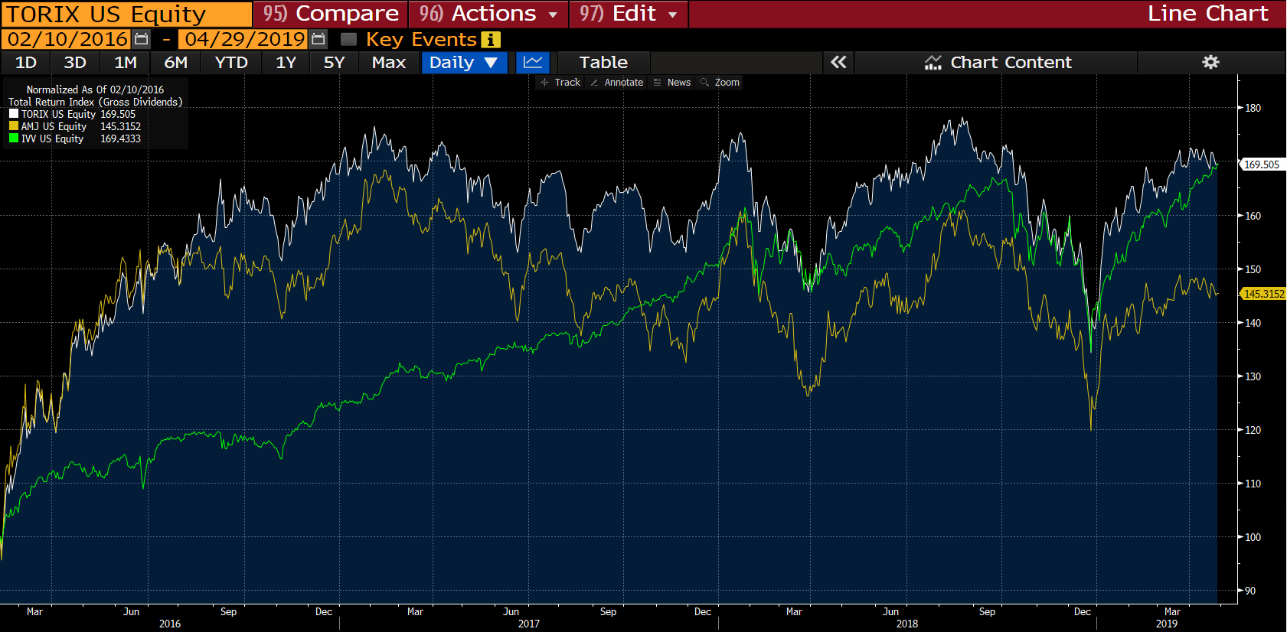
Return Comparison
  Tortoise, MLPs, and S&P 500
  If we had a client buy and hold from day one, returns are exactly the same as S&P 500 with much greater volatility
  Entry point was extremely important with MLPs; had opportunities to start 2016 and end of 2018

Slide 7
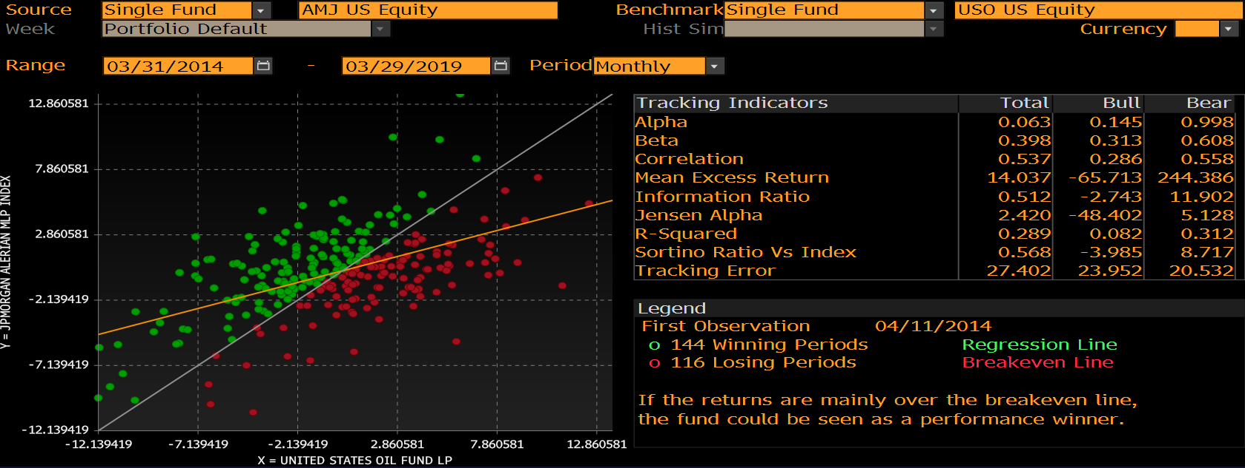
Exposure to Crude Prices
  Correlation to Crude & Overall Standard Deviation
  Over the past 5 years, the correlation of returns relative to crude are 54% (within historical long term norms)
  However, exposure to crude when oil prices are falling (bear) is twice as high as when oil prices are rising (bull)
  We have experienced increased exposure to falling oil prices and have not been equally compensated on the upside
  AMJ vs. WTI Crude Prices: 5 Year Correlation and Risk

Slide 8
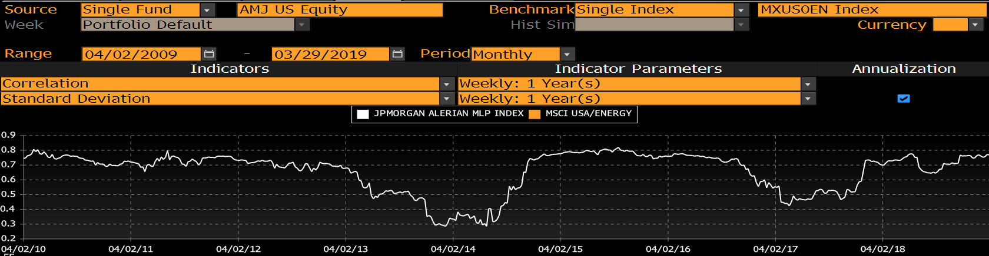
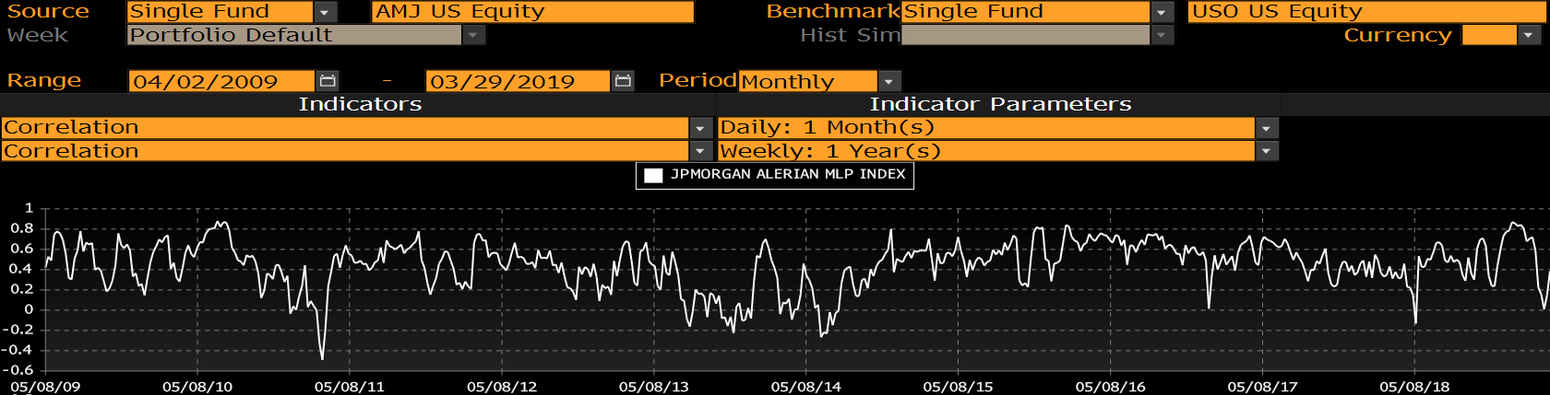
Avoiding an Energy Bet Looking Forward
  We are trying to avoid making an overweight bet on the energy sector
  Correlation of MLPs to the energy sector have creeped back up to around 80% and short term correlations to crude prices have risen as volatility spiked
  We were always aware of this overlap but invested more due to the “alternative” nature of the asset class (income opportunity, defensive properties during periods of rising rates and/or inflation)
  While MLP fundamentals have improved, macro uncertainty and oil prices will likely drive asset class returns moving forward and we expect this high correlation to continue
  Rolling Correlations: AMJ vs. MSCI US Energy Index
  Short Term Rolling Correlations: AMJ vs. Crude Oil Prices

