Slide 1
Recommending selling MMM
Very disappointing 1Q19 earnings, despite lowered expectations
While we had hoped for a recovery in 2019, this will most likely not materialize as the CEO reduced guidance once more
This quarter showed weakness across the board, destabilizing MMM investment thesis of being a diversified industrial player
MMM is embarking on a restructuring plan, which we think is a sign of struggle at this stage of the economic cycle
The litigation charges are not surprising but put some additional pressure on the story going forward

Slide 2
Is the investment thesis broken? Thesis point #1
Thesis #1: diversified industrial company offers various sources of revenue stream and thus some stability:
We are surprised by the extent of the revenue and earnings miss across segments at this point of the macro cycle
The management team admitted to operating deficiencies in responding to a slow down
Additional destocking possible: negative comments on inventory during the call:
Grainger and MSC Industrial Direct Co. have warned of moderating demand
Honeywell CEO is being more cautious in its guidance: “We don’t see any signs of problems, but we’re planning cautiously for the second half because short cycle can turn very, very quickly”
Meanwhile MMM is guiding to improvement in 2H

Slide 3
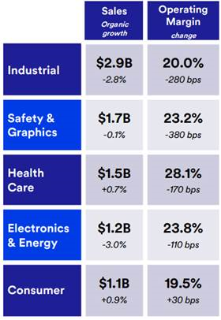

Slide 4
Thesis point #2
Thesis #2: Margin story from scale and international expansion:
Its operating margins contracted in every segments (ex-consumers that saw a 30bps expansion)
While margin contraction in itself is not a reason to sell a stock, we think the underlying reasons for it is more concerning
Delayed reaction to the slow down shows operating deficiencies
Restructuring as a solution to their problem?
2,000 jobs cut.
Cost-cutting action should generate $100 million in savings in 2H but likely won't be enough to stabilize total 2019 margins.
Could boosts margins in 2020 by 75-100 bps (BUT as part of their 200-300bps margin expansion plan highlighted in November, not in addition to it)
While the cost cutting is necessary when a business runs into setbacks, we are worried taking such actions in today’s macro environment (aka late cycle) could limit future levers in the event of a global recession near term

Slide 5
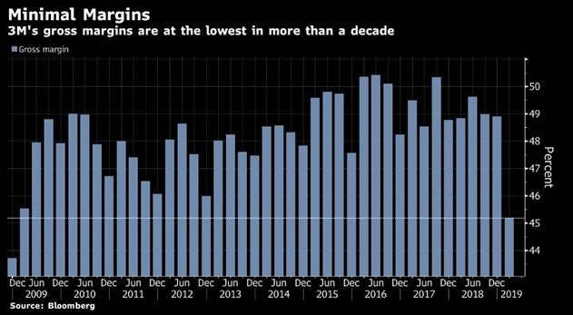

Slide 6
Thesis point #3
Thesis #3: high ROIC
ROIC guidance was cut from 22%-25% previously guided to 20%-22%
The new mid-point is below 2018 results of 22%

Slide 7
Thesis point #4
Thesis #4: good capital allocator
Liabilities are beginning to compound
Debt has been a key lever to EPS growth (through share buybacks) for a long time (~3% annually)
Cash flow concerns: FCF conversion reaffirmed but it’s on lower capex spend, which means underlying CFO is declining vs. prior expectations → this could constrain MMM capital deployment
Litigation risks: could pressure cash and constrain capital as well

Slide 8
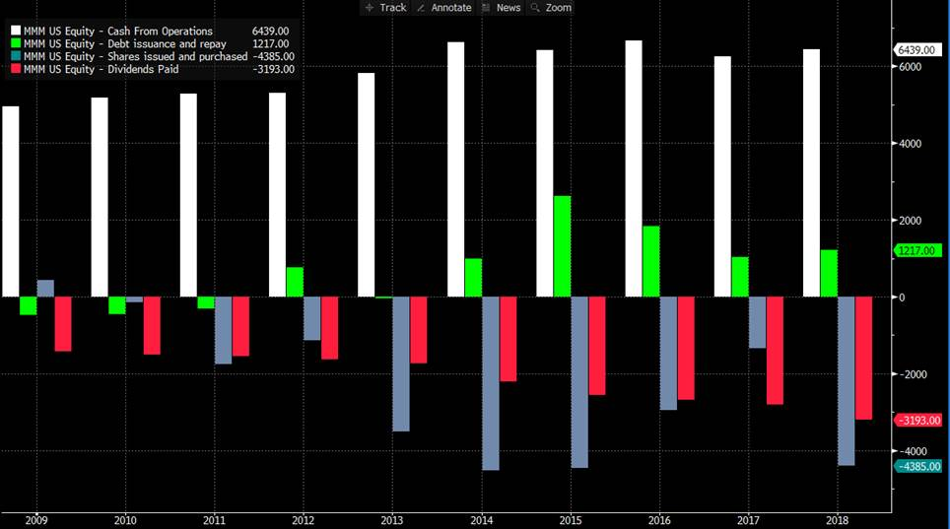

Slide 9
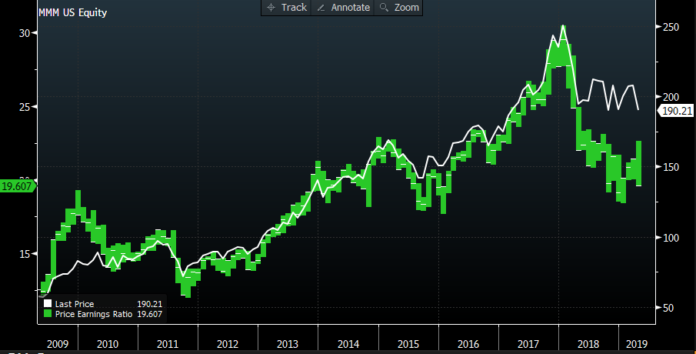
Valuation

