Slide 1
Exxon (XOM) Sell Thesis
Initial investment thesis is broken
Quality of returns put at risk by capital allocation decisions
No longer the industry leader
Defensive characteristics now uncertain
More broadly we see the traditional oil industry more at risks now vs. prior cycles due to a changing landscape:
Increase of electric vehicle penetration
Renewable energy becoming a better competitor to natural gas.
States mandating a % of energy coming from renewable sources

Slide 2
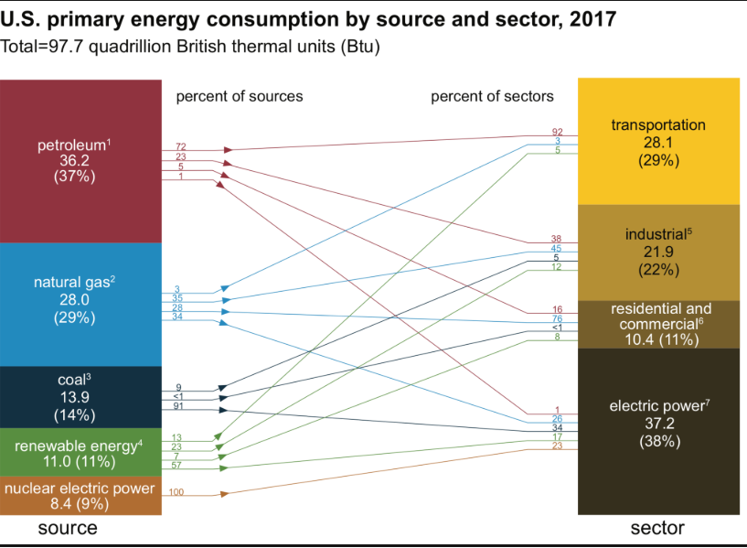
Oil and Natural Gas Use Per Sector

Slide 3
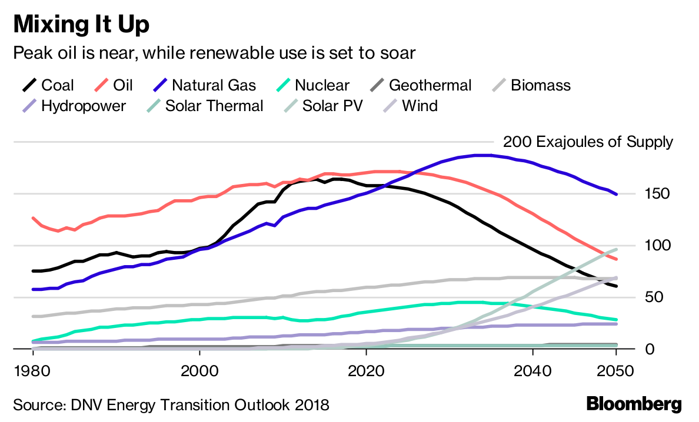

Slide 4
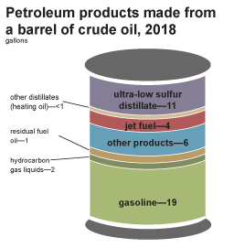
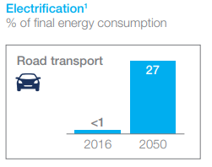
Electric Vehicles Impact on Oil
The impact of EV is twofold: less demand for oil, more demand for electricity (that can be satisfied by natural gas or renewable energy).
Less demand for oil: Electric vehicles (EV) could become less expensive than internal combustion engine vehicle in early to mid 2020.
In 2018, about 142.86 billion gallons (or about 3.40 billion barrels) of finished motor gasoline were consumed in the United States, a daily average of about 391.40 million gallons (or about 9.32 million barrels per day). The world crude oil production is currently about 82M barrels/day (or 1.56B gallons of gasoline).
If the trend line of EV sales holds globally, by 2025 EV adoption could represent 10-12% of vehicles sold, removing the demand for 30 million gallons of fuel/day globally (today the estimate is 2.6 millions gallons of gasoline per day displaced by EV, which is <1% of total gasoline consumption). That would represent a 2% drop in demand based on today’s demand.
More demand for electricity: As electric vehicles demand increases, the need for electric power increases.
EVs when plugged into the grid have a load characteristic that is similar to a new house popping up on the grid.
EVs today use a very small fraction of global electricity – estimated at 0.06%, but hypothetically if EVs were to be 30% of automobiles sold at some point in the 2030s, that figure would rise to about 4-5% of TWh of electricity produced (per Cowen)

Slide 6
Renewable Energy Impact on Natural Gas
Natural gas is a bridge between coal and renewable energy. It is not clean energy as it releases methane during its exploitation phase.
Renewable energy is becoming more cost efficient, which could put pressure on natural gas consumption.
The cost of utility-scale wind and solar, lithium-ion batteries, and LED lights has fallen at least 70% in the last ten years.
Bloomberg New Energy Finance says that wind and solar electricity will make up 50% of the world’s energy mix by 2050, as prices fall and storage capacity increases.
Natural gas can still be used to fill in when renewable production fluctuates. As a result, it is estimated that natural gas’ share of the global electricity supply falls from 21% today to 15% by 2050.
48% of the Fortune 500 and 63% of the Fortune 100 have promised to cut their greenhouse gases, increase their use of renewable energy or improve their energy efficiencies.

Slide 7
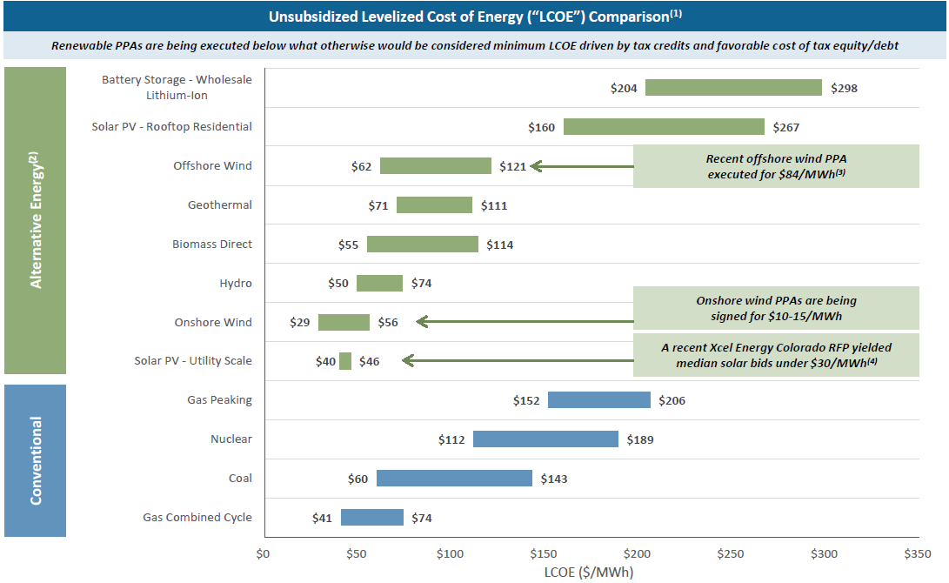

Slide 8
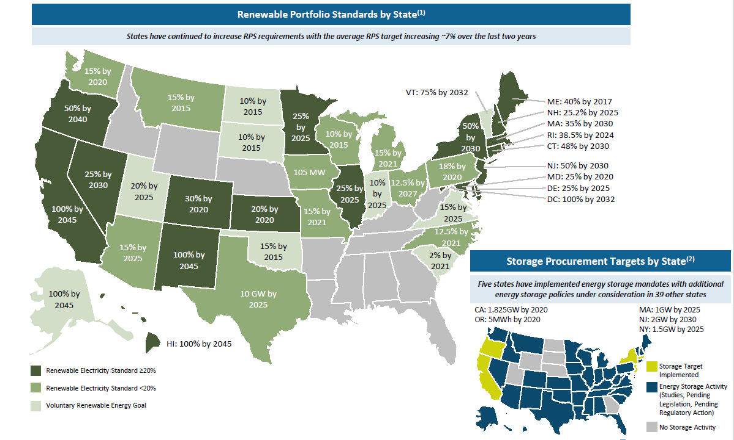

Slide 9
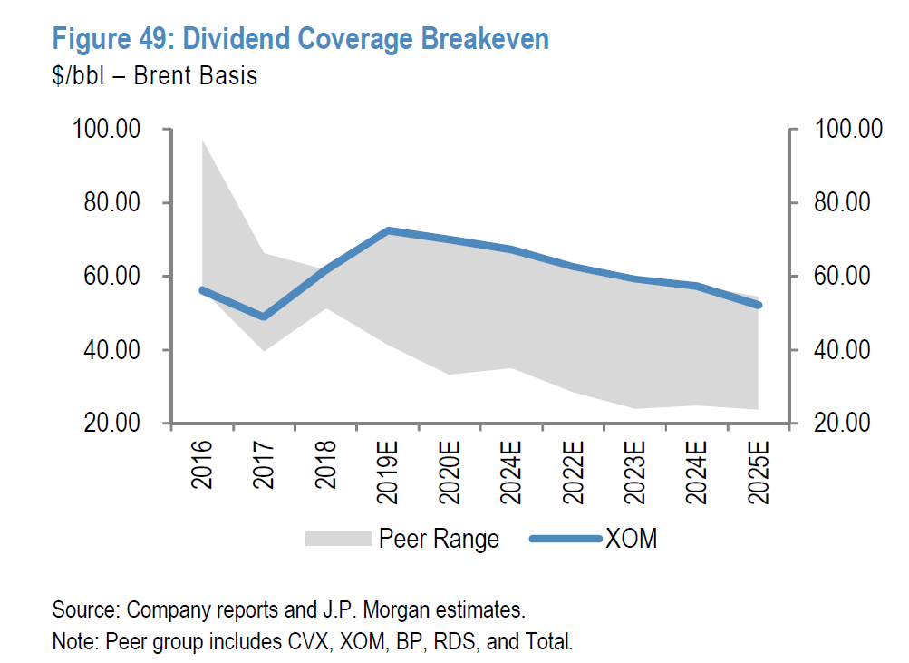
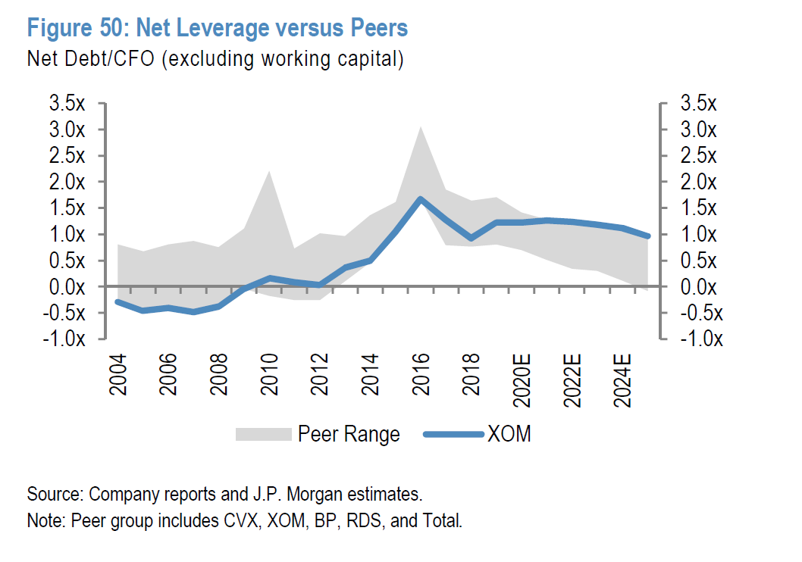
Thesis #1
Initial thesis #1: strong balance sheet means the company can be opportunistic in current environment to drive future growth and profitability (acquisitions, dividend increase, buybacks)
Exxon’s balance sheet used to be best in class but recently deteriorated.
Its leverage ratio is no longer best in class vs. peers.
The company is focusing on investing in growth projects, which means acquisitions and buybacks are not a priority.
Dividend coverage breakeven (looking at the Brent $/barrel) is also the highest vs. peers, which puts pressure on increasing dividends when oil price go down.

Slide 10
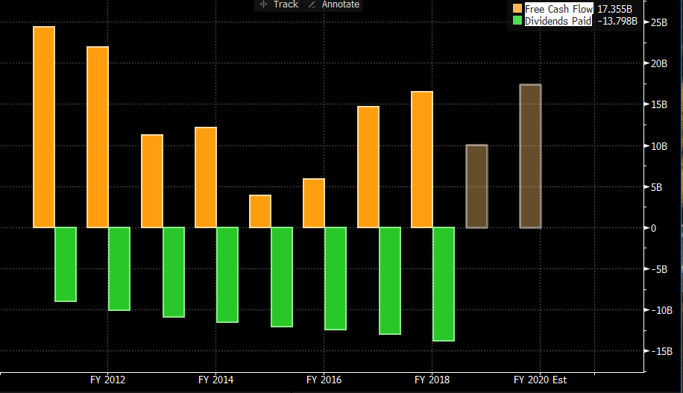
Exxon free cash flow not always covering dividend

Slide 11
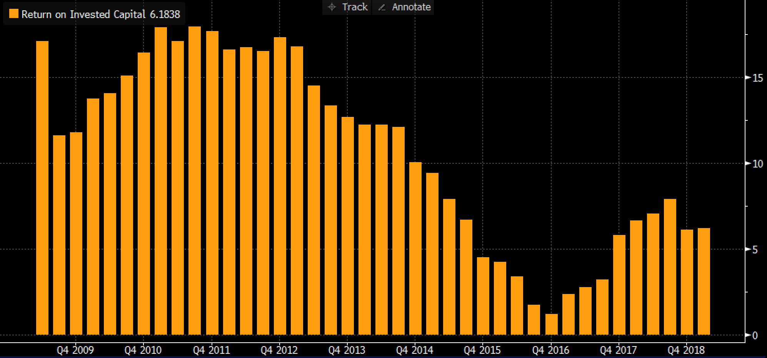
Thesis #2
Initial thesis #2: large "quality" business and industry leader = best balance sheet and return on capital in the industry due to low production costs and high operating efficiency
Free cash flow has deteriorated as the company is increasing capex to fund new growth projects.
Return on Invested Capital (ROIC) has declined with the company’s decline in net income

Slide 12
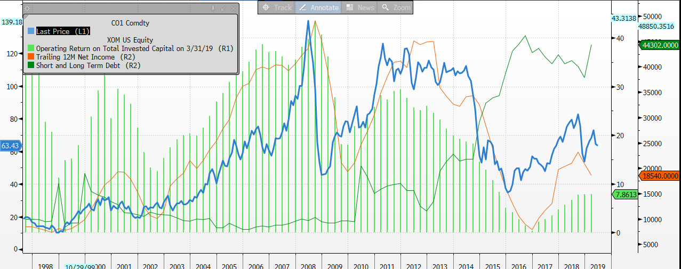

Slide 13
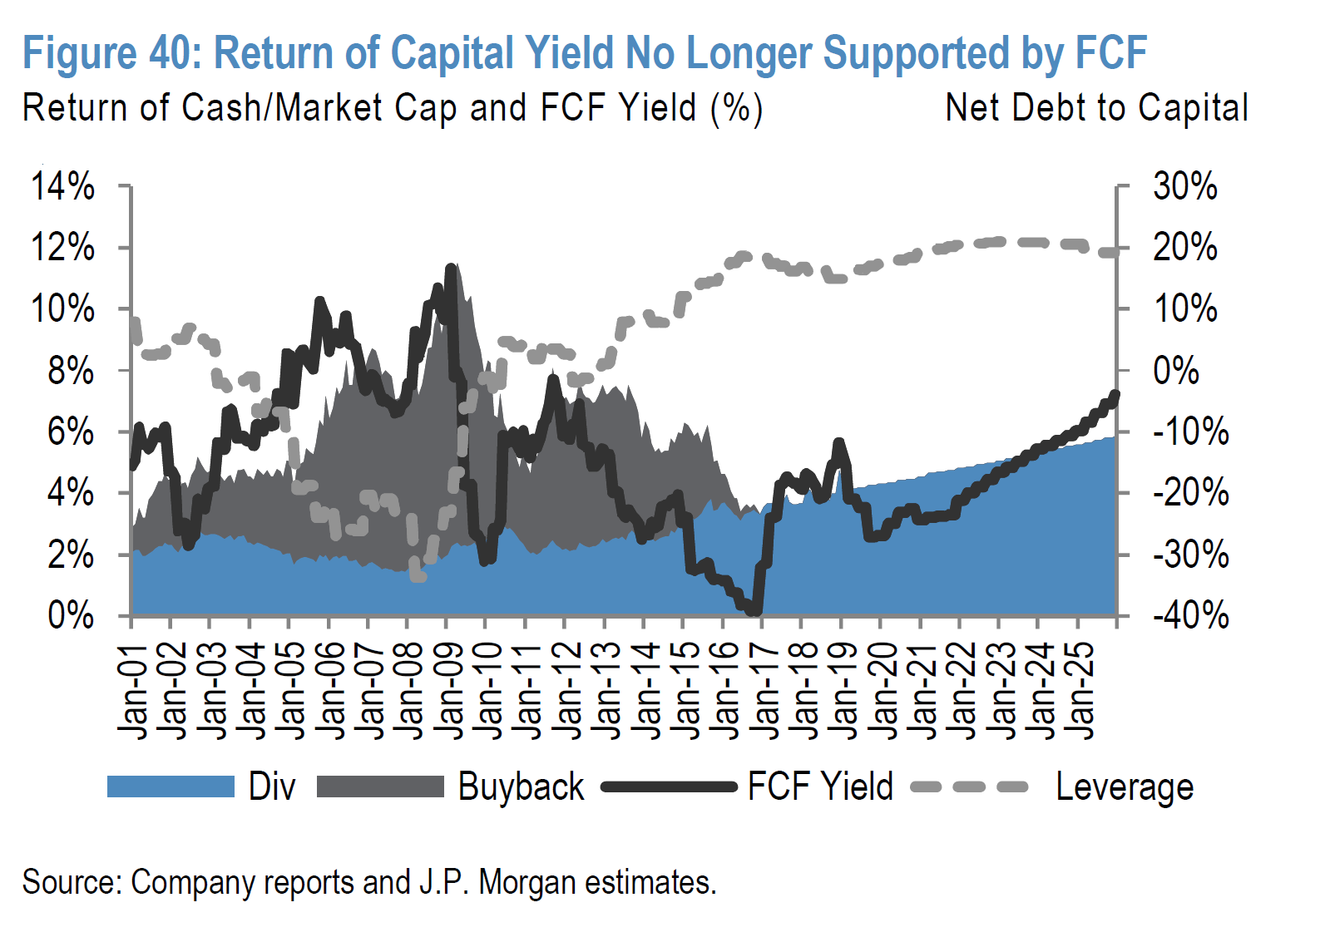

Slide 14
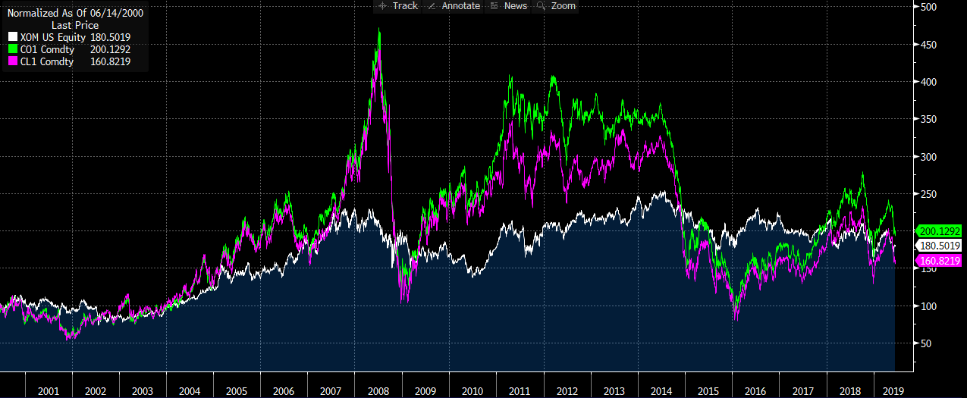
Thesis #3
Initial thesis #3: low "beta" name (less commodity sensitivity) to reduce volatility of our overall energy equity exposure yet still participate in higher commodity demand/prices over time
Price of oil is hard to predict. It poses some near-term risk when the company invests in long term growth projects, which we have experienced in the last couple of years with Exxon. We think the prior stability Exxon was providing to the portfolio might not hold true going forward as quality has deteriorated.

Slide 15
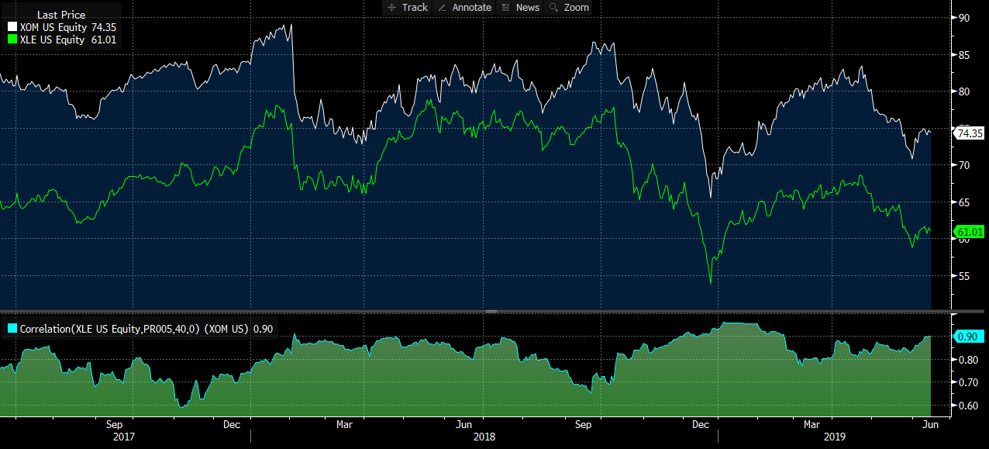
Last 2 years Exxon/energy sector correlation = 90%

Slide 16
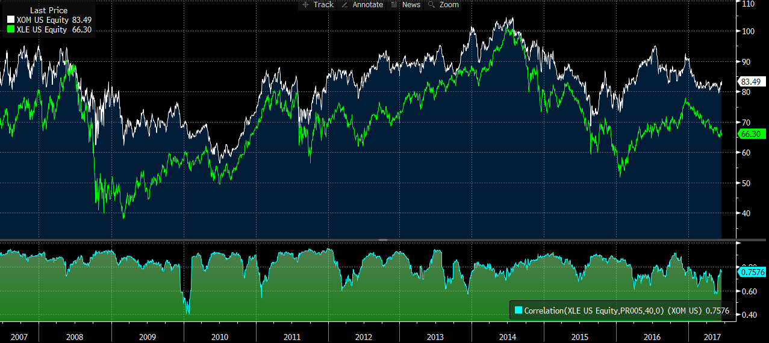
2007-2017 Exxon/energy sector correlation = 75%

Slide 17
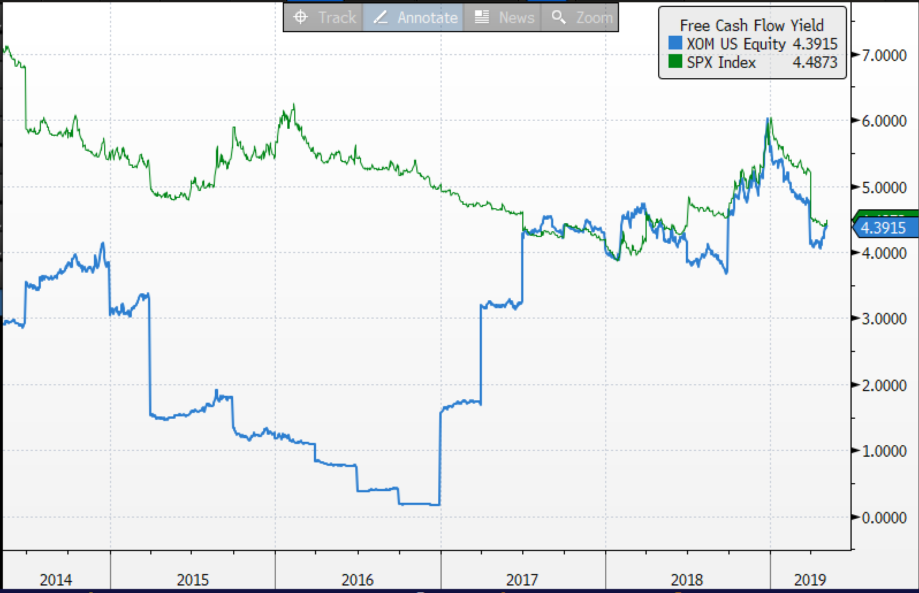
Valuation
On a relative basis, XOM is in line with the S&P 500, while offering more risks

Slide 18
