Slide 1
Union Pacific (UNP) Sell Thesis
Original Buy Thesis:
1. Pricing power: Railroads offer 4x the fuel efficiency of trucking per ton-mile of freight – a secular tailwind
2. History of compelling long term shareholder returns
3. Industry leading operating ratio and improving ROIC driving returns to shareholders via dividends/buybacks. Real shareholder yield of 6.5% (2.5% dividend yield, 4% buyback)

Slide 2
Thesis Point #1: pricing power at risk
Volumes down this year:
Drop in industrial equipment imports (correlates with carloads volume)
Tariffs impact on volumes could have been hidden by last quarter’s weather issues, meaning the recovery we are expecting might not happen
Falling frac sand demand: data points from producers imply Permian basin demand of Northern White frac sand continued decelerating. UNP has the most exposure to the region as local sand hauled shorter distances by truck gains share
Coal continues its decline
Forest products declining
Intermodal looks down ~10% this quarter
Transportation by truck is taking share from rail:
Truckers have been lowering prices since the beginning of 2019, increasing the appeal to switch to trucking (historically rail has been cheaper than truck)
Capacity constraints is still there in trucking but it’s getting better: regulation is getting looser, alleviating the drivers shortage
Longer term: port of Wilmington expansion – The project will nearly double the size of the existing port (2021 completion) and build a new 1.2M TEU terminal (2023 completion). This follows news from last week that the Port of Virginia increased capacity by 30%. Also recent port data has indicated that the East Coast ports have been taking share from ports on the West Coast. This shift has the potential to drive incremental demand for intermodal service at CSX and NSC (East US) at the expense of UNP and BNSF (West US)

Slide 3
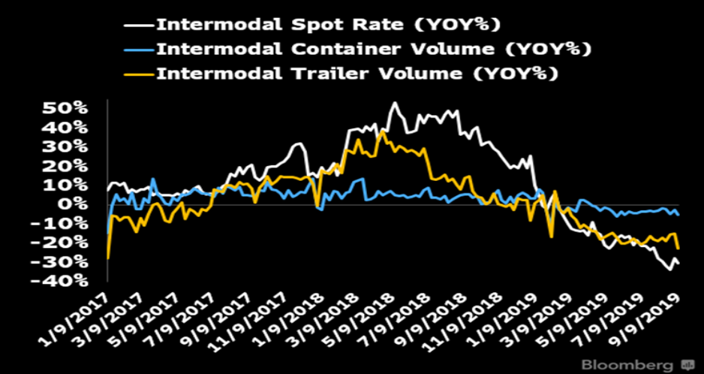
Intermodal trends
Reasons for the weakness include:
Looser trucking capacity
Service cuts from the implementation of PSR
Softening imports (trade?)
Severe flooding in 1H in the Midwest

Slide 4
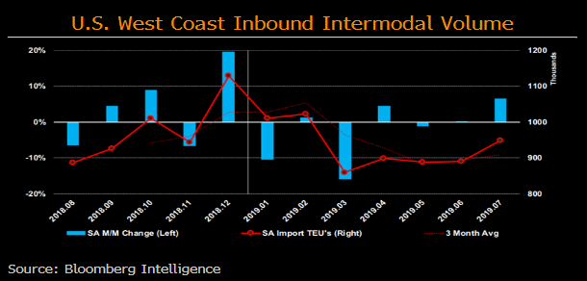
West Coast Ports
Imported containers into L.A. and Long Beach, CA which comprises 35% of US imports and 77% of West Coast volume are down 2.8% in 2019 through August (Bloomberg)
International accounts for 44% of UNP’s intermodal volume.

Slide 5
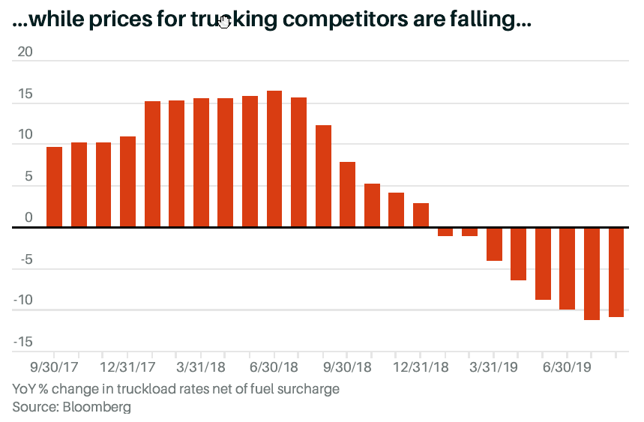
This year, spot truck rates are down as much as 20%
This could increase competition of the alternative way of moving goods that historically proved to be more expensive than rail.
Rails had increased prices recently, following the trucking industry trend.

Slide 6
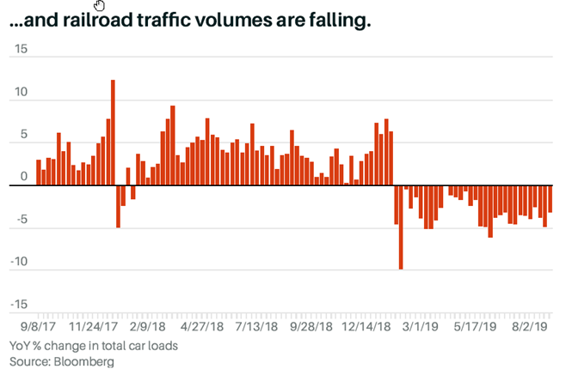
Rails volume trend

Slide 7
Expectations are high for UNP
Expectations are high for UNP following its precision railroading implementation.
Consensus has a 4% revenue growth in 2020 and 280 bps FCF margin improvement.
If volume continues to drop, we think it will be difficult for them to keep their operating ratio guidance.

Slide 8
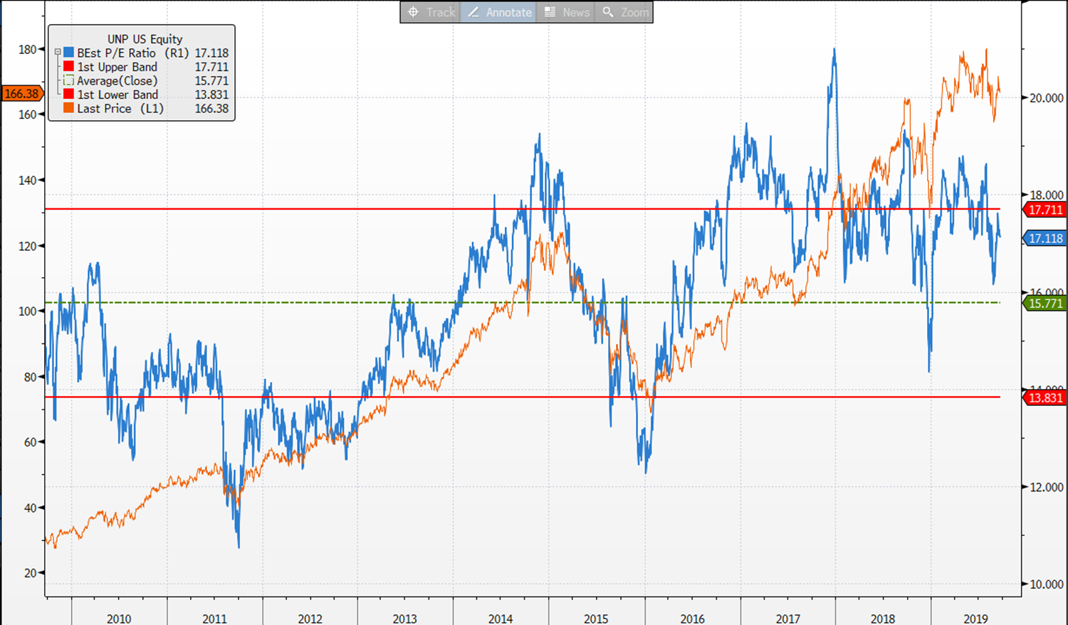
UNP valuation chart
We bought UNP in November 2015

