Slide 1
October 2019 Trade: adding to STZ

Slide 2
Adding to Constellation Brands (STZ)
Based on recent valuation, we are adding 60bps to STZ from cash
Stock recently pulled back but investment thesis is not broken, we see opportunity for upside:
Corona Seltzer launch next Spring could be a good growth opportunity
Divestiture of lower priced wine & spirit brands will help STZ focus on core 10 power brands going forward
Change of chairman and CEO at Canopy Growth (Cannabis acquisition) shows desire to refocus company on profitability

Slide 3
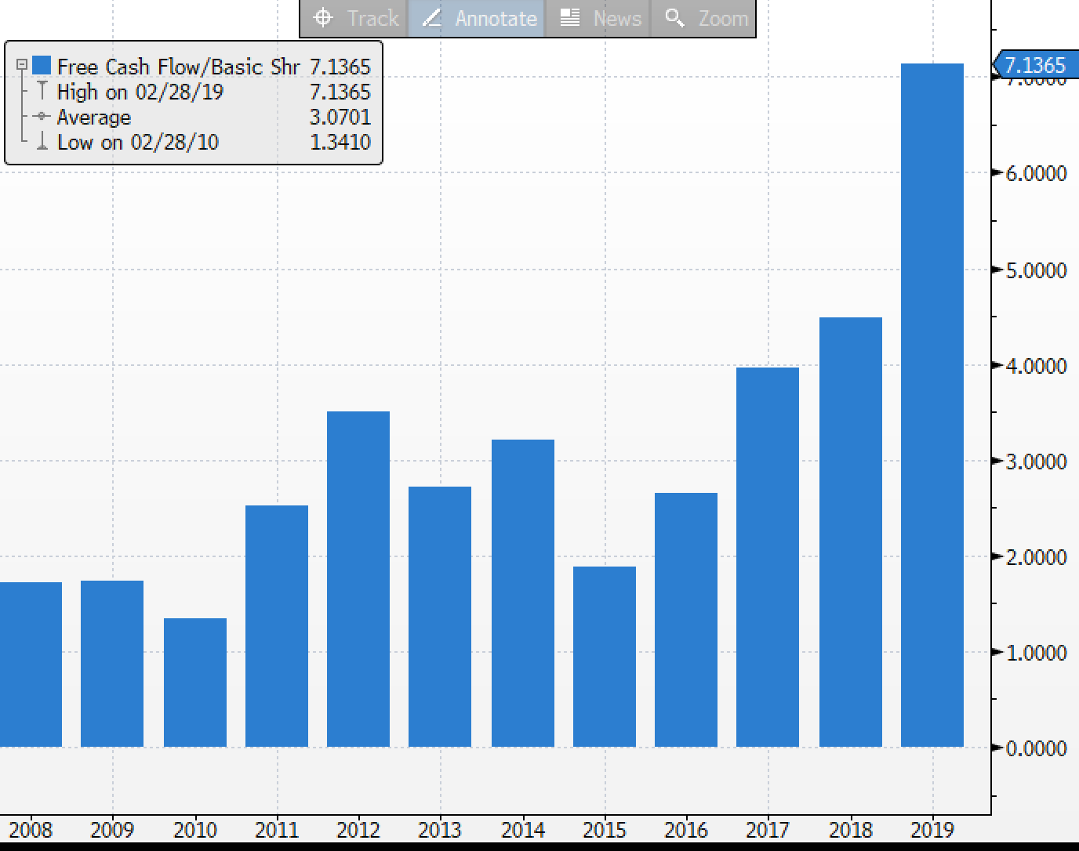
Valuation
Price target of $226
Valuation still attractive, FCF keeps growing

