Slide 1


January, 2020
2019 performance review

Slide 2
Outlook 2020
Fundamentals are sound but risks are rising
U.S. economic growth expected to continue in 2020
We expect GDP growth to continue in 2020, trending near 2.0% YoY.
U.S. consumer is still robust, as the U.S. continues to experience declining unemployment, higher wages, increased consumer spending, and a steadily growing housing market.
Consensus revenue growth estimate for the S&P 500 is 5.4% for 2020. Estimate for earnings growth is 9.6%, but we expect some headwinds from tariffs and higher wages. U.S. equity valuations are modestly above average.
Tariffs and policy uncertainty at the forefront of U.S. concerns
Even though trade tensions have cooled, we expect tariffs currently in place to have modest negative effect on U.S. GDP growth of -.50 to -.75.
The continued grounding of Boeing’s 737 Max airplane has the potential to slow U.S. exports (-7.5%) and GDP (-.25 to -.40).
International markets are spotty as global growth slows
For 2020, the International Monetary Fund is forecasting modest global growth at 3.6%, with only 1.7% growth in developed countries.
Growth in Europe is slowing with weakness in the industrial sector, especially in Germany. Geopolitical uncertainty remains high in Italy and Britain.
Global risks remain but have shifted
Geopolitical tensions are high given a rise in populism, Middle East tensions and voter unrest.
China’s slowing economy and high debt remain a concern given authorities’ efforts to constrain credit growth.
Most government bond yields in Europe and Japan are negative which shows investors’ concern of slowing GDP growth. This indicates that monetary policy will be less effective in stimulating economic growth.
Information is current and believed to be accurate as of 12/31/2019

Slide 3
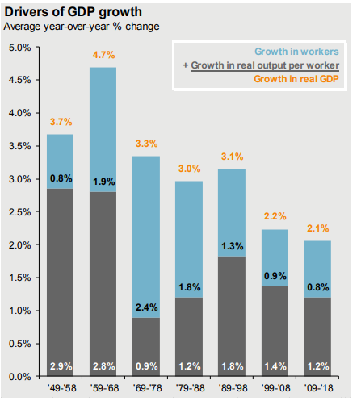
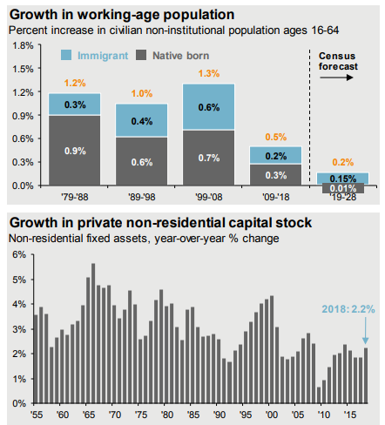
GDP trend growth

Slide 4
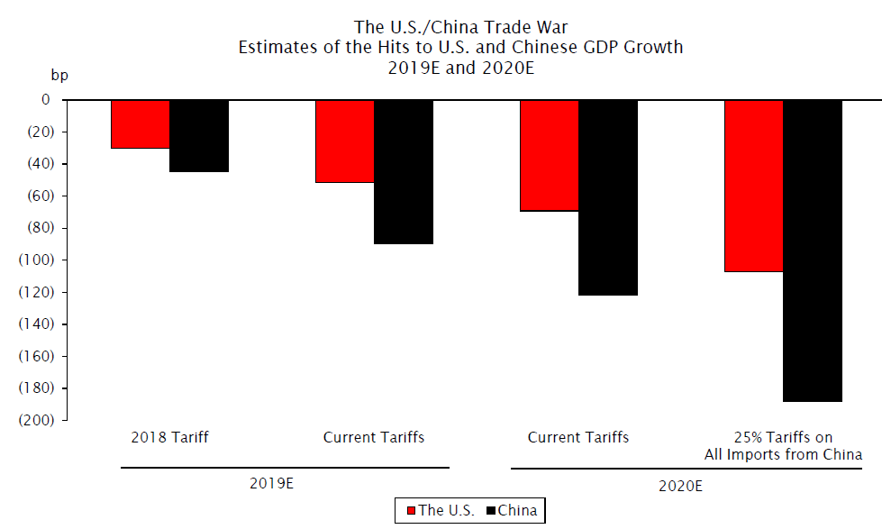
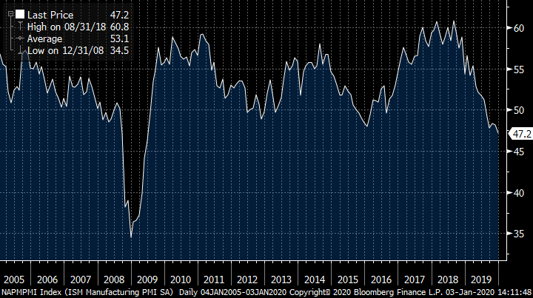
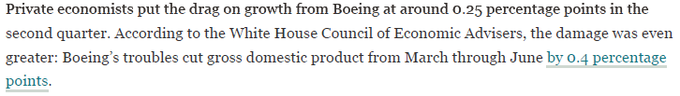
Economic Concerns
Tariffs, manufacturing and Boeing

Slide 5
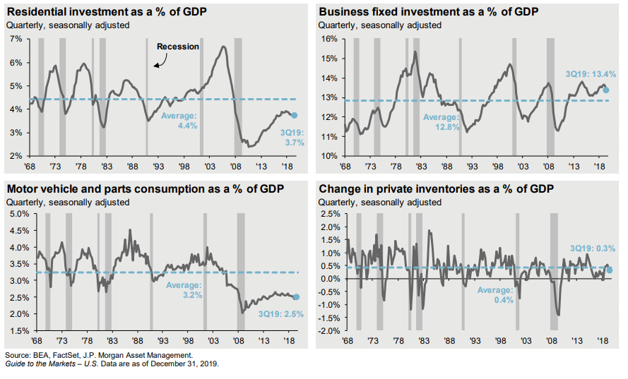
Any slowdown will be milder than 2008
Few excesses

Slide 6
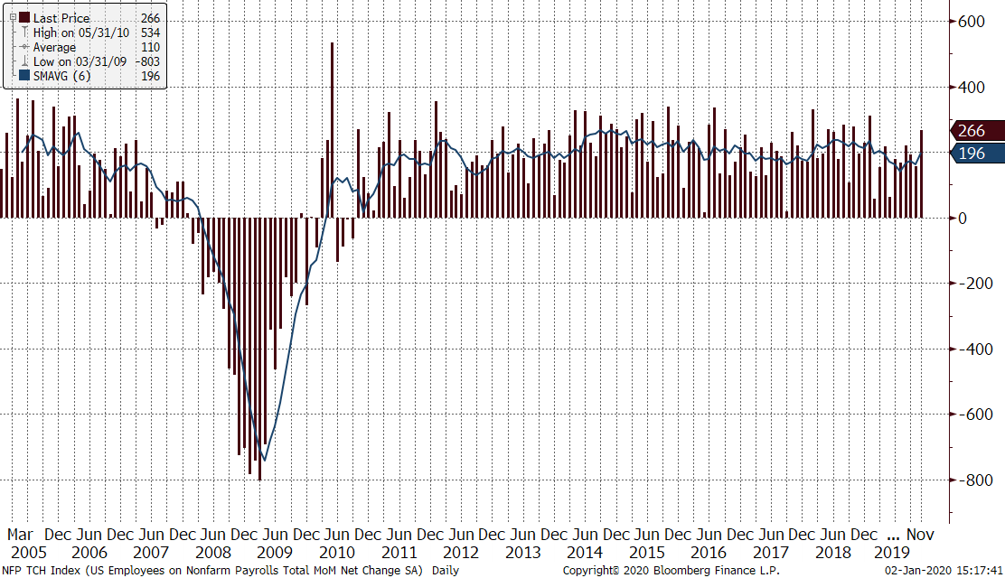
Payrolls remain strong

Slide 7
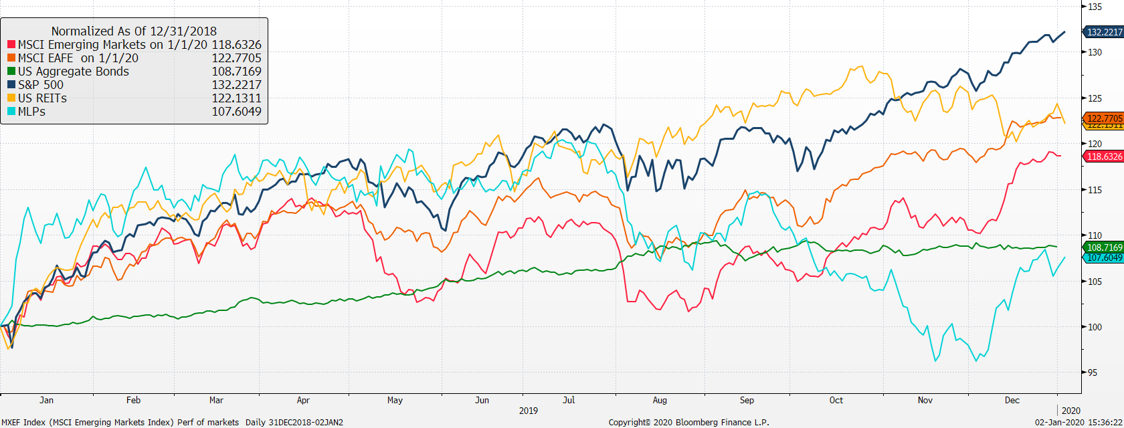
Return of Market Indices
Up 32.2%, US Stocks have led returns, yet again.
Up 8.7, bonds have been impressive. Maintaining a diversified portfolio of assets should help to mitigate overall volatility with the intention of providing strong risk-adjusted returns over time.
US stocks continue to outperform international stocks.
Source: Bloomberg. EAFE is MSCI EAFE Index, Emerging Markets is MSCI Emerging Markets and U.S. Bonds is Barclays U.S. Aggregate. REITs is the DJ US Select Real Estate Securities Index. MLPs is Alerian MLP Index. The above information is through 6/30/2018. See last page for important information.

Slide 8
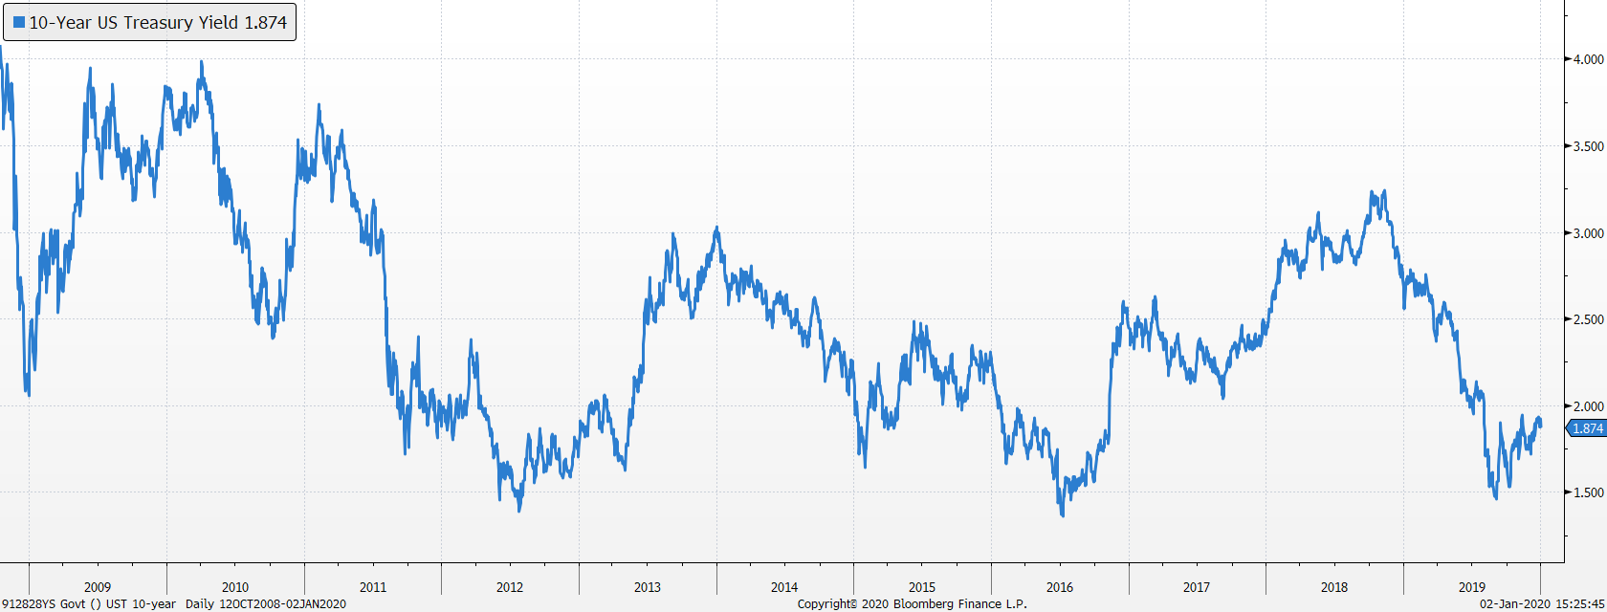
Bond markets
US Treasury 10-Year Yield
Yields have collapsed over the past year with the 10-year yield cut in half 3.15% to 1.51% before ending at 1.87%.
Our bond duration is 4.5 years

Slide 9
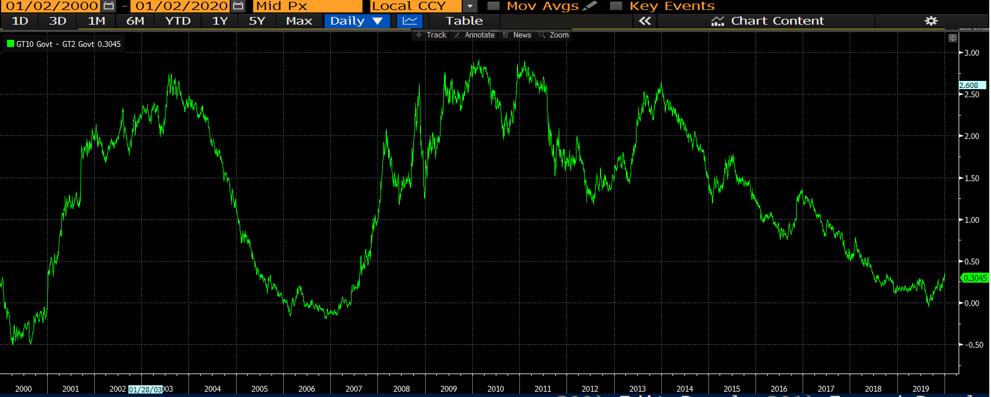
Bond market spreads (10y-2y)
Late cycle
Spread Between 10-Year Treasury Yield and 2-Year Treasury Yield
Recession less likely?

Slide 10
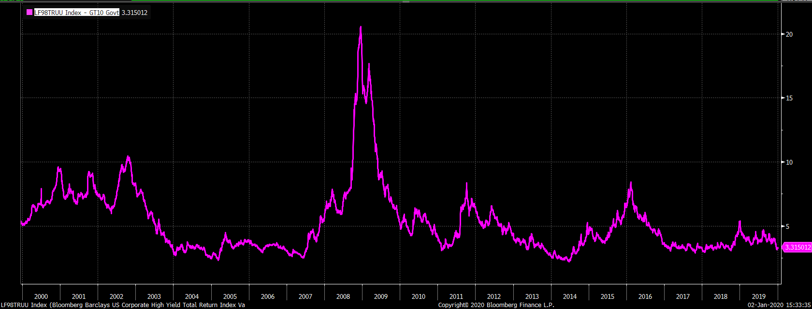
High Yield Spreads
Indicator of fear in the bond market
Spread Between High Yield Corporate bonds and Intermediate Treasury Yield
Spreads have fallen since yearend
4% high yield spread is about normal

Slide 11
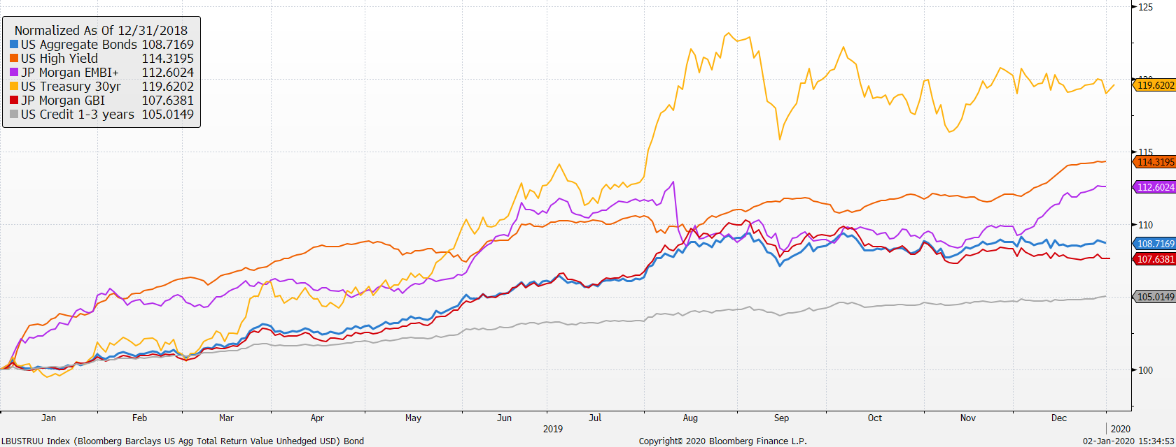
Market Returns
Performance of bond markets
2019 was a great year for fixed income

Slide 12
Performance - Active Bond funds v AGG
Mix has added value especially when rates rise
Since 2015 performance of active bond managers verses Bloomberg Barclay’s US Aggregate Bond Index

Slide 13
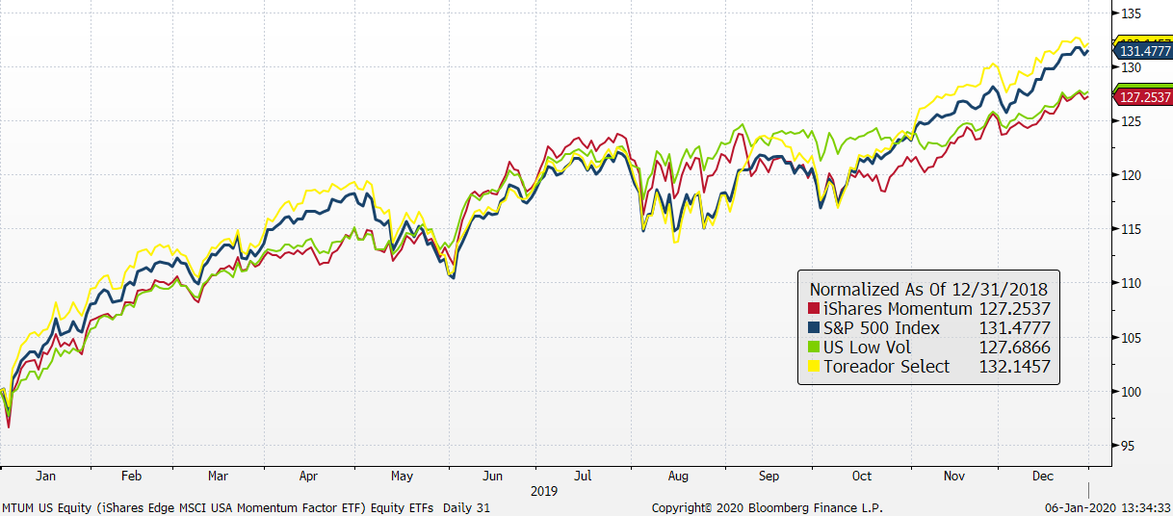
U.S. stock market ETFs
Low Volatility has held up well, while momentum has lagged
Source: Factset

Slide 14
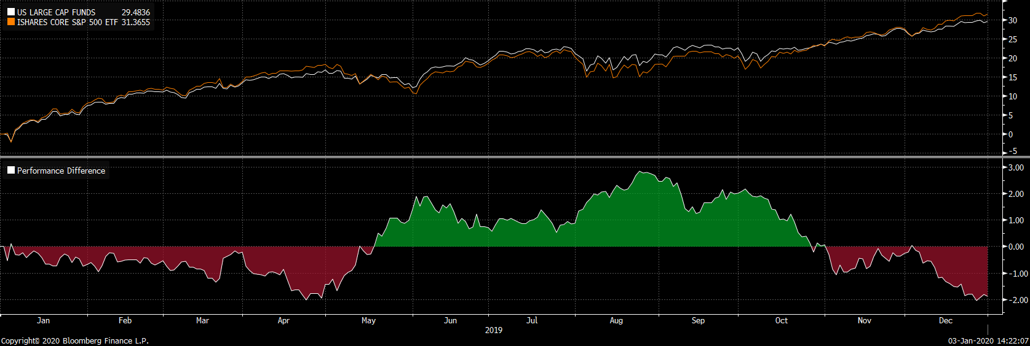
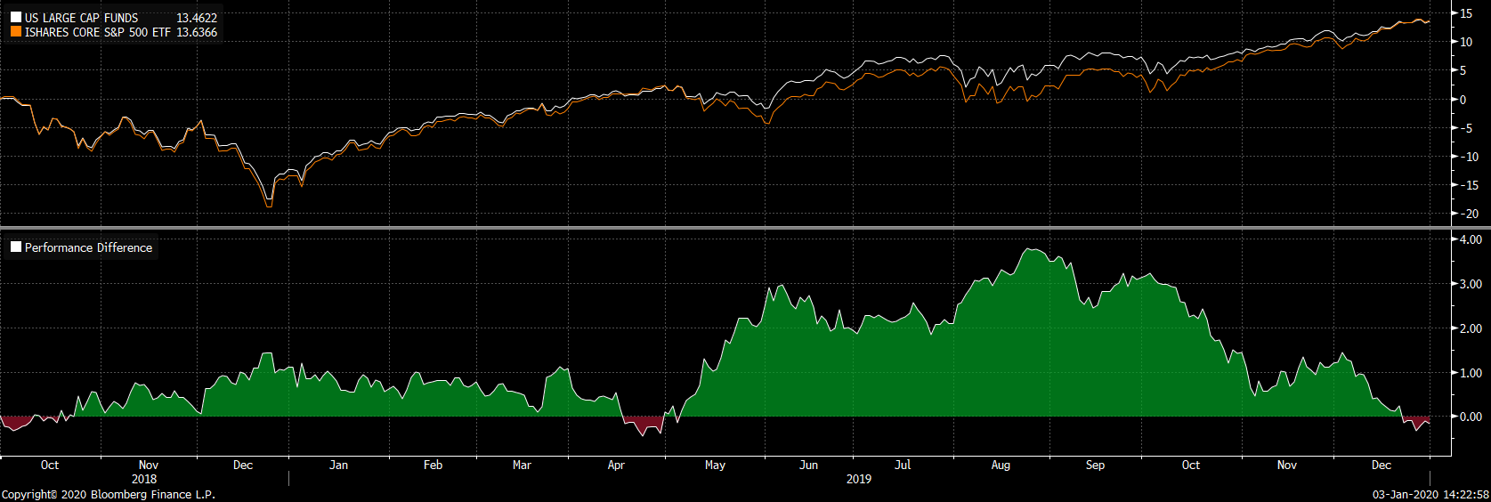
Performance: Stock Funds v IVV
Funds have added value even in strong market
YTD performance of active stock managers verses IVV ETF
Since 9/2018, performance of active stock managers verses IVV ETF

Slide 15
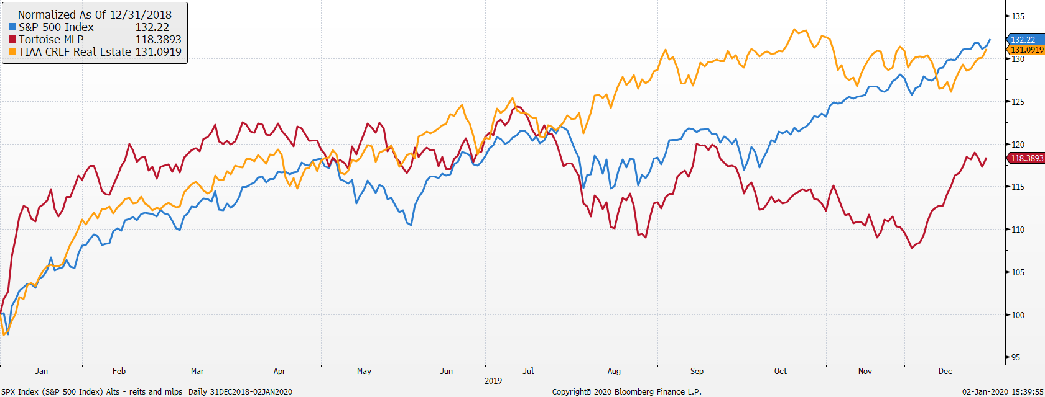
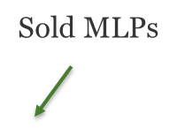
REITs are holding their own

Slide 16
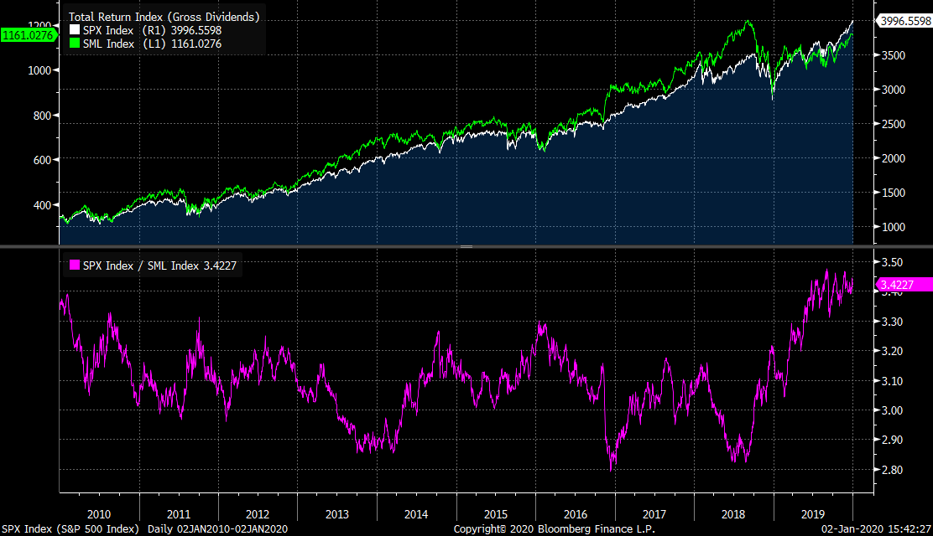
Small cap stocks have held up relative to large cap

Slide 17
Vehicle performance as of 12/31/19

Slide 18
Growth model changes
Portfolio changes 2019
2/22 reduced short term bonds, international developed equities and increased core bonds, US large cap and EM stocks
4/30 sold Tortoise MLP fund and added to US large cap
5/14 Increased US small cap from US large cap
11/4 Increased US small cap from US large cap
Portfolio changes 2018
1/30 reduced bonds, US large cap, increased international stocks, MLPs and Market Neutral
9/28 Changed US large cap vehicles
  70% IVV 40% TOSZX
  10% SPHQ 40% USMV
  10% USMV 20% MTUM
  10% IWF
9/28 Replace IEFA with JPIN
11/28 Sold QMNIX to IGSB
12/11 Added 2% to Real Estate

Slide 19
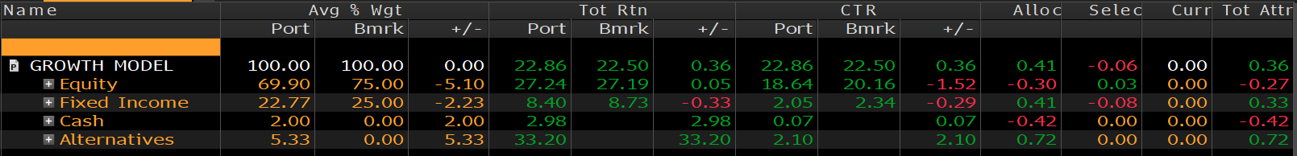
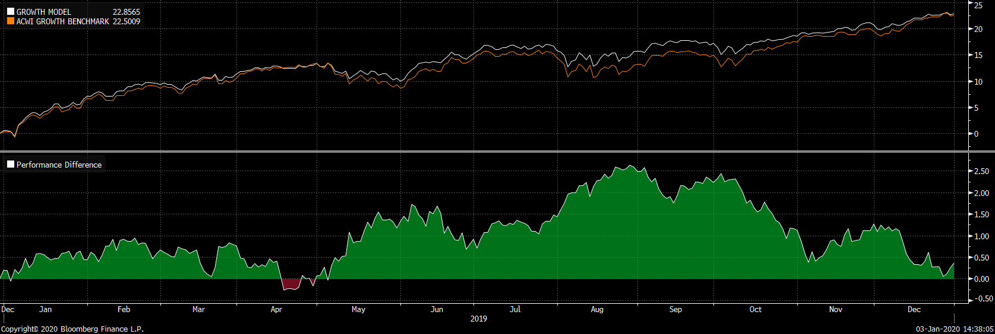
Growth Model attribution
Relative to 75% ACWI & 25% US Aggregate
Performance 2019
Performance Past Year
Alts added value
Cash dragged down returns

Slide 20
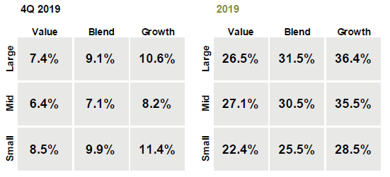
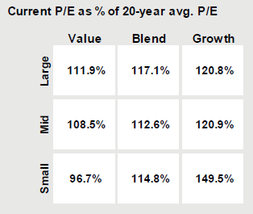
S&P 500 – What happened during Q4 & 2019
The S&P 500 was up 9.1% in Q4 and 31.5% in 2019
  Growth went back to outperforming Value in Q4.
  Current P/E multiples across almost all styles are at a premium to long-term average.
  In Q4 we made the following changes to the portfolio: added to Constellation Brands and Cisco.

Slide 21
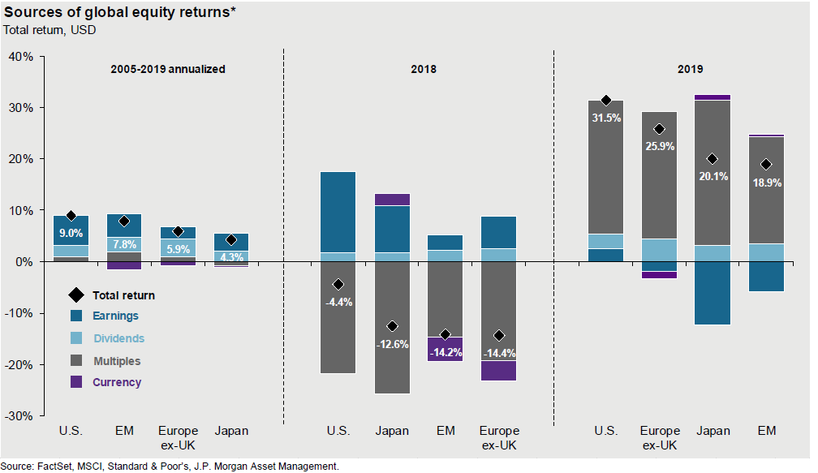
Sources of Global Equity Returns

Slide 22
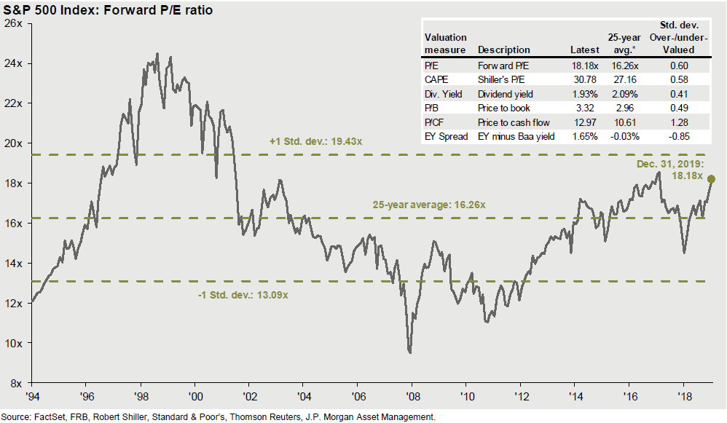
S&P 500 Forward P/E Ratio

Slide 23
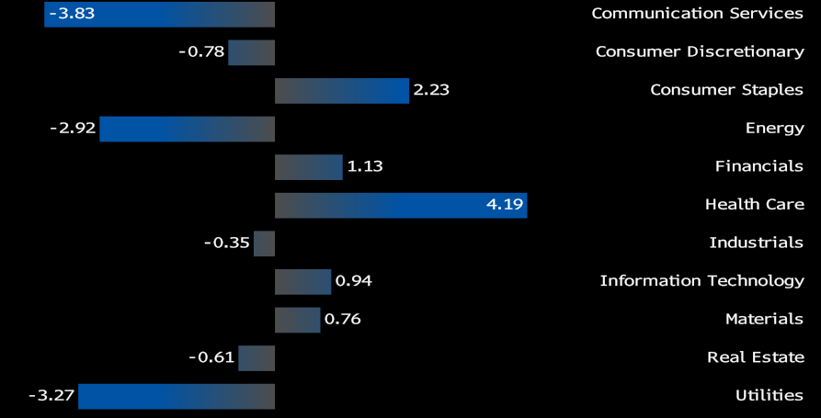
Focus Equity Sector Weights vs. SP500

Slide 24
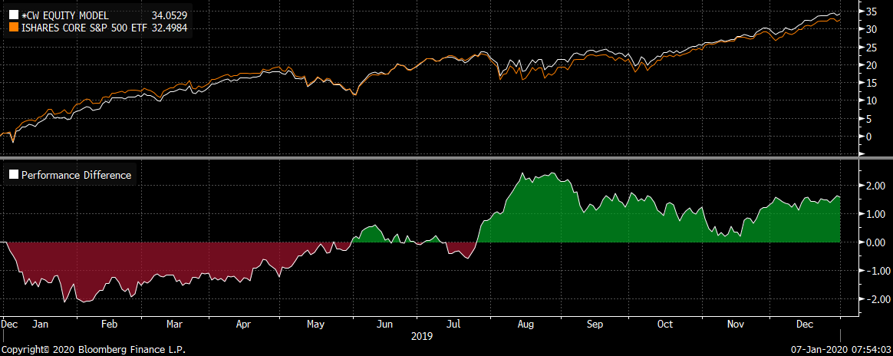
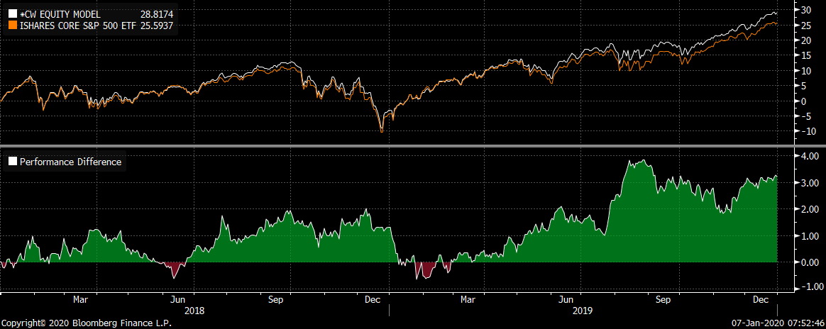
Focus Model versus S&P 500 ETF
For 2019, +1.55% over S&P 500
For past two years, +3.27% over S&P 500

Slide 25
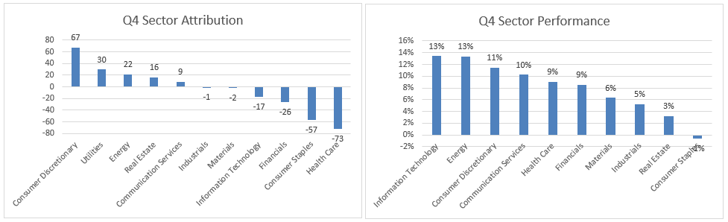
Q4 2019 Focus Equity Sector Attribution
In Q4 Focus Equity performed in-line with the S&P 500.

Slide 26
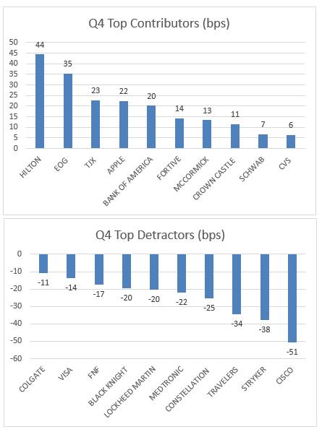
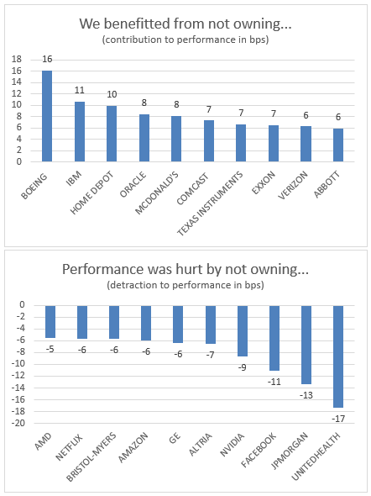
Q4 2019 Contributors & Detractors

Slide 27
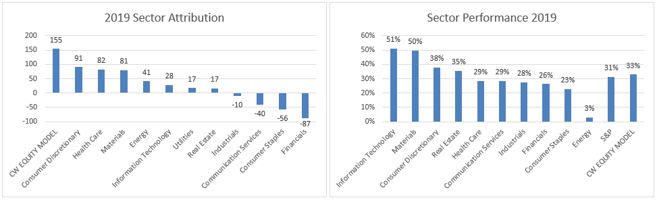
2019 Focus Equity Sector Attribution
After a strong Q4, led by Consumer Discretionary, Utilities and Energy, we ended the year ahead of the S&P by 155bps.

Slide 28
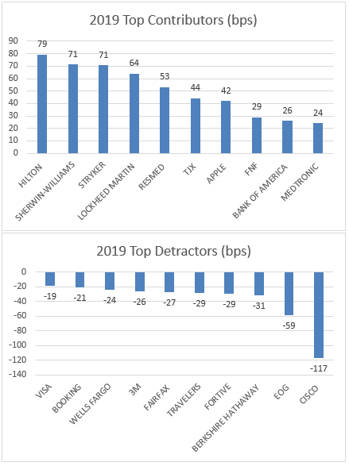
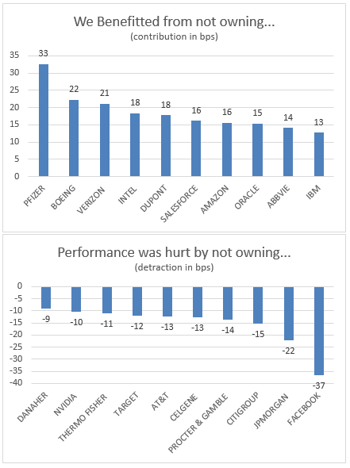
2019 Contributors and Detractors

Slide 29
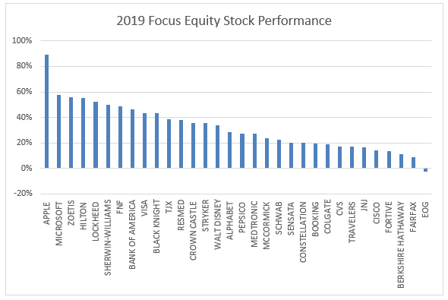
Focus Equity 2019 Individual Stock Performance

