Slide 1
February 2020
Xylem

Slide 2
Xylem |ˈzīləm|
1) The tissue in plants that brings water upward from the roots;
2) a leading global water technology company.

Slide 3
Investment thesis
Xylem has strong sustainable secular growth drivers in a fragmented industry:
Access to clean water is a necessity
Population growth & urbanization
Aging infrastructure
More defensive sales base thanks to:
50% of sales to utility sector
sticky client base due to high switching costs
high level of replacement parts demand
Long-term contracts with ½ of the revenue base recurring
Margin expansion overtime from productivity efforts
M&A strategy has increased their scope in the water cycle
Valuation is attractive today

Slide 4
Industry overview
Total addressable market size to be approximately $560 billion – XYL is serving $61B currently.
Wastewater transportation is a fragmented sector.
Demand for fresh water is rising rapidly due to:
population growth
industrial expansion
increased agricultural development
Water consumption estimated to double every 20 years.
By 2025, more than 30% of the world’s population is expected to live in areas without adequate water supply.
Existing water supply infrastructure is aging and often inefficient: ~1 out of 6 gallons of treated water is lost prior to reaching the end customer → loss of revenue for utility companies.
“Non-revenue" water is a major financial challenge for many utilities globally.

Slide 5
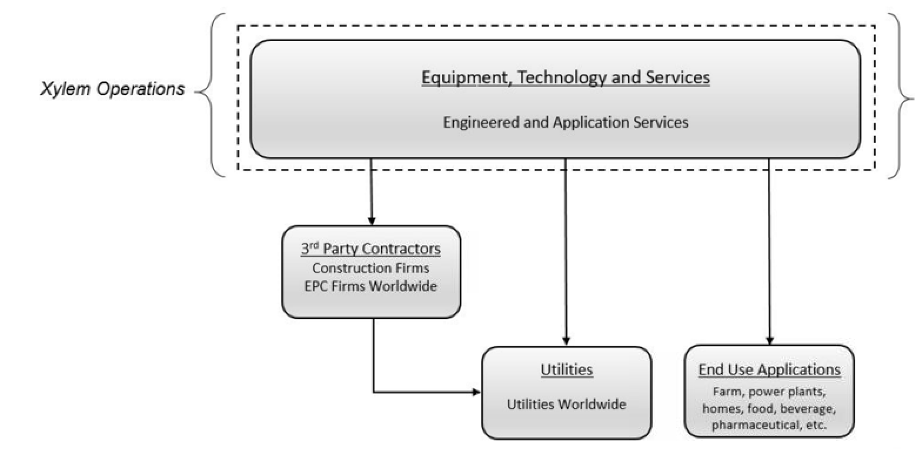
Water industry supply chain

Slide 6
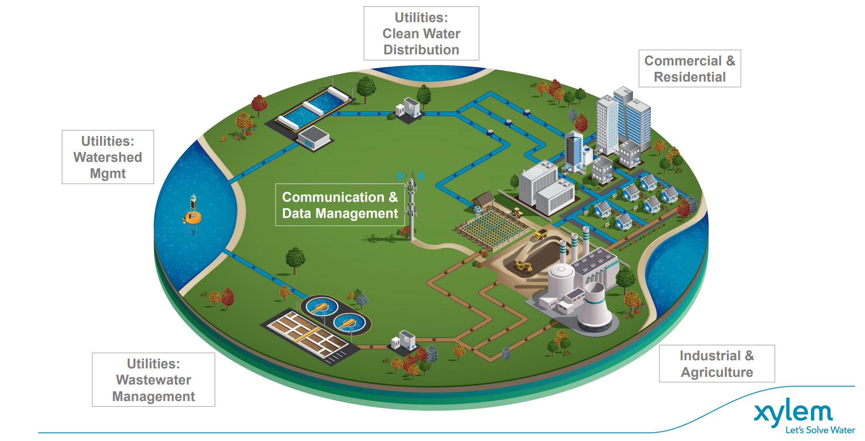
Water cycle

Slide 7
Company description
Xylem is a $11B market cap company, $5B in revenue in 2019.
Its products and services move, treat, analyze, monitor and return water to the environment. Also offers a portfolio of smart metering, network technologies and advanced analytics solutions for water, electric and gas utilities.
Clients are public utilities, industrial, residential and commercial buildings.
½ of its revenue is recurring.
Large portion of sales are driven by aftermarket service & replacement parts.
Over 2,000 patents protecting its intangible assets.
Sticky client base due to high switching costs.
Xylem’s continuous innovation and strong reputation for quality helped the company gain market share in the past years.

Slide 8
Revenue breakdown: geography & end markets

Slide 9
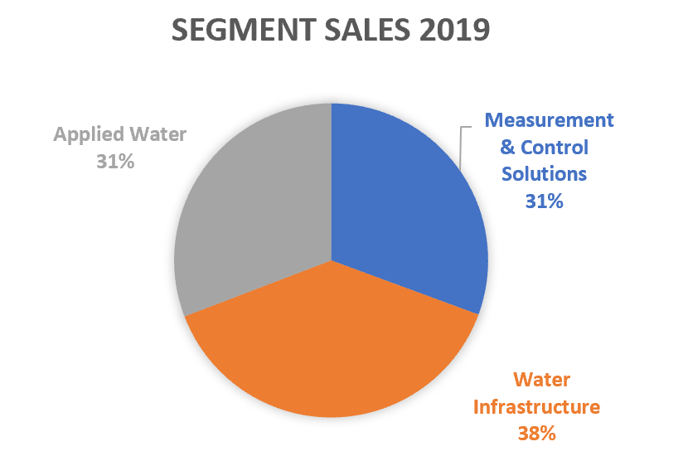
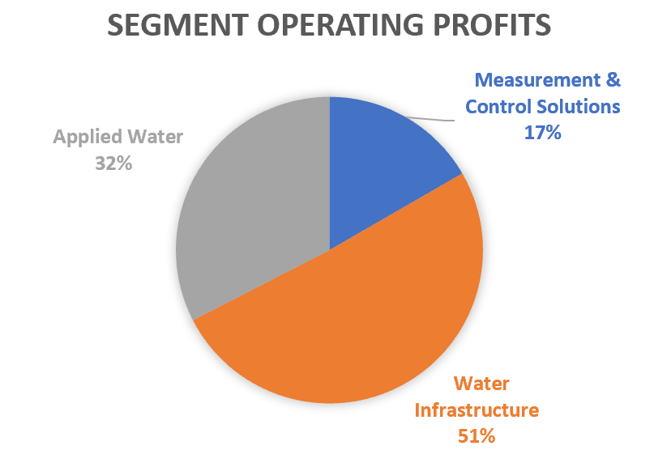
Segments overview

Slide 10
Water Infrastructure
3-4% top line growth
Utilities and Industrial end markets
Direct channel sale
Served market size of $18B
Drivers to growth:
(i) the increase in both the type and amount of contaminants found in the water supply
(ii) increasing environmental regulations
(iii) the need to increase system efficiencies to optimize energy and other operational costs
(iv) the retirement of an aging water industry workforce that has not been systematically renewed at utilities and other end user customers
(v) the build-out of water infrastructure in the emerging markets
Transport & treatment of water: collects water from a source, treats it and distributes it to users, and then treats and returns the wastewater responsibly to the environment
Products offered: pumps, filtration, disinfection and biological treatment equipment, mobile dewatering equipment (sale and rental)

Slide 11
Applied Water
2-3% sales growth
Residential, commercial and industrial end markets
Specialized distribution partners as end markets vary widely
Served market size of $19B
Drivers to growth:
Population growth
urbanization
regulatory requirements
Water pressure boosting systems for heating, ventilation and air conditioning, and for fire protection systems to the residential and commercial building services markets
Pumps, heat exchangers and controls provide cooling to power plants and manufacturing facilities, circulation for food and beverage processing, as well as boosting systems for agricultural irrigation

Slide 12
Measurement & Control Solutions
6-7% top line growth
Utility infrastructure and services end markets
Sale through distributors in the US and direct sales in emerging markets
Served market size of $24B
Drivers to growth:
Increasing regulation
Aging infrastructure
Worldwide movement towards smart grid implementation
Water scarcity and conservation
Need to prevent revenue loss (via inaccurate meter readings, leaks or theft)
XYL offers software and services including cloud-based analytics, remote monitoring and data management, leak detection, condition assessment, asset management and pressure monitoring solutions
Smart meters, network communication devices, data analytics, test equipment, sensors, software and critical infrastructure services
High switching costs for customers: clients often sign long-term contracts (up to 15-20 years), which consist of equipment purchases in the first few years, followed by a subscription fee during the latter part of the contract

Slide 13
Customer base
Water and wastewater utilities that supply, treat and monitor clean water or
transport, treat and analyze wastewater or storm water through an infrastructure network
Engineering, procurement and construction (EPC) firms and third party contractors, which work with utilities to design and build water and wastewater infrastructure networks
Farms
mines
power plants
Industrial facilities (such as food and beverage and pharmaceutical manufacturers)
Residential and commercial customers

Slide 14
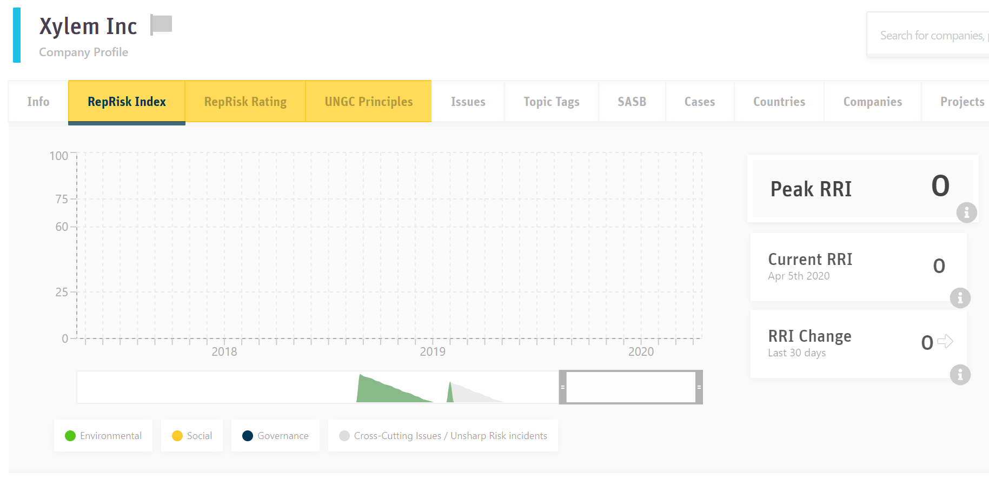
ESG score

Slide 15
Growth drivers
Rising pollution
Stricter regulations
Global population growth: water consumption is estimated to double every 20 years
Water scarcity in developing countries: by 2025, more than 30% of the world’s population is expected to live in areas without adequate water supply
Aging infrastructure in developed countries: 1 out of 6 gallons of treated water does not reach the end client (lost revenue for utilities)
M&A is part of their strategy to extend their reach in the water cycle
Margins have expanded over time thanks to productivity efforts (simplification and integration efforts of recent acquisitions, as well as increasing mix of digital & software sales that have a higher margin

Slide 16
Capital allocation
Net debt/EBITDA: 2.2X (target 2.5-3X)
Capex: pretty steady at 4-5% of sales
Dividend: 1.7% yield
Share repurchase: opportunistic & to manage dilution

Slide 17
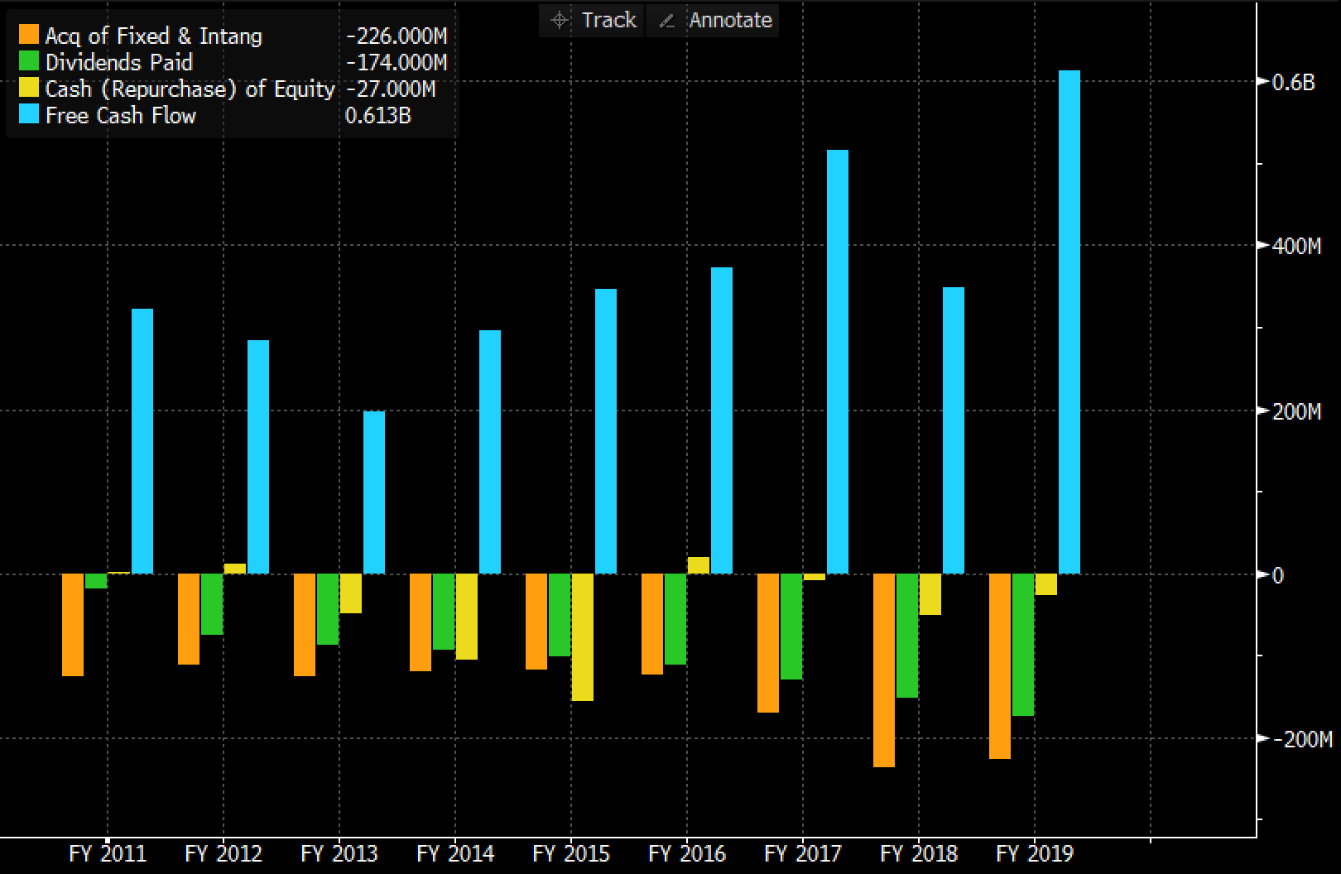

Slide 18
Valuation

Slide 19
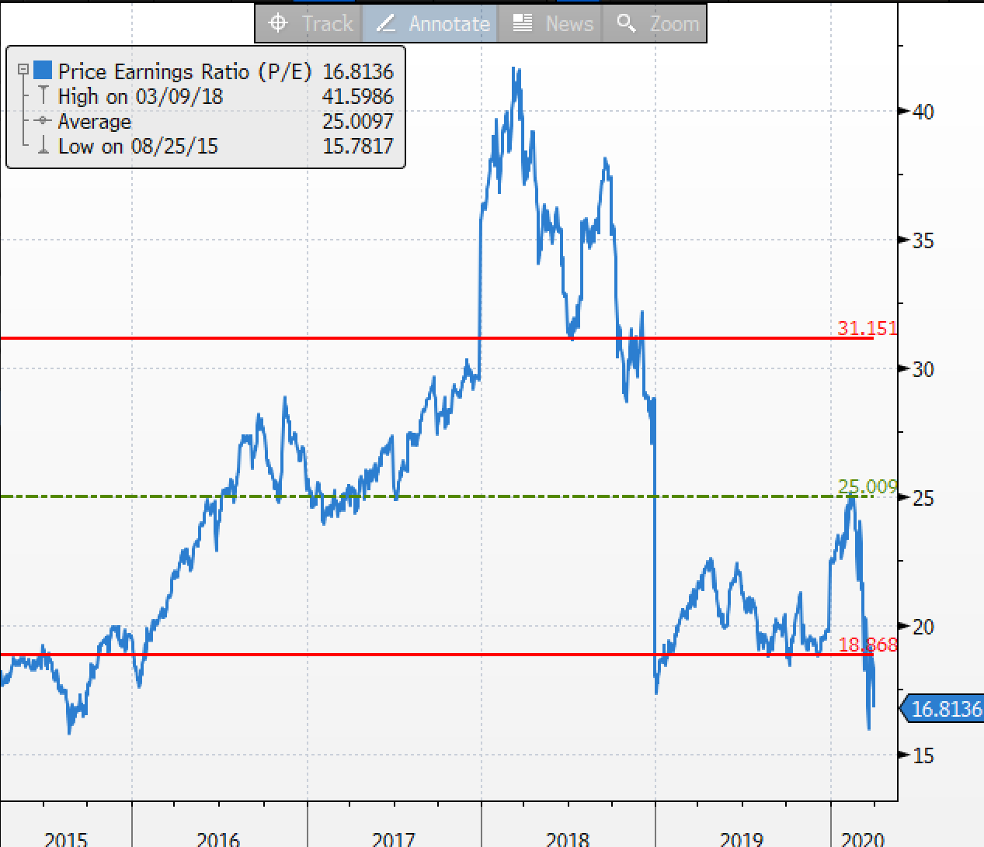

Slide 20
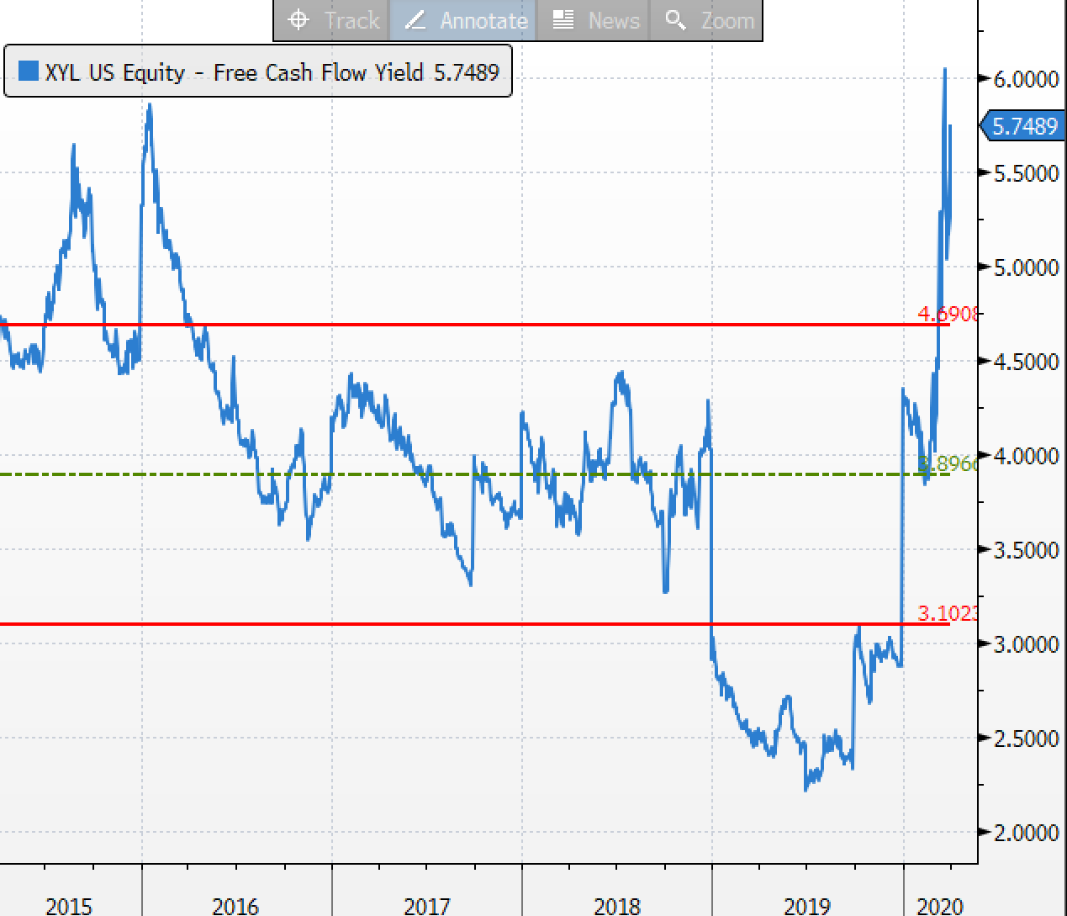

Slide 21
Risks
FX
Competition

Slide 22
Conclusion
Xylem is an industrial company serving various end markets, more defensive in nature
Stable sales base
Secular growth drivers are sustainable
Valuation today is attractive

