Slide 1
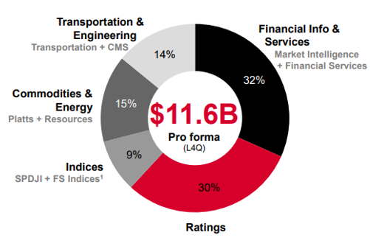
S&P Global (SPGI) Ratings, Indices and Data
Company Description
S&P Global is a highly profitable company with established “information” businesses with deep moats in attractive industries.
S&P Global is focused on shareholders and returns 75% of its free cash flow to stockholders in dividends and share buybacks.
Over the past several years, S&P Global has demonstrated an enviable history of revenue growth and margin expansion.
With the merger of IHS Markit, S&P Global will combine many unique data sources, enhance data analytics capabilities which will allow them to broaden addressable markets.
Business lines for S&P Global*
Business units
Ratings - S&P Global business units are anchored by their ratings business which operates in a duopoly with Moody’s.
Indices - S&P Global owns the S&P 500 index fund and other funds which they collect royalties from passive ETFs using those indices.
Financial services - Financial services includes Capital IQ, trading services, private security valuations, supply chain management and other services.
Data - Merger with IHS Markit builds S&P’s vast collection of data and ability analyze data which we expect will open new markets.
Source: S&P Global
* Business lines are proforma including IHS Markit
1 Reflects an approximate allocation of IHS Markit index revenue from Financial Services to Indices
Information is current and believed to be accurate as of 01/31/2021

