Slide 1
S&P Global
January 20, 2021

Slide 2
S&P Global
Investment thesis
S&P Global is a highly profitable company that has established businesses with deep moats in attractive industries
S&P Global is focused on shareholders and returns 75% of free cash flow in dividends and share buybacks
Over the past several years, S&P Global has demonstrated an enviable history of revenue growth and margin expansion
With the merger of IHS Markit, S&P Global will combine many unique data sources, enhance data analytics capabilities and hopefully broaden addressable markets.

Slide 3
Contents
S&P Global
  History
  Business units
  Finances
  Capital allocation
  Growth drivers
  ESG
IHS Markit
  Business lines
Merger
Risks
Valuation

Slide 4
History, abbreviated
1860 Henry Varnum Poor publishes history on railroads and canals
1888 James H. McGraw purchases American Journal of Railway Appliances
1896 Charles Dow creates the Dow Jones Industrial Average
1909 Warren Cummin Platt begins publishing the monthly National Petroleum News
1916 Poor’s Publishing issues its first credit rating
1941 Standard Statistics and Poor’s Publishing merge to form Standard and Poor’s
1957 S&P 500 index is introduced
1966 McGraw-Hill acquires Standard and Poor’s
1973 Wells Fargo and American National Bank launch first fund tracking S&P 500 index
1976 Vanguard offers S&P 500 index fund for retail investors
1987 Reid Nagle founds SNL Financial – roots of Capital IQ
1993 SPDR to track S&P 500 issued
2012 Joint venture with Dow Jones Indices
2013 McGraw-Hill education is sold
2018 Acquires Kensho (AI) and Panjiva (supply chain intelligence)
2019 Chinese regulators open the door for S&P Ratings (China) Ltd.

Slide 5
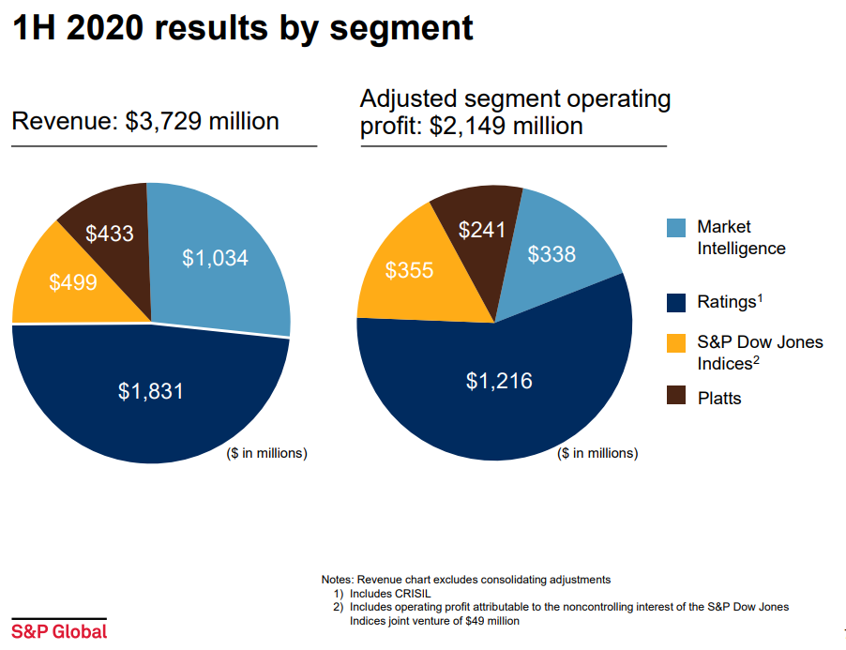

Slide 6
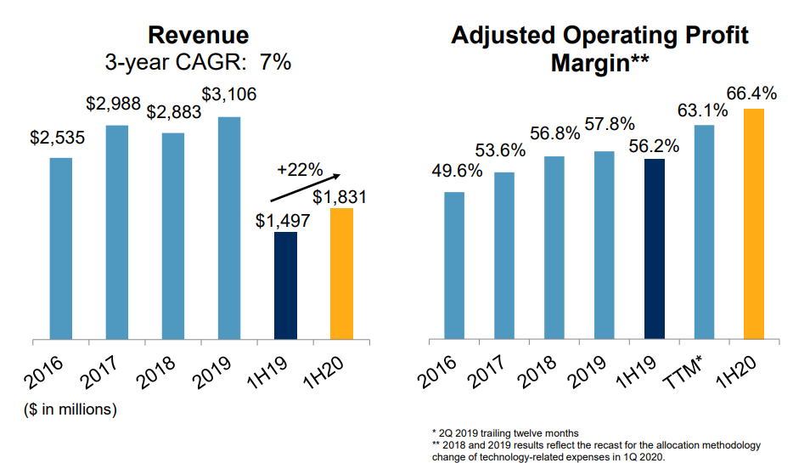
Ratings
Profitable business. Duopoly Moody’s and S&P control 93% of US
Necessary workflow for issuers and buyers
3-4% pricing gains annually, fee is a modest take
Rating revenue per supervisor has increased with margins
Rating revenue is 50% transaction based, so some cyclicality
Expanding in China

Slide 7
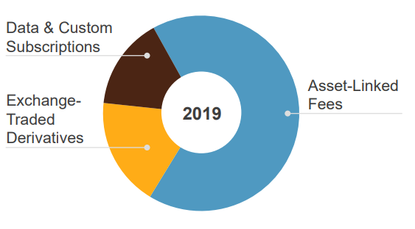
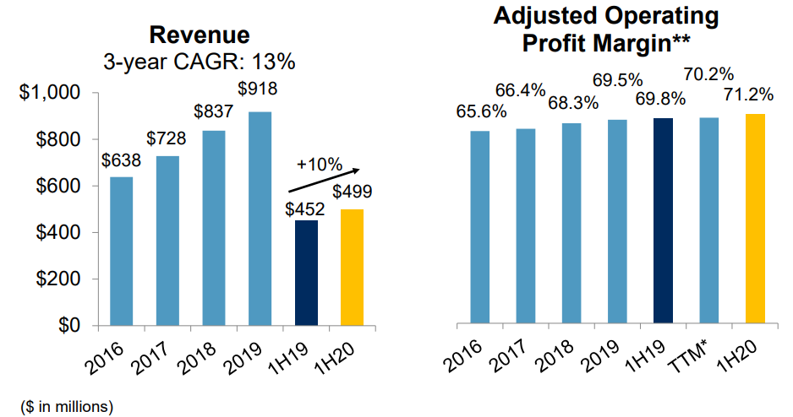
Dow Jones Indices
Build out ESG, Smart beta and factor indices
Expand EM and global offerings
Own “SPDR” trademark
S&P about 1/4 of industry
27% owned by CME

Slide 8
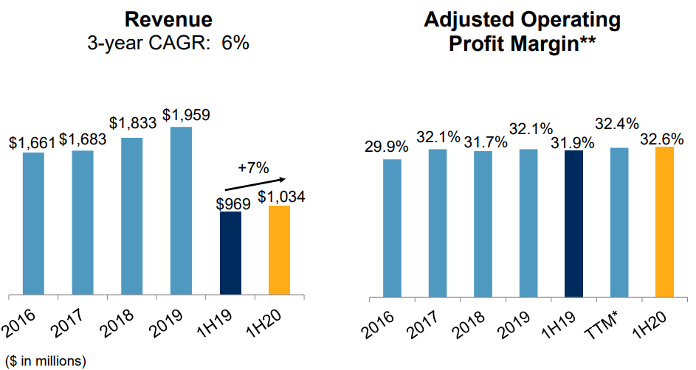
Market Intelligence
95% subscription revenue and 95% renewal rates
Market Intelligence (Capital IQ / SNL), Panjiva
Credit risk solutions
Area that stands to gain the most from IHS Markit merger

Slide 9
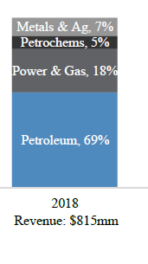
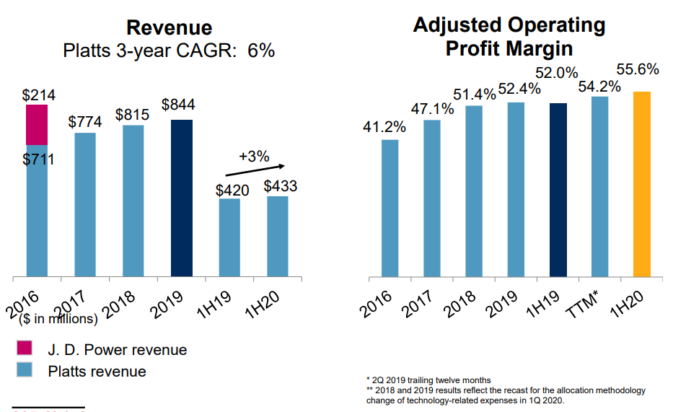
Platts
Coverage across commodity markets
Trade flow analytics
Pursue unique benchmarks in new regions and markets
Derivatives trading drives subscriptions
92% subscriptions with 94% renewal rates

Slide 10
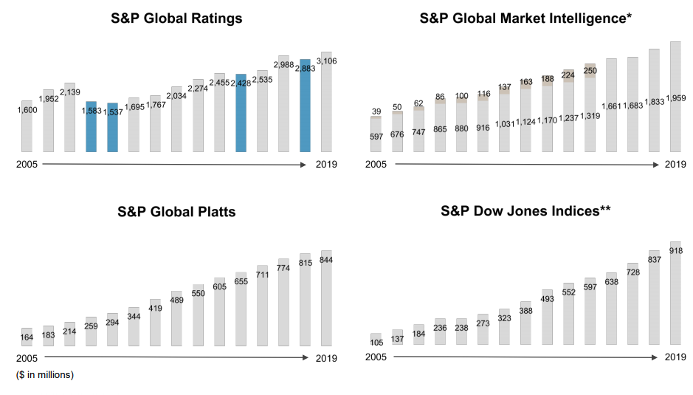
SPGI Consistent revenue growth
4-year CAGR of 6%

Slide 11
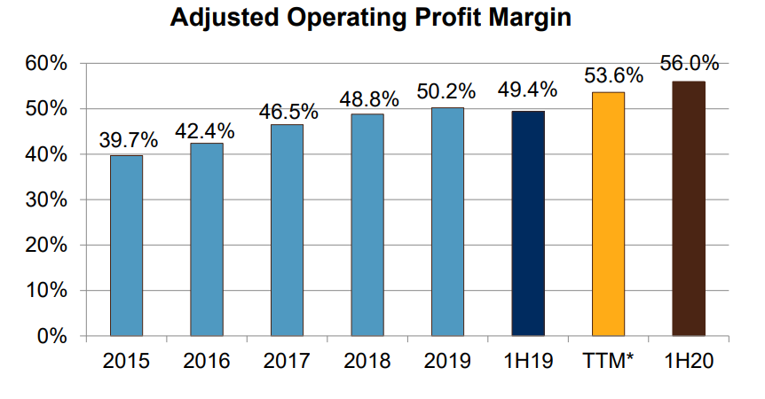
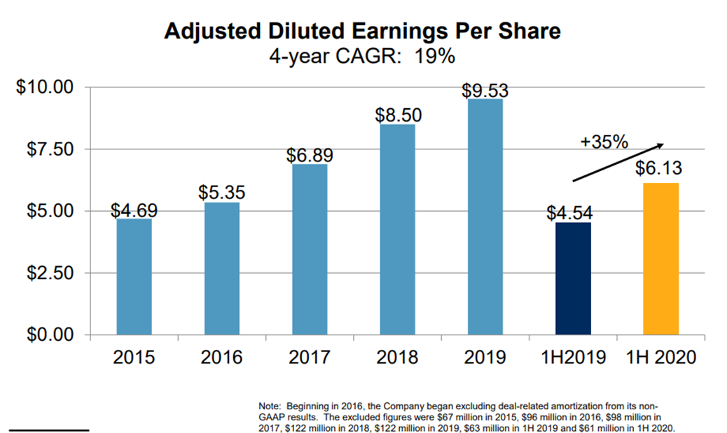
Rising sales, rising margins

Slide 12
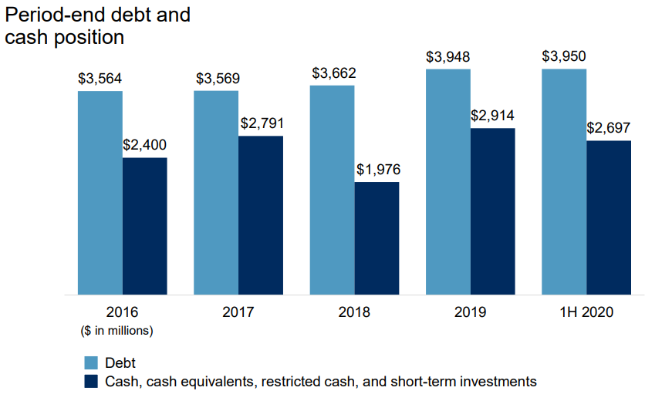
Balance sheet
Little net debt
Target leverage to EBITDA ratio of 1.75% to 2.25%
Moody’s rates S&P long term debt A3 stable

Slide 13
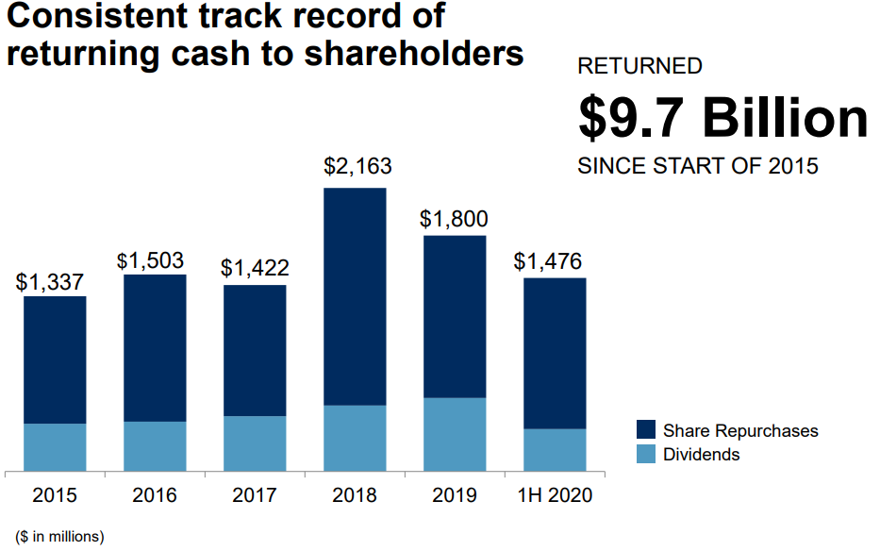
Capital allocation
Return 75% of FCF to shareholders
Target leverage to EBITDA ratio of 1.75% to 2.25%
47-year track re3cord of annual dividend growth

Slide 14
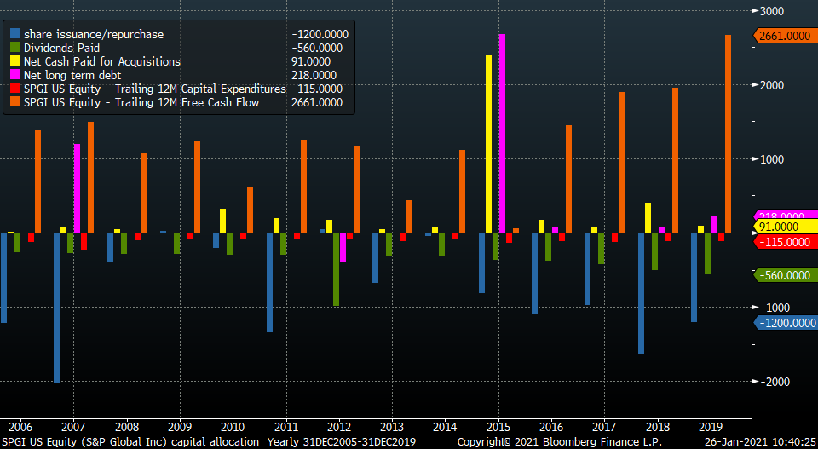
Capital allocation

Slide 15
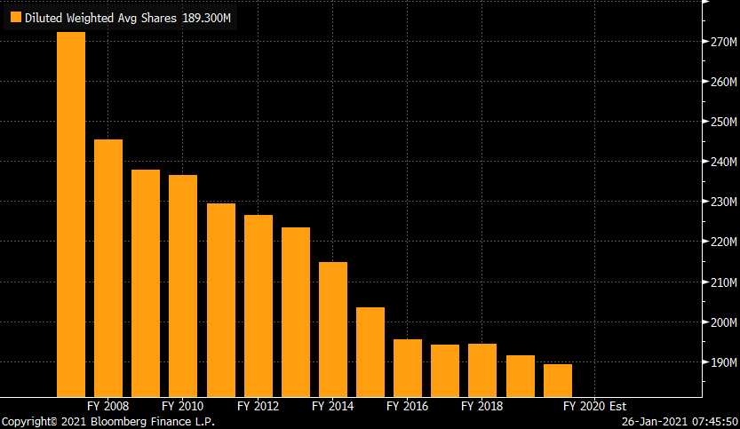
Outstanding shares
Shares down 30% since 2007

Slide 16
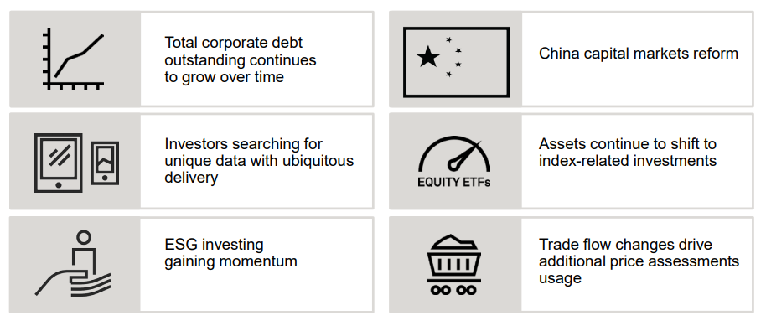
Growth Drivers

Slide 17
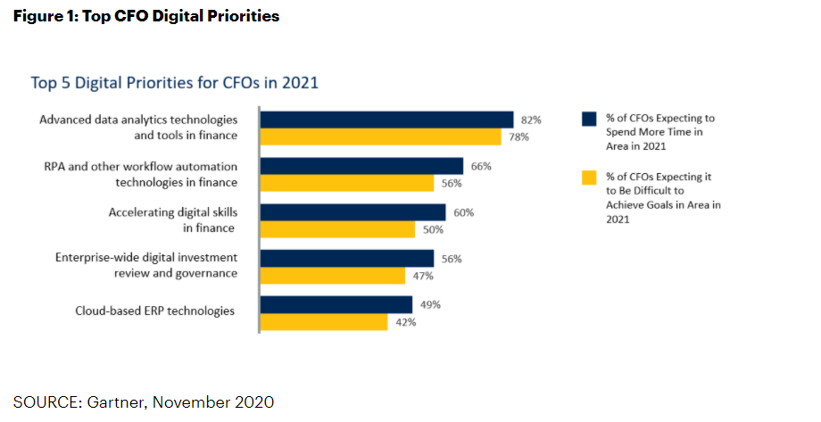
Gartner Group survey
Data analytics is key spend area

Slide 18


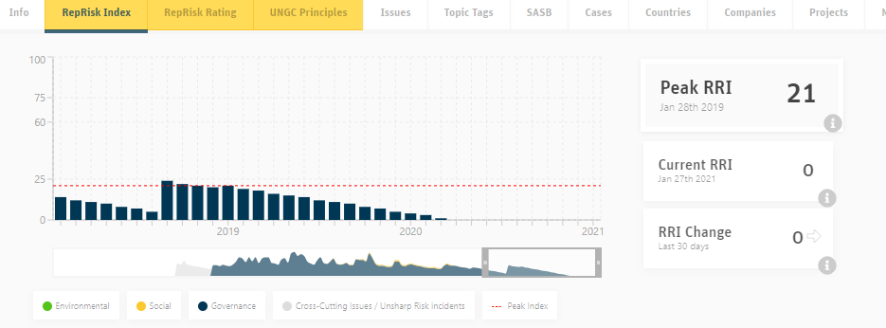
Excellent ESG scores

Slide 19
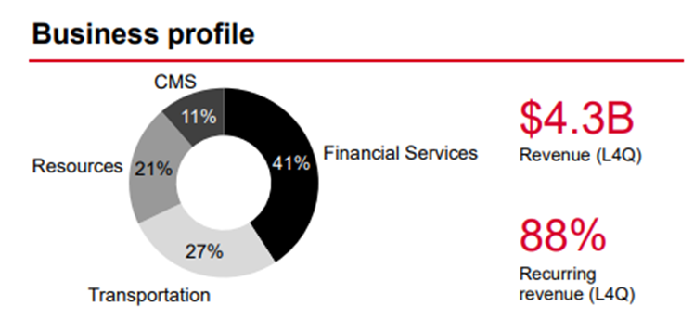
IHS Markit

Slide 20
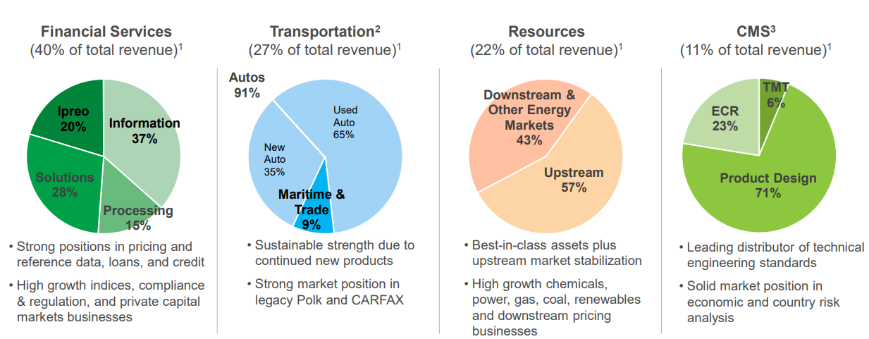
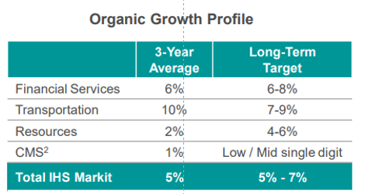
IHS Markit

Slide 21
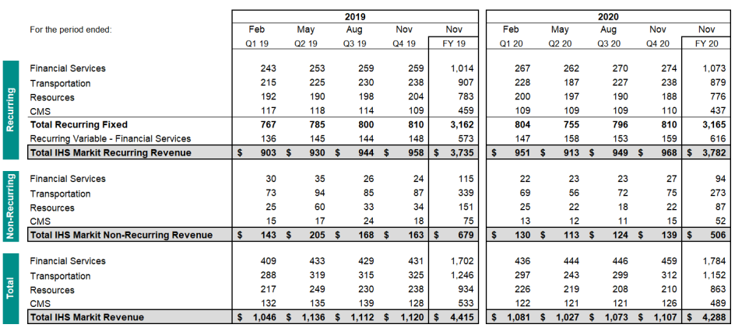
IHS Markit revenue
Organic growth averages 6% stalled last year to 0%
Recurring organic growth rose 3% last year
88% recurring revenue
Nonrecurring revenue fell -15% last year

Slide 22
Business lines

Slide 23
Business lines 2

Slide 24
IHS History

Slide 25
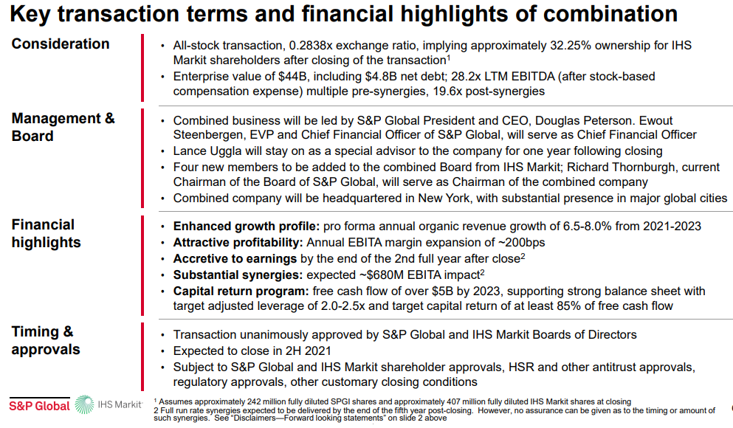
Merger

Slide 26
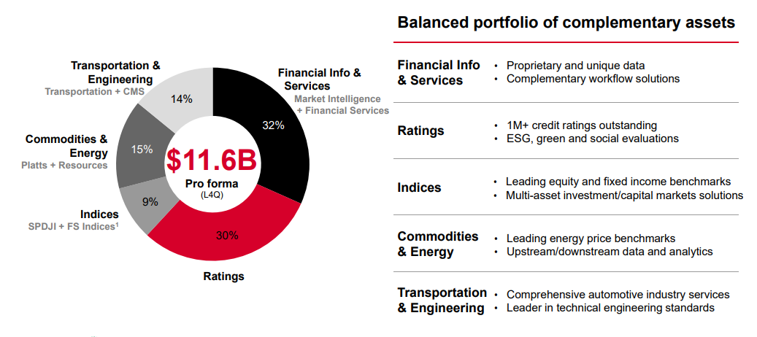
Combined

Slide 27
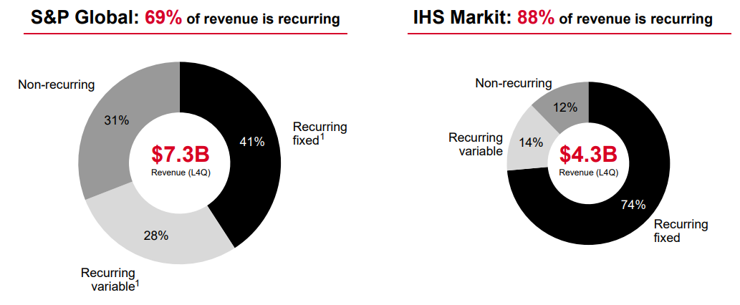
High level of recurring revenue
69% recurring for combined

Slide 28
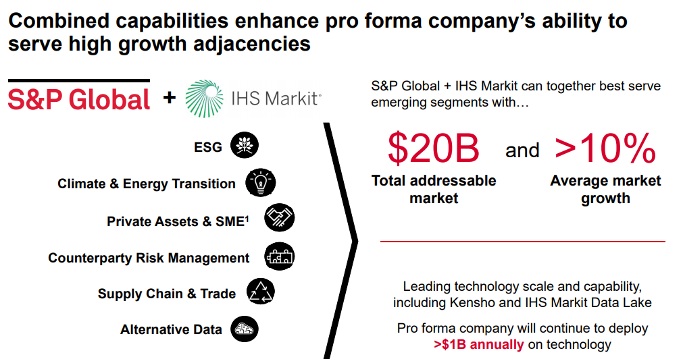
Growth drivers

Slide 29
Concerns
IHS Markit a collection of small nonconforming business
SPGI stocks has had a great run driven by rising margins – as good as it gets?
Late cycle for bond issuance / finance sector instability / defaults
Equity markets – drop in AUM, change in trend to indexing
Macro factors affecting markets
Oil prices

Slide 30
Valuation

