Slide 1
Sensata Trim l Equity Research l March 2021

Slide 2
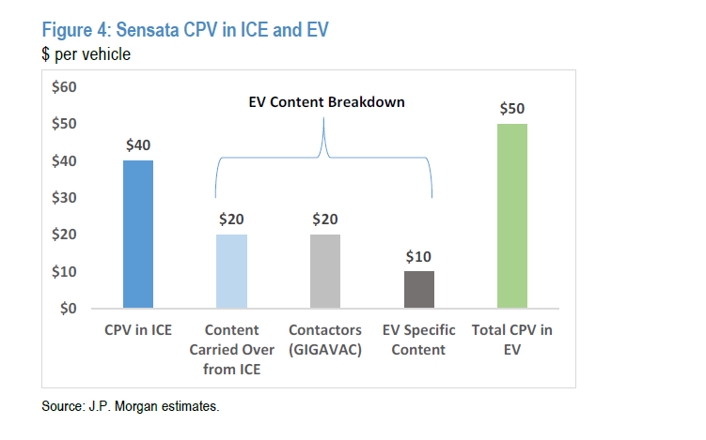
Trimming Sensata 50 bps Proceeds to go to IVV
Sensata’s long-term investment thesis is not broken, thus we want to remain invested in the name for now. However, we want to be prudent in managing the position size – this stock is not the most liquid we own.
Managing position size, ST’s active exposure is 2.40%, we want to bring it closer to 2% after a big run in the last year - best performer in the portfolio YTD (+176%)
Valuation has moved up, and upside potential is not as attractive as it was, thus increasing the risk/reward potential (see valuation charts next slide)
Why remain invested? Sensata’s investments towards greater electric vehicle exposure is working (light grey column below)
Its content per vehicle (CPV) is now above its internal combustion engines CPV (blue column below is traditional engine, green is electric vehicle) - this explains its big stock rebound since last year as the bear case doesn’t have as much to hold on to.
Internal Use Only

Slide 3
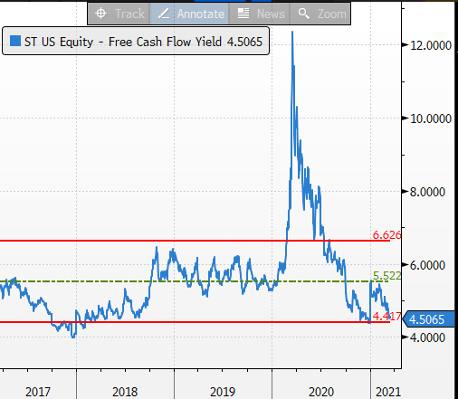
Valuation charts: P/E and FCF yield
Source: Bloomberg
Internal Use Only

