Slide 1
2019 Q1 Review

Slide 2
Outlook 2019
Fundamentals are sound but risks remain
Expect U.S. economy to slow in 2019
While the 2018 tax cuts remain in place, their contribution to year-over-year growth will begin to fade. We expect economic growth to slow but remain positive. The U.S. consumer remains healthy, benefitting from wage growth and strong employment
Expect current tariffs to have small negative effect on U.S. growth, but their effect on companies’ supply chains and earnings will be larger. Further protectionism on consumer goods, specifically technology and autos, would have a greater effect on growth and earnings
Consensus revenue growth estimates for the S&P 500 are ~5% for 2019. Earnings growth will slow in the second half as further margin expansion will be difficult given rising interest costs, tariffs and higher wages
U.S. equity valuations have improved given strong earnings growth and falling prices
International markets are spotty as global growth slows
For 2019, the International Monetary Fund is forecasting healthy global growth at 3.5%, albeit slightly down from 2018’s forecast of 3.7%. Forecasted growth in China has fallen to 6.2%. U.S. protectionism may harm growth in countries that rely on exports to the U.S.
Growth in Europe is slowing with weakness in industrial sector especially in Germany. Geopolitical concerns are high in Italy and Britain
Risks remain but have shifted
While inflation has remained under control and below 3.0%, inflation risks have increased as tight labor markets and tariffs put upward pressure on prices
China’s slowing economy and high debt levels remain a concern given authorities efforts to constrain credit growth
Higher U.S. interest rates and stronger U.S. Dollar have been headwinds for emerging market economies, especially those that have substantial debt in U.S. Dollars
Information is current and believed to be accurate as of 3/14/2019

Slide 3
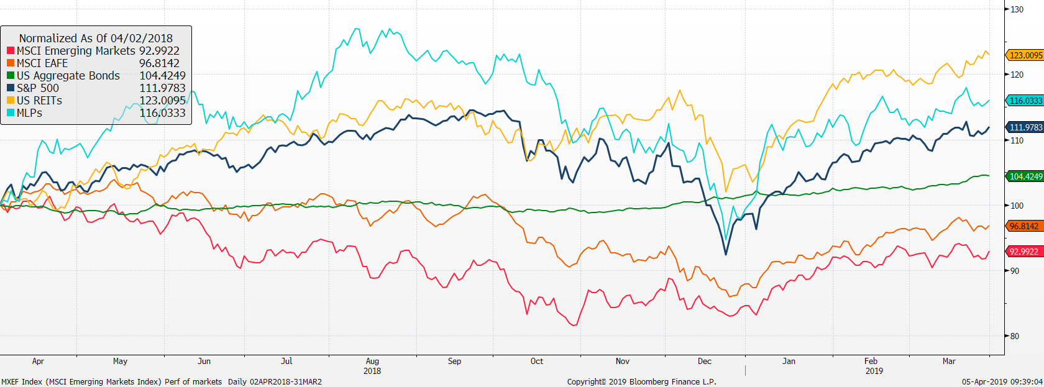
Return of market indices
YTD, alternatives have performed well. REITs are up 15.8% and MLPs are us 16.8%.
Equity markets have recovered from end of December with S&P 500 up 13.6%, EAFE 10.1% and EM up 9.9%.
Bond yields have fallen and since November 2018 have returned 4.8%, since December up 2.9%.
Maintaining a diversified portfolio of assets has helped to mitigate overall volatility with the intention of providing strong risk-adjusted returns over time.
Source: Bloomberg. EAFE is MSCI EAFE Index, Emerging Markets is MSCI Emerging Markets and U.S. Bonds is Barclays U.S. Aggregate. REITs is the DJ US Select Real Estate Securities Index. MLPs is Alerian MLP Index. The above information is through 12/31/2018. See last page for important information.

Slide 4
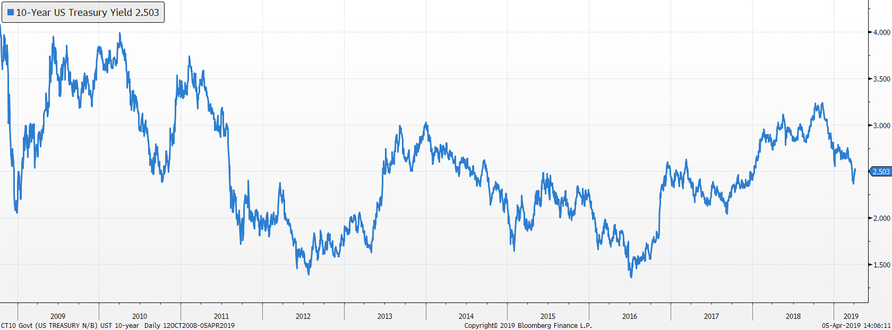
Bond markets
US Treasury 10-Year Yield
Yields fell at the end of 2018 and have continued to fall due to expectations of slower growth
Our bond duration is 4.5 years, was increased a bit at the beginning of the year

Slide 5
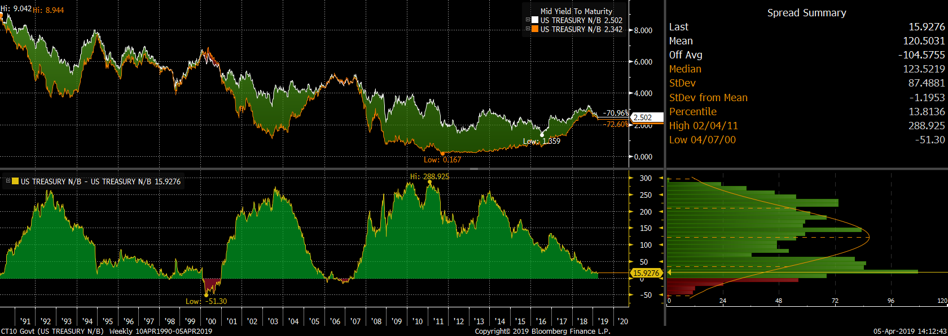
Bond market spreads (10y-2y)
Late cycle
Flat yield curve has been a good predictor of recessions. Percentile has dropped from 16th to 13th

Slide 6
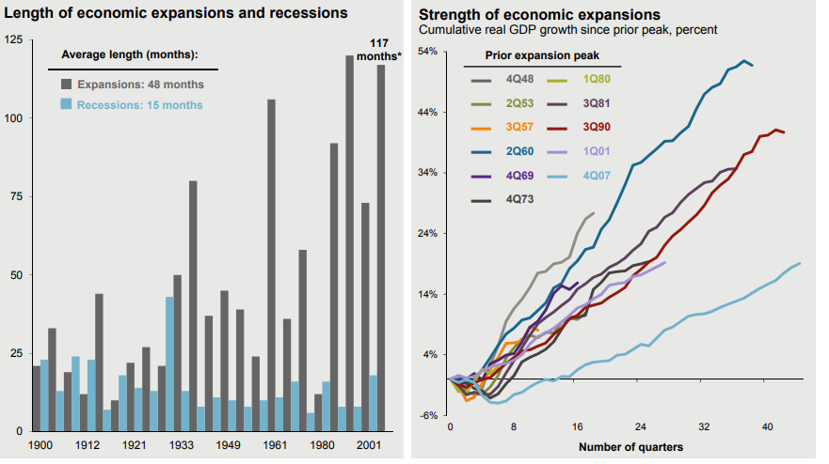
Expansion has been slow moving

Slide 7
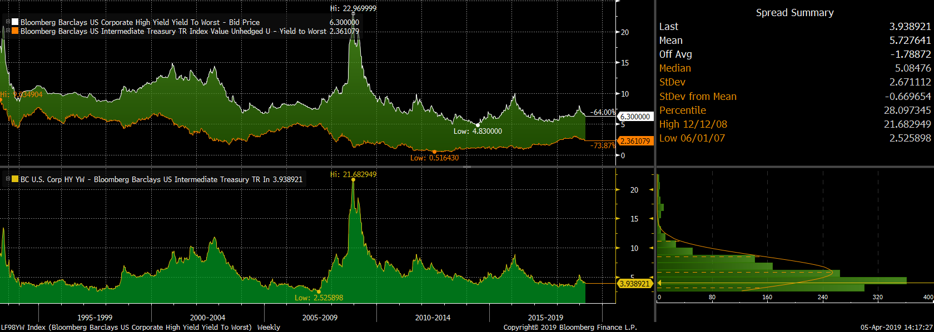
High Yield Spreads
Spreads have fallen since yearend
Spread percentile has decreased from 46th to 28th

Slide 8
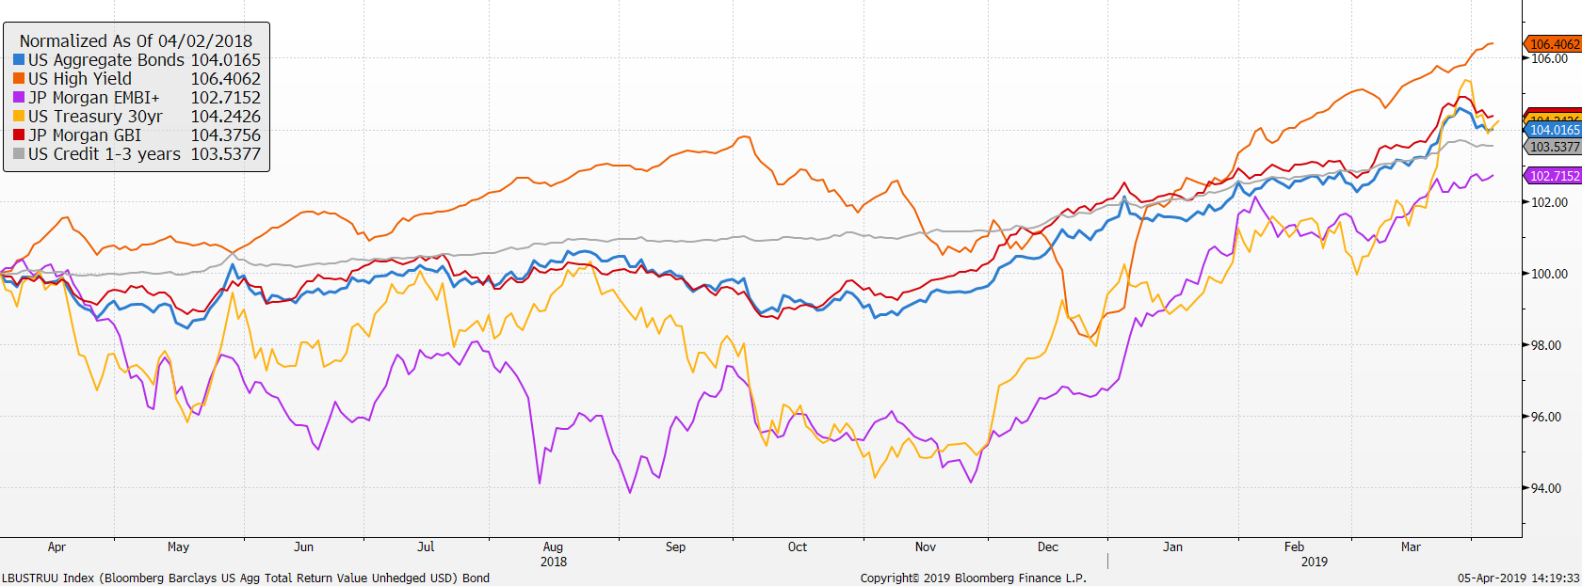
Market Returns
Performance of bond markets
EM bonds has recovered after being hit by strong dollar and higher US rates
Performance has been solid

Slide 9
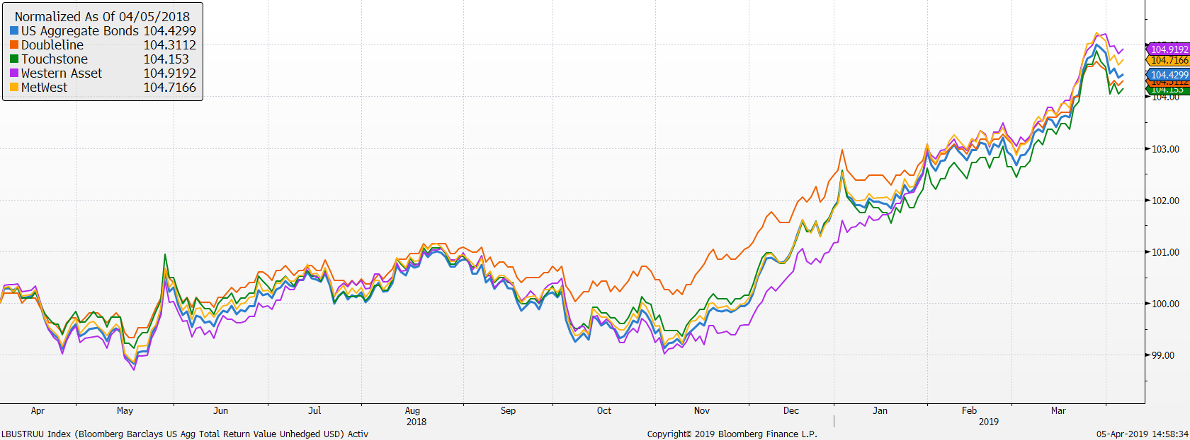
Active bond managers
Doubleline has lagged as rates have fallen
Western Asset and MetWest have outperformed

Slide 10
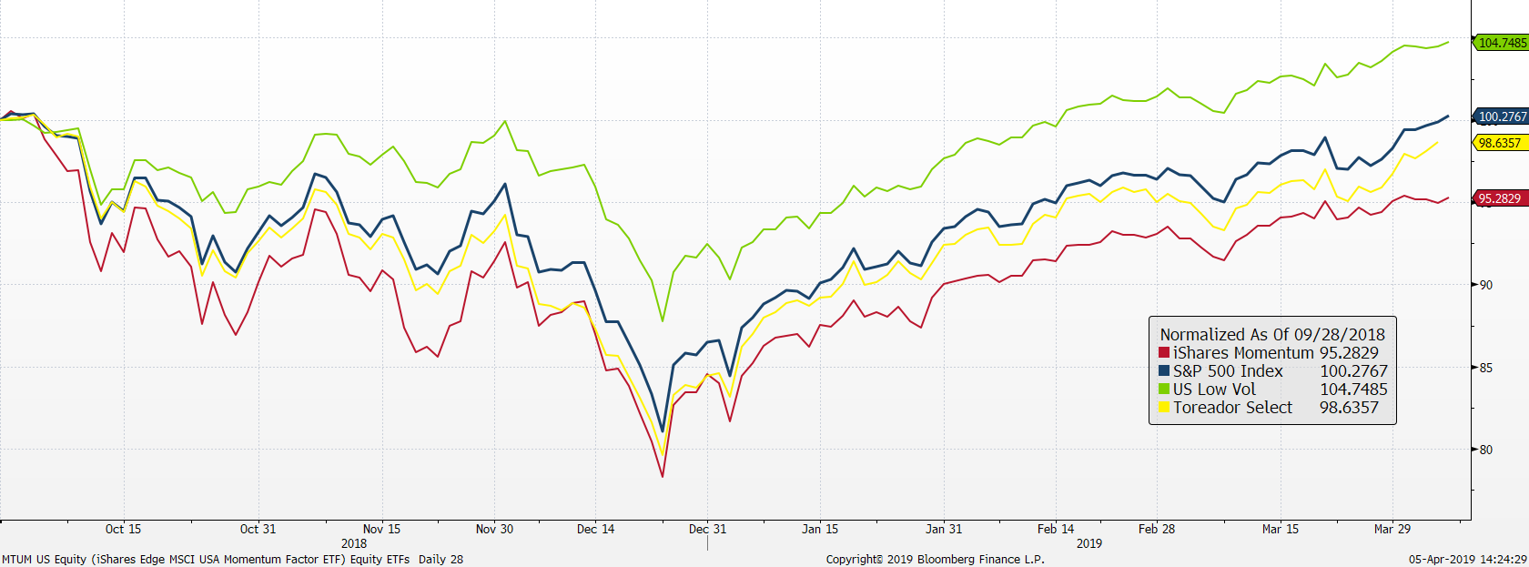
U.S. stock market ETFs
Low Volatility did well during Q4 2018 +5.96 over IVV
Toreador has performed well this year +1.32 over IVV
Source: Factset

Slide 11
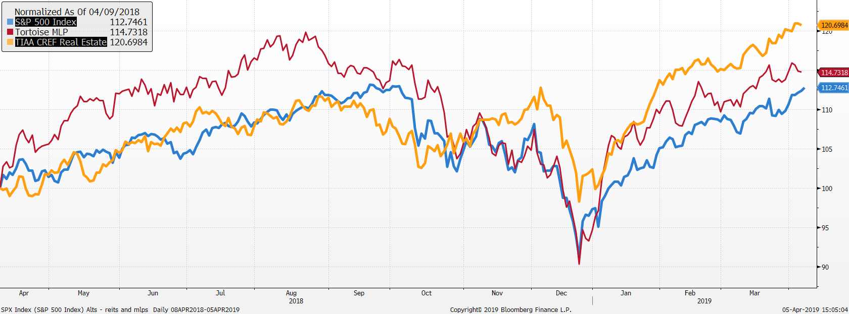
REITs and MLPs are outperforming!

Slide 12
Vehicle performance as of 3/31/19

Slide 13
Asset Class Returns
First quarter rebound!

Slide 14
Growth model changes
Portfolio changes 2019
2/22 reduced short term bonds, international developed equities and increased core bonds, US large cap and EM stocks
Portfolio changes 2018
1/30 reduced bonds, US large cap, increased international stocks, MLPs and Market Neutral
9/28 Changed US large cap vehicles
  70% IVV 40% TOSZX
  10% SPHQ 40% USMV
  10% USMV 20% MTUM
  10% IWF
9/28 Replace IEFA with JPIN
11/28 Sold QMNIX to IGSB
12/11 Added 2% to Real Estate

Slide 15
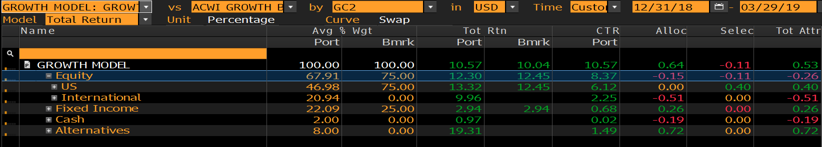

Growth Model attribution
Relative to 75% ACWI & 25% US Aggregate
Performance Q1 2019
Performance Past Year
Lower duration hurt as rates fell versus Aggregate Bonds
Alts dragged down returns

Slide 16
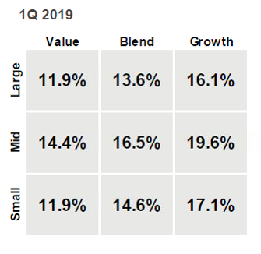
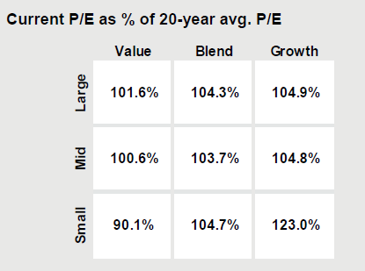
S&P 500 – What happened during 1Q 2019
The S&P 500 was up over 13% in Q1
  In Q1 growth stocks performed best, reversing the trend from Q4.
  Current P/E multiples across almost all styles are at a slight premium to long-term average.

Slide 17
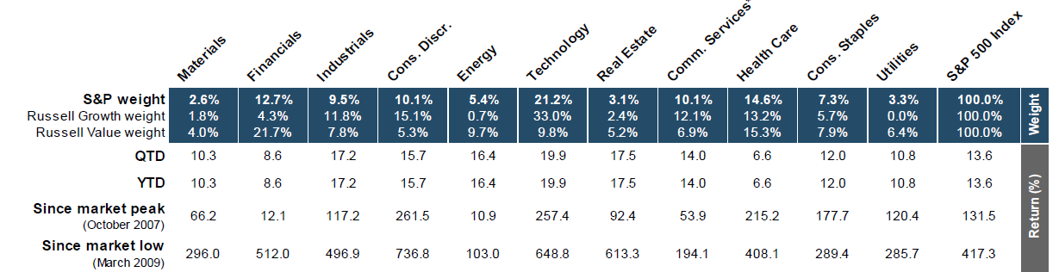
Sector Returns
Q1 best performing sectors: Tech and REITs
2018 best performing sectors: Healthcare and Utilities
Q1 worst performing sectors: Healthcare and Financials
2018 worst performing sectors: Energy and Materials

Slide 18
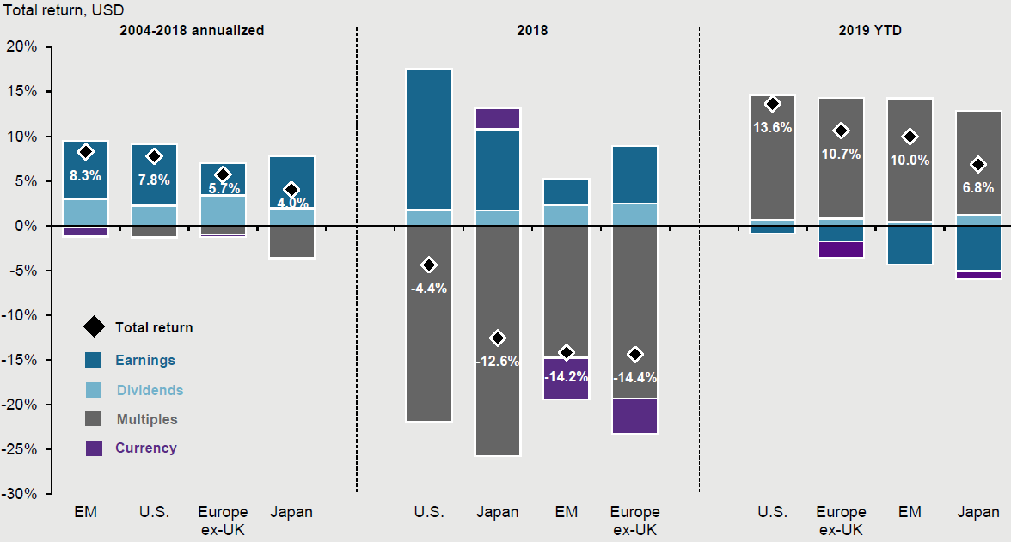
Sources of Global Equity Returns

Slide 19
Focus Equity Highlights – Q1 2019
What has driven performance YTD?
Our US equities underperformed the market by 110 bps in Q1.
Underperformance was driven by Healthcare and Consumer Discretionary.
What’s worked?
Biggest contributors to outperformance: Tech and Utilities
Top contributors to outperformance: SYK (+89), CSCO (+89), TJX (+63)
What didn’t?
What we didn’t own: FB (-41), NFLX (-19), AMZN (-55) = -115bps
Top detractors to Q1 performance: CVS (-30), RMD (-27)

Slide 20
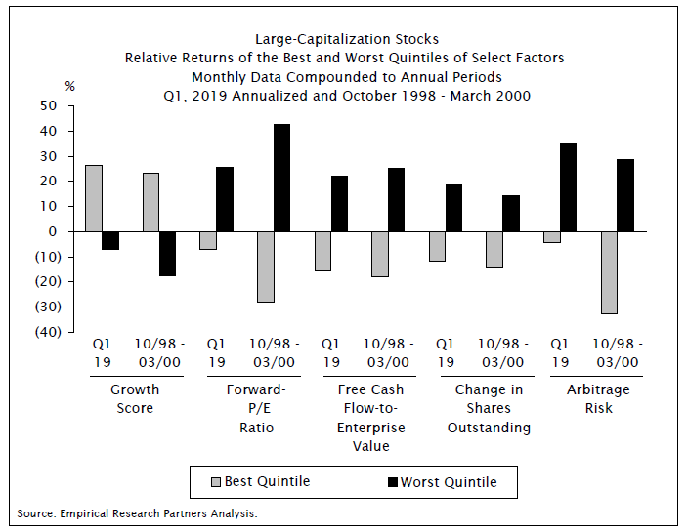
Performance by Factors

Slide 21
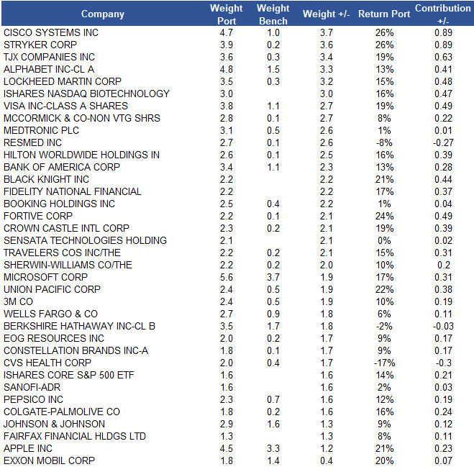

Slide 22
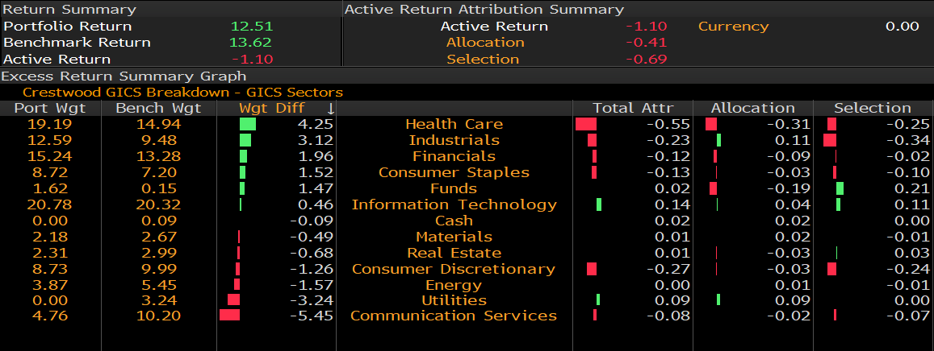
Attribution Q1 2019

Slide 23
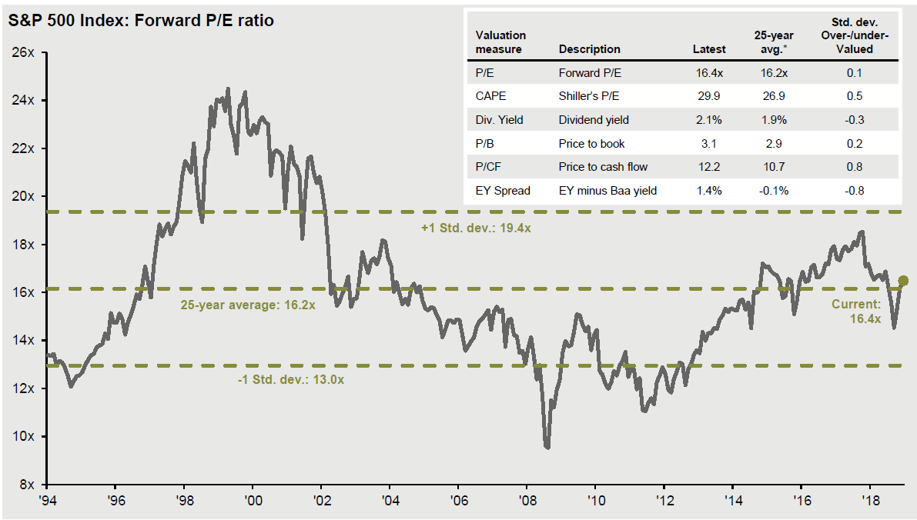
S&P 500 Forward P/E Ratio

Slide 24
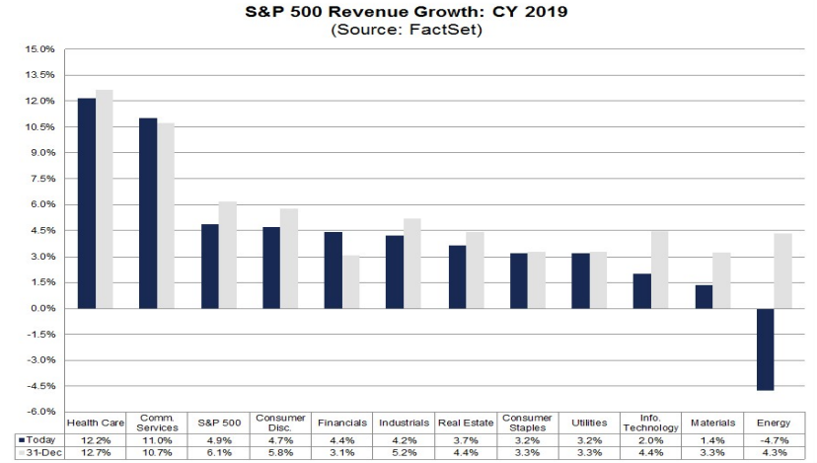
2019 Expected Revenue Growth by Sector

Slide 25
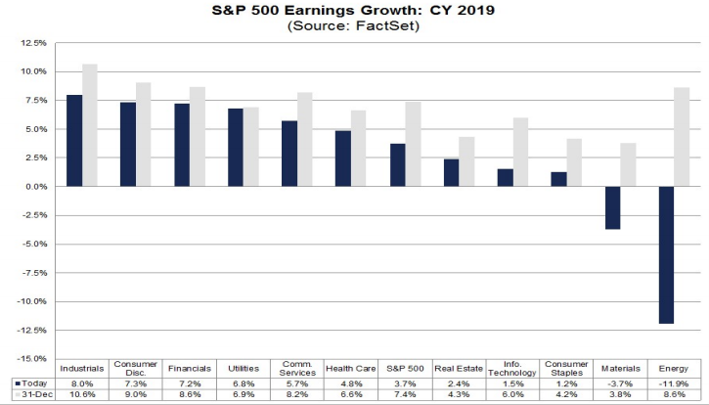
2019 Expected Earnings Growth by Sector

