Slide 1
Schwab Initiation

Slide 2
Schwab investment thesis
Schwab is a vertically integrated online broker that leverages its custody services to grow assets under management, earning fees on cash balances, low cost Schwab ETFs and mutual funds, trading and advisor network.
Schwab has averaged 6% organic core net new asset growth as retail clients and advisors are attracted to Schwab’s low cost trading and custody services.
Schwab is vertically integrated and offers Schwab ETFs and Funds. Schwab’s revenue come from interest spread on cash funds (56%), and asset management fees (32% ). Trading revenues have fallen from 50%-60% of total in early 1990’s to only 8% in 2018.
Conservative, well-managed firm who is a leader in online trading and focused on leveraging platform.
Over the next year, management expects cap-ex growth to slow to 3-5% from current 6-7% growth.
Schwab is on the cusp of generating excess capital which they plan to return to shareholders. Expect a 20%-30% payout ratio for dividends (1.7%) and management has approved a $4b share buyback which could amount to 4% to 5% of shares

Slide 3
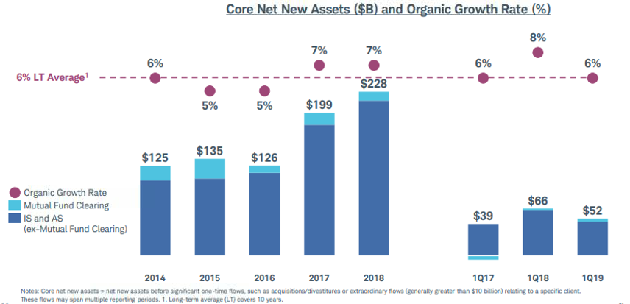
Offensive - Asset growth
Schwab is a leader in the advisor channel and has developed attractive low cost options for investors.
Schwab AUM is $3.25t while investable wealth in US is estimated at $45t

Slide 4
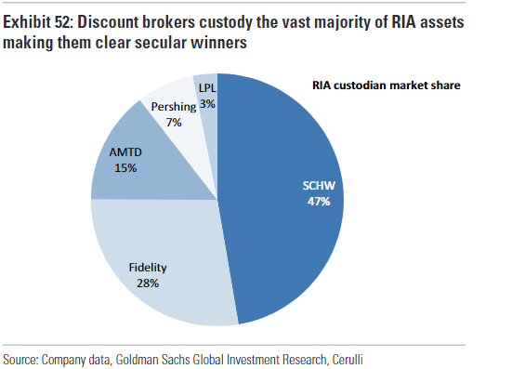
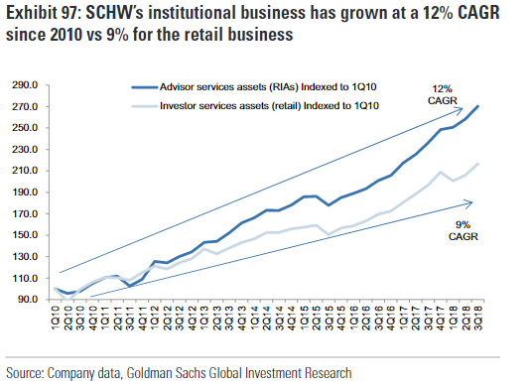
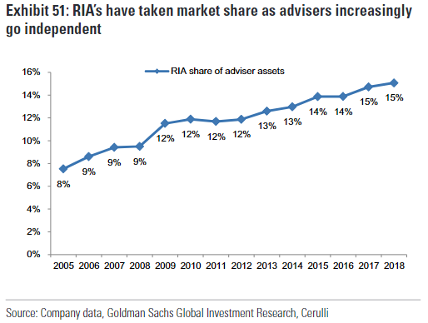
Asset Growth Driver
Advisor network
Schwab has the highest exposure to the RIA channel
At 12% growth, the RIA channel is fastest growing segment of advisor population and gaining market share
GS expects RIA channel to contribute 3-5% of total growth in client assets

Slide 5
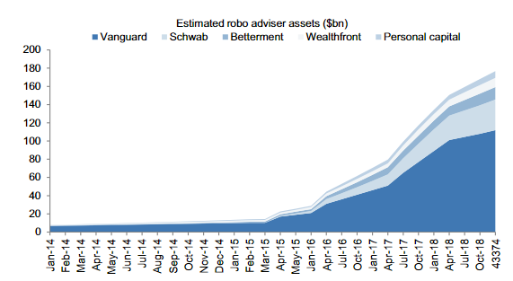
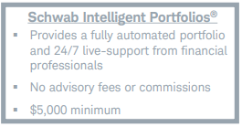
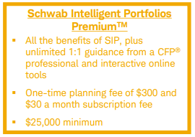
Asset Growth Driver
Robo Advisor
In 4 years, Robo advisor has attracted over 315k accounts and $38b in assets. Schwab is second to Vanguard in this fast growing market. Robo advisor has cash levels of 5%-23%.

Slide 6
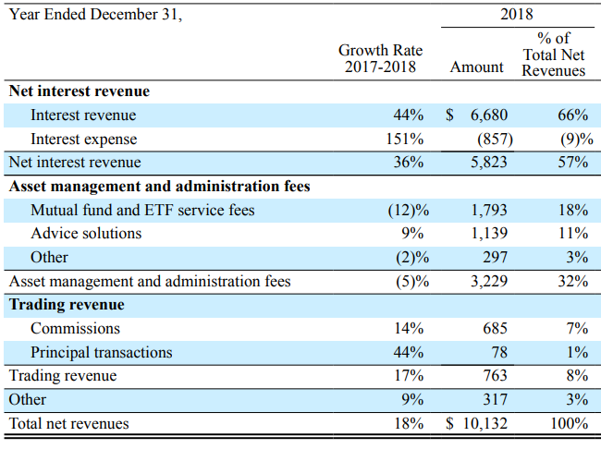
Revenue sources
Schwab relies more on interest and less on trading than peers
Concerns over cash leaving sweep and going to funds that pay higher rate. Schwab paid .27% on deposits and had a funding costs of .37% in 2018

Slide 7
Historical revenue sources

Slide 8
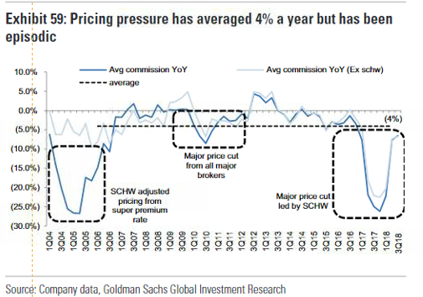
Trading
Basically giving trading away…
Schwab has low exposure to trading - 8% of revenue - and has lead price cuts

Slide 9
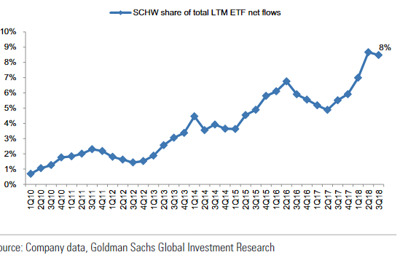
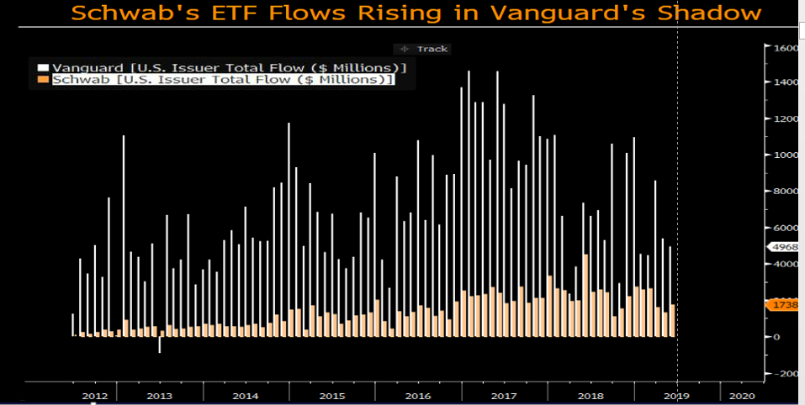
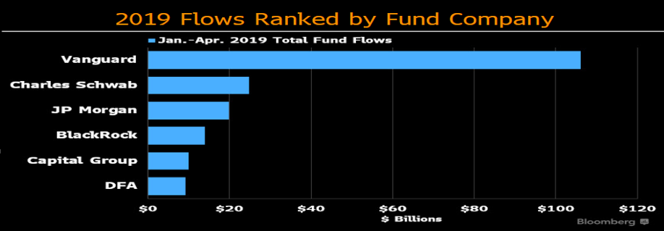
ETFs and funds
Schwab has quickly gained traction in ETF market
RIA are more likely to use ETFs
Schwab has scale – 91% of their ETFs have over $1b in asset versus 70% for Vanguard, 34% for iShares and 15% for Powershares
Vertical integration provides steady inflows.
In 2019, Schwab inflows were second to Vanguard’s

Slide 10
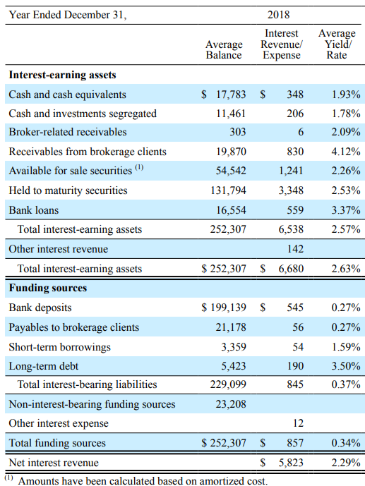
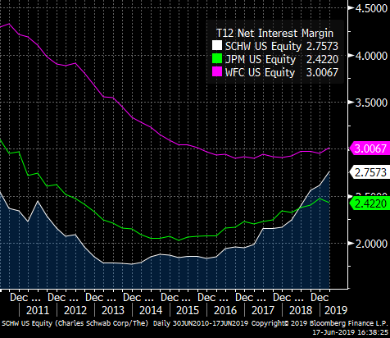
Net Interest Margin
Schwab owns mainly quality bonds
Loan exposure is small
Funding sources/deposits are growing. Deposits are on balance sheet
CSB Tier 1 leverage ratio of at least 5% to be considered well capitalized. Schwab targets 6% for CSC and 6.25% for CSB

Slide 11
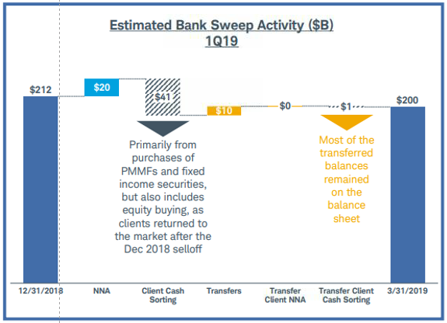
Deposits in flux

Slide 12
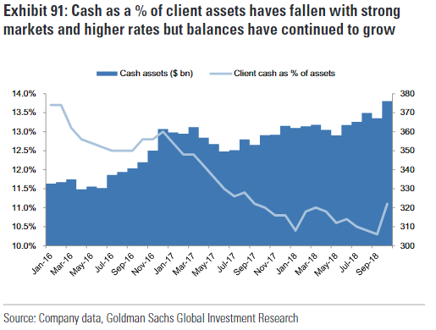
Defensive
Few loans and small risk of loan defaults affecting balance sheet
Cash balances may rise during market turmoil – deposits rose $18b in Q4 2018
Schwab’s ETF’s and Mutual Funds are index funds with zero relative performance risk
Reduction in on balance sheet deposits will free up capital for share buybacks

Slide 13
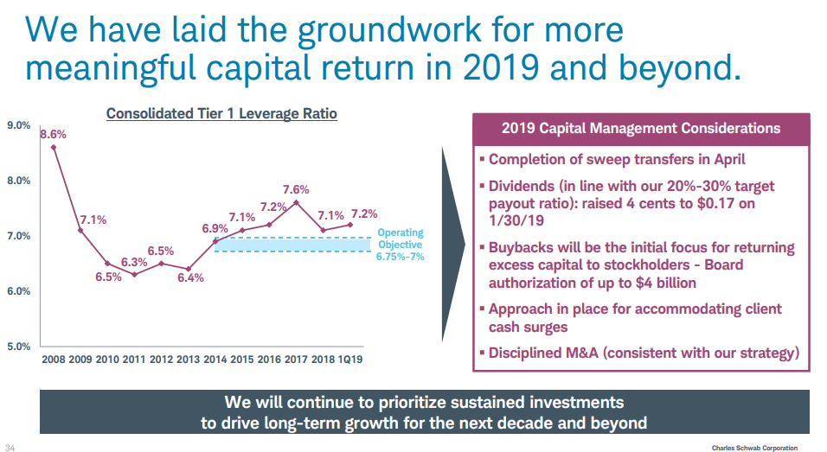
Capital allocation
Schwab has maintained a 20% dividend payout. They have transferred off balance sheet MM balances to on balance sheet improving ROE and higher net interest income.

Slide 14
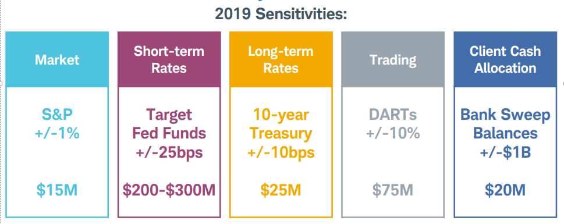
Risks
Falling interest rates and deposit balances are big swings for earnings.
$200m is roughly 2% of revenue
Deposits fell $12b in first quarter 2019
Failure to grow assets
Recession with prolonged period of low rates
Continued fee compression

Slide 15
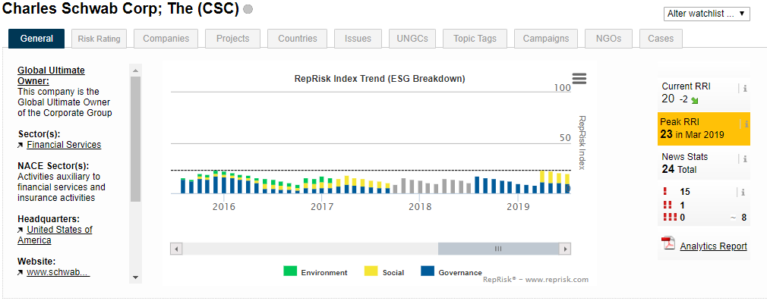
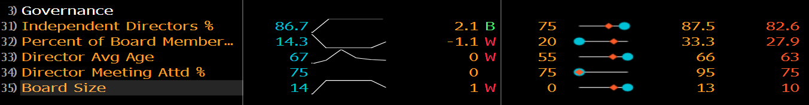
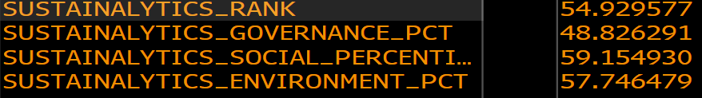
ESG scores

Slide 16
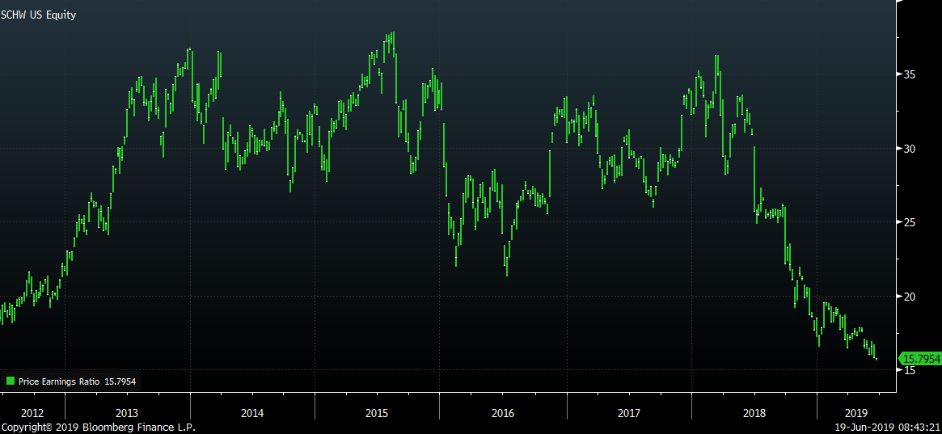
Valuation

Slide 17
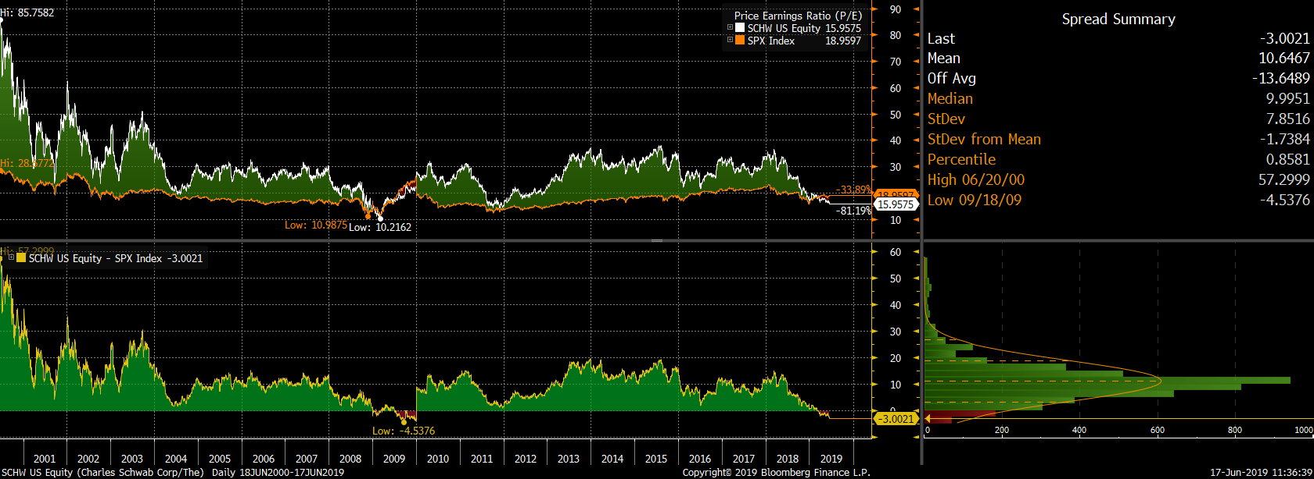
Relative Valuation

