Slide 1
Wells Fargo – Sell Recommendation

Slide 2
Wells Fargo’s Thesis
Best franchise in banking due to disciplined loan writing and quality mortgage underwriting
Atrocious governance
Abused clients
Tarnished brand
Large deposit base that provides low cost funding
Balance sheet is frozen and deposits growth has slowed
Funding costs have risen above peers
Strong capital ratios put WFC in a good position to be opportunistic, invest for the long-term and return capital to shareholders
Company is working hard to improve culture and repair image

Slide 3
Why now?
Wanted to be patient, but with valuation in-line with bank sector, will we regain premium? If so, when?
Last QTR earnings report showed troubles are affecting financials
Balance sheet restriction is affecting net interest margin
They have no clue when restrictions will be lifted and what they need to do
Earnings power is threatened
Wells has tried to changed their culture –
Replaced former Chairman, John Stumpf with CEO, Tim Sloan, and added CFO Elizabeth Duke, a former Fed member, as independent chairman.
Named 6 new independent directors
On 4/20/18 Wells reported a $1b settlement with OCC and CFPD relating to forced car insurance and mortgage fees.
Recent moves to improve firm’s standing with employees
Increased base minimum hourly wage to $15.00 an increase of 11%
Increased 401k and profit sharing programs
Increased stock incentive compensation
Overdraft rewind, zero-balance alerts, debit card on/off capability, and P2P payments
CEO position becoming difficult to fill

Slide 4
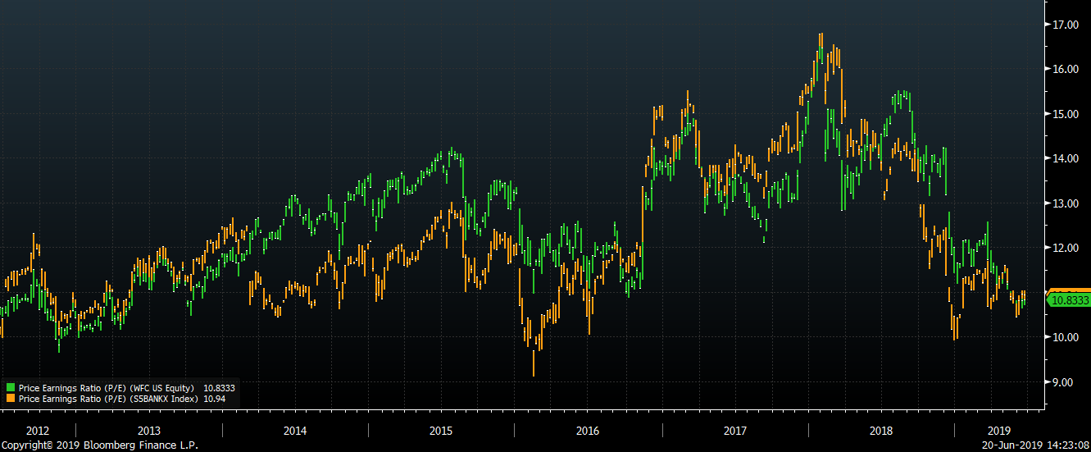
Valuation
Price to Earnings ratio is in-line with S&P 500 Bank Index’

Slide 5
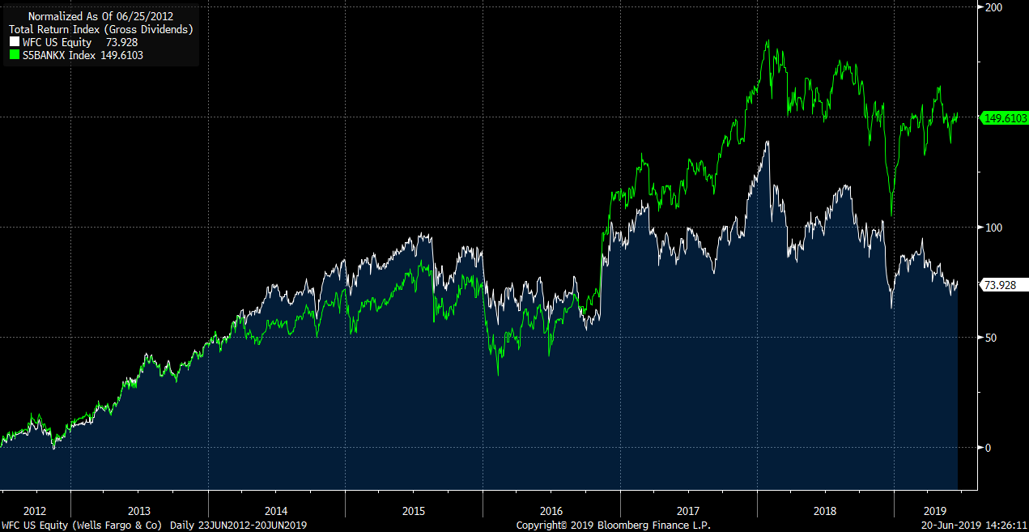
Performance
Performance has lagged due to scandals and balance sheet freeze
Federal Reserve restricts size
More fake accounts
Sept 2016: Fake account scandal
CEO Tim Sloan resigns

Slide 6
Scandals – a summary
September 2016: The fake account scandal
September 2016: Improperly repossessing service members’ cars
December 2016: Wells Fargo fails its ‘living will’ test
March 2017: More fake accounts
March 2017: Flunked community lending test
April 2017: Whistleblower wins $5.4 million and his job back
August 2017: Lawsuit over overcharging small business retailers
February 2018: Federal Reserve restricts size
February 2018: Sacramento sues over discrimination against black and Latino borrowers
March 2018: Wealth management investigation emerges
April 2018: $1 billion settlement for mortgage locks and auto-loan issues
May 2018: Altering business information without client knowledge
May 2018: $480 million to settle securities-fraud lawsuit
June 2018: SEC fine for leading investors astray
July 2018: Refunds over add-ons like pet insurance and legal services
July 2018: Private Bank wealth management issues
August 2018: Wells Fargo pays $2.1 billion for its role in housing bubble
August 2018: Hundreds of houses foreclosed on due to computer glitch
March 2019: Wells Fargo among advisors sanctioned by SEC for fee-disclosure practices

