Slide 1


October, 2019
2019 Q3 performance review

Slide 2
Outlook 2020
Fundamentals are sound but risks are rising
U.S. economic growth expected to continue in 2020
We expect GDP growth to continue in 2020 at moderately low rates, trending toward 2% YoY.
U.S. consumer is still robust, as the U.S. continues to experience declining unemployment, higher wages, increased consumer spending, and a steadily growing housing market.
Consensus revenue growth estimates for the S&P 500 are ~5% for 2020. Estimates for earnings growth are ~10%, but we expect some headwinds from rising tariffs and higher wages. U.S. equity valuations are slightly above average.
Tariffs and policy uncertainty at the forefront of U.S. concerns
Expect current tariffs to have small negative effect on U.S. growth. However, full implementation of threatened tariffs could subtract up to 1% of GDP growth.
Tariffs and other trade restrictions threaten supply chains and corporate profitability especially in technology and industrial sectors.
Policy uncertainty is hurting business confidence, increasing the odds of negative growth.
International markets are spotty as global growth slows
For 2020, the International Monetary Fund is forecasting healthy global growth at 3.5%, with only 1.7% growth in developed countries. U.S. protectionism may harm growth in countries that rely on exports to the U.S.
Growth in Europe is slowing with weakness in the industrial sector, especially in Germany. Geopolitical uncertainty remains high in Italy and Britain.
Global risks remain but have shifted
Escalating trade rhetoric and increased tariffs threaten to slow global growth.
Geopolitical tensions are high given a rise in populism, uncertainty around Brexit and voter unrest.
China’s slowing economy and high debt levels remain a concern given authorities’ efforts to constrain credit growth.
Most government bond yields in Europe and Japan are negative which shows investors’ concern of slowing GDP growth. This indicates that monetary policy will be less effective in stimulating economic growth.
Information is current and believed to be accurate as of 10/15/2019

Slide 3
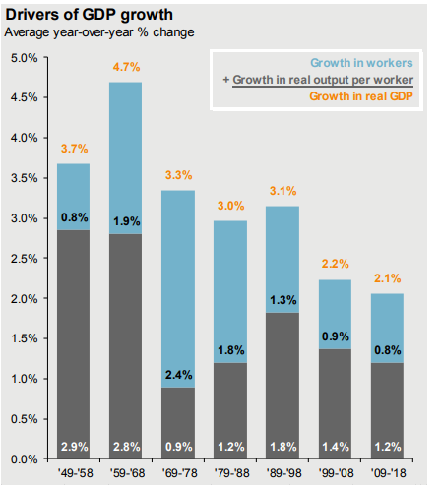
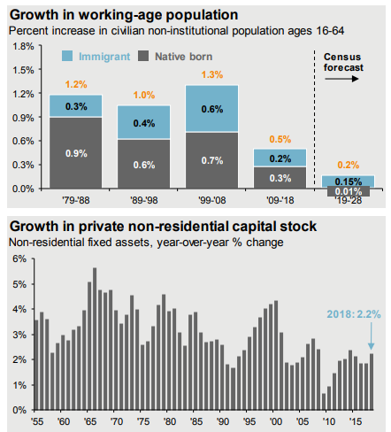
GDP trend growth

Slide 4
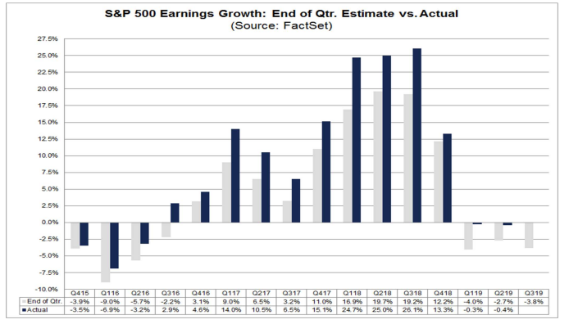
S&P 500 earning growth has stalled
Q3 expectations are negative

Slide 5
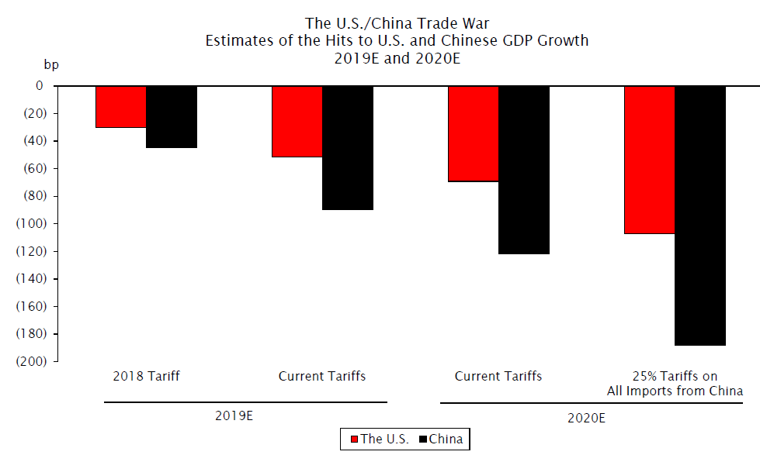
Tariffs

Slide 6
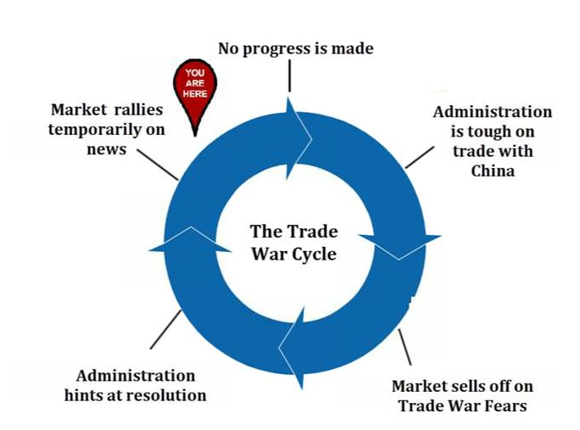
Trade war cycle

Slide 7
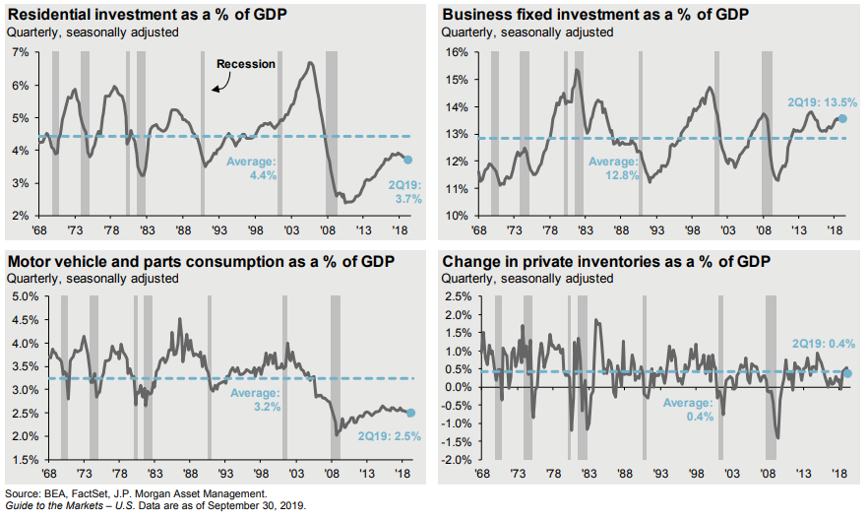
Why slowdown will be milder – no boom

Slide 8
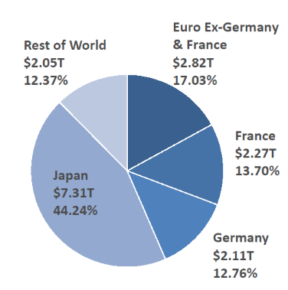
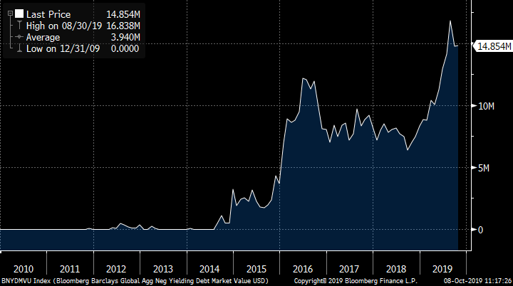
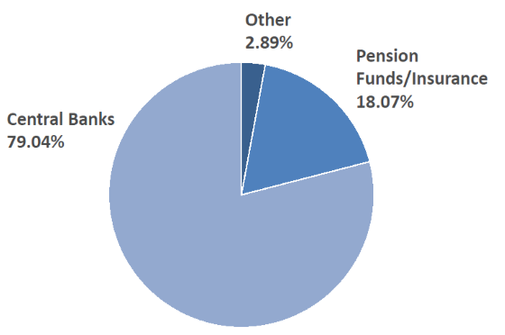
Negative yields ~25% of bonds
Mainly Japan & Europe

Slide 9
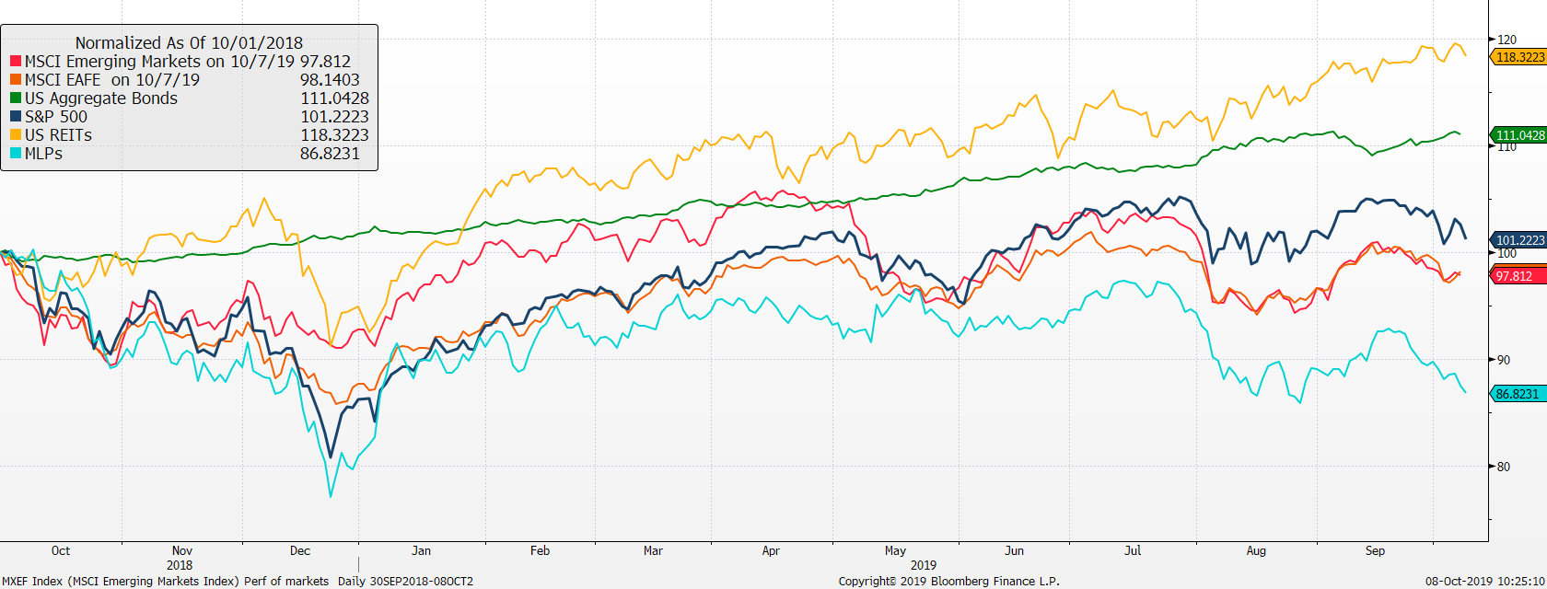
Return of Market Indices
Up 18%, REITs have led returns. Glad we sold MLPs as they have lagged.
Up 11%, bonds have been most impressive. Maintaining a diversified portfolio of assets should help to mitigate overall volatility with the intention of providing strong risk-adjusted returns over time.
US stocks continue to outperform international stocks.
Source: Bloomberg. EAFE is MSCI EAFE Index, Emerging Markets is MSCI Emerging Markets and U.S. Bonds is Barclays U.S. Aggregate. REITs is the DJ US Select Real Estate Securities Index. MLPs is Alerian MLP Index. The above information is through 6/30/2018. See last page for important information.

Slide 10
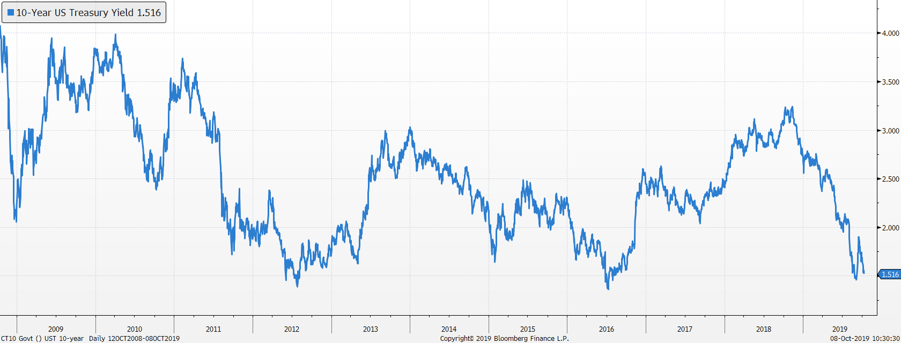
Bond markets
US Treasury 10-Year Yield
Yields have collapsed over the past year with the 10-year yield cut in half 3.15% to 1.51%.
Our bond duration is 4.5 years

Slide 11
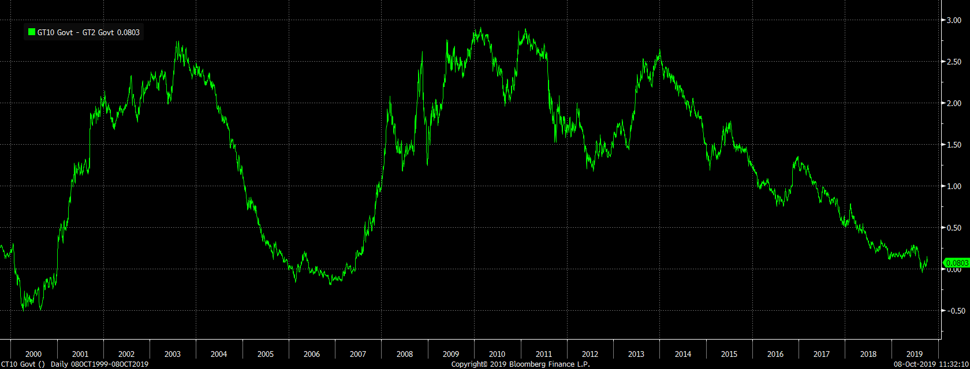
Bond market spreads (10y-2y)
Late cycle
Spread Between 10-Year Treasury Yield and 2-Year Treasury Yield
Inverted yield curve has historically been a good predictor of recessions. Currently, the yield curve is close to flat, but it does not mean that a recession is eminent, especially given the slow-moving nature of this expansion.

Slide 12
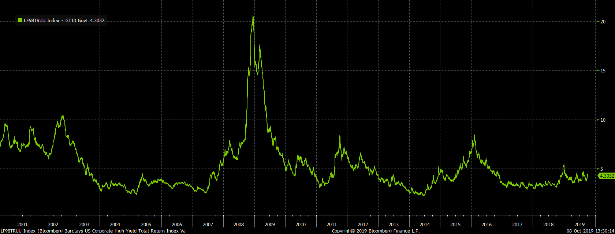
High Yield Spreads
Indicator of fear in the bond market
Spread Between High Yield Corporate bonds and Intermediate Treasury Yield
Spreads have fallen since yearend
4% high yield spread is about normal

Slide 13
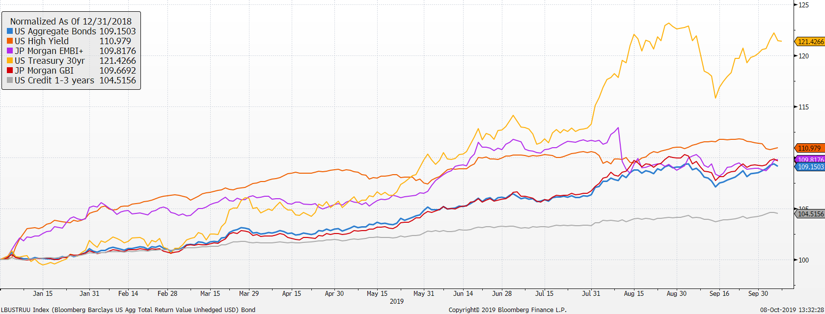
Market Returns
Performance of bond markets
2019 has been a great year for fixed income

Slide 14
Performance - Active Bond funds v AGG
Mix has added value especially when rates rise
Since 2015 performance of active bond managers verses Bloomberg Barclay’s US Aggregate Bond Index

Slide 15
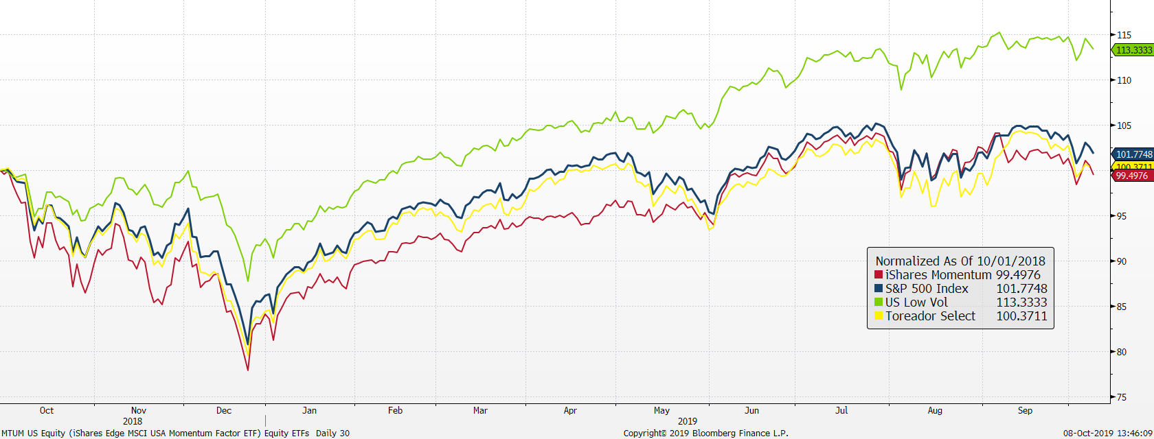
U.S. stock market ETFs
Low Volatility has been strong and driving performance especially during downturns
Source: Factset

Slide 16
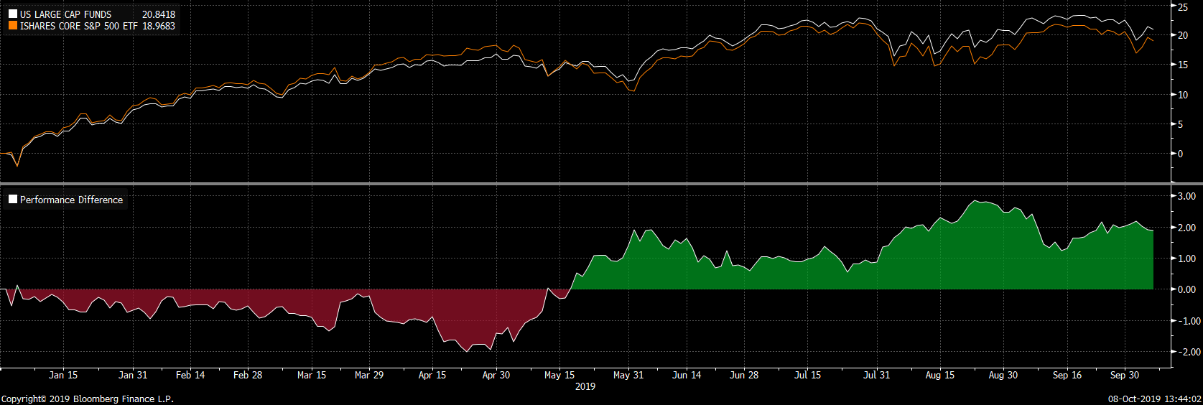
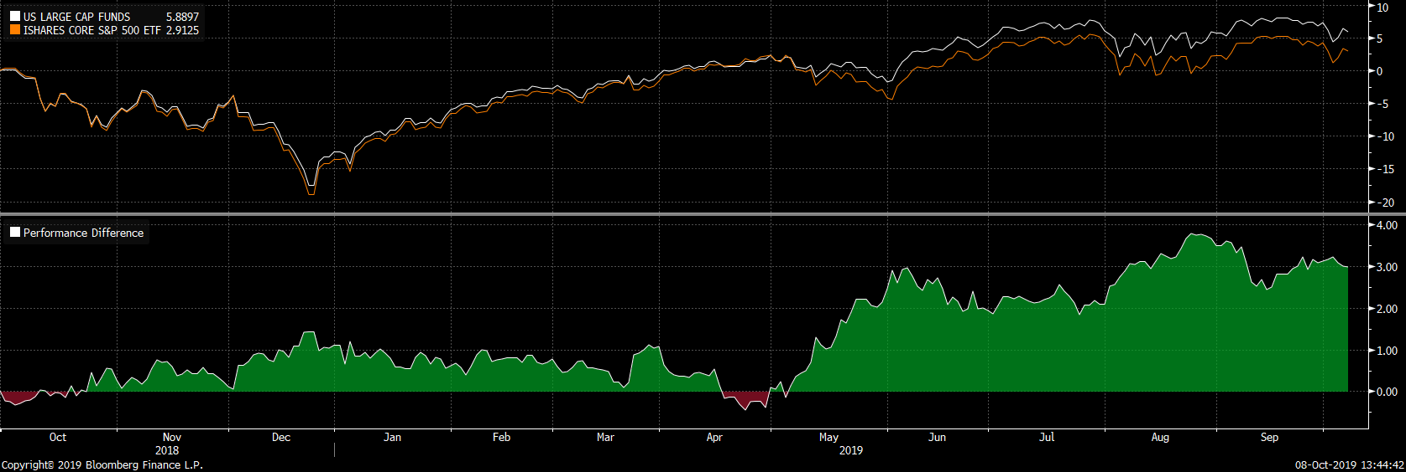
Performance: Stock Funds v IVV
Funds have added value even in strong market
YTD performance of active equity managers verses IVV ETF
Since 9/2018, performance of active equity managers verses IVV ETF

Slide 17
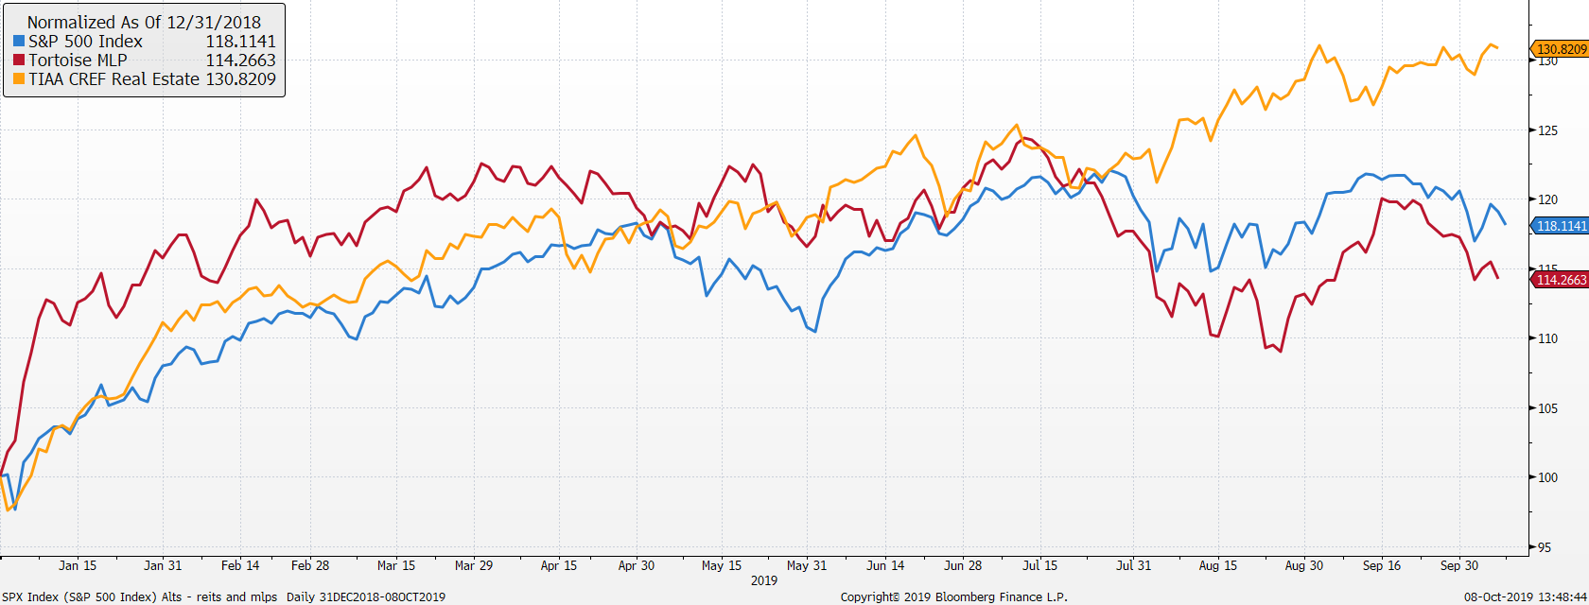
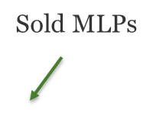
REITs and MLPs are outperforming!

Slide 18
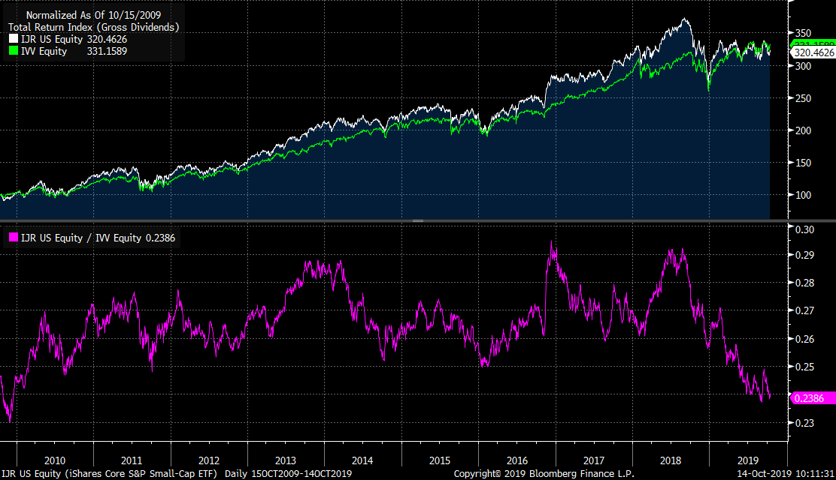
Small cap stocks have underperformed large cap stocks over the past year

Slide 19
Vehicle performance as of 9/30/19

Slide 20
Growth model changes
Portfolio changes 2019
2/22 reduced short term bonds, international developed equities and increased core bonds, US large cap and EM stocks
4/30 sold Tortoise MLP fund and added to US large cap
5/14 Increased US small cap from US large cap
Portfolio changes 2018
1/30 reduced bonds, US large cap, increased international stocks, MLPs and Market Neutral
9/28 Changed US large cap vehicles
  70% IVV 40% TOSZX
  10% SPHQ 40% USMV
  10% USMV 20% MTUM
  10% IWF
9/28 Replace IEFA with JPIN
11/28 Sold QMNIX to IGSB
12/11 Added 2% to Real Estate

Slide 21
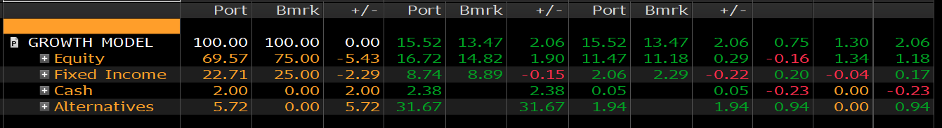
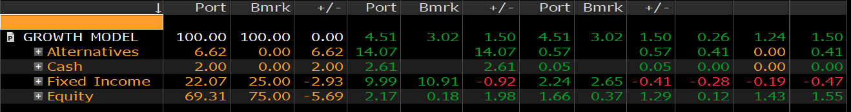
Growth Model attribution
Relative to 75% ACWI & 25% US Aggregate
Performance YTD 2019
Performance Past Year
Equity funds and alts added value
Cash dragged down returns

Slide 22
Model returns

Slide 23
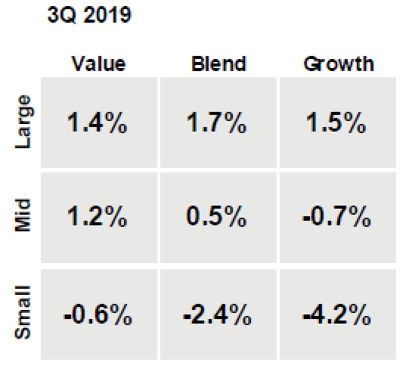
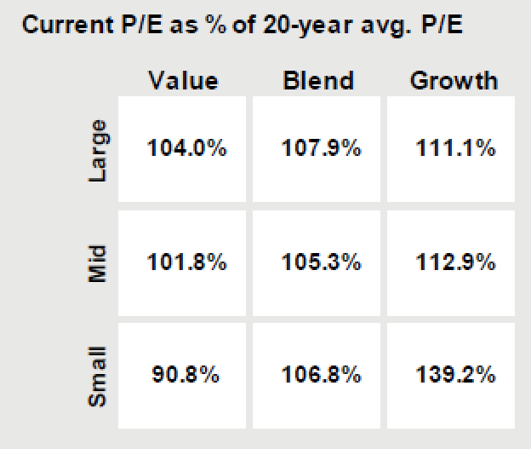
S&P 500 – What happened during 3Q 2019
The S&P 500 was flat in Q3
  In Q3 we saw a reversal of prior quarters trends, with growth no longer the performance leader.
  Current P/E multiples across almost all styles are at a premium to long-term average.
  In Q3 we made the following changes to the portfolio: added to CVS, ST and FTV, bought ZTS, sold UNP.

Slide 24
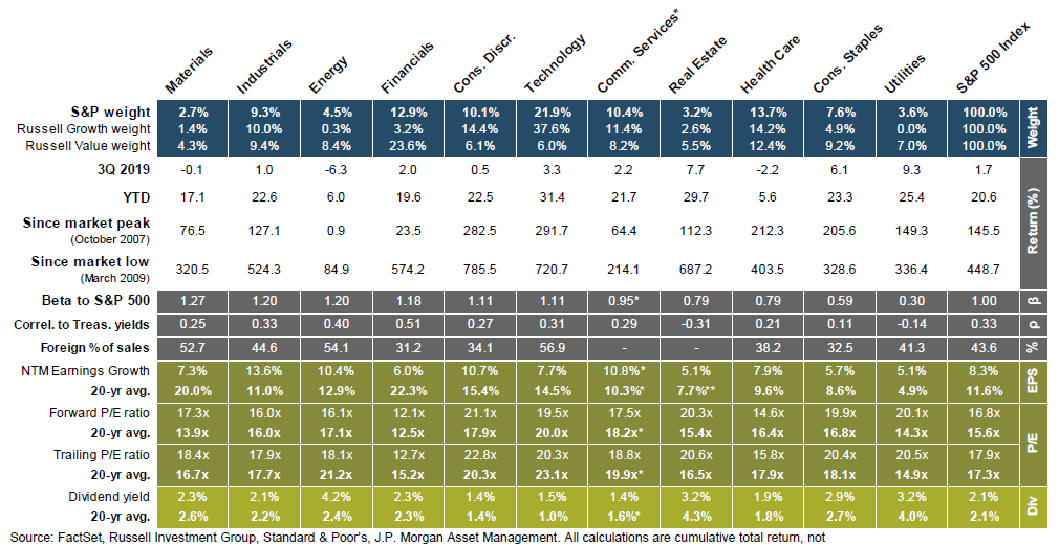
Sector Returns

Slide 25
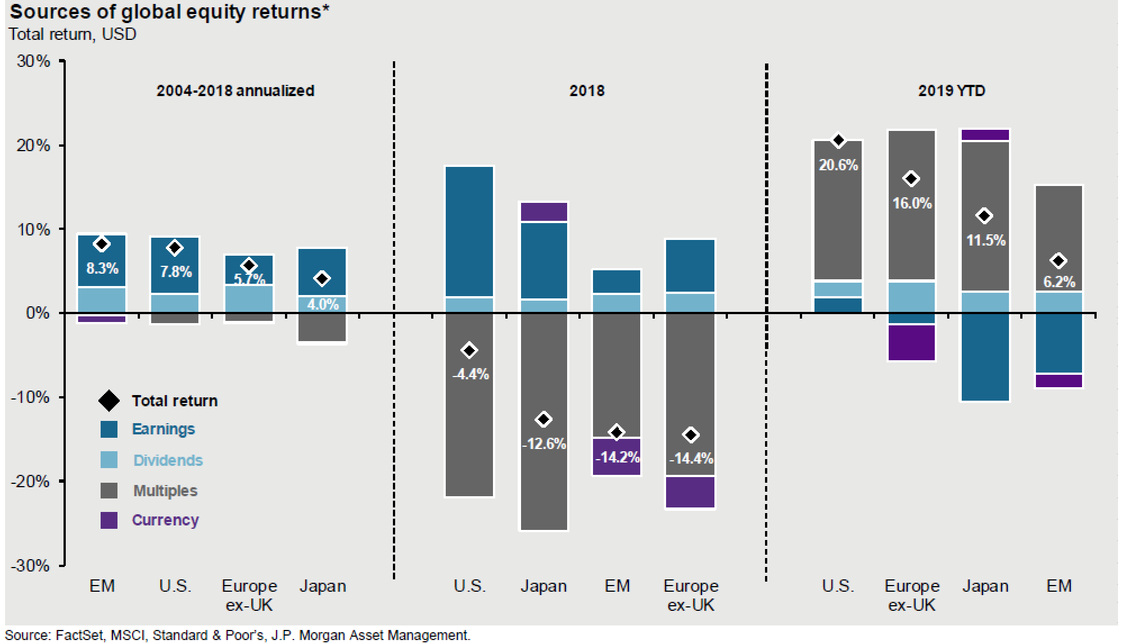
Sources of Global Equity Returns

Slide 26
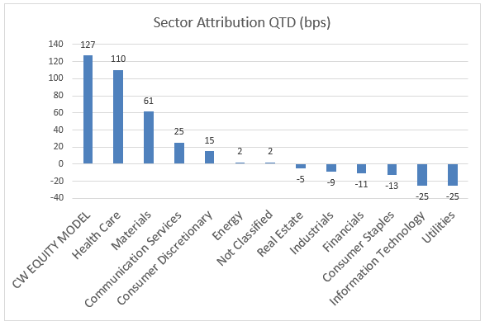
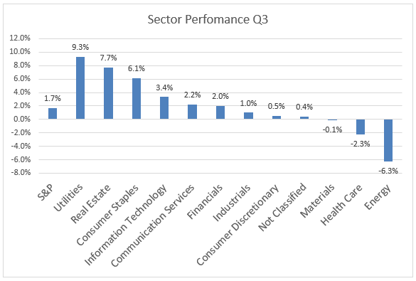
Q3 Focus Equity Sector Attribution
In Q3 Focus Equity outperformed the S&P by 127 bps

Slide 27
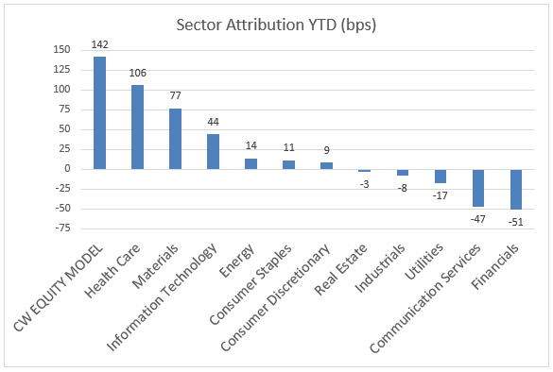
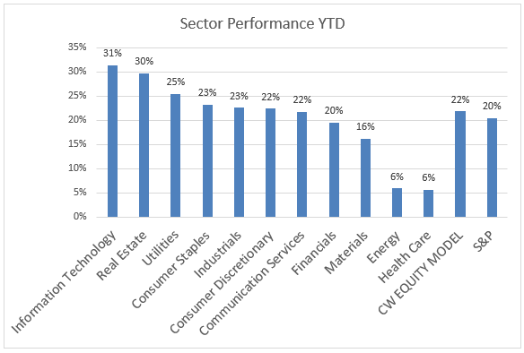
YTD Focus Equity Sector Attribution
After a strong Q3 led by healthcare, materials and communication services we are now ahead of the S&P by 142bps.

Slide 28
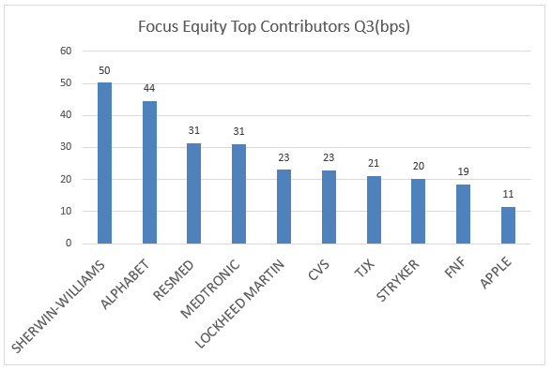
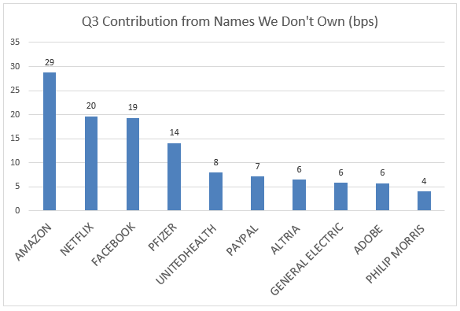
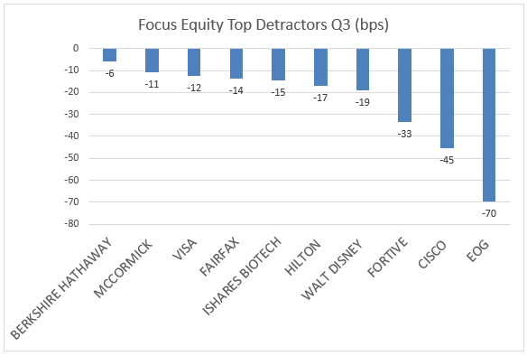
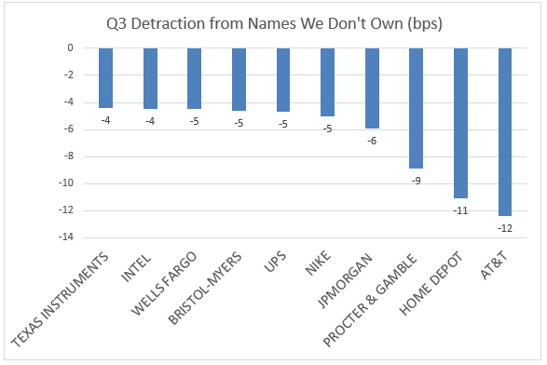
Q3 Contributors & Detractors

Slide 29
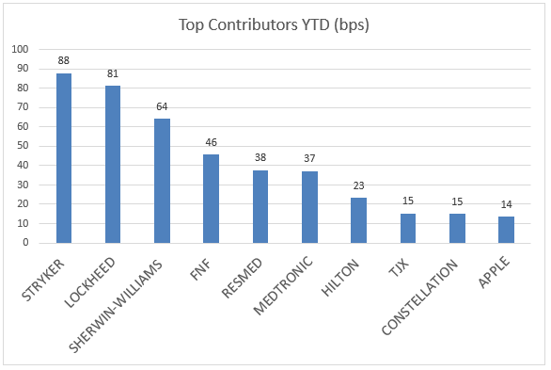
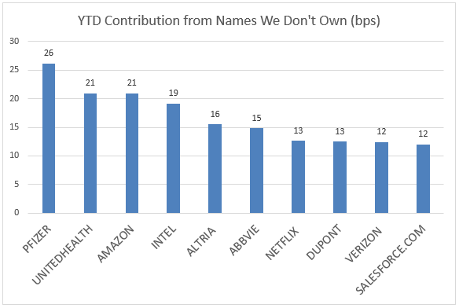
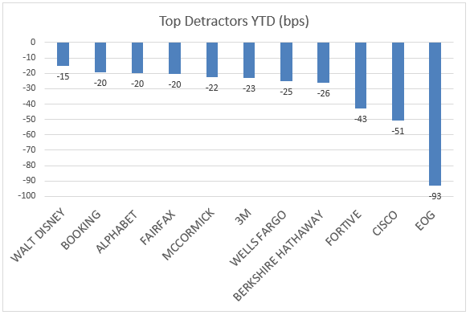
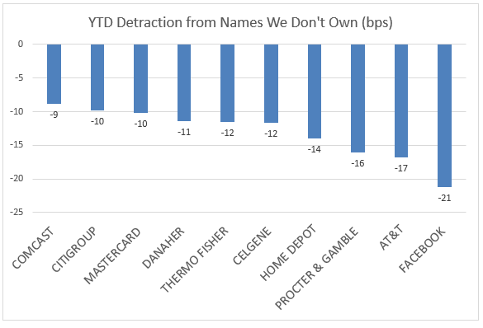
YTD Contributors and Detractors

Slide 30
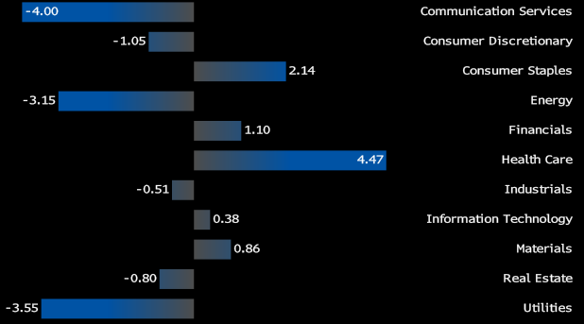
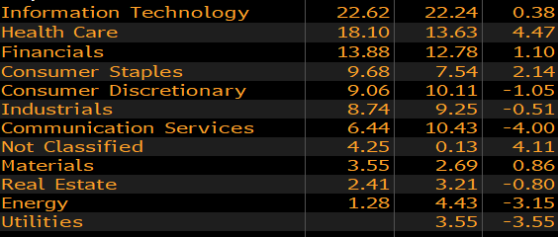
Focused Equity Sector Weights

Slide 31
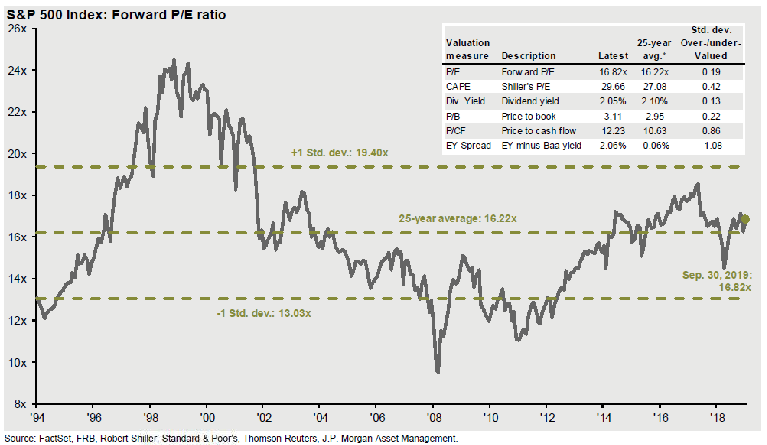
S&P 500 Forward P/E Ratio

Slide 32
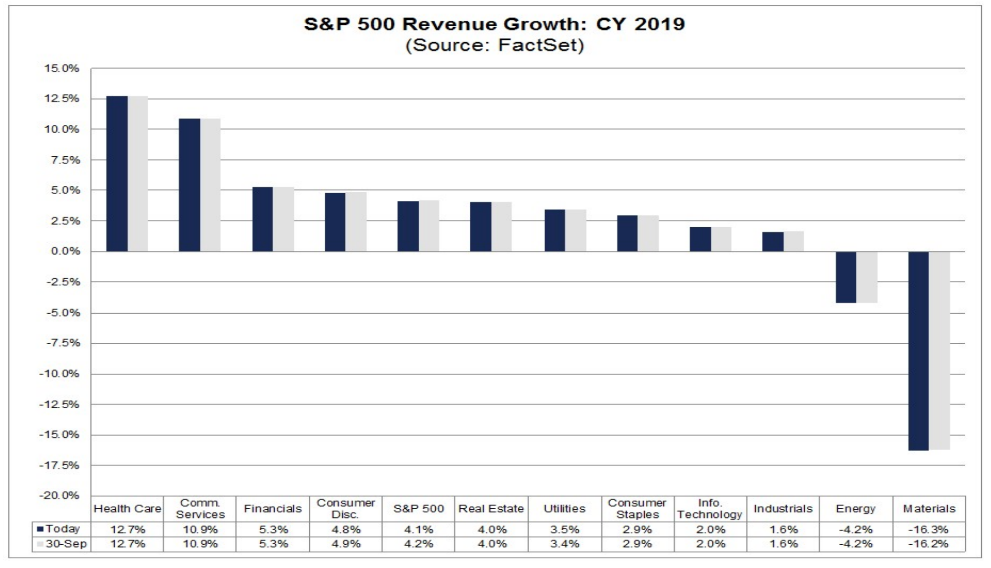
2019 Expected Revenue Growth by Sector

Slide 33
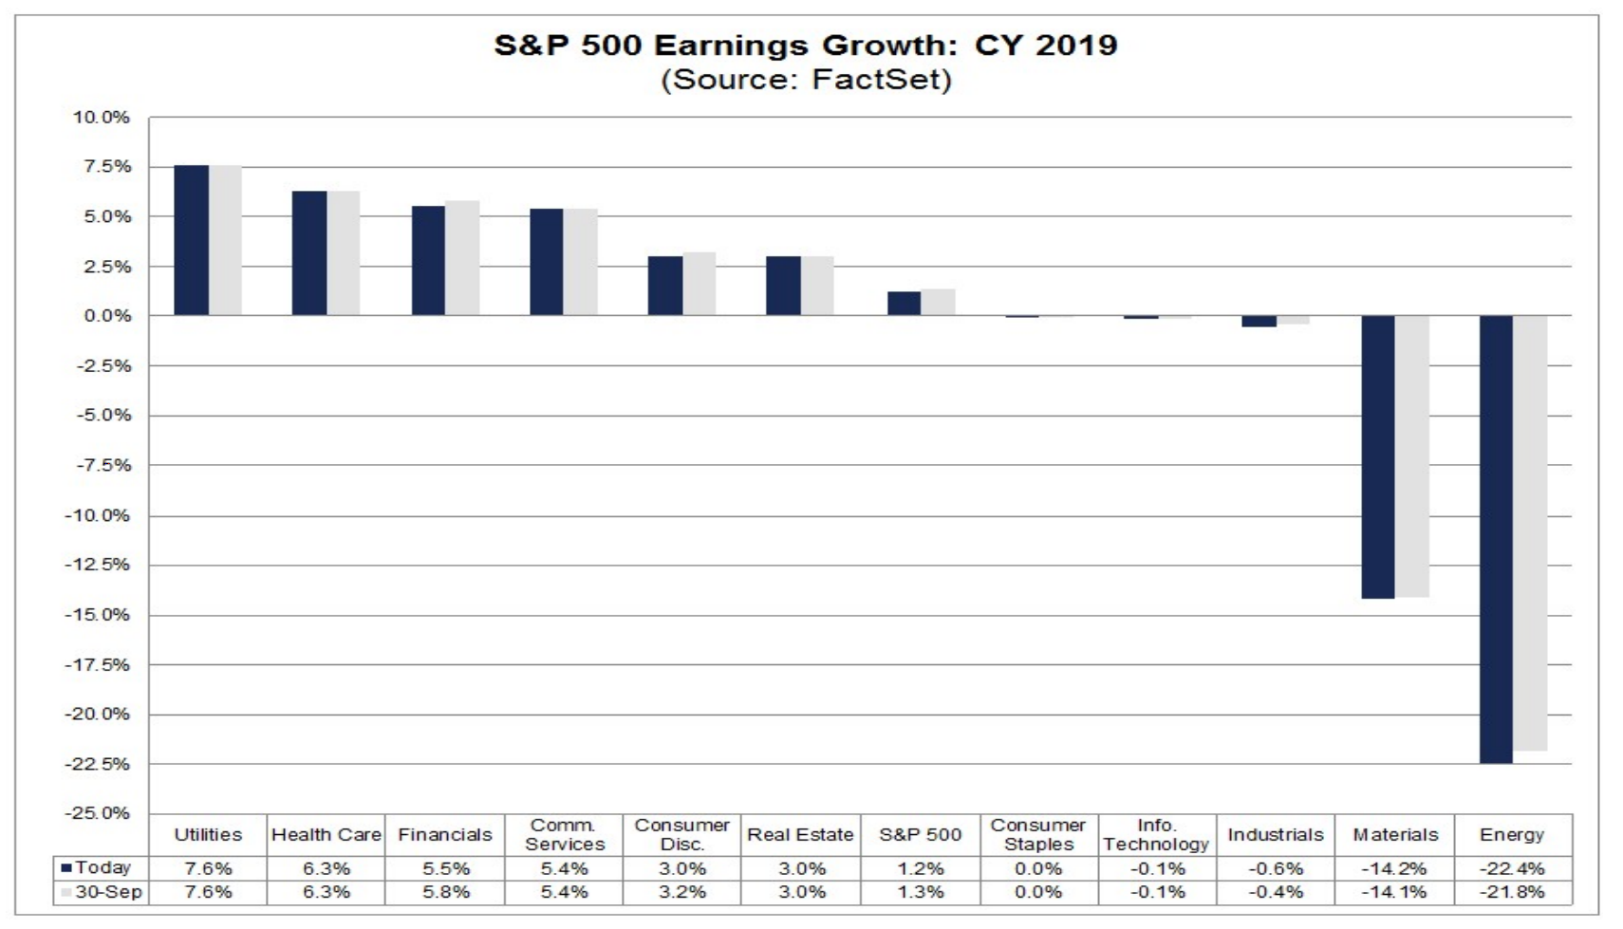
2019 Expected Earnings Growth by Sector

Slide 34
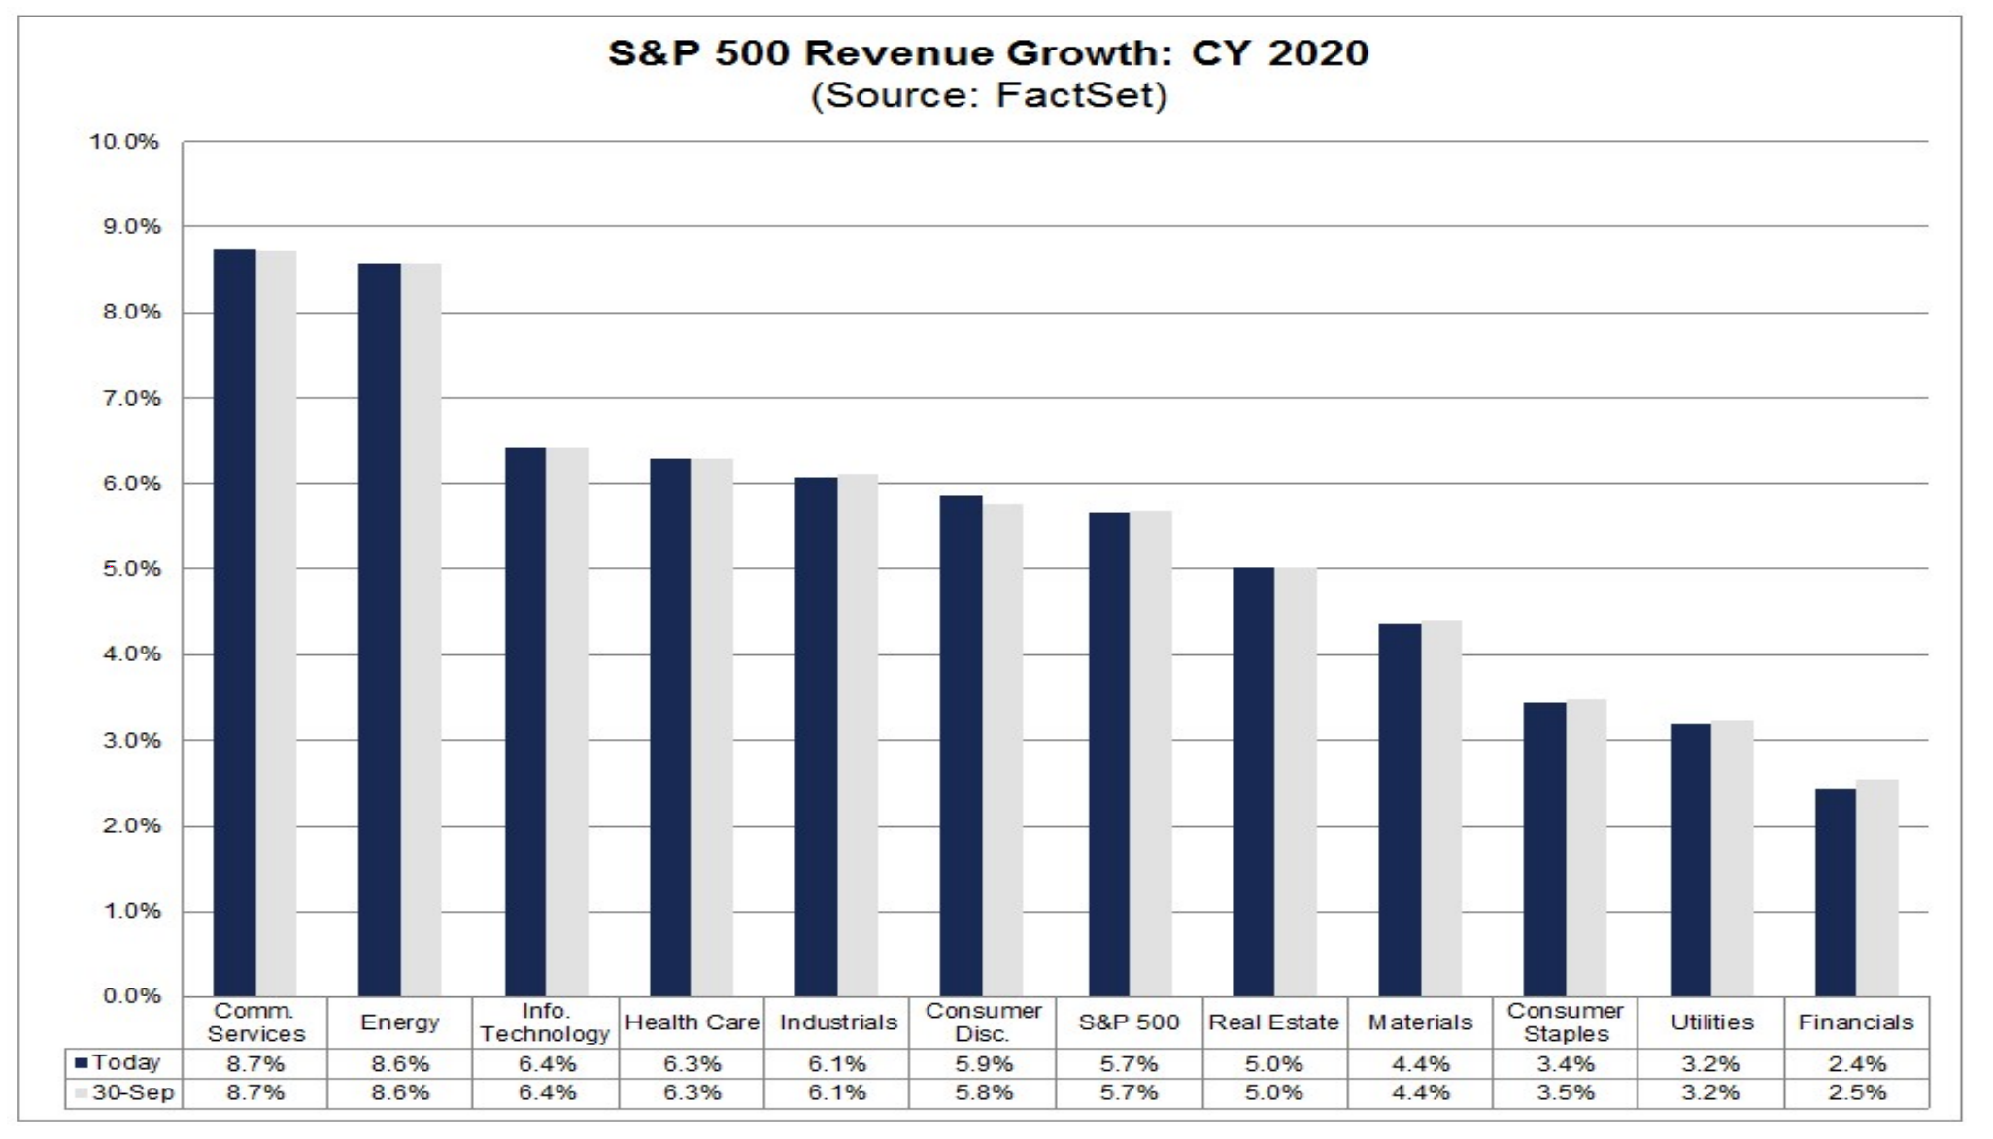
2020 Expected Revenue Growth by Sector

Slide 35
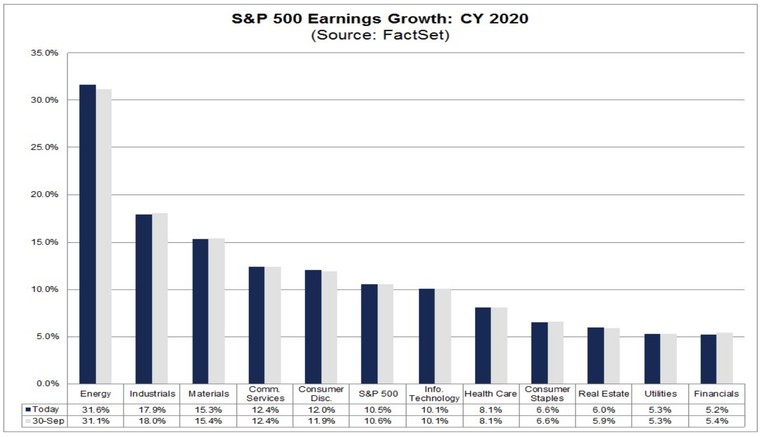
2020 Expected Earnings Growth by Sector

Slide 36
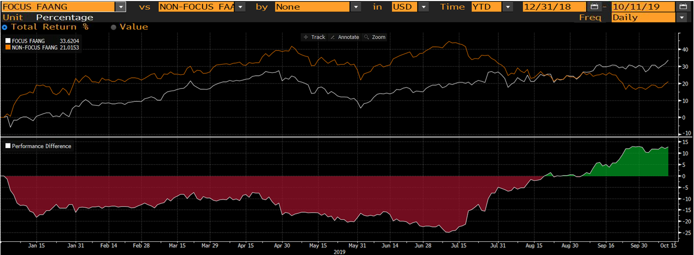
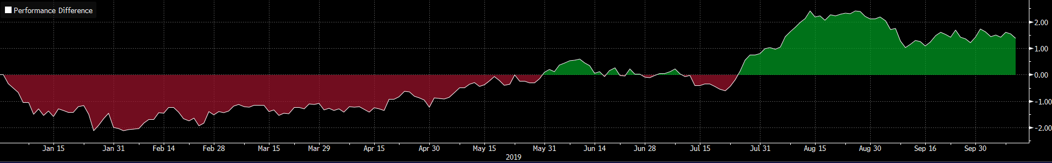

Conclusions
The market turned more defensive in Q3.
We outperformed when the market focused on quality.
Reversal of weaker cash flow FANG names benefited us.
Owning quality names in the weakest sectors added most of the outperformance.

